Slide 1
Android
Lesson 2 by Callum Taylor

Slide 2
Introduction
All code and presentation slides can be found over at https://github.com/scruffyfox/AndroidCourse
Twitter/app.net/github: @scruffyfox
http://(blog.)callumtaylor.net

Slide 3

Introduction
https://github.com/scruffyfox/AndroidCourse/tree/Lesson-2

Slide 4
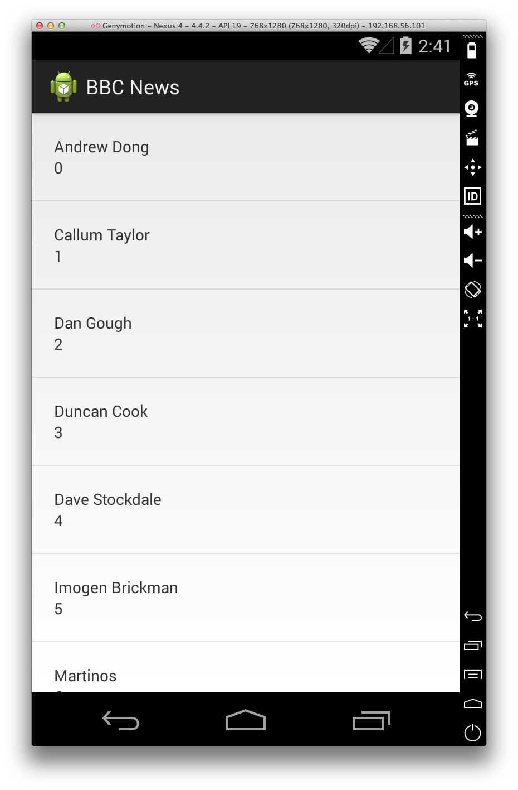
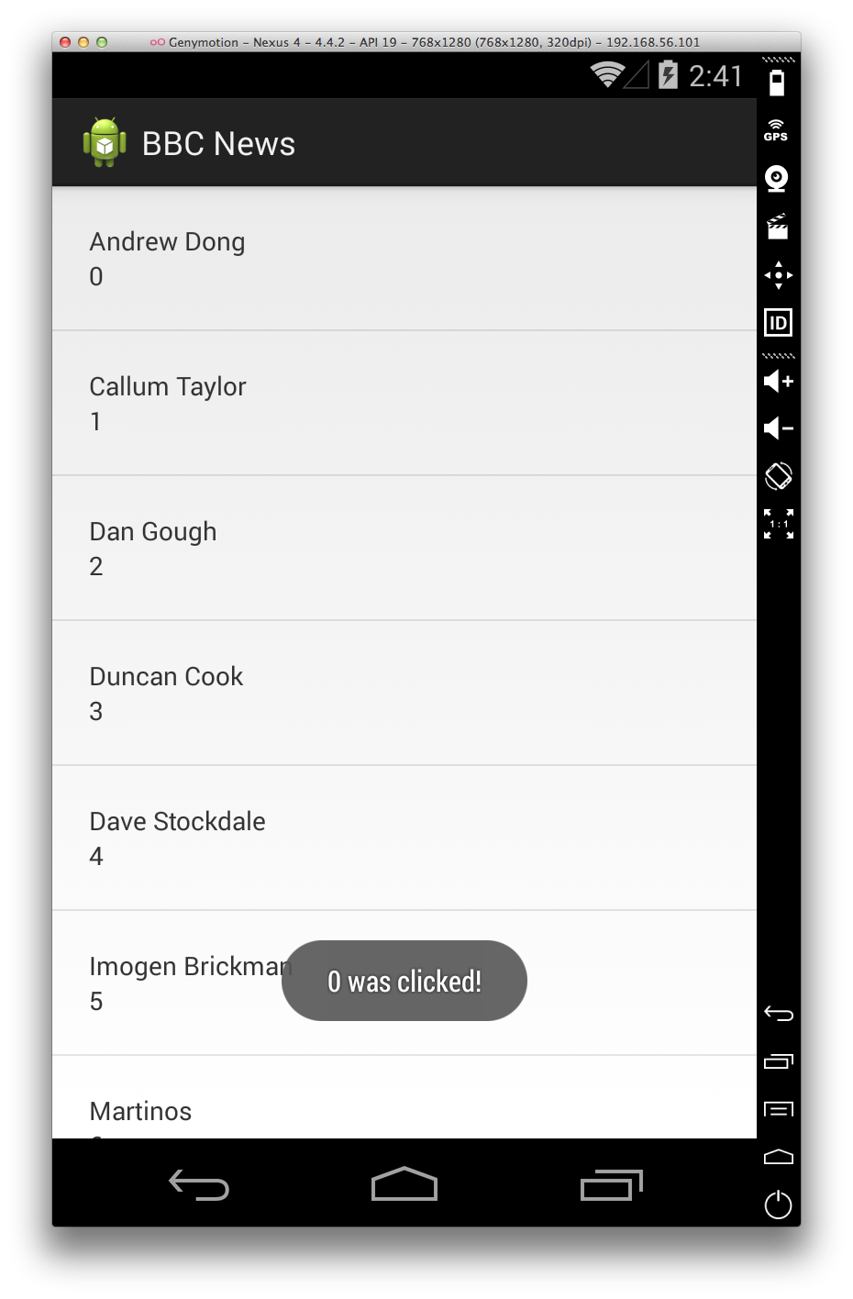
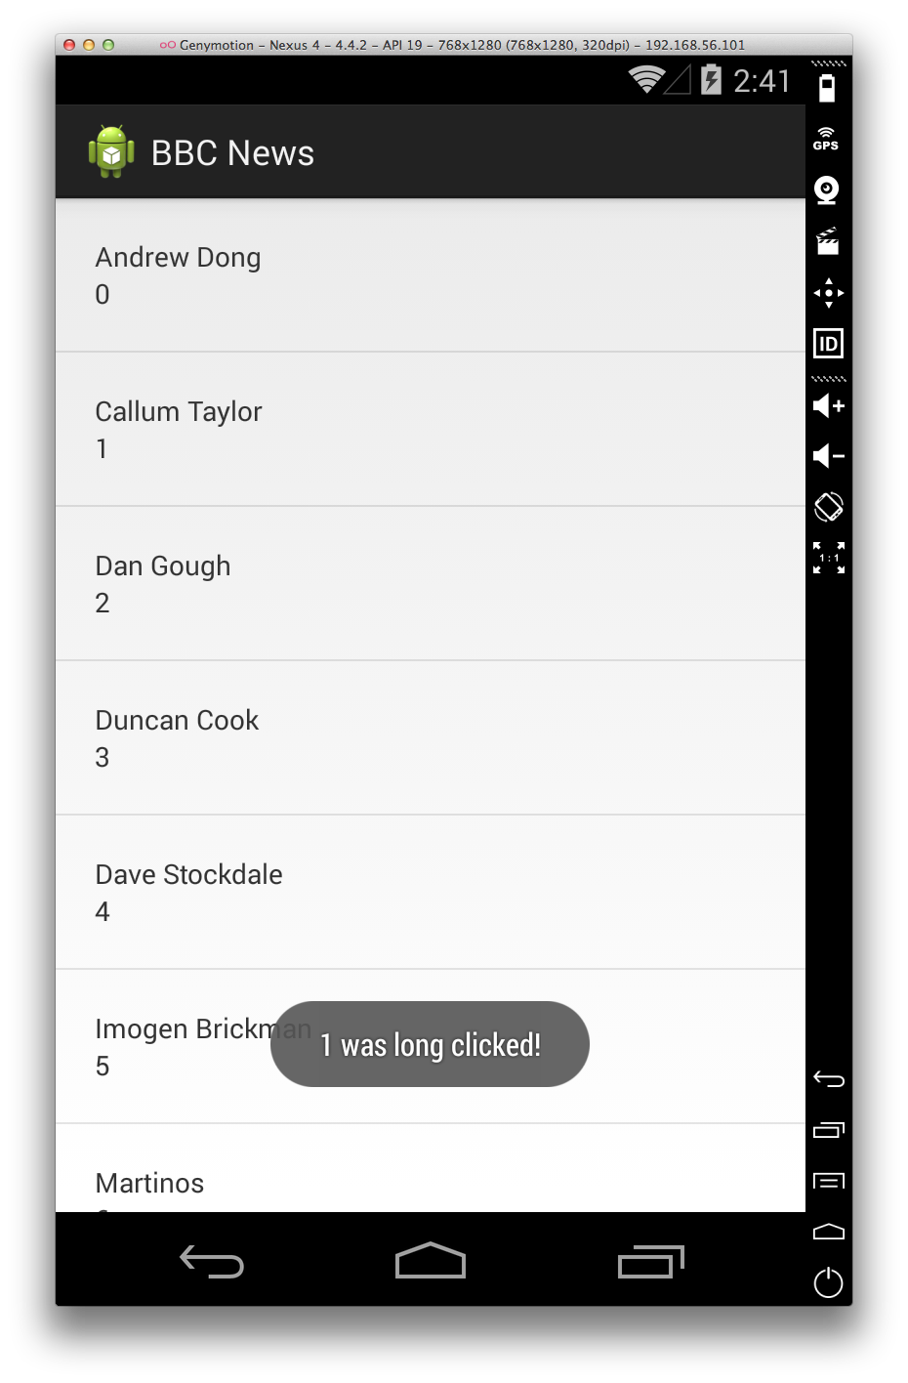
What we’re going to make
Notes:
This is what we’re going to make today

Slide 5
What we’re going to make
ListView
ArrayAdapter/BaseAdapter
findViewById
View Holder paradigm
Notes:
This is what we’re going to make today

Slide 6
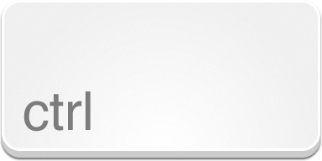

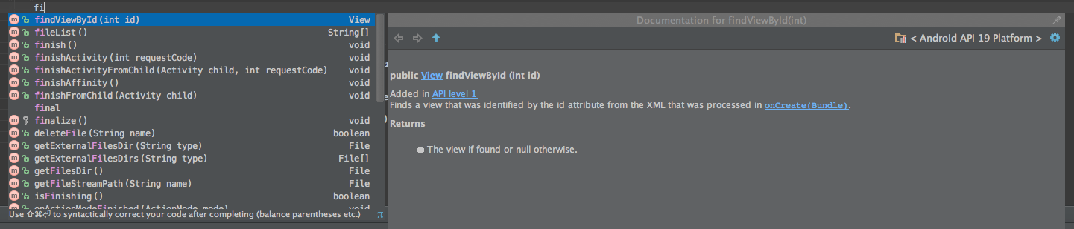
IDE Tips
+
Notes:
Control + space will be the most popular shortcut you use, pressing it will bring up the codesense suggestion dialog when you type to allow you to find the method/variable you’re looking for. It will also bring up the documentation for the highlighted method. Press enter to auto complete

Slide 7

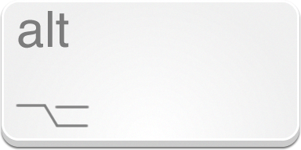
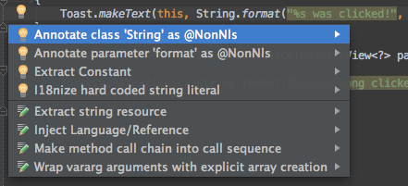
IDE Tips
+
Notes:
Pressing alt and enter will open up the quick fix menu which will give you some useful functions such as refracting a string or reversing an if statement

Slide 8
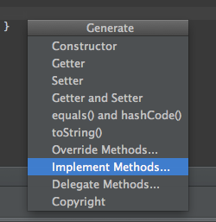
IDE Tips
+
Notes:
Pressing control and enter will bring up the generate menu which is useful when overriding methods from the super class you don’t know the name of

Slide 9

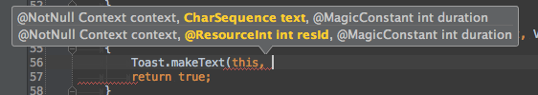
IDE Tips
+
Notes:
Pressing control and p will bring up the parameters for a method as you’re typing.

Slide 10
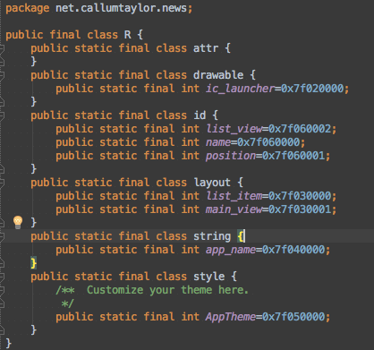
How R.java works
R.layout.list_item
R.id.name
R.drawable.ic_launcher
Notes:
Because Android is made up of 2 parts, java source and XML resources, there needs to be a way for the java code to access and use the xml resources. The way that this is handled is by using a file called R.java.
R.Java is automatically generated for you and lives under the build/source/r folder.
Every XML resource is given an ID which you can reference in code using the static ints found in R like so

Slide 11
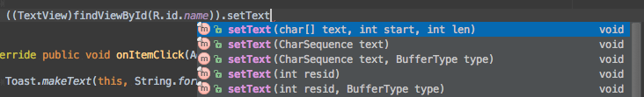
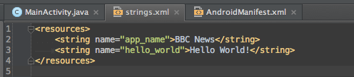
How R.java works
R.string.hello_world
Notes:
When writing code, 9 times out of 10, the method which you’re using to change the UI will have at least 2 overflows, one for straight input via code, and one for reference to a resource
Here we have the option to either write in text manually, or reference a resource file which would be stored in the strings.xml file such as the “hello_world” field we used before

Slide 12
How Adapters work
getCount()
getItem(int position)
getItemId(int position)
getView(int position, View convertView, ViewGroup parent)
Notes:
Adapters are very clever in its design of serving a large data set to the UI of an app. The pattern consists of a few core methods.

Slide 13
How Adapters work
getCount()
Exactly what it says – returns the number of items in the current data set

Slide 14
How Adapters work
getItem(int position)
Returns the item from the data set at the specific position

Slide 15
How Adapters work
getItemId(int position)
Returns the item’s id at the position. Can just return 0, but return a reliable int ID/representation of the item to increase performance of the list view

Slide 16
How Adapters work
getView(int position, View convertView, ViewGroup parent)
Returns the view in the list. This is where we do all of our data inflating into the screen which the user sees.
Position is the position of the item in the dataset
ConvertView is the view that will be shown
Parent is the parent view of the view being shown (usually the list view)

Slide 17
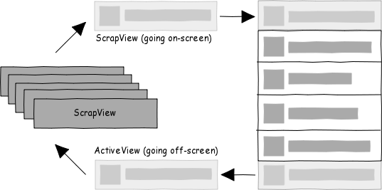
How List Views work
Notes:
List views are very clever with how they show the views on the screen. If you have a data set of say 10,000 items, obviously to have 10,000 views on the screen would cause the phone to firstly crash, but also to be EXTREMELY slow. The way a list view works to solve this is called view recycling.
When you scroll up or down, the view at the top or bottom drops off the screen, when it is no longer visible, it will get put into a scrap view heap, and when a new view is shown on the screen, that view is recycled from the stack, back on to the screen. This is why when we only set the views when convertView is null, it will jump around as you scroll.

Slide 18
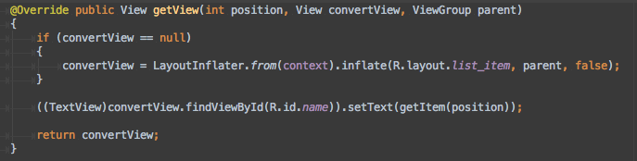
How List Views work
getView(int position, View convertView, ViewGroup parent)
Notes:
In our adapter, this is where convertView comes in handy.
When a new view is being created, convertView will be null. Here it will be safe to create our view and return it. But when convertView is not null, that is the view being recycled, so we don’t have to create another view, we can just reuse the same view but change the contents to reflect the data.

