Slide 1
Android
Lesson 4 by Callum Taylor

Slide 2
Introduction
All code and presentation slides can be found over at https://github.com/scruffyfox/AndroidCourse
Twitter/app.net/github: @scruffyfox
http://(blog.)callumtaylor.net

Slide 3

Introduction
https://github.com/scruffyfox/AndroidCourse/tree/Lesson-4

Slide 4
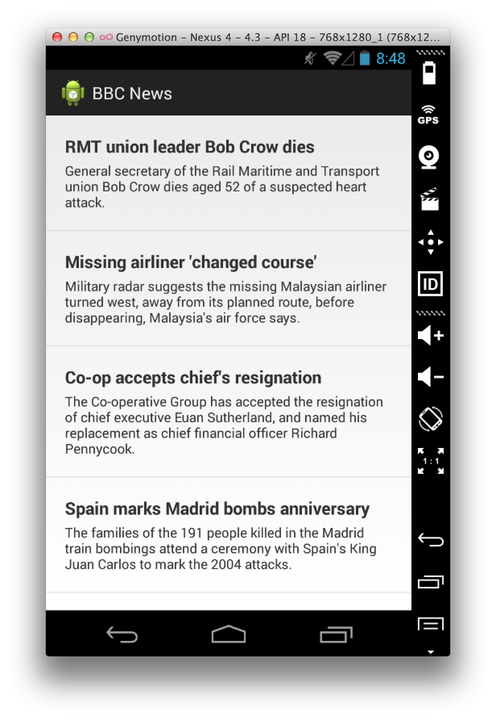
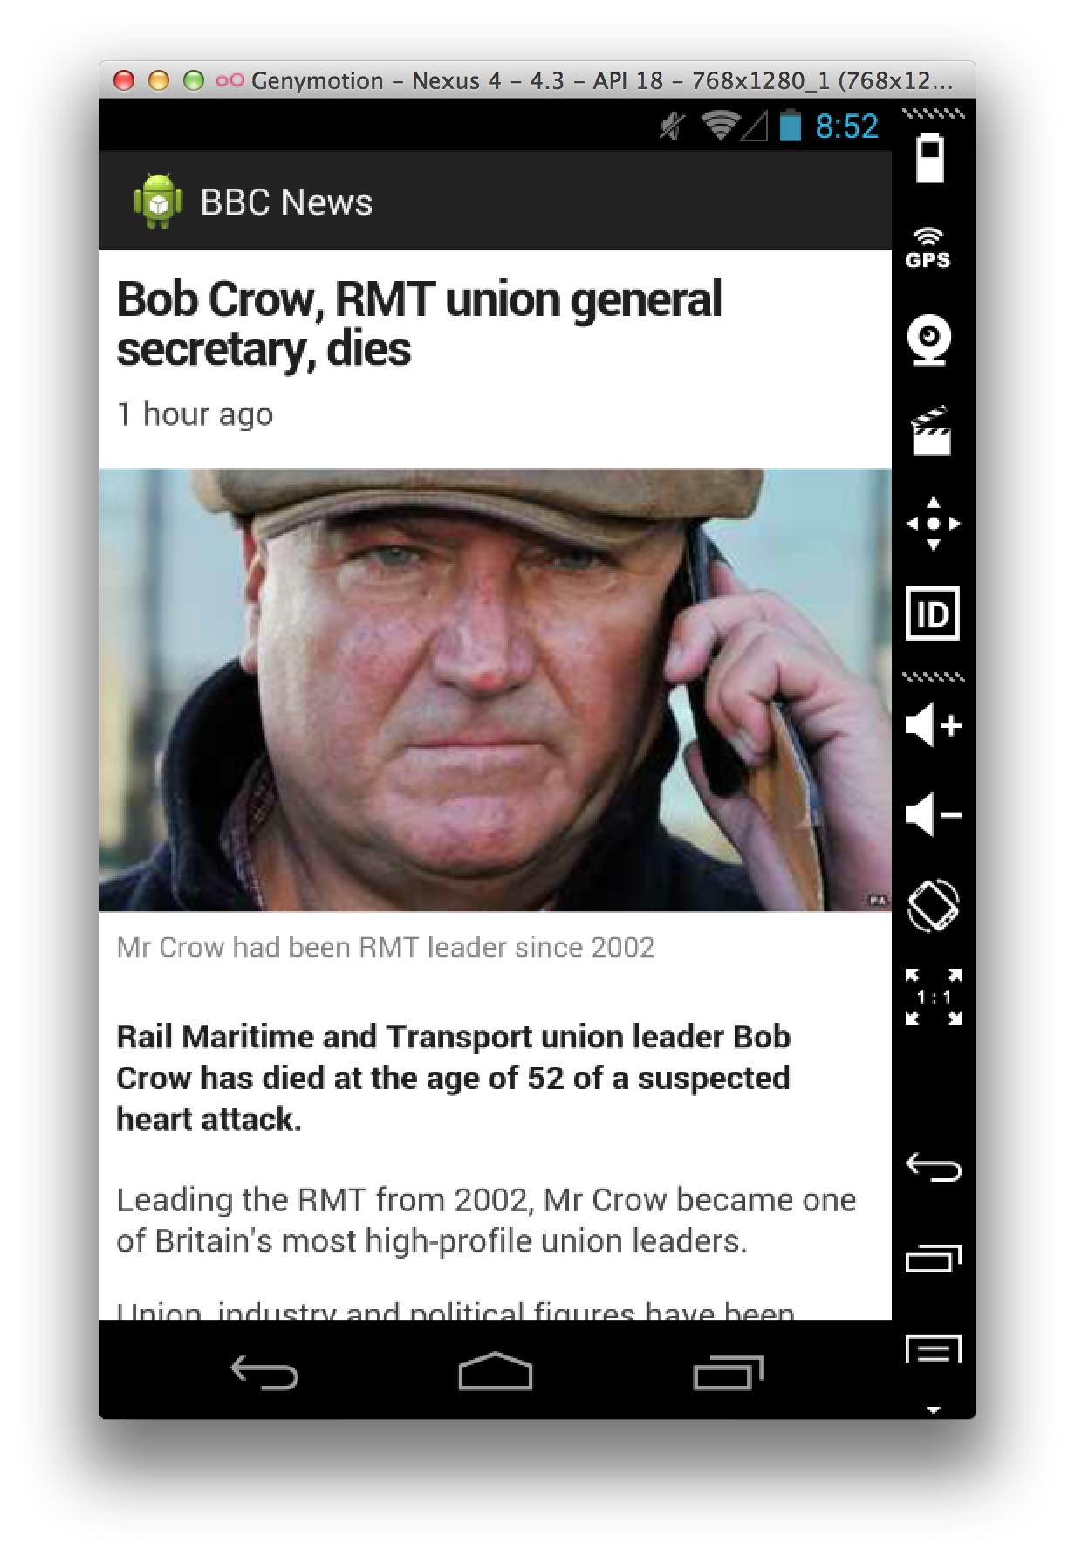
What we’re going to make
Notes:
This is what we’re going to make today

Slide 5
What we’re going to make
Loading from an API
Caching models to disk
Web Views
Notes:
This is what we’re going to make today

Slide 6
Async Http Client
https://github.com/scruffyfox/AsyncHttpClient

Slide 7
API
http://android.3sidedcube.com/bbcnews/

