Slide 1
Android
Lesson 2 by Callum Taylor

Slide 2
Introduction
All code and presentation slides can be found over at https://github.com/scruffyfox/AndroidCourse
Twitter/app.net/github: @scruffyfox
http://(blog.)callumtaylor.net

Slide 3

Introduction
https://github.com/scruffyfox/AndroidCourse/tree/Lesson-2

Slide 4
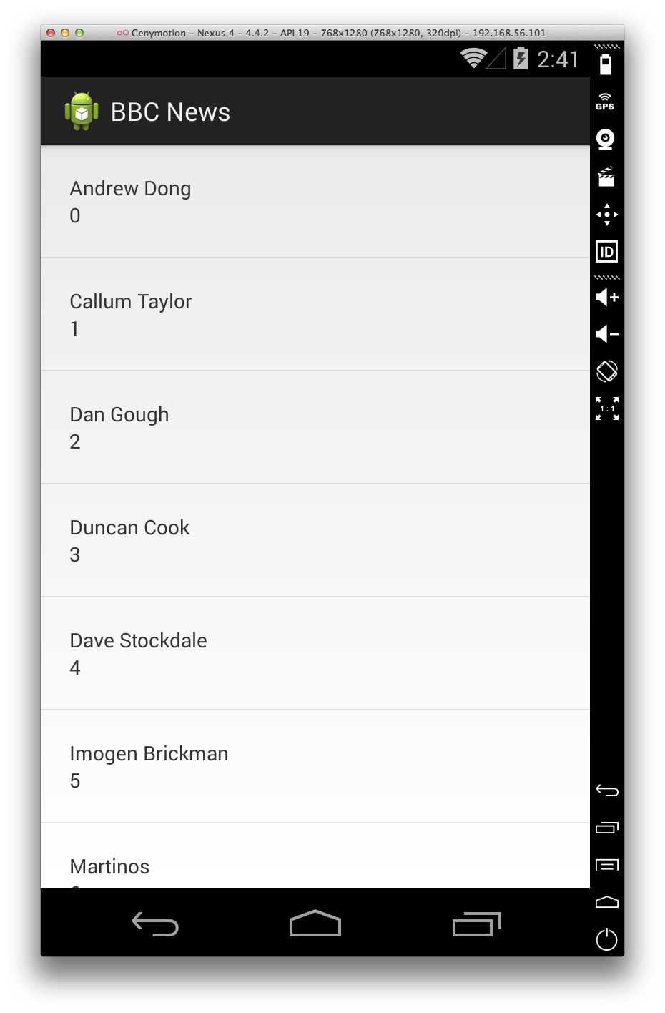
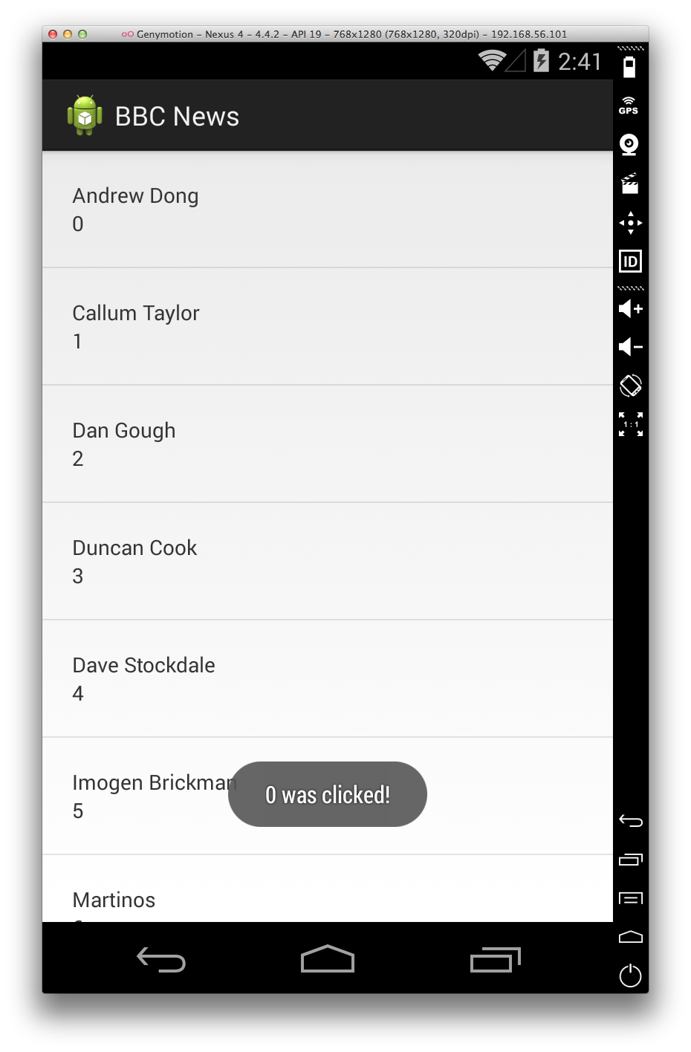
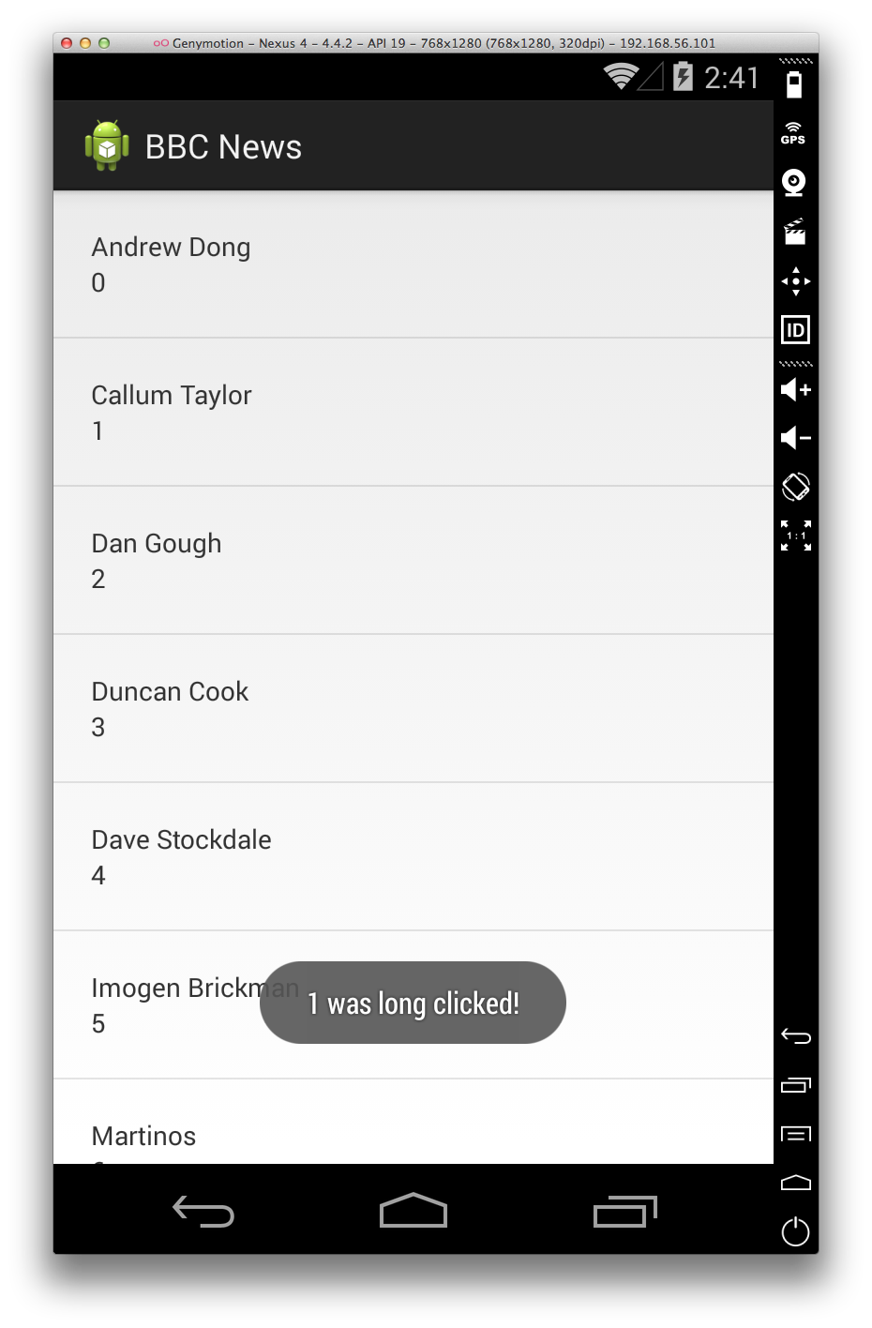
What we’re going to make
Notes:
This is what we’re going to make today

Slide 5
What we’re going to make
ListView
ArrayAdapter/BaseAdapter
findViewById
View Holder paradigm
Notes:
This is what we’re going to make today

Slide 6


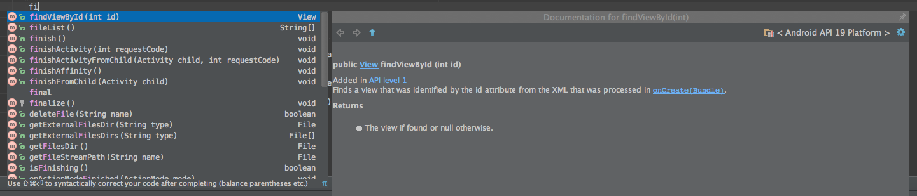
IDE Tips
+
Notes:
Control + space will be the most popular shortcut you use, pressing it will bring up the codesense suggestion dialog when you type to allow you to find the method/variable you’re looking for. It will also bring up the documentation for the highlighted method. Press enter to auto complete

Slide 7


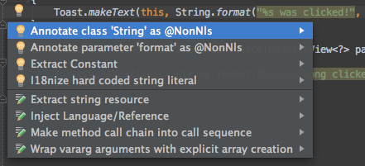
IDE Tips
+
Notes:
Pressing alt and enter will open up the quick fix menu which will give you some useful functions such as refracting a string or reversing an if statement

Slide 8
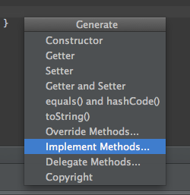
IDE Tips
+
Notes:
Pressing control and enter will bring up the generate menu which is useful when overriding methods from the super class you don’t know the name of

Slide 9

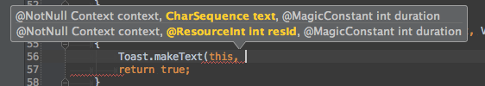
IDE Tips
+
Notes:
Pressing control and p will bring up the parameters for a method as you’re typing.

Slide 10
IDE Demo

