Slide 1
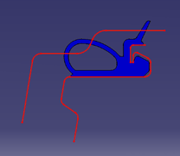
w
g
bf
h
cr
bf
cr
g
h
w
body flat
corner radius
seal gap
seal height
seal width

Slide 2
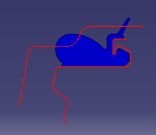
w
g
bf
h
cr
bf
cr
g
h
w
body flat
corner radius
seal gap
seal height
seal width

