Slide 1
Scrutiny
Debugger
Scrutiny Debugger

Slide 2
V
A
R
M

Slide 3
i
✔️
?

Slide 4
100%

Slide 6
XLSX
CSV

Slide 8
scval
Y

Slide 9
123.4
123.4
ABC
Button

Slide 10
100
100
75
75
50
25
50
0
25
0

Slide 11
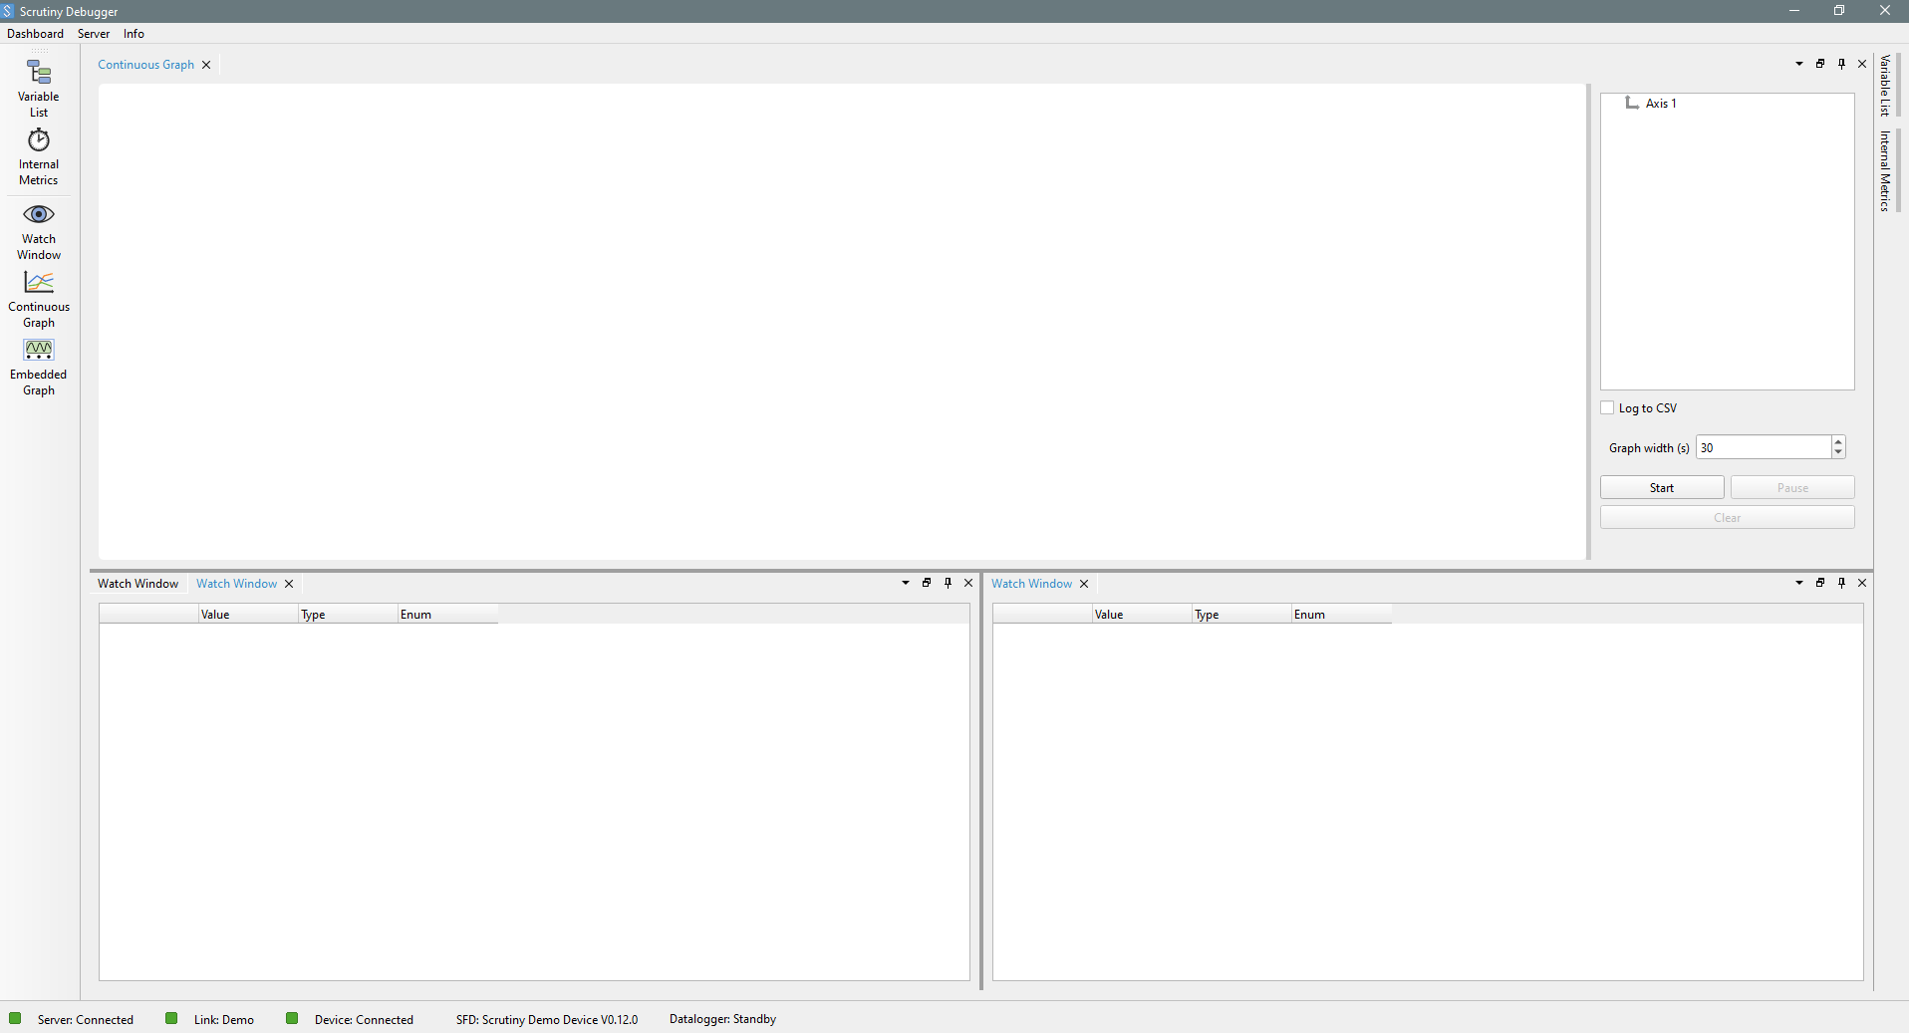
Menu bar
DASHBOARD
Single instance
Variable list
Multi instance
Sidebar
Server/device comm. link
Server Loaded SFD
Device Datalogger state
Client/Server comm.
Server/device
Comm.
Status bar

Slide 12
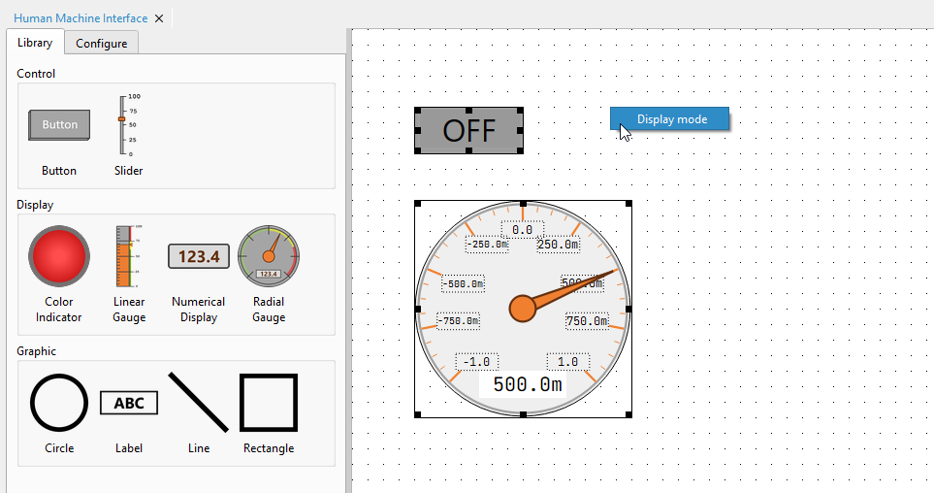
Left menu
(edit mode)
Work zone
(edit mode)
Available Widgets
User placed widgets

Slide 13
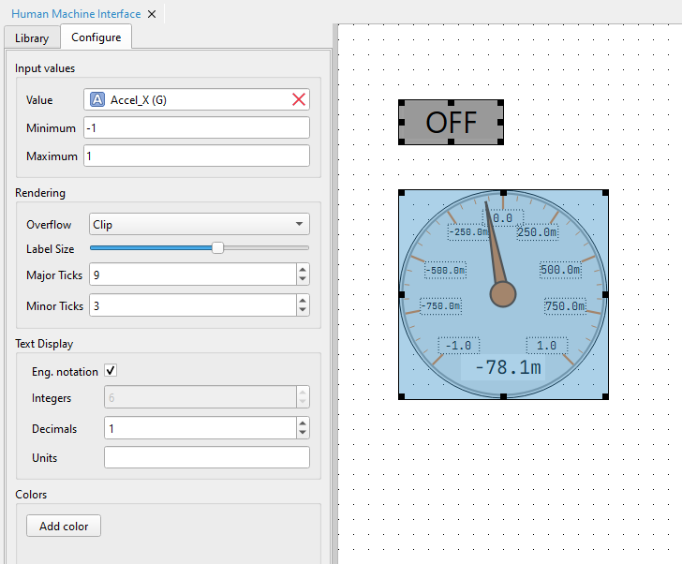
Work zone
(edit mode)
Input values (tied to watchables)
Resize handle
Selected widget
Constant configuration (Not tied to watchables)

Slide 14
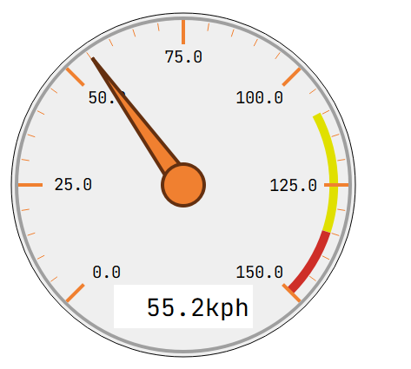
Label
Major tick
Minor tick
Pointer
Color bands
Text display

Slide 15
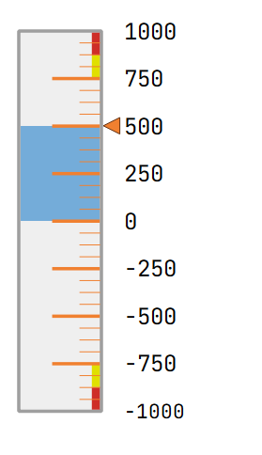
Major tick
Label
Minor tick
Fill color
Pointer
Zero Point
Color bands

Slide 16
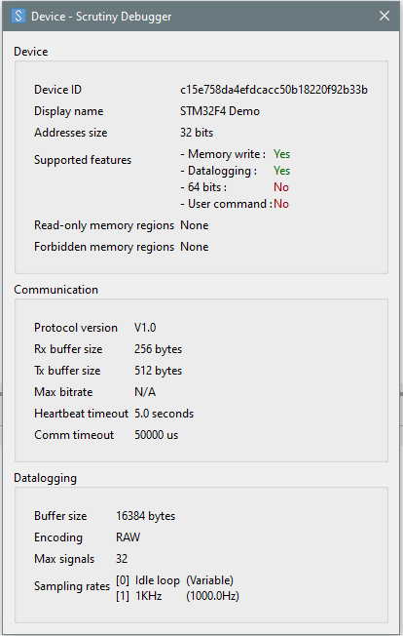
Firmware hash
Name set in the firmware
Architecture pointer size
Compile time features enabled
(see instrumentation guide)
Protected memory regions defined in the firmware (if any)
Communication parameters set in the firmware
Firmware timeouts (compile-time constants)
Datalogging configuration

Slide 17
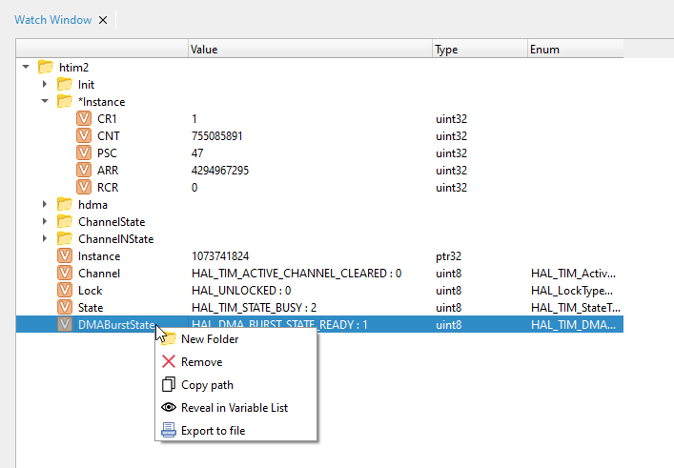
Pointed Var
Pointer

Slide 18
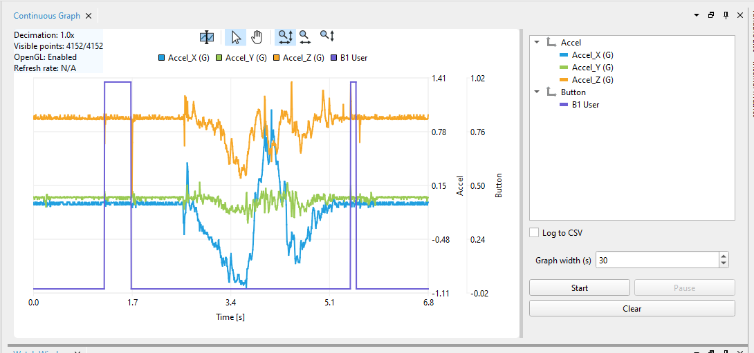
Stats
Toolbar

Slide 19
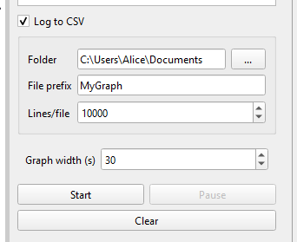
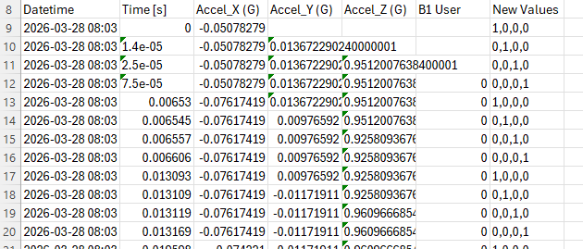
MyGraph_0000.csv
MyGraph_0001.csv …
Moving window size (GUI Limit)

Slide 20
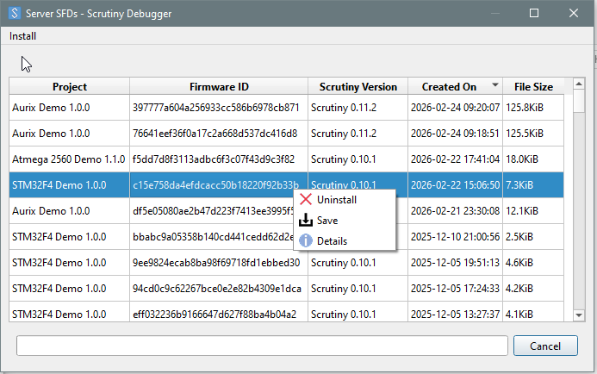
Upload: GUI → Server
Download: Server → GUI

