Slide 1



Desafio_Relatório_Vendas
View in Power BI
Last data refresh:
02/02/2026 13:25:36 UTC
Downloaded at:
02/02/2026 14:10:34 UTC

Slide 2
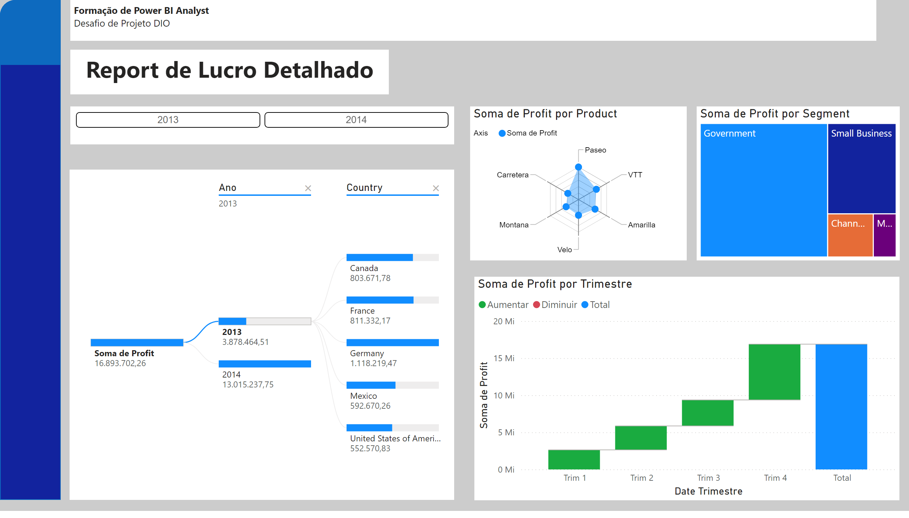

Desafio_
Notes:
textbox
No alt text provided
ChicletSlicer1448559807354
No alt text provided
RadarChart1446119667547
No alt text provided
decompositionTreeVisual
No alt text provided
waterfallChart
No alt text provided
treemap
No alt text provided
shape
No alt text provided
shape
No alt text provided
textbox
No alt text provided

