Slide 1
CHEM 280: Final Presentation
Spencer Schmidt

Slide 2
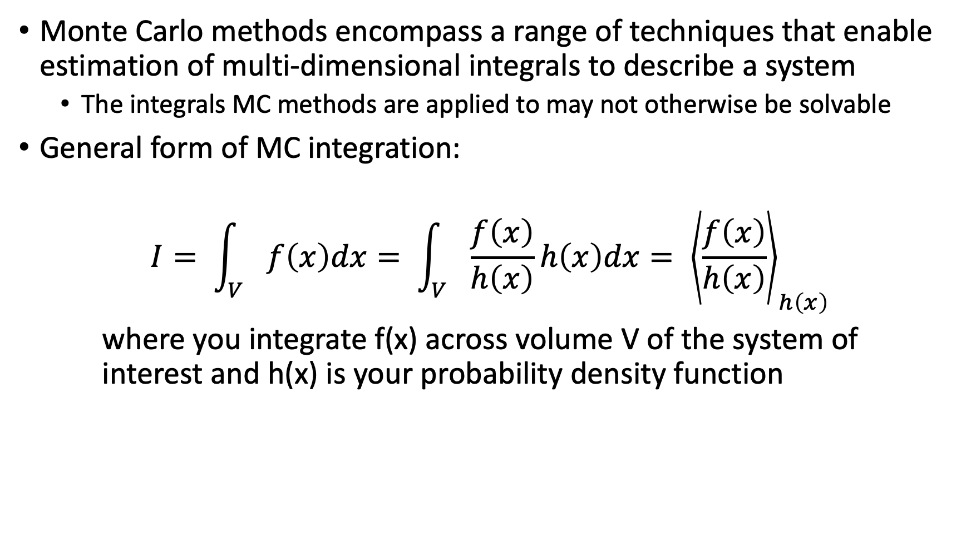
Molecular Simulations: Introducing the Monte Carlo Methods
Monte Carlo methods encompass a range of techniques that enable estimation of multi-dimensional integrals to describe a system
The integrals MC methods are applied to may not otherwise be solvable
General form of MC integration:
$$I= \int_{V}{f\left(x\right)dx= \int_{V}{\frac{f\left(x\right)}{h\left(x\right)}h\left(x\right)dx= {\left\langle \frac{f\left(x\right)}{h\left(x\right)}\right\rangle }_{h\left(x\right)}}}$$
where you integrate f(x) across volume V of the system of interest and h(x) is your probability density function

Slide 3

Molecular Simulations: Introducing the Monte Carlo Method
Selecting a probability density function (PDF):
Technically, you can select any PDF but the simplest is a uniform probability density function (UPDF):
$$h\left(x\right)=\frac{1}{V}$$
where V is the sample volume

Slide 4
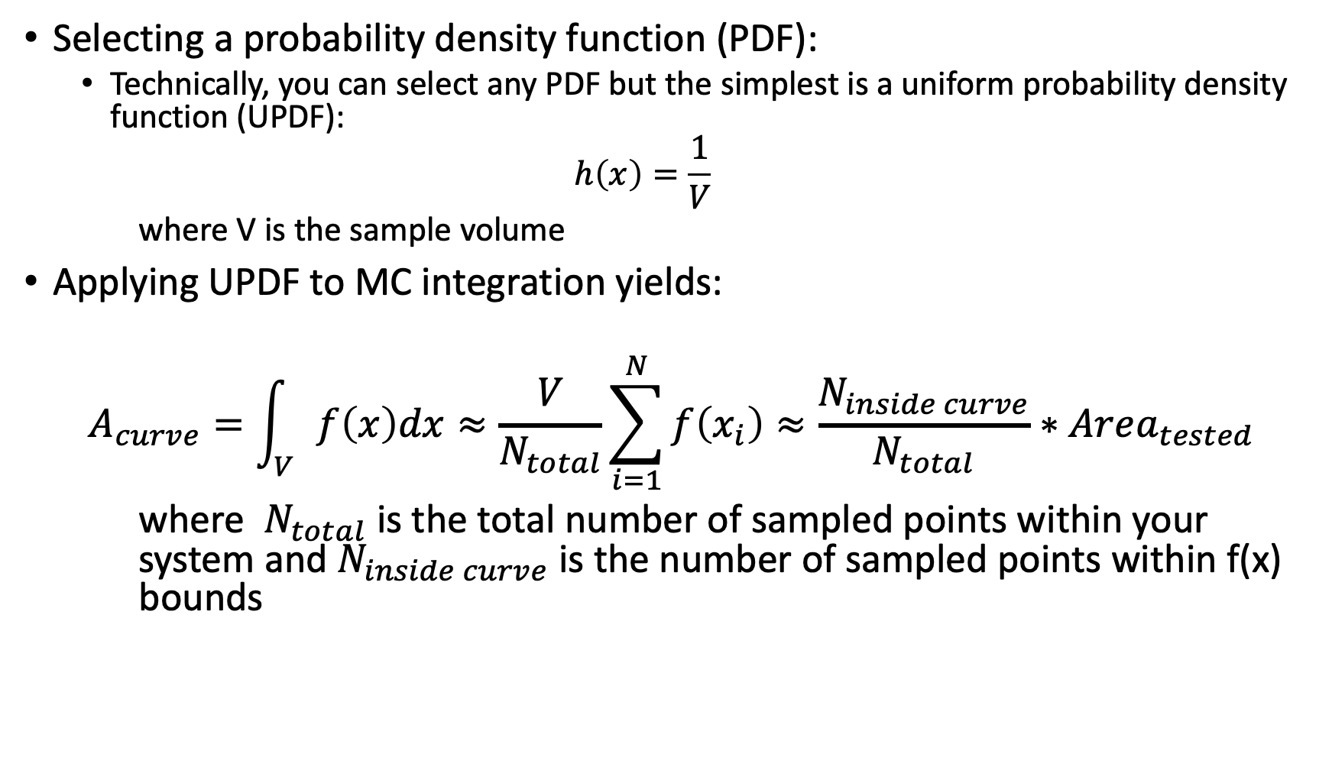
Molecular Simulations: Introducing the Monte Carlo Methods
Selecting a probability density function (PDF):
Technically, you can select any PDF but the simplest is a uniform probability density function (UPDF):
$$h\left(x\right)=\frac{1}{V}$$
where V is the sample volume
Applying UPDF to MC integration yields:
$$A_{curve}=\int_{V}{f\left(x\right)dx}≈\frac{V}{N_{total}}\sum_{i=1}^{N}{f\left(x_{i}\right)}≈\frac{N_{inside curve}}{N_{total}}∗Area_{tested}$$
where $N_{total}$ is the total number of sampled points within your system and $N_{inside curve}$ is the number of sampled points within f(x) bounds

Slide 5
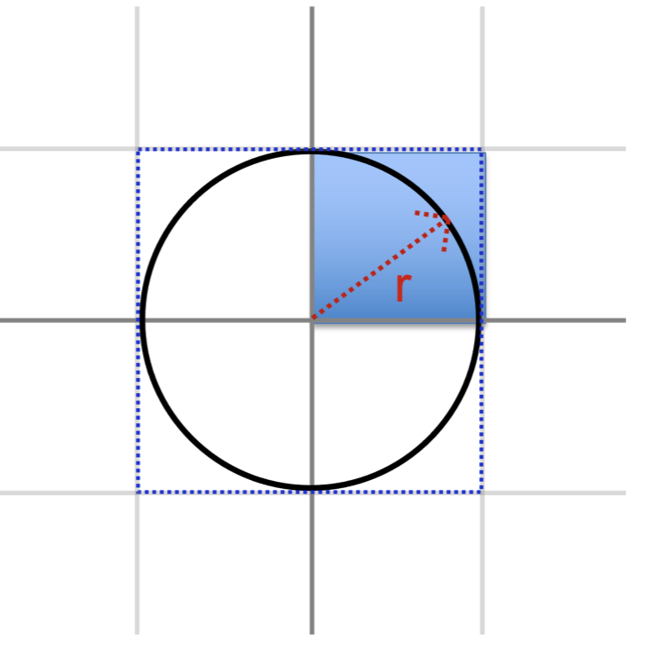
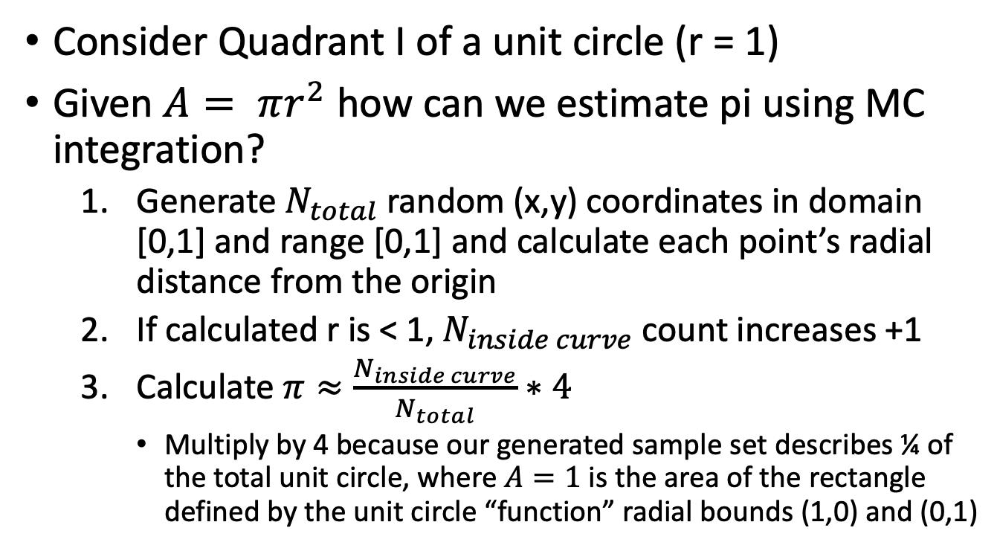
Molecular Simulations: Applying MC Integration to Estimate Pi
Consider Quadrant I of a unit circle (r = 1)
Given $A= πr^{2}$ how can we estimate pi using MC integration?
Generate $N_{total}$ random (x,y) coordinates in domain [0,1] and range [0,1] and calculate each point’s radial distance from the origin
If calculated r is < 1, $N_{inside curve}$ count increases +1
Calculate $π≈\frac{N_{inside curve}}{N_{total}}∗4$
Multiply by 4 because our generated sample set describes ¼ of the total unit circle, where $A=1$ is the area of the rectangle defined by the unit circle “function” radial bounds (1,0) and (0,1)

Slide 6
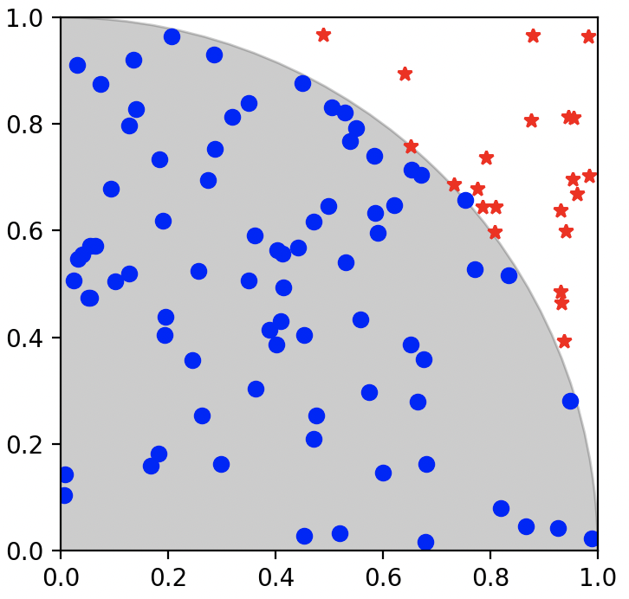
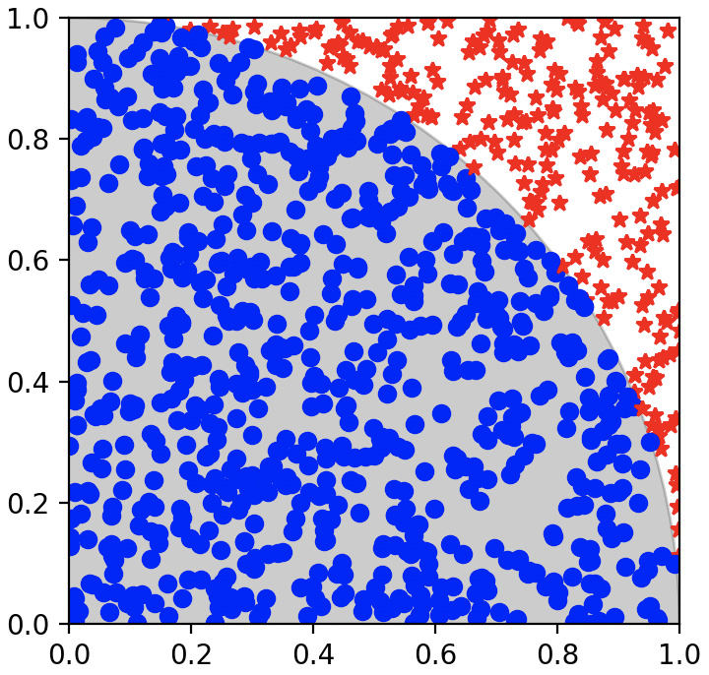
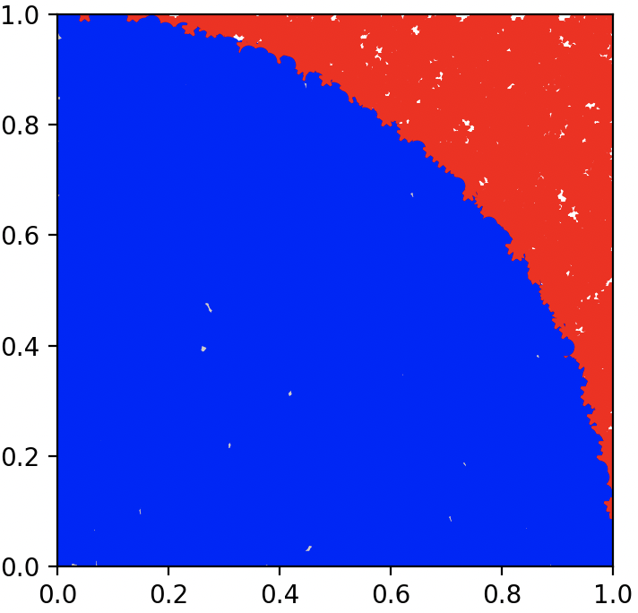




Molecular Simulations: Applying MC Integration to Estimate Pi
Increasing the number of generated points → increased probability of a better-defined unit circle → increased goodness of prediction for the value of $π$ when averaged over multiple simulations
$$N_{total}=100$$
$$π≈2.68$$
$$N_{total}=1000$$
$$π≈3.172$$
$$N_{total}=10000$$
$$π≈3.144$$

Slide 7
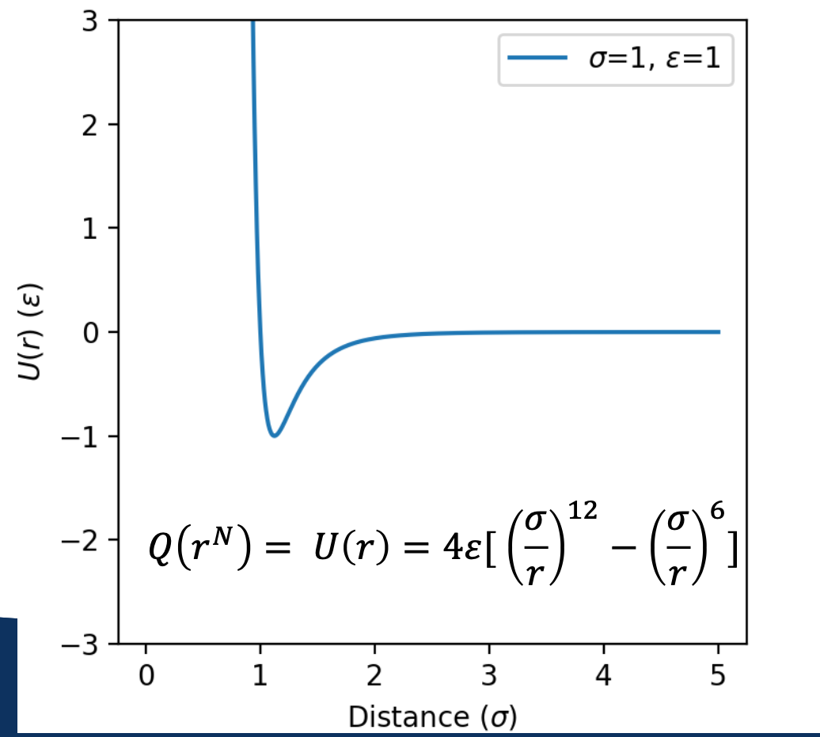
Molecular Simulations: Applying MC Integration to an Atomic System
Consider two atoms far apart at a distance where they do not interact that begin to move closer together
Initially, the interatomic potential thermodynamically favors the atoms to move closer together until an equilibrium distance is reached, then at closer distances the interaction becomes energetically unfavorable
Now expand this spatial-dependent potential energy to a system of several moles of atoms
Calculating the potential between selected pairs of atoms is feasible but system-wide calculations quickly become arduous

Slide 8
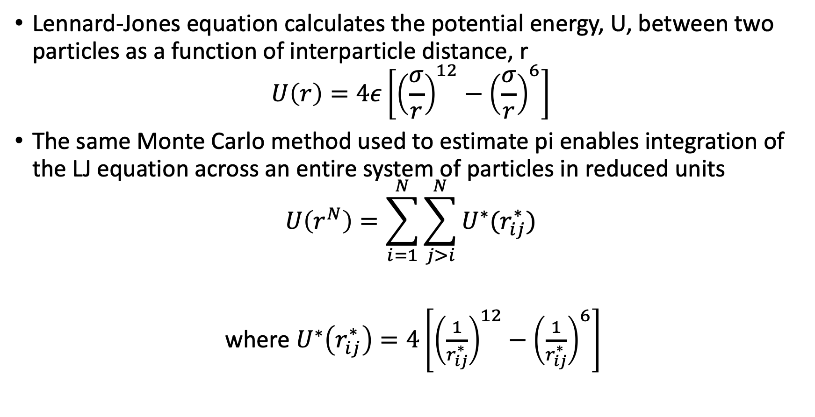
Molecular Simulations: Applying MC Integration to an Atomic System
Lennard-Jones equation calculates the potential energy, U, between two particles as a function of interparticle distance, r
$$U\left(r\right)=4ε\left[{\left(\frac{σ}{r}\right)}^{12}−{\left(\frac{σ}{r}\right)}^{6}\right]$$
The same Monte Carlo method used to estimate pi enables integration of the LJ equation across an entire system of particles in reduced units
$$U\left(r^{N}\right)=\sum_{i=1}^{N}{\sum_{j>i}^{N}{U^{∗}(r_{ij}^{∗})}}$$
where $U^{∗}\left(r_{ij}^{∗}\right)=4\left[{\left(\frac{1}{r_{ij}^{∗}}\right)}^{12}−{\left(\frac{1}{r_{ij}^{∗}}\right)}^{6}\right]$

Slide 9
Molecular Simulations: Applying MC Integration to an Atomic System
For the argon system considered, all parameters (T, V, P, n) were held constant while the spatial arrangement was varied
Spatial arrangement can be varied by generating random sets of coordinates for the same number n of particles or reading in different coordinates from a file
It is also necessary to define a unit volume within the system that is representative of the entire system’s behavior
Similar to the pi calculation: Quadrant I was taken to be the representative unit cell that, when mirrored across the other three quadrants, accurately depicted the state of each quadrant and, subsequently, the entire circle

Slide 10
Programming: Comparing Python and C++ Languages
Python is an interpreted language, i.e. when you run .py code an interpreter must process each line of code to convert it into something that can be read into machine code
C++ is a compiled language, i.e. when you run .cpp code it does not need an interpreter; it can be directly converted into machine code
This outwardly implies the added interpretation step makes Python slower than C++ by default
However, this is not always the case, depending on how you write your code (slides 10 – 13 offer a case study of this behavior)

Slide 11
Programming: Comparing Python and C++ Languages
One approach to increasing the processing speed of Python language is to use NumPy
NumPy is a Python library for multidimensional array generation and processing, with advantages when applied to handling large datasets
A conventional approach to data processing is an iterative approach where the code loops through processing subsets of data contained within a larger dataset (**time consuming in large volumes**)
NumPy’s array handling capabilities enables a more “batch” approach, i.e. it can be leveraged to process much larger datasets contained within a defined array in a single statement

Slide 12
Programming: Comparing Python and C++ Languages
On a note about personal preference between the language types used:
Python and NumPy can be faster to type in some cases as you don’t have to specify value type for each new value you define and they have some built-in functions that can streamline writing (e.g. the random number generation exercises, NumPy’s array handling capabilities)
However, the required specificity for values and defining some functions manually in C++ forces me to slow down and really think about what I want my code to do and how I should design its process flow
I’m somewhat surprised to find myself slightly favoring C++ at the moment

Slide 13
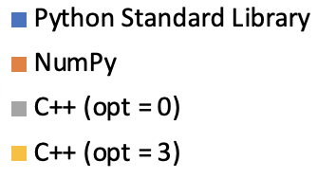
Programming: Assessing Code Performance
The number of points generated was changed by orders of magnitude to assess each code type’s performance
As anticipated, Python Standard Library was slowest
NumPy was consistently the fastest by >50%
Average run time (s)
1000
10000
100000
# of Points Generated

Slide 14
Programming: Assessing Code Performance
Both Python Standard Library and NumPy run times increased by ~10x for each 10x increase in # of points generated
C++ (opt = 0) was unchanged from 1000 to 10000 points generated but then doubled from 10000 to 100000 points generated
C++ (opt = 3) run times were consistent across the three test conditions
Average run time (s)
1000
10000
100000
# of Points Generated

Slide 15
Programming: Assessing Code Performance
NumPy having the fastest average run times was a bit unexpected
Python is still an interpreted language, so I anticipated that the run time through an interpreter would still take longer than an optimized C++ (opt = 3), which can be directly converted into machine code
The next slide discusses why NumPy may have been faster than C++ in the present case study (tldr, NumPy used an array while C++ iterated through a for loop)
Average run time (s)
1000
10000
100000
# of Points Generated

Slide 16
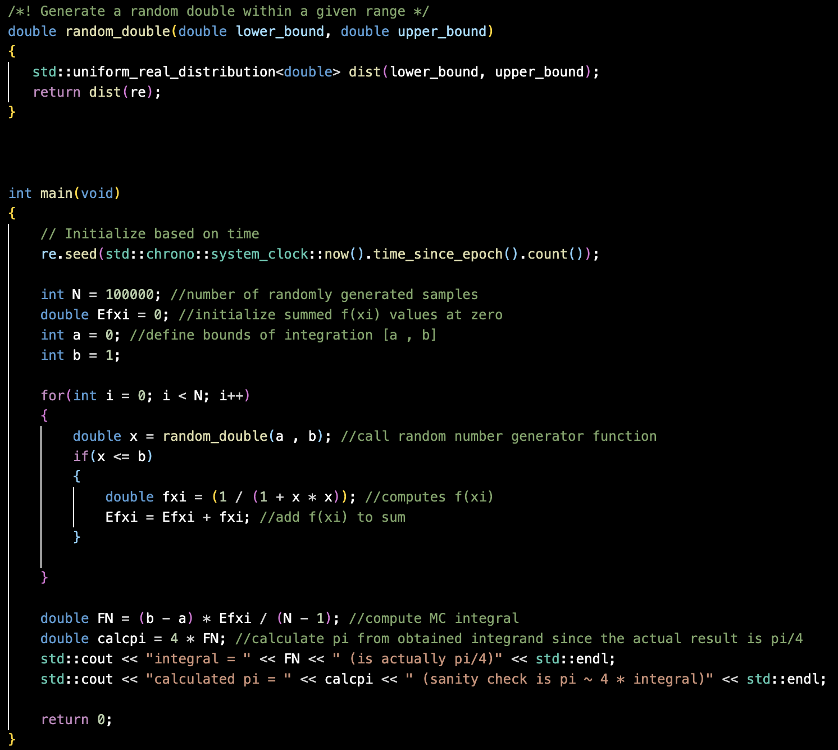
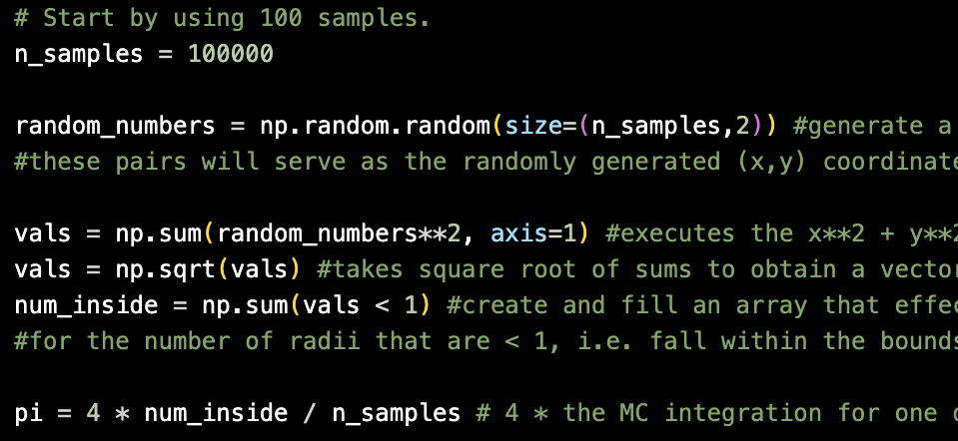
Right: C++ code must complete the for loop each time it generates a single random number, processes each point individually, then adds the processed point to a growing sum
Below: NumPy generates an entire array of random numbers in one statement and processes the array as a unit in subsequent statements

Slide 17
Software Engineering: Integrating a Workflow to Projects
For any project, but especially large and/or multifile projects, it’s desired to have a method of tracking project changes
At times it may be necessary to revert a project to a previous version or pull a specific aspect of a previous version to the current project state
Version control with software like Git enables this tracking and accessing previous versions of a project
With version control software, the user can save desired versions of a project to track its progress and retain aspects that have been altered or deleted entirely in subsequent versions

Slide 18
Software Engineering: Integrating a Workflow to Projects
With version control software like Git, a project can be “branched” i.e. a given project version may effectively be split into multiple lineages where each lineage is a version path through a different set of changes
Project versions existing on different branches may also be merged if it is desired to load some unique aspect of one branch’s project into the other branch

Slide 19
Software Engineering: Process Flow Considerations for Code Efficiency
For small data applications, e.g. single values, a chronological, linear succession of individual statements may be sufficient to process the value
Increasing data size to a few or more values introduces the desire to apply processing statements to each value in a dataset in an automated, iterative fashion
This both reduces the workload for writing the code itself and can make the code run more efficiently by looping the code to effectively use the same statements to process several pieces of data in succession
Significantly increasing data size sees the iterative loop method become time consuming to the point that designing a new method by which an entire dataset is applied to a function in a single statement becomes more efficient
Here we arrive at the tested NumPy ability to organize entire datasets into multi-dimensional arrays

Slide 20
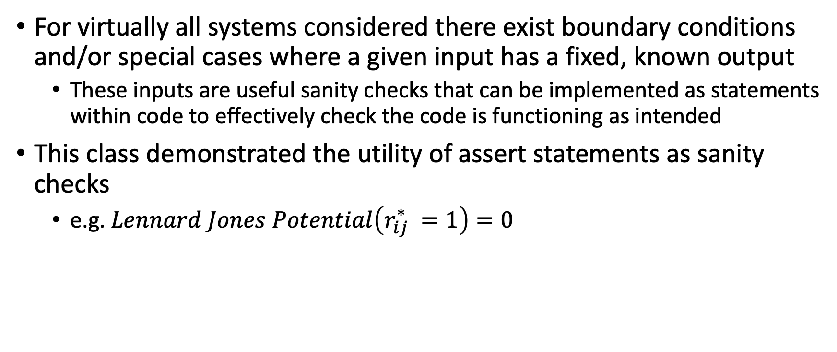
Software Engineering: Assessment Commands as Sanity Checks
For virtually all systems considered there exist boundary conditions and/or special cases where a given input has a fixed, known output
These inputs are useful sanity checks that can be implemented as statements within code to effectively check the code is functioning as intended
This class demonstrated the utility of assert statements as sanity checks
e.g. $Lennard Jones Potential\left(r_{ij}^{∗} =1\right)=0$

