Slide 1
What we have done:
Coupled Tilio's thermodynamic model to the core evolution code.
For given P and composition, self-consistent calculation of latent heat, Cp, expansivities, density
Empirical relation between electrical resistivity and S concentration.
Scaling relations to estimate internal magnetic field strength, magnetic Reynolds number, Rossby number and convective lengthscale

Slide 2
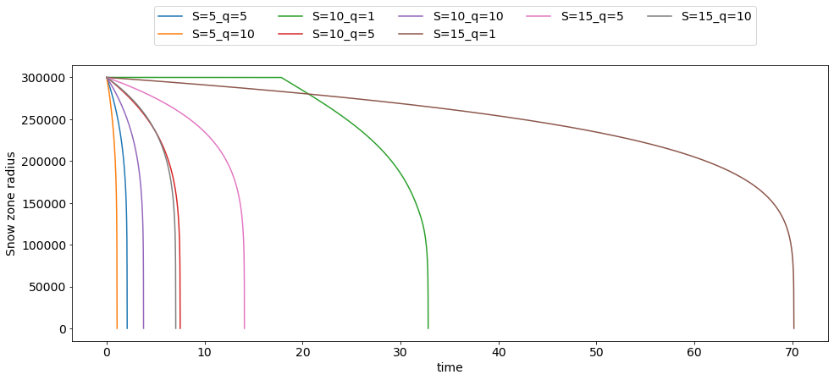
300 km body

Slide 3
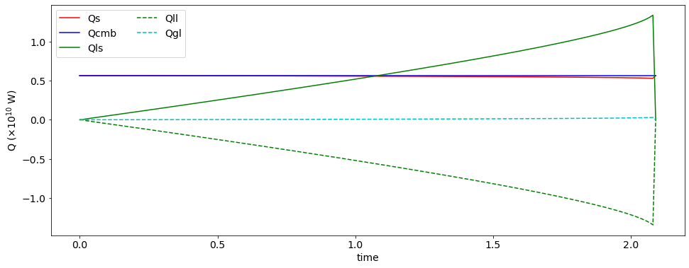
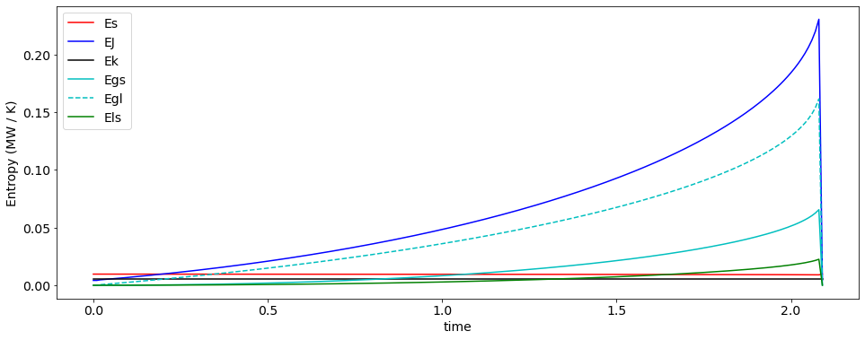
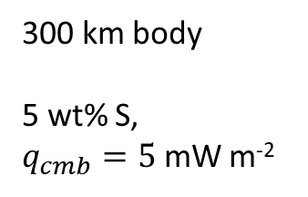
300 km body
5 wt% S,
$q_{cmb}=5$ mW m⁻²

Slide 4
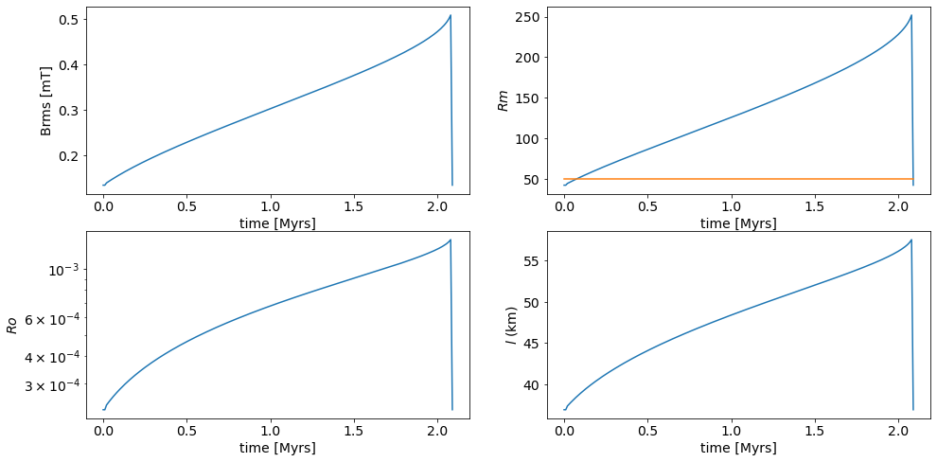

5 wt% S, $q_{cmb}=5$ mW m⁻²

Slide 5
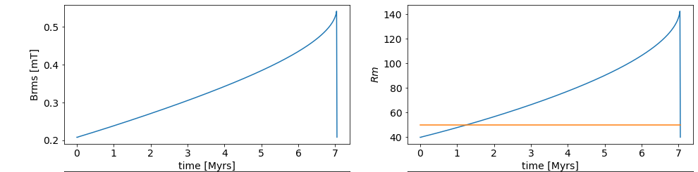
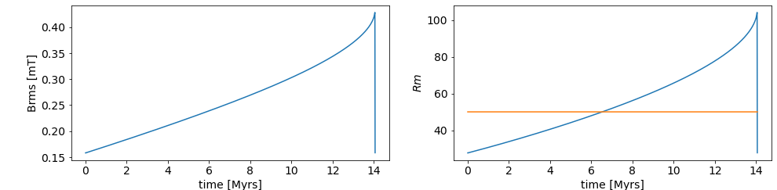
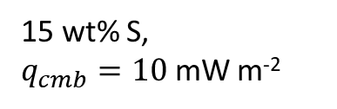
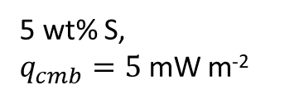
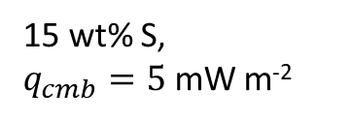
15 wt% S,
$q_{cmb}=10$ mW m⁻²
15 wt% S,
$q_{cmb}=5$ mW m⁻²
5 wt% S,
$q_{cmb}=5$ mW m⁻²

Slide 6
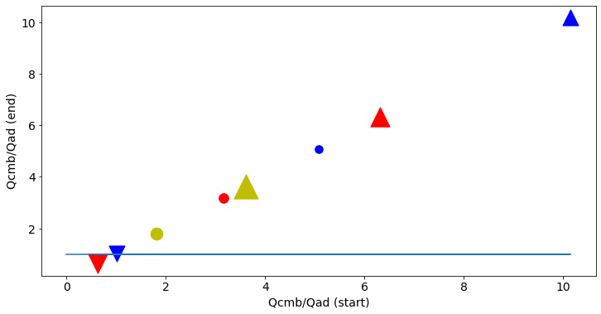
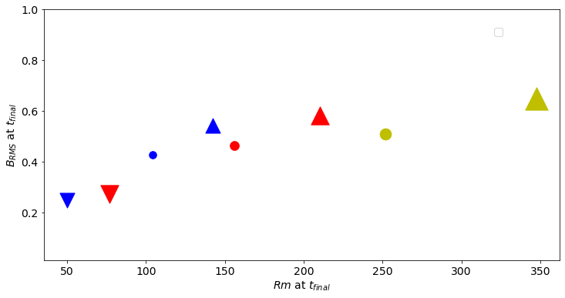
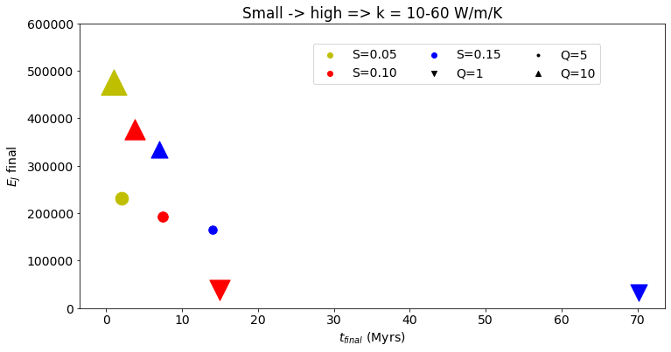
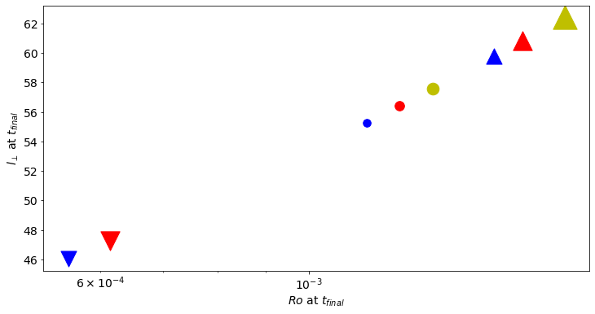
300 km body

Slide 7
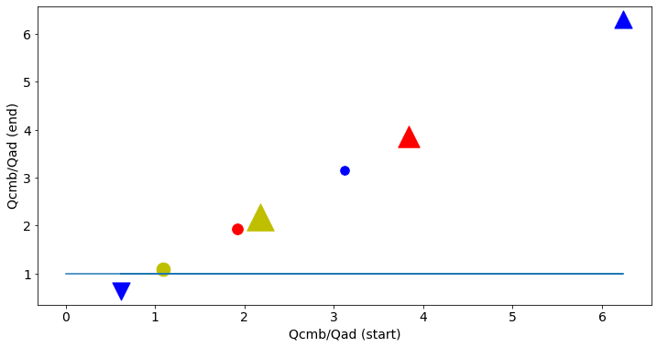
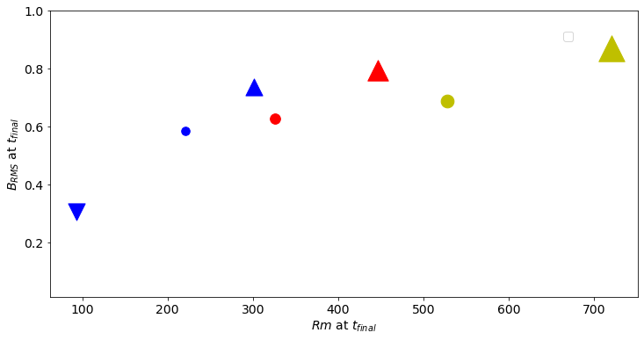
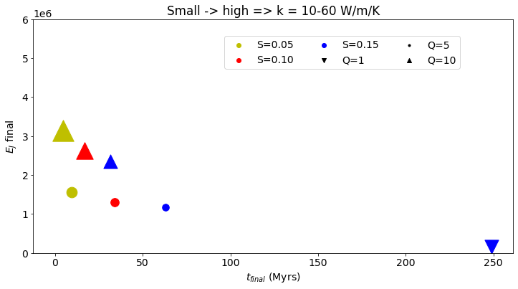
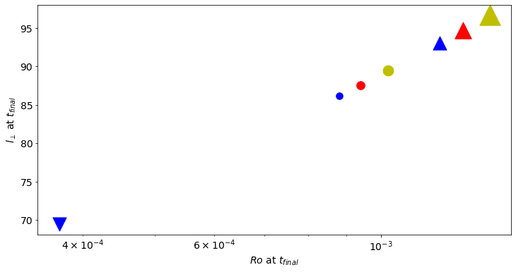

Slide 8
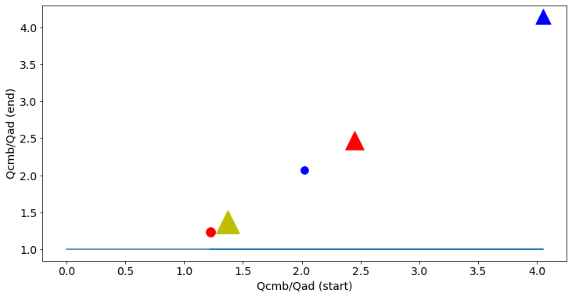
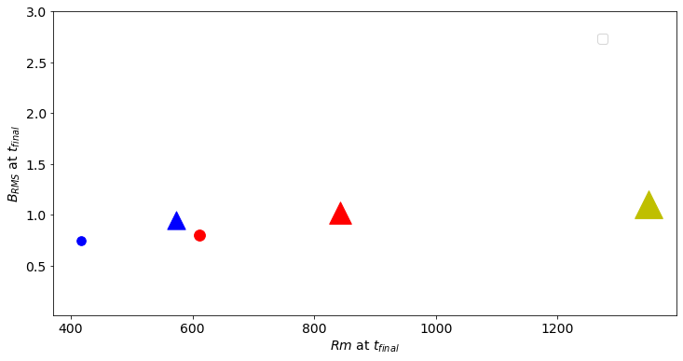
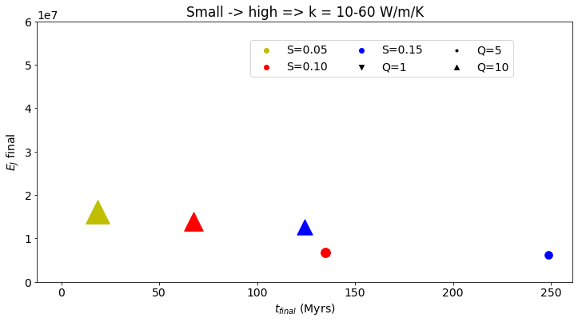
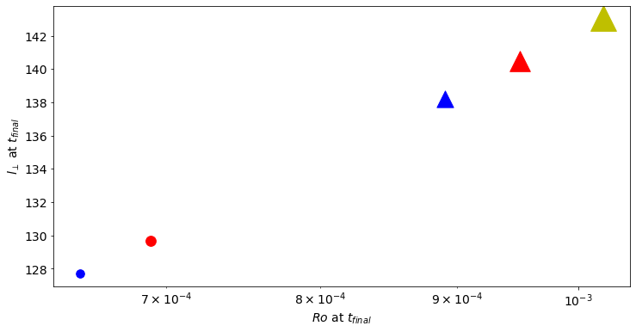

Slide 9
What we have done:
Coupled Tilio's thermodynamic model to the core evolution code.
For give P and composition, self-consistent calculation of latent heat, Cp, expansivities, density
Empirical relation between electrical resistivity and S concentration.
Scaling relations to estimate internal magnetic field strength, magnetic Reynolds number, Rossby number and convective lengthscale
Future models?
1. Thermal strat models? Let core become completely stratified and see if we still get snow
2. Different CMB pressures? Does this open up a wider range of core chemistry's that allow snow?

