Slide 1
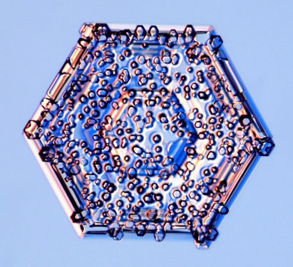





Modeling secondary ice production in mixed-phase clouds
Sylvia Sullivan¹, Corinna Hoose², Alexei Kiselev², Thomas Leisner², and Athanasios Nenes^{1,3,4}
EGU AS3.3 – Atmospheric Ice Particles
¹ Department of Chemical and Biomolecular Engineering, Georgia Institute of Technology
² Institute of Meteorology und Climate Research, Karlsruhe Institute of Technology
³ IERSD, National Observatory of Athens, Palea Penteli, Greece
⁴ ICE-HT, Foundation for Research and Technology Hellas, Patras, Greece
Image taken from Kenneth Libbrecht www.its.caltech.edu/~atomic/

Slide 2








At warmer subzero temperatures, measured ice numbers can be much higher than INP numbers:
ice-nucleating particle
Homogeneous nucleation
Heterogeneous nucleation
N_{ice}
1:1 line
N_{INP}

Slide 3
Could secondary ice production explain the difference?
Droplet shattering
N_{ice}
1:1 line
Rime splintering
Breakup upon ice hydrometeor collision
N_{INP}

Slide 4
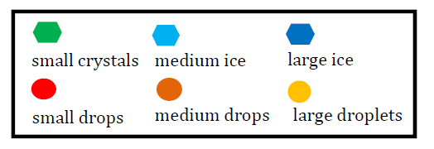

I. How much can secondary production enhance ice crystal number concentrations?
T

Slide 5
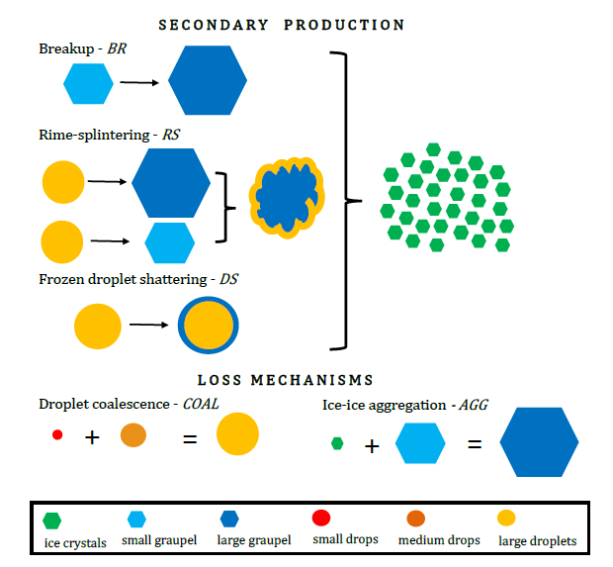

A six-hydrometeor-class parcel model was constructed to estimate N_{i} from secondary production.

Slide 6
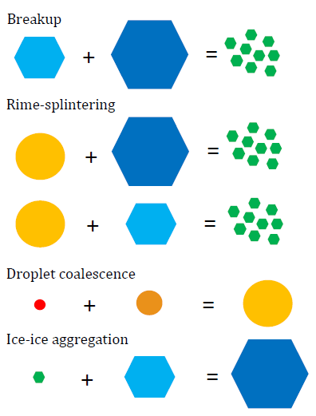
A first set of simulations uses ‘process weightings’.
 | Case 1 | Case 2 | Case 3
η_{BR} | 0% | 50% | 100%
η_{RS} | 0% | 50% | 100%
η_{COAL} | 100% | 50% | 0%
η_{AGG} | 100% | 50% | 0%
Suppressed secondary production
Intermediate secondary production
Only secondary production

Slide 7
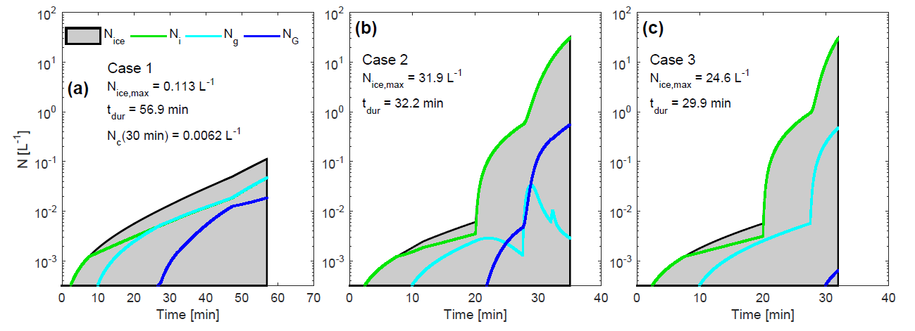
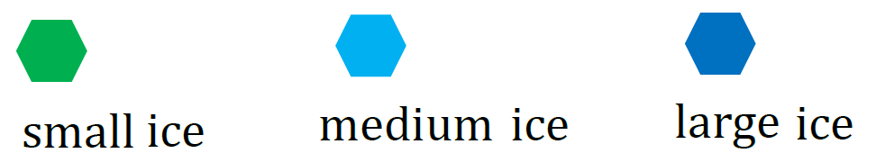
These process weighting simulations show an enhancement of N_{i} by 10³ through secondary production…
N_{ice,max} = 0.01 L⁻¹
over 60 min
N_{ice,max} = 30 L⁻¹
over 30 min
N_{ice,max} = 24 L⁻¹
over 30 min
Sullivan et al. 2017 JGR
Notes:
Cyan

Slide 8
What about atmospherically relevant “cloud states”?
u_{z,2}
or
T
u_{z,1}
n_{aer,1}
n_{aer,2}

Slide 9
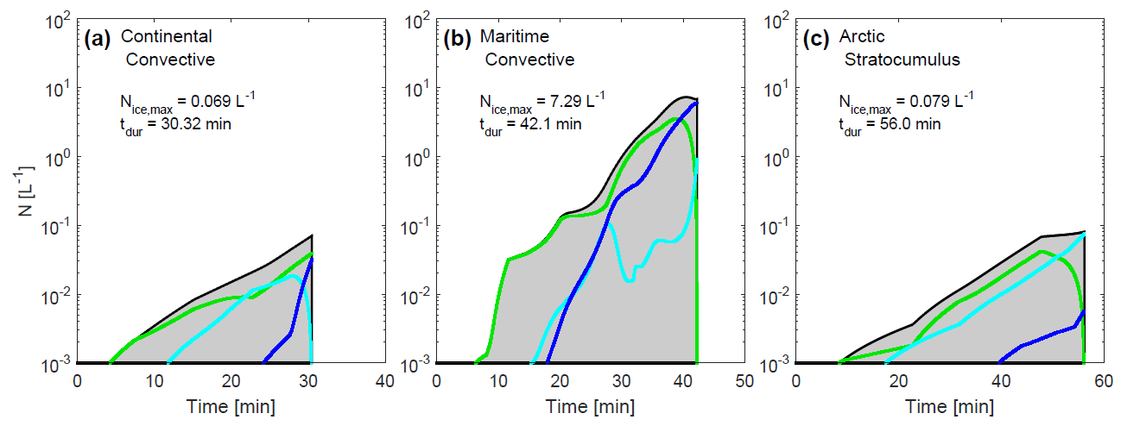
… and “cloud state simulations” show that enhancement is largest for maritime convective clouds.
N_{ice,max} = 0.07 L⁻¹
over 30 min
N_{ice,max} = 7 L⁻¹
over 40 min
N_{ice,max} = 0.071 L⁻¹
over 50 min
Sullivan et al. 2017 JGR
Notes:
in agreement with observations

Slide 10
I. How much can secondary production enhance ice crystal number concentrations?
by 10³
largest for maritime convective clouds
II. How much primarily nucleated ice must exist to initiate secondary production?

Slide 11
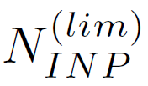
Could secondary ice production explain the difference?
Droplet shattering
N_{ice}
1:1 line
Rime splintering
Breakup upon ice hydrometeor collision
N_{INP}
Ice-nucleating particle to initiate secondary ice production

Slide 12
A set of thermodynamic simulations is run.
 | BRth | RSth | DSth
T₀ | 256, 258, 260, 262, …, 272 K
u_{z} | 0.1, 0.5, 1, 1.5, 2, …, 5 m s⁻¹
T_{0,2}
u_{z,2}
or
T_{0,1}
u_{z,1}
Notes:
We use weightings, eta, to “turn on and off”, different processes. This gives an idea of the maximum ice crystal number concentration enhancement from each process.

Slide 13
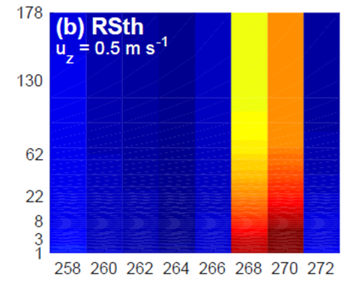
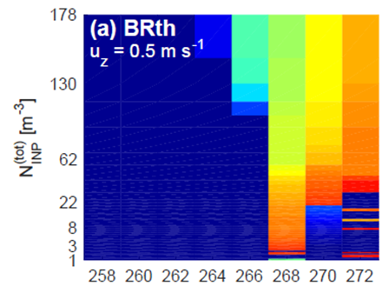
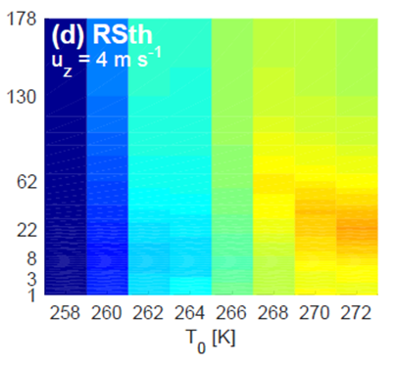
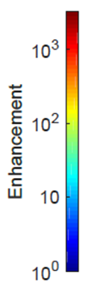
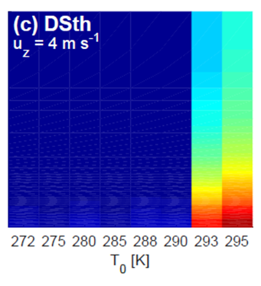

Breakup can have an N_{INP}^{(lim)} of up to 0.07 L⁻¹.
For droplet shattering and rime splintering, appropriate temperature ranges are more important.
Sullivan et al. 2018 ACP
Notes:
First we show enhancements for a fixed updraft and a range of initial temperatures.
For BR, N_INP^(lim) ranges from 32.8 m-3 at 272 K to 21.5 m-3 at 270 K to 2.1 m-3 at 268 K. It goes back up to 0.143 L-1 at 266 K. The enhancements occur from warmer initial temperatures only because these allow the formation of graupel. If T_0 is too low, sufficient riming does not occur; the parcel reaches the temperature for homogeneous nucleation too quickly.
For RS, a clear optimal temperature zone is evident in panel b at 268 and 270 K. This “blurs out” at the higher updraft in panel d because the parcel spends less time in just this optimal zone, so enhancements of lower magnitude occur over a wider T0 range.
For DS, a very warm cloud base temperature is needed for large enhancement (although from 272 to 290 K there is still about a not-so-visible, 5-fold enhancement). The model incorporates a basic representation of large droplet coalescence at warmer temperatures, and if T0 is too low, there is insufficient time for droplets of “shatter-ale” diameter to form. This formulation is due to ICE-T / COPE observations from Lawson et al. 2015, Taylor et al. 2016, and Lawson et al. 2017.

Slide 14
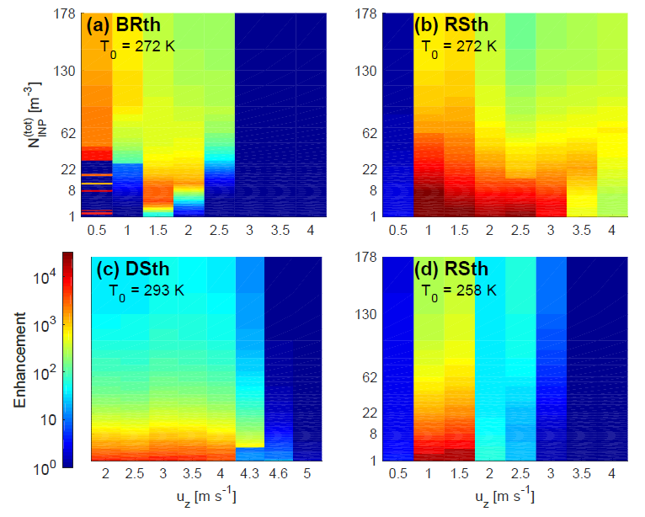
For the processes involving the liquid phase, there are u_{z} ‘sweet spots’.
N_{INP}^{(lim)} is evident again.
Sullivan et al. 2018 ACP
Notes:
Now we show enhancements for a fixed initial temperature and a range of updrafts.
Again BR is the only process with clear N_INP^lim values. For all processes, but particularly those involving the liquid phase, there seem to be kind of “sweet spots” in the updraft velocity. These modest vertical motions keep the hydrometeors in an appropriate temperature range for a longer time. They also allow formation of larger hydrometeors (either large droplets or large graupel by coalescence or riming respectively) which are a key ingredient in the secondary production tendencies.

Slide 15
I. How much can secondary production enhance ice crystal number concentrations?
by 10³ or 10⁴
largest for maritime convective clouds
II. How much primarily nucleated ice must exist to trigger secondary production?
up to 0.07 L⁻¹ for breakup
T₀ and u_{z} are more influential when the liquid phase is involved

Slide 16

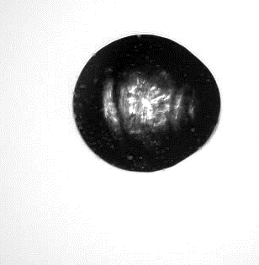
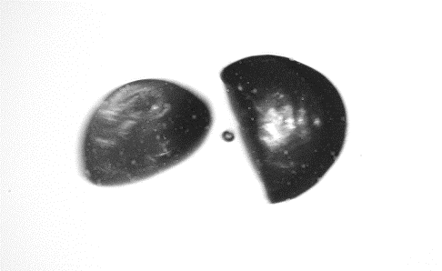
Open PhD position at KIT, Germany, to study droplet shattering and rime-splintering
400 µm
Contact: Alexei Kiselev alexei.kiselev@kit.edu http://www.imk-aaf.kit.edu/43_979.php
During the EGU, please contact Dr. Heike Wex, the co-convener of the AS3.3 Session “Atmospheric
Ice Particles” on Wednesday from 8:30 to 12:00 in hall X5 or during the poster session

Slide 17
I. How much can secondary production enhance ice crystal number concentrations?
by 10³ or 10⁴
largest for maritime convective clouds
II. How much primarily nucleated ice must exist to trigger secondary production?
up to 0.7 L⁻¹ for breakup
T₀ and u_{z} are more influential when the liquid phase is involved
Investigating the contribution of secondary ice production to in-cloud ice crystal numbers, JGR 2017 doi: 10.1002/2017JD026546
Initiation of secondary ice production in clouds, ACP 2018 doi: 10.5194/acp-18-1593-2018

Slide 18
Supplementary slides

Slide 19
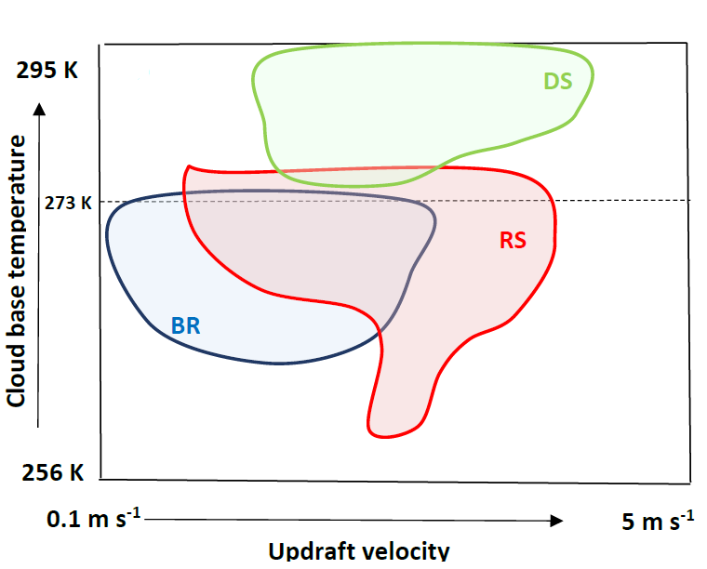
Summary schematic
Investigating the contribution of secondary ice production to in-cloud ice crystal numbers JGR 2017
doi: 10.1002/2017JD026546
Initiation of secondary ice production in clouds ACP 2018
doi: 10.5194/acp-2017-387

Slide 20

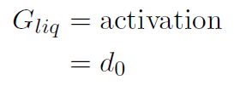


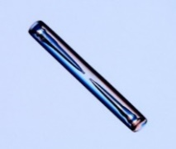
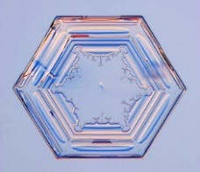
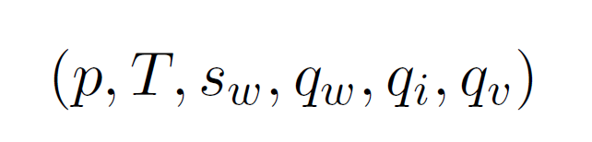
Hydrometeor number and moist thermodynamic tendencies are solved iteratively.
a
a
c
c
Crystal images from Kenneth Libbrecht
Notes:
Spheroidal geometry from Jensen and Harrington 2015 and an inherent growth factor from Chen and Lamb 1994 are used

Slide 21


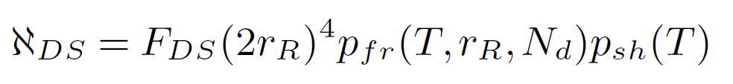


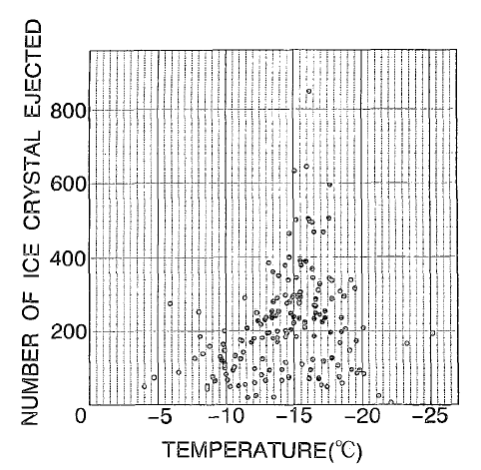


Secondary ice production parameterizations in more detail…
Rime splintering
Droplet shattering
Breakup upon ice hydrometeor collision
Notes:
The rime splintering formulation is based upon Hallett and Mossop 1974. It uses their laboratory measurement of 3 x 10^8 fragments per kilogram rime multiplied by the mass of riming large droplets. The droplet shattering formulation is based upon droplet levitation experiments (Lauber et al. 2017 in preparation) and Paukert et al. 2017. The shattering probability is assumed to be normally distributed. Then the freezing probability uses the DeMott et al. immersion INP parameterization scaled by a fraction (1 - f_imm) that do not nucleate immediately and a factor (50) of small droplets that coalesce to form a large one. The nucleation rate is reduced accordingly. F_DS comes from Lawson et al. 2017 or a sigmoid from droplet levitation experiments (shown on next two slides).

Slide 22
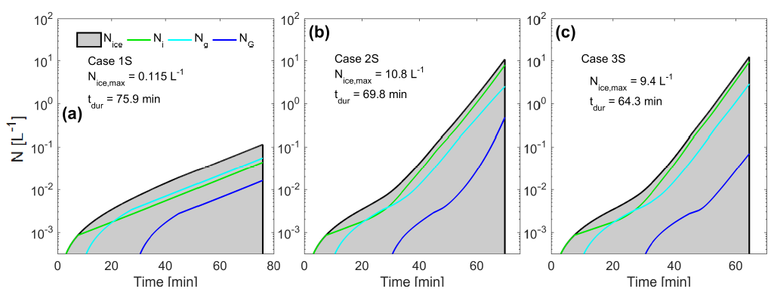
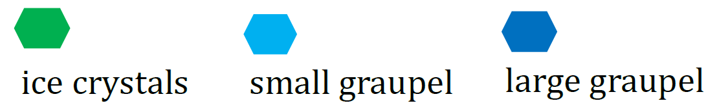
The secondary production rate is ten times slower when ice hydrometeor sphericity is assumed.

Slide 23
“Cloud state simulations” set aerosol and dynamic properties representative of cloud types.
 | Continental convective | Tropical maritime | Arctic stratocumulus
Updraft | larger mean, more variable | intermediate mean and variability | smaller mean, less variable
Cloud base temperature | intermediate cloud base temperature | warmer cloud base temperature | cold cloud base temperature
Activation rate (“aerosol proxy”) | higher activation rates | intermediate activation rates | lower activation rates

Slide 24
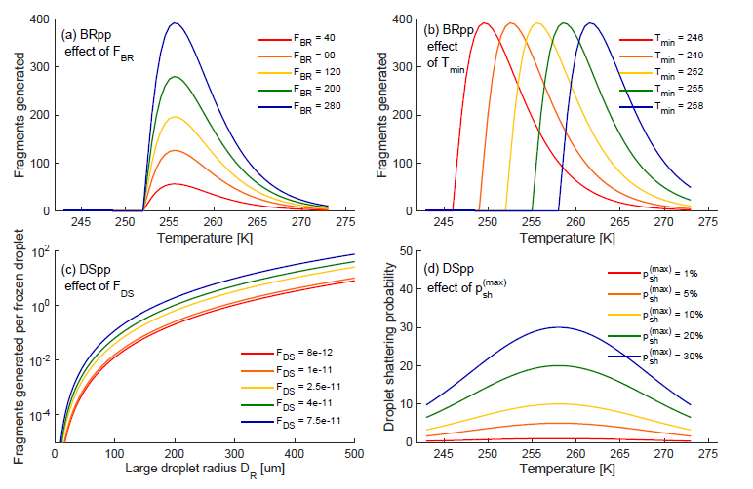
What are the effects of various parameter perturbations?

Slide 25
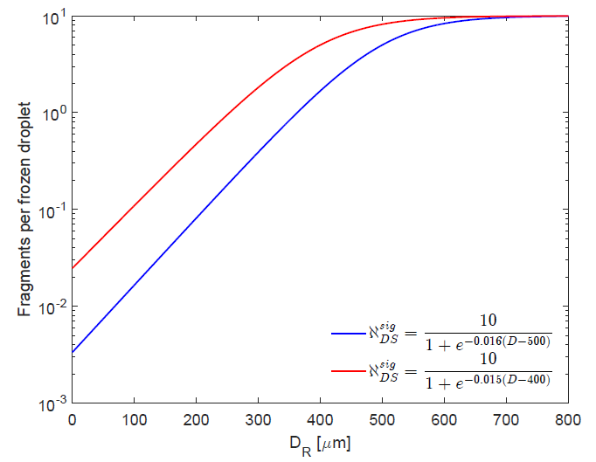
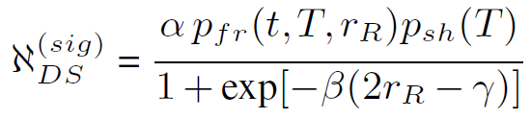
A sigmoidal fragment number generates more fragments from small (D ~ 100 um) droplets and less from very large (D ~ 1 mm) ones.

Slide 26
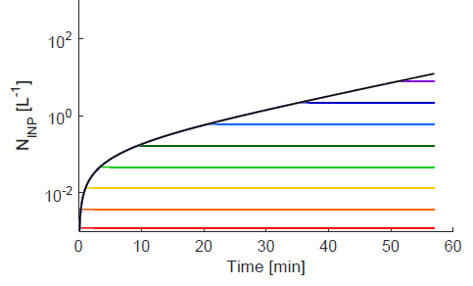
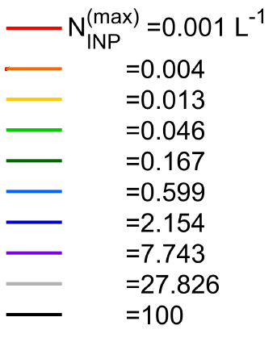
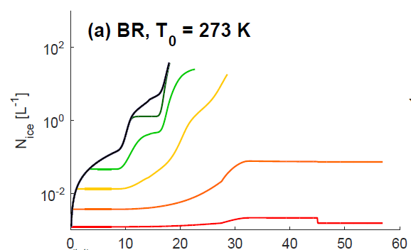
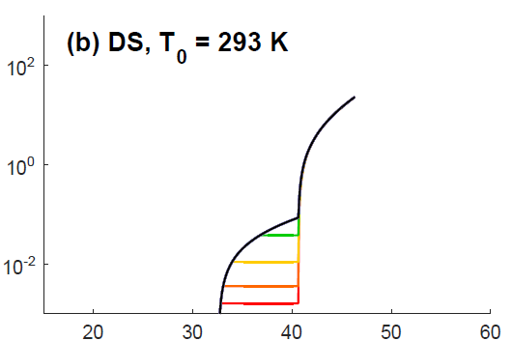

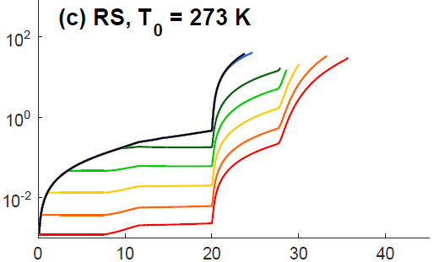
N_{ice} evolution is determined by non-linearity and one- or two-phasedness.
Notes:
We look first at the evolution of the ice hydrometeor number in the adiabatically rising parcel.
We run ten simulations for each process with varying INP number concentrations from 0.001 L-1 up to 100 L-1. These variations make a large impact on both the magnitude and timing of the breakup tendency. They have an impact on the timing of the rime splintering one. And do not make much difference to the droplet shattering ones.
Droplet shattering simulations must be run from warmer initial temperatures to allow the formation of sufficiently large droplets by coalescence. Condensational growth is insufficient.

Slide 27



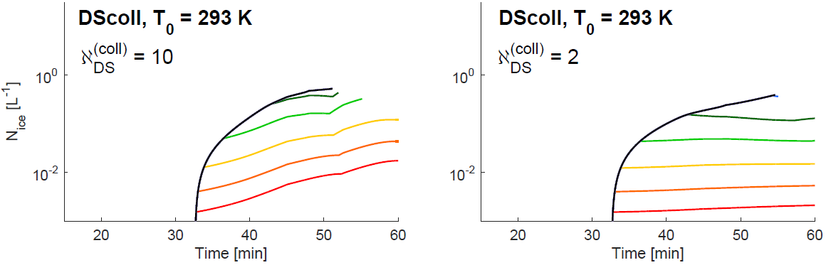
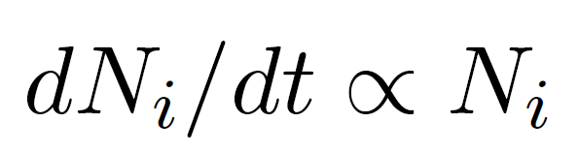
What if we change the formulation of droplet shattering to be collisional?
Now a strong dependence on INP
Only enough ice is generated to balance out consumption.
…but also a much slower generation rate.
Notes:
It is important to note that now the ice generation rate is proportional to the number of ice crystals. If the fragment number is only 2, there is no net gain; for every collision, one crystal is generated and one is consumed. But in the case the dependence on the number of nucleating aerosol is much higher.

Slide 28
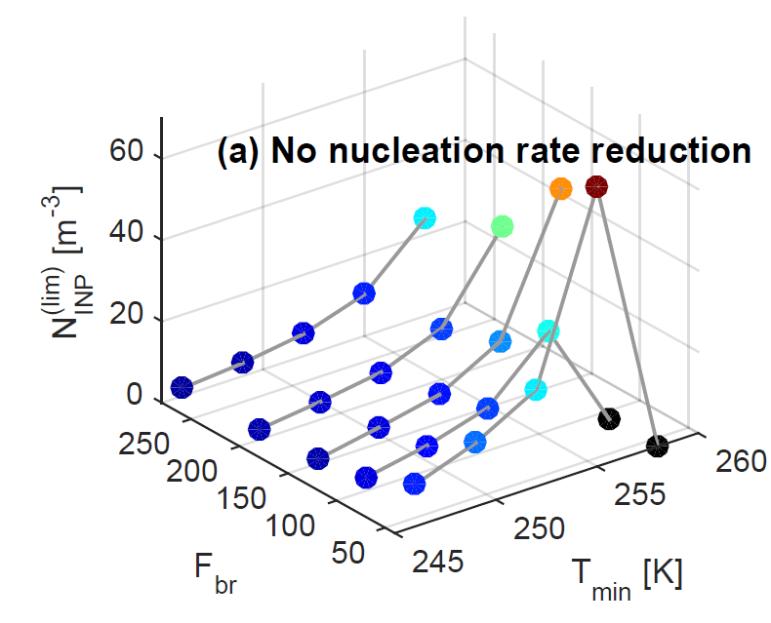
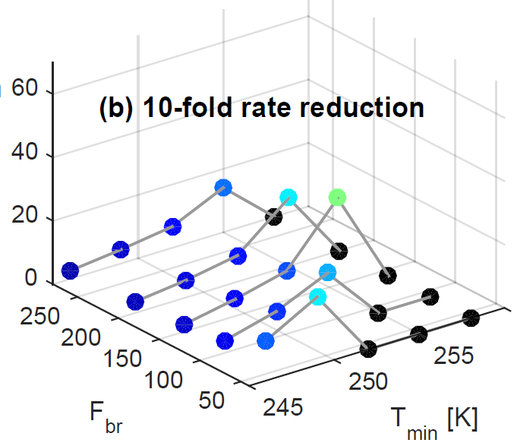
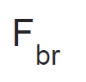
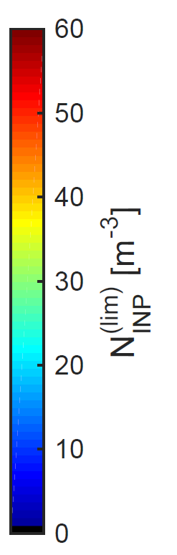
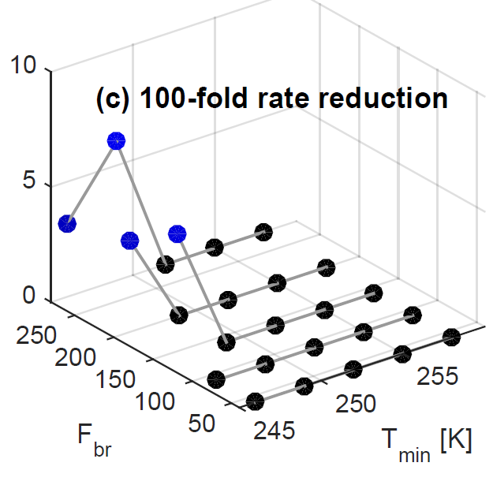
As the nucleation rate slows, secondary ice production occurs for less and less of the parameter space.
BRpp
Notes:
(1) When the dots are black, no enhancement in ice crystal number concentration from secondary production occurs. When there is no nucleation rate reduction, 8% of the parameter space has no enhancement; when it is reduced 10-fold, 32% of the space; and when it is reduce 100-fold, 84% of the space.
(2) F_br is the leading coefficient of the fragment generation function from breakup. As it gets higher, fewer INP are needed to generate an enhancement from secondary production.
(3) T_min is the lower bound, the temperature below which no collisional breakup occurs. As it gets higher, more INP are needed to generate an enhancement from secondary production.

Slide 29
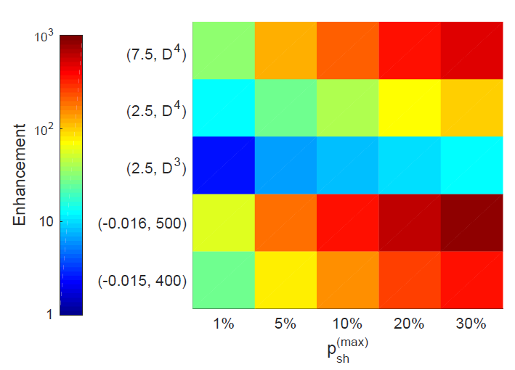
Increasing p_{sh}^{(max)} increases enhancement linearly.
The largest enhancements come from a sigmoidal fragment generation function.
DSpp
Notes:
DSpp: On the y-axis, are different fragment generation functions, e.g. (7.5, D^4) is a fourth-order polynomial with 7.5 leading coefficient and (-0.016, 500) are two parameters within a sigmoid. These functions are also shown in supplementary slides. On the x-axis are different maximum probability of shatter.
The largest enhancements come from a sigmoidal fragment generation function because this calculates more fragments from small droplets (D ~ 100 um) and less for very large ones (D ~ 1 mm) than the polynomial fragment generation function.
There are monotonic, linear increases in the enhancement magnitude with p_sh^max.
RSpp:

Slide 30
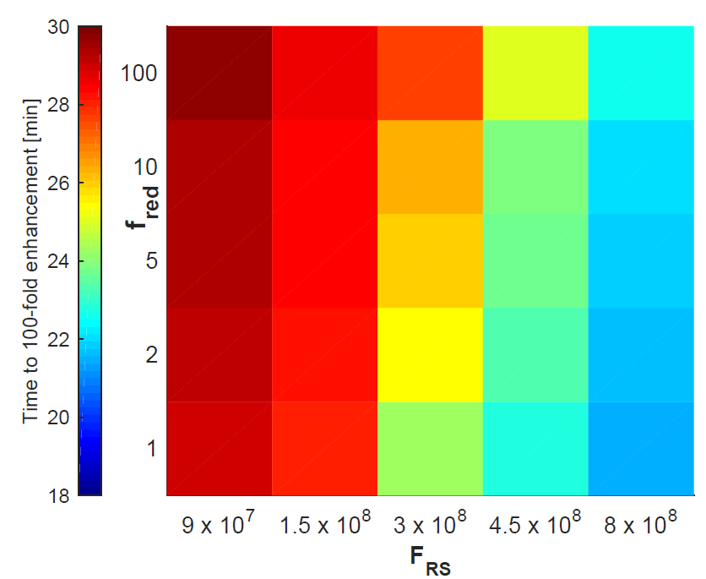
Reducing the nucleation rate slows the enhancement timing.
Reducing the fragments generated per kilogram rime has a larger impact.
RSpp
Notes:
RSpp: On the y-axis, are different different nucleation rates; f_red represents a nucleation reduction factor. On the x-axis is the leading coefficient of the fragment generation function (i.e. fragments generated per kg of rime). ** Now we are looking at the timing of enhancement, not its magnitude. **
Reducing the nucleation rate slows the enhancement timing, although it has no meaningful impact on N_ice^max as seen in the default sims. Reducing the fragments generated per kg rime also slows enhancement timing.
The “liquid phase change”, i.e. that to F_RS, has a bigger impact than the “ice phase change”, i.e. that to f_red.

