Slide 1
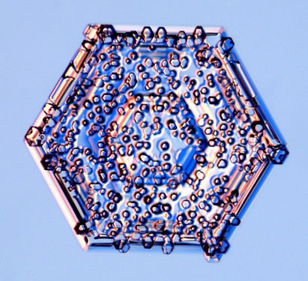




Modeling the relative contributions of secondary ice formation processes to ice crystal number concentration within mixed-phase clouds
Sylvia Sullivan^{1,2}, Corinna Hoose², and Athanasios Nenes^{1,3,4}
EGU AS1.27 – Observing and modeling processes in moderately supercooled clouds – 19 April 2016
¹ Department of Chemical and Biomolecular Engineering, Georgia Institute of Technology
² Institute of Meteorology und Climate Research, Karlsruhe Institute of Technology
³ IERSD, National Observatory of Athens, Palea Penteli, Greece
⁴ ICE-HT, Foundation for Research and Technology Hellas, Patras, Greece
Image taken from Kenneth Libbrecht www.its.caltech.edu/~atomic/

Slide 2
Motivation
Observed atmospheric ice number concentrations can be orders of magnitude higher than the ice nuclei number concentrations.
This enhancement can be explained by secondary ice processes.
Parcel model simulations are useful to understand the importance of various parameters to this microphysics.
1. Rime splintering
2. Breakup upon graupel-graupel collision
Notes:
Especially at warmer subzero temperatures

Slide 3
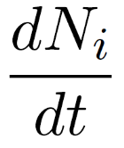
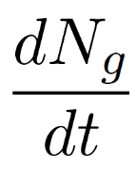
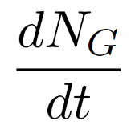
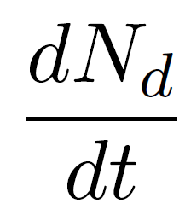
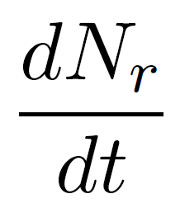
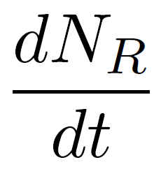
Hydrometeor number tendencies
rime splintering
ice-ice aggregation
nucleation
breakup upon collision
ice crystals
small graupel
large graupel
rime splintering
droplet coalescence
activation
small droplets
medium droplets
large droplets
A generation function is defined for each phase.
Notes:
These etas act as process weightings or pseudo process efficiencies. It is a mathematical handle to test the limits of the parameter space, to know what the maximum ice enhancement could be if secondary processes were amplified.

Slide 4


Hydrometeor number tendencies
characteristic time for depositional or riming growth to next bin
ice crystals
characteristic time for condensational growth to next bin
small droplets
A generation function is defined for both phases.
A time delay formulation is used for hydrometeor growth as in Yano and Phillips 2011.

Slide 5





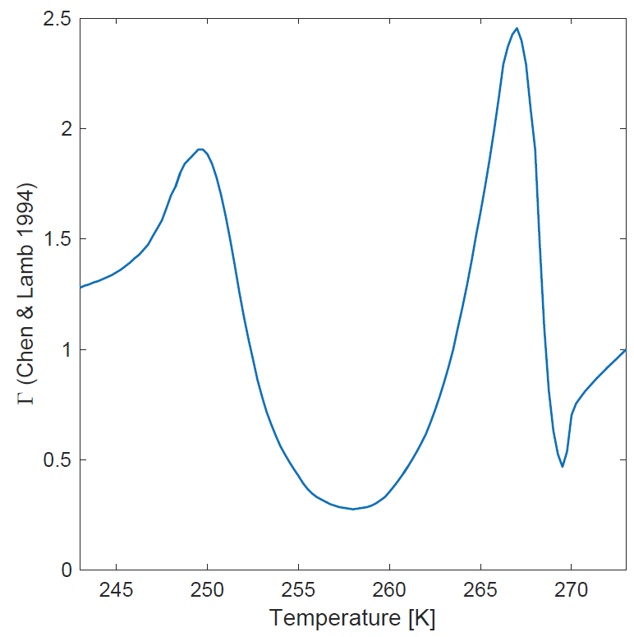
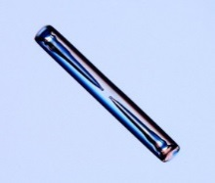
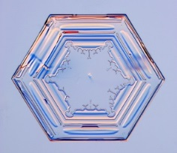
Moist thermodynamic tendencies
We use spheroidal geometry as in Jensen and Harrington 2015 and an inherent growth factor as in Chen and Lamb 1994.
a
a
c
c
Hydrometeor tendencies
Moist thermodynamic tendencies
Ice crystal images from K. Libbrecht

Slide 6
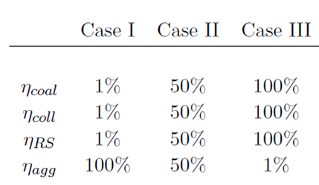
Testing the parameter space
Minimal secondary ice
Intermediate secondary ice
Maximal secondary ice
Notes:
We weight the different terms within the generation function with a “pseudo-efficiency”.
The intermediate case gives an indication of how linear v. nonlinear the effects are.
When the process contribution is 0, a given process has no impact. When the process contribution is 1, it is the only active process.
The cumulative change in ice hydrometeor number normalized by the change only due to primary formation. In this sense, it is a quantification of how much secondary processes contribute to ice number at a given time.
Why can eta assume different values?

Slide 7
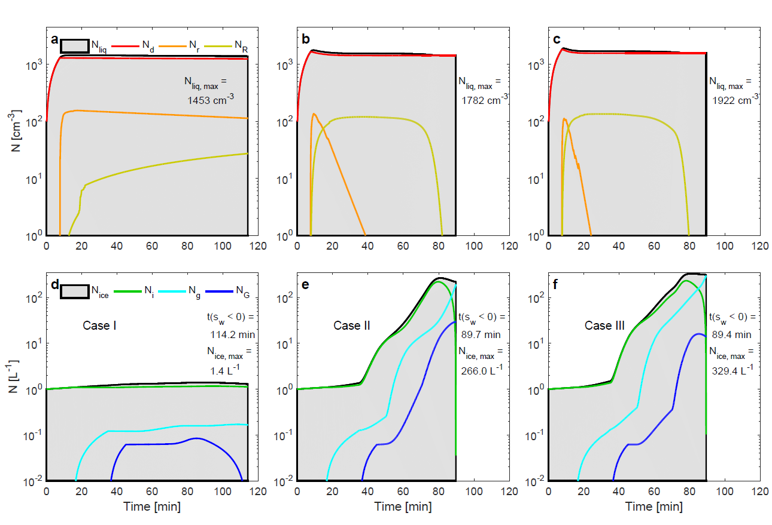
II. Inter-
mediate
III. Maximal
I. Minimal secondary ice
In this framework, with only process weightings, it is possible to significantly change N_{ice} and cloud lifetime.
Notes:
All of these simulations are halted when the parcel becomes subsaturated with respect to water because there is no representation of the Wegener-Bergeron-Findeison process.
Case III, with the most active microphysics and secondary production, has the highest liquid hydrometeor number. When rime splintering and coalescence becomes more efficient, the not-so-small droplet number is consumed very quickly.
(2) Case III also has the highest ice hydrometeor number. The increases are highly non-linear with process efficiency. Case I → Case II (190% increase in Nice); Case II → Case III (23% increase in Nice). In particular, when rime-splintering and collisions are efficient, ice crystal number rapidly increases after production of large graupel.
(3) Case I, the cloud with limited secondary ice production, is longer lived. Subsaturation takes a longer time.
The liquid hydrometeor number is almost exclusively determined by the number of small droplets since this number is so much larger than the others.
This is also the case for the ice hydrometeor number except right before subsaturation when the small graupel number dominates.
Ice enhancement can effectively be ‘turned off’ by making aggregation efficient and rime splintering + collisions inefficient.
There is not a large difference in the number evolutions between Cases II and III, same lifetime, only a slightly larger maximum Nice for Case III, so the enhancement change with microphysical efficiencies is not linear.

Slide 8

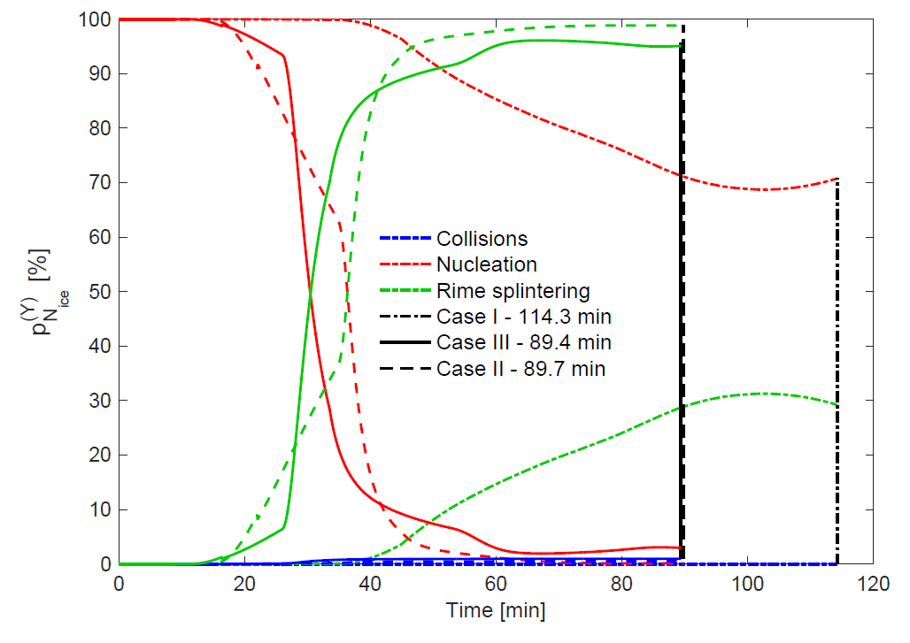
How much do process contributions change with weightings?
Process contribution
0 % → process Y is inactive 100 % → only process Y is active
Breakup - collisions
Ice nucleation
Rime splintering
Minimal secondary ice
Intermediate
III. Maximum
The contribution of breakup upon collision to N_{ice} remains quite limited.
Notes:
When the process contribution is 0, a given process has no impact. When the process contribution is 1, it is the only active process.
State which case is in which line type: “Case I is shown in the dotted-dashed line, Case II in the dashed line, and Case III in the solid line.”
Why is the contribution from collisions so limited? P_coll is limited because this process does not initiate until ice hydrometeors have grown depositionally to a sufficient size. The characteristic time for depositional growth to this size is longer than the time scale for other enhancement processes like rime splintering to initiate.

Slide 9
Define three states within the parameter space:
Cloud states
Continental convective conditions | Tropical maritime convective conditions | Arctic stratocumulus conditions
larger, more variable updrafts intermediate cloud base temperature higher activation rates many, smaller droplets initially
Notes:
Ncoll higher for tropical maritime case because there is an intermediate LWC and moderate updraft (allows time for depositional growth and branching, generation of higher si)
Ncoll also higher for Arctic mixed-phase case because there is moderate updraft (allows time for depositional growth and branching, generation of higher si) and cloud base is colder
NRS intermediate for continental clouds because LWC is higher and DSD may be narrow
NRS high for marine clouds because DSD is more likely to be bimodal and LWC moderate
NRS lower for Arctic clouds because cloud base is so cold and DSD may not be bimodal
Nagg higher for Arctic clouds because cloud base is cold and generation of larger ice hydrometeors is more likely and for marine clouds (because of higher supersaturation → more dendritic features which could interlock)
Nagg intermediate for continental clouds (slower growth with higher hydrometeor number)
Ncoal higher for continental clouds because of large Nd and large updrafts
Ncoal intermediate for continental clouds because of intermediate Nd and updraft
Ncoal small for Arctic clouds because of small Nd and updraft

Slide 10
Cloud states
Continental convective conditions | Tropical maritime convective conditions | Arctic stratocumulus conditions
larger, more variable updrafts intermediate cloud base temperature higher activation rates many, smaller droplets initially |  | smaller, less variable updrafts cold cloud base temperature lower activation rates few, larger droplets initially

Slide 11
Cloud states
Continental convective conditions | Tropical maritime convective conditions | Arctic stratocumulus conditions
larger, more variable updrafts intermediate cloud base temperature higher activation rates many, smaller droplets initially | intermediate updrafts warmer cloud base temperature intermediate activation rates intermediate initial droplet number and size | smaller, less variable updrafts cold cloud base temperature lower activation rates few, larger droplets initially

Slide 12
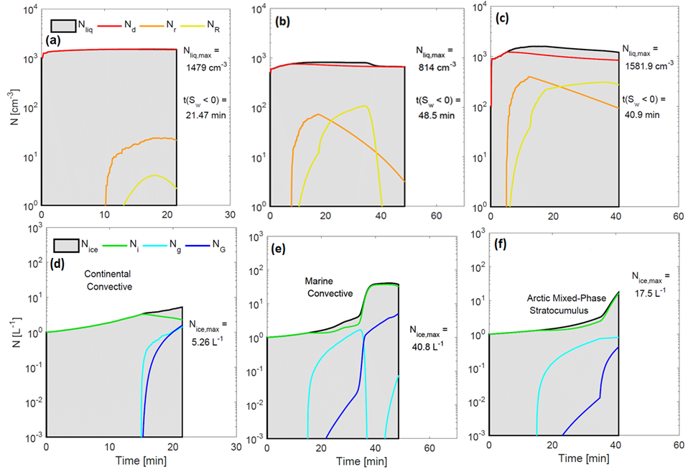
In agreement with observations, ice enhancement is most probable for a maritime convective case.
Notes:
Continental convection: Growth of small droplets deplete supersaturation before significant secondary ice production. Larger drop and graupel numbers do not have time to develop.
Maritime convection: Secondary ice production is most significant: modest updrafts and small droplet numbers allow larger drops and graupel to form without depleting supersaturation.
Arctic stratocumulus: Secondary ice formation is significant toward the end of cloud evolution. But weaker updrafts and limited droplet numbers cannot sustain this production.

Slide 13
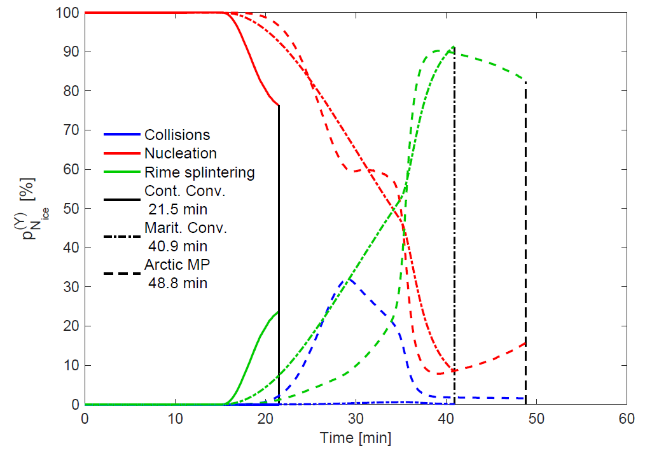
How much do contributions change between the cloud states?
Breakup - collisions
Ice nucleation
Rime splintering
Cont. Conv.
Arctic MP
Marit. Conv.
Both collisions and rime splintering contribute to N_{ice} within the maritime convective case.
Notes:
Pcoll,max 0, 31.2, 1.2
PRS,max 23.6, 89.6, 90.8

Slide 14
Conclusions
We have constructed a six-bin ‘secondary ice model’ with time delays and generation functions.
Testing the parameter space:
The maximum ice enhancement is O(10²), but contributions from breakup upon collision remains less than 5%.
Cloud states:
Secondary ice processes are most important for maritime convective conditions with modest updrafts and initial droplet numbers.
Thanks for your attention. Questions?
Notes:
for a 221% increase in computational time

