Slide 1



Importance of updraft velocity to cloud ice crystal formation
Sylvia Sullivan
Advisor: Athanasios Nenes
Collaborators: Dongmin Lee, Lazaros Oreopoulos, and Donifan Barahona
Funding: NESSF (NNX13AN74H)
School of Chemical Engineering Colloquium 2016

Slide 2


Cloud formation is generation of a new phase within the atmosphere.
lifted condensation level
T_{LCL}
NO
SO₂
HONO
O₃
NO₂
O₃
New droplets or ice crystals can form on particle surfaces.
Lapse rate
𝛤
NO₂
H₂SO₄
NO₂
H₂SO₄
SO₂
O₃
NO
NO
water vapor
q_{V}
surface
temperature
T_{s}
updraft velocity

Slide 3
Phase affects the radiative impact of clouds.
8 km
Cirrus
Lapse rate
𝛤
Mixed-phase
S
αS
4 km
Cumulus
(1-α)S
0 km

Slide 4
The number and size of hydrometeors also affects the radiative impact of clouds.
αS
S
S
αS
(1-α)S
(1-α)S

Slide 5
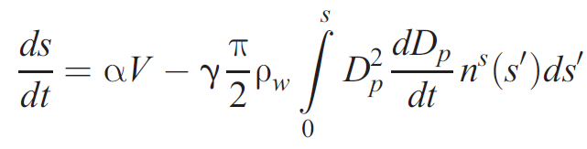
𝛻 q_{V}
𝛻 T
𝛻 q_{V}
𝛻 T
Crystallization and condensation will happen for supersaturated conditions.
supersaturation balance
source from ascent to colder temperatures and lower pressures
sink to droplet or ice crystal growth on particles

Slide 6

Within the ‘cloud reactor’, is the controlling factor for crystallization the temperature ramp or the seed loading?
source from ascent
sink to growth
𝛻 T
updraft velocity
water vapor
Lapse rate

Slide 7
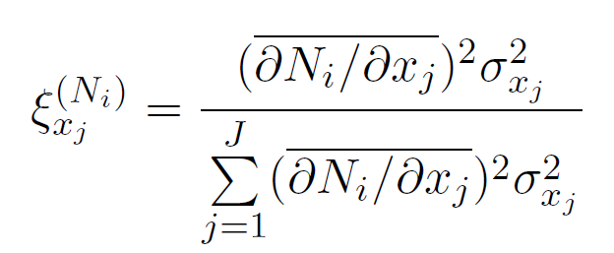
Is the controlling factor for ice crystal formation the updraft velocity or the aerosol number?
sensitivity
input variance
temporal attribution
0 % - x_{j} is not linked to variability in N_{i}
100 % - all variability in N_{i} is linked to x_{j}

Slide 8

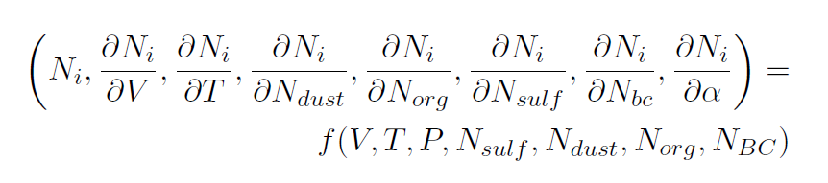
Globe: Lauritzen, 2010
Global climate models are very expensive...
Automatic differentiation

Slide 9
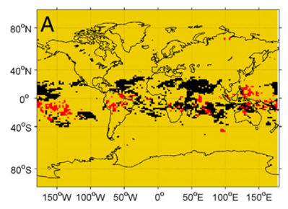
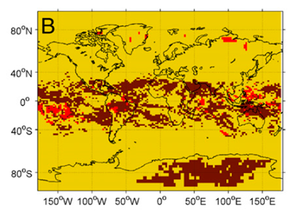
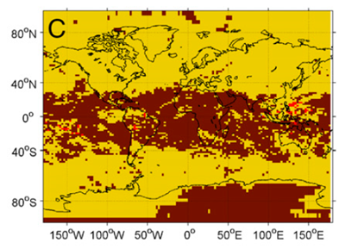
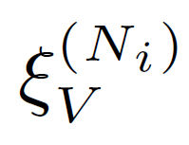
We calculated attributions in runs of two global climate models with various setups.
attribution grid – which x_{j} has the highest temporal attribution?
different descriptions of which material in the atmosphere can act as seed
is largest.
In this first model, the temperature ramp controls crystallization more than seed loading.

Slide 10
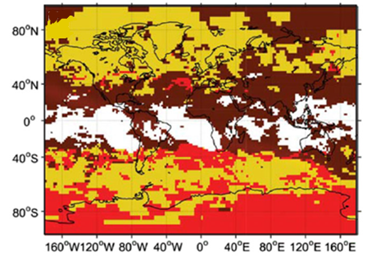
We calculated attributions in runs of two global climate models with various setups.
attribution grid – which x_{j} has the highest temporal attribution?
In the second model, the seed loading controls crystallization more than temperature ramp.

Slide 11
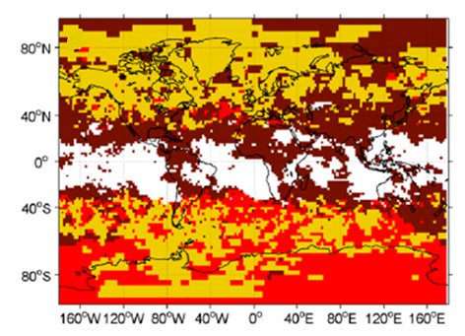


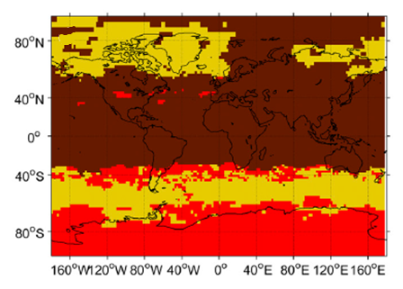
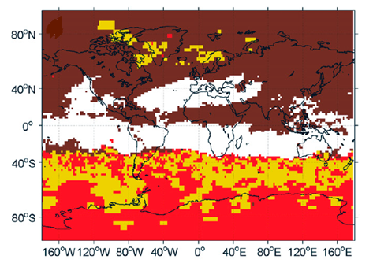


This analysis was robust to output resolution, simulation duration, and seasonality.

Slide 12
Crystal number was controlled by updraft velocity in the first model …
… and by aerosol numbers in the second.
The first model contained an approximate description of turbulence.
water vapor
q_{V}
water vapor
q_{V}

Slide 13
Crystal number was controlled by updraft velocity in the first model …
… and by aerosol numbers in the second.
1. The first model contained an approximate description of turbulence.
2. The first model tracked aerosol number explicitly rather than mass.

Slide 14
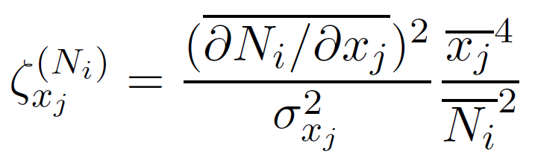
1. Is the controlling factor for ice crystal formation the updraft velocity or the aerosol number?
temporal attribution
2. Why is the updraft velocity so influential?
temporal attribution fraction
<< 1 – fluctuations in x_{j} are large
>> 1 – any fluctuations in x_{j} are amplified
Is it because updraft has large variability or because the model is inherently sensitive to it?

Slide 15
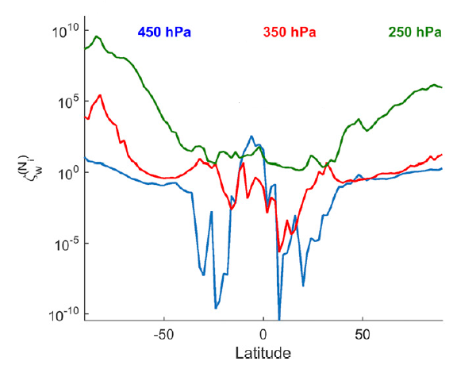
temporal attribution fraction
<< 1 – fluctuations in x_{j} are large
>> 1 – any fluctuations in x_{j} are amplified
At higher latitudes and altitudes, updraft sensitivity cause its large attribution.
At lower latitudes and altitudes, updraft variance cause its large attribution.

Slide 16
In summary,
within an atmospheric ‘cloud reactor’, the controlling factor for crystallization is the temperature ramp for realistic formulations.
Why? to better determine cloud radiative forcing from models
How? efficient and robust attribution analysis using automatic differentiation
What next? make better measurements of updraft velocity at low latitudes and altitudes
𝛻 T
updraft velocity
water vapor
Lapse rate

