Slide 1
Sales &
Marketing Analytics
Capstone 3, Unsupervised Learning
Steven Salmons

Slide 2
Overview
What Use case & Data
Who Audience: Executives, Marketing
Why New customer segments, advertising campaign
With Modeling (UMAP) & Clustering (KMeans)
Analysis Best, Worst, and High Potential
Caveats

Slide 3

Use Case & Data
Marketing requests analysis of the previous year’s sales data, in order to identify customer segments for an upcoming advertisement campaign.
These segments should be groups (clusters) of similar orders, to facilitate targeted advertising and promotional discounts.
Data Source: Kaggle
Generated Sales data, ~15k records, from Sep 2024 through Sep 2024

Slide 4
Audience
Executive Leadership
Why
Identify, fund campaigns that lead to successful conversion; halt unsuccessful
Brand loyalty, recognition for high customer value
Alignment with shareholders, earnings
Marketing & Advertising Dept
Why
Ensure targeting is accurate and inclusive
Identify gaps, potential expansion
Better understanding of advertisement lifecycle, age, medium etc…

Slide 5
Modeling & Clustering
UMAP
Pattern recognition, grouping
Data retention (small, large scale)
Performance at any scale
KMeans
Easy to use
Spherical, regular clustering
Massive data set
Low noise, anomalies
Speed of delivery
Easily manage outliers
= Dynamic customer segments, identified across the entire sales history

Slide 6
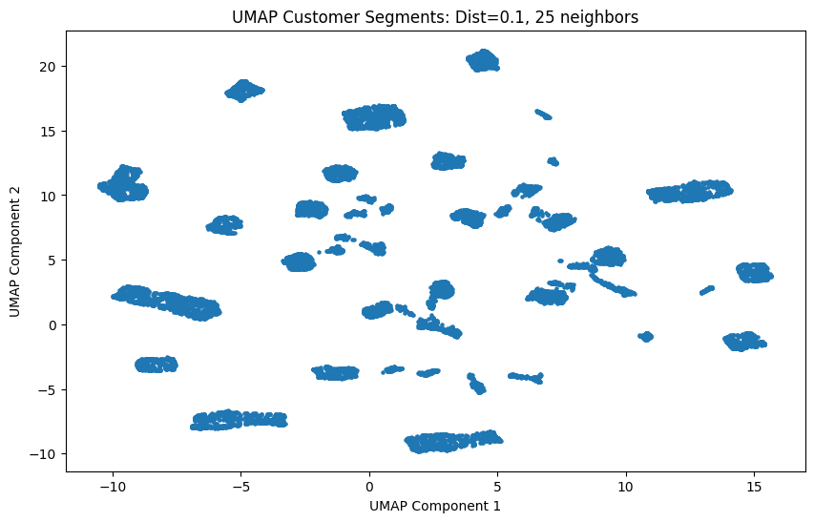
Model Analysis
Runtime (not wait time)
UMAP ~30 seconds
t-SNE ~2.5 minutes (5x slower)
Applied scale
~15k records/1 year
~30k records/2 years?
UMAP ~1 minute est.
t-SNE ~5 minute est.
Customer Segments

Slide 7
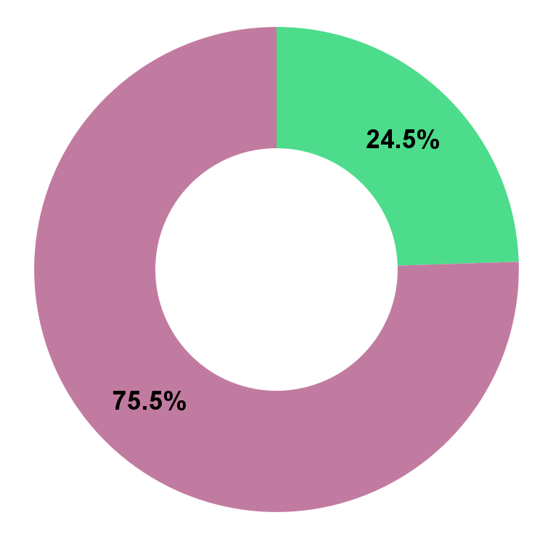
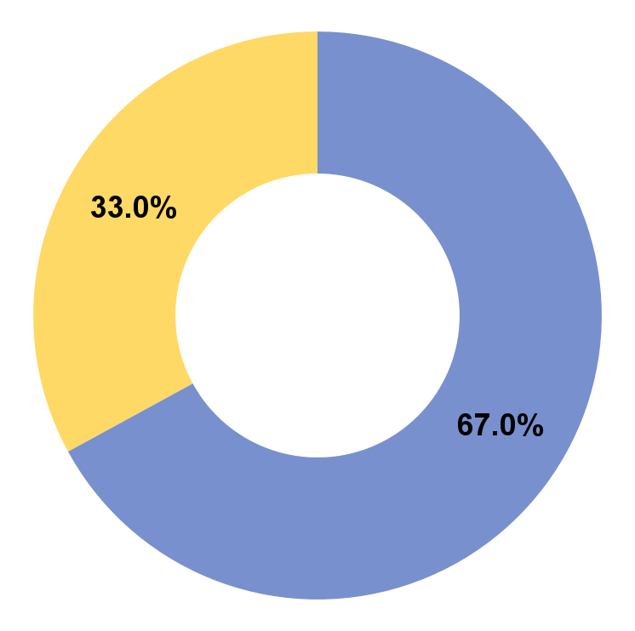

Segment Analysis (All Sales)
Customer Demographic
Age 40-55
$3,000/order
Loyalty 24.5%
Non-Loyalty 75.5%
Completed 67%
Cancelled 33%
Most Purchased Smartphones
Most Cancelled Headphones

Slide 8
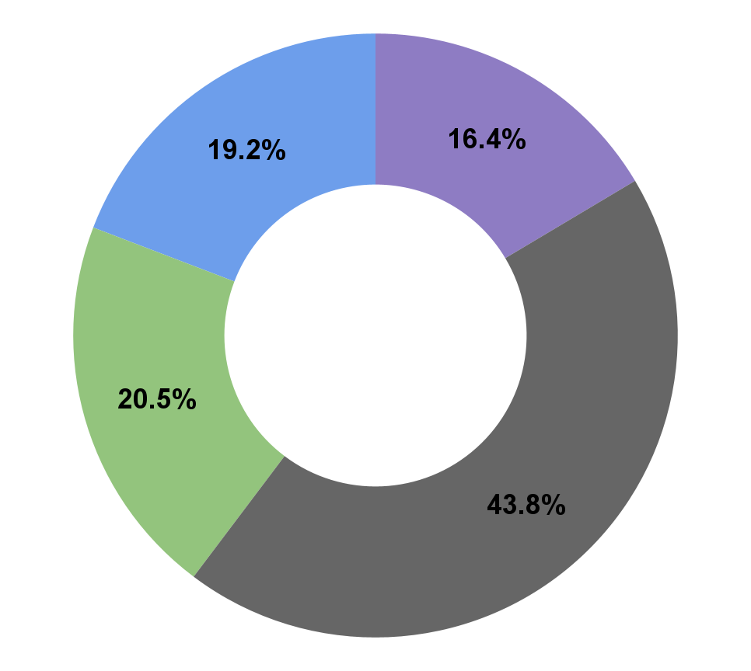
Segment Analysis
Top Performing
Top 3 12, 15, 14
56% of all sales
$3,300/order
Top 30%
32.3% Cancellation Rate
Bottom 30%
Complimentary Products
Smartphone
Smartwatch
Laptops

Slide 9
Segment Analysis
Worst Performing
Segments 3, 7*, 16 , 29, 31
Lowest Avg. Sales < $1,500/order
High Cancellation Rates
Segment 31 42%
Segment 3 34%
Caveat: Typically smaller in size, less impact on overall sales…

Slide 10
Segment Analysis
High potential: Segment 7
High density Top 10 in size
Worst Avg. Sales $1,350/order
Low Cancellation 29%
… so?
Prime Target for Marketing Campaign!
Exclusive, limited time offers
BOGO
Bundles
“Things you might like”
Driving a higher Total Price has ripple effect
Successful campaign = Significant impact

Slide 11
Caveats
Expansive data
Targeted objectives = better analysis
Document points of interest for later
Accurate Product data = critical
Products + $ales relations
Bad data quality = misleading clusters
Get/Stay on Target
Query and deliver on objectives
After, branch out for context
Stream of Events
Models and data are pieces of much larger puzzle
Collaboration is key

