Slide 1




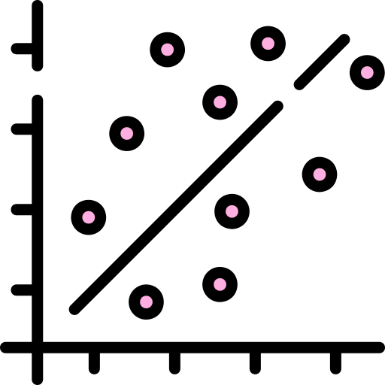
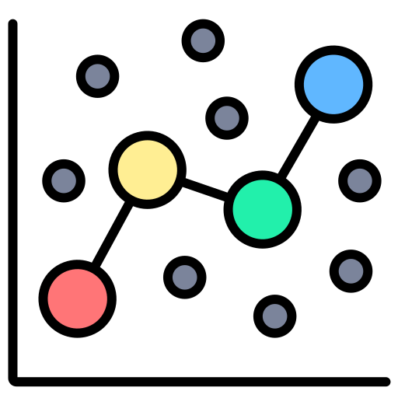
Home
Singapore Fertility Trends Dashboard
Welcome!
This dashboard explores Singapore declining fertility trends, Thus will present how key demographic indicator – such as marriages and divorces are related to fertility , Use the options below or the tabs to navigator through the page.
At a Glance
Trends & EDA
Correlation Analysis
Regression Analysis
Explore ->
Explore ->
Explore ->
Explore long-run trends in fertility, marriage and divorce
Correlation, association analysis and clustering
Model fertility, marriage and divorce indicators
Home
Trend & EDA
Correlation Analysis
Regression Analysis
Home Page
This home page presents the key demographic indicators, highlights the latest fertility level, and shows the overall trend in Singapore’s total fertility rate.

Slide 2
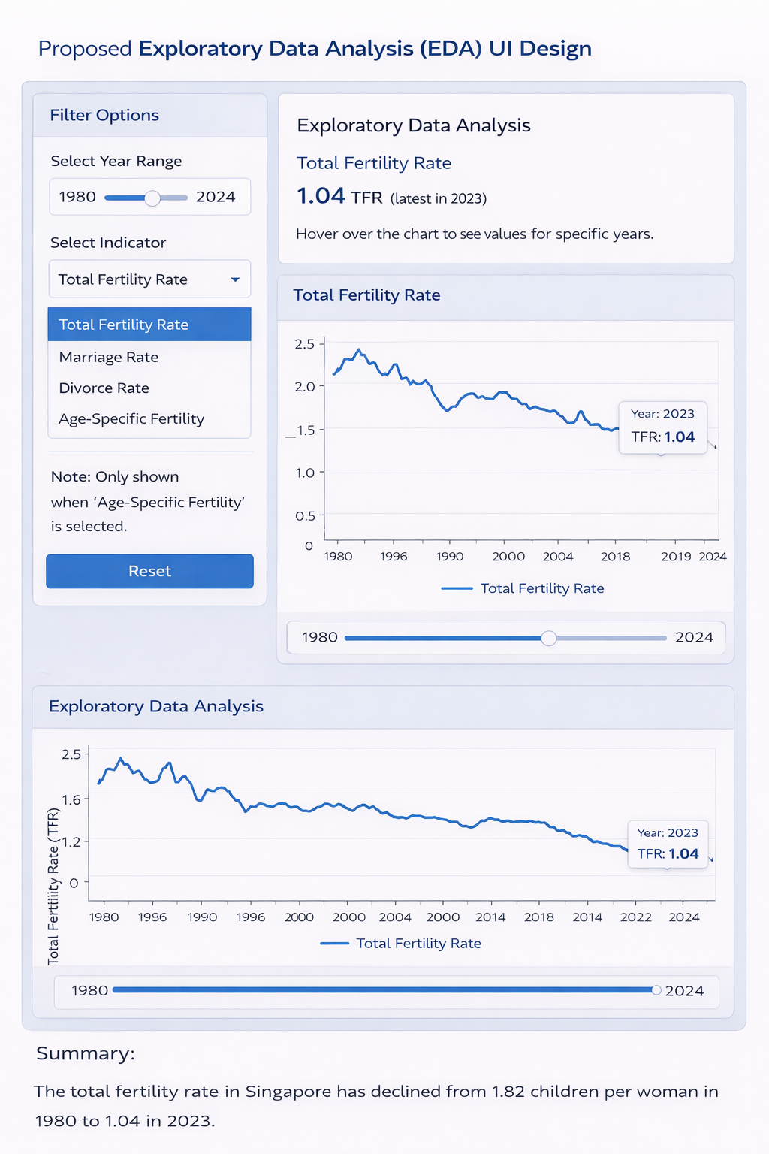

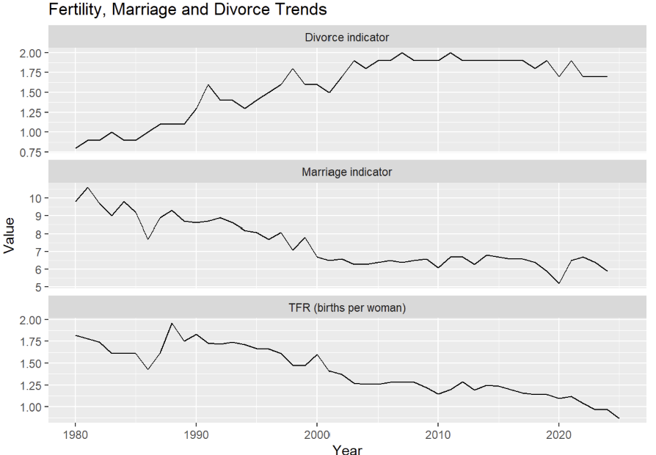
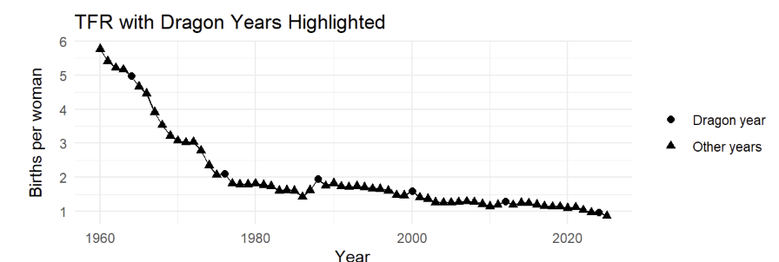
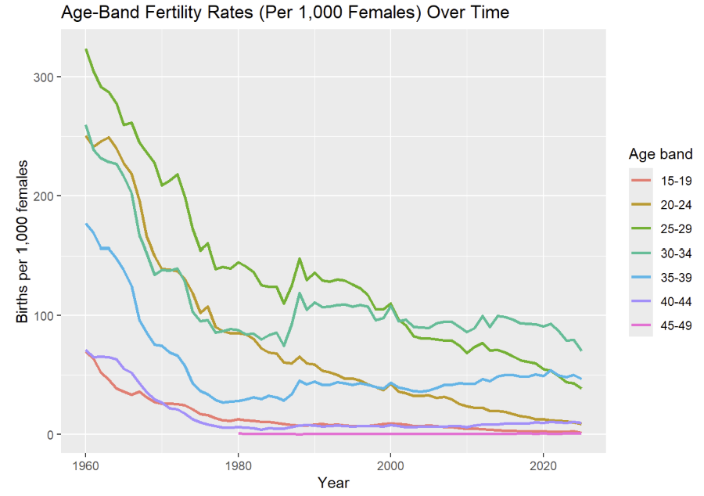
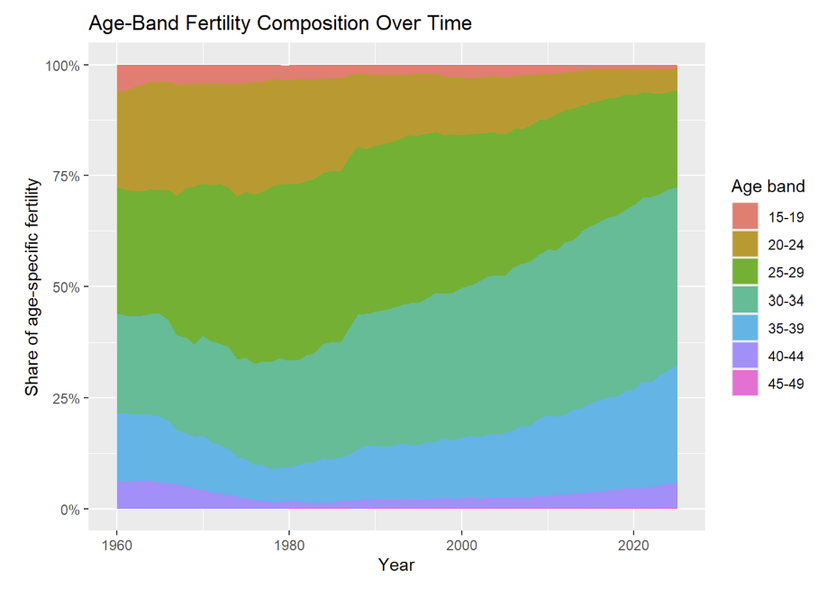
Use slider to let user filter (sliderInput())
Use radio buttons to let users filter between age bands (radioButtons())
Fertility, Marriage and Divorce Trend
Apply
Age-band Fertility Rates
The total fertility rate in Singapore has declined from xxx children per woman in Year xxx to xxx in Year xxx

Slide 3
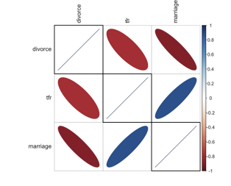
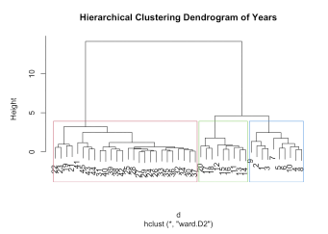
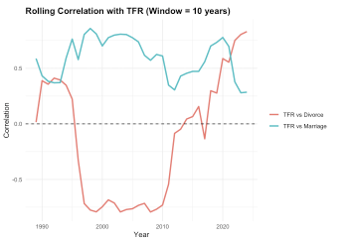
Home
Correlation Specification
Clustered Correlation Plot of TFR, Marriage and Divorce
Select Year Range
Use slider to let user filter (sliderInput())
Hierarchical Clustering Dendrogram of Years
Rolling Correlation of TFR with Marriage and Divorce

Slide 4
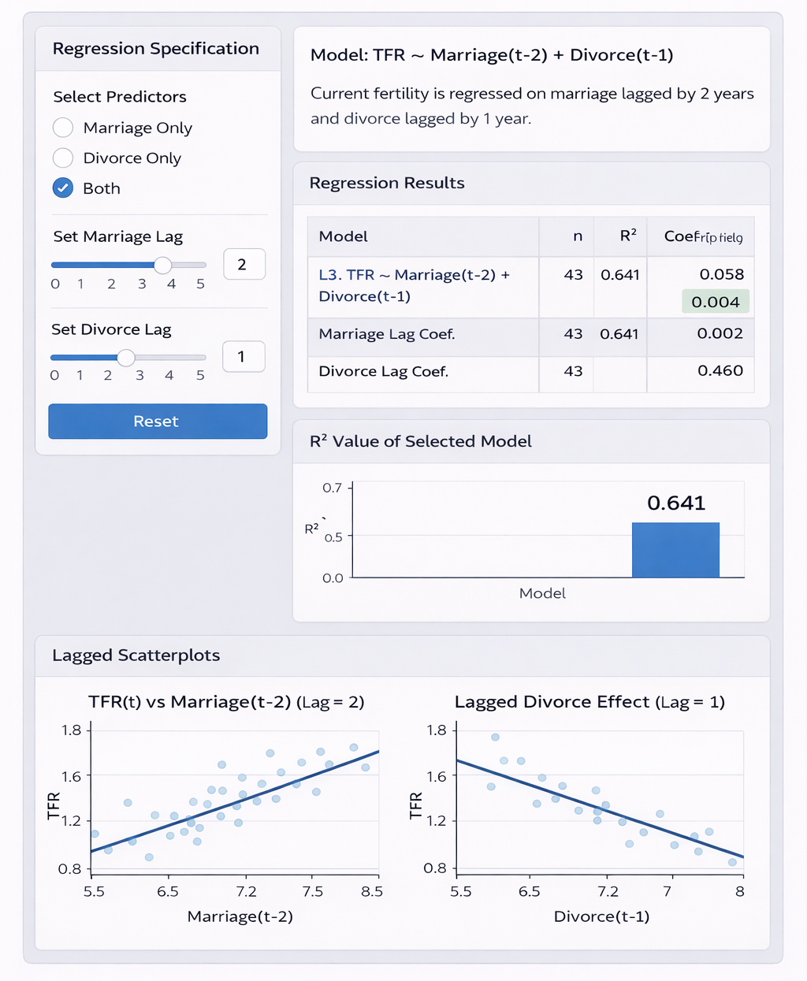
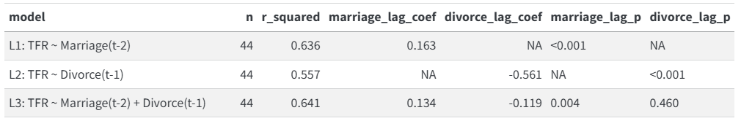
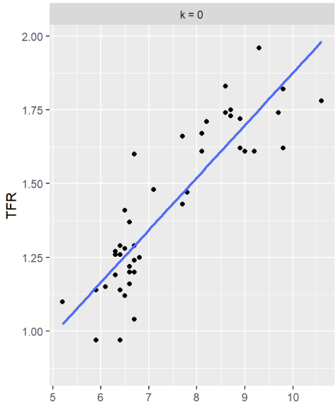
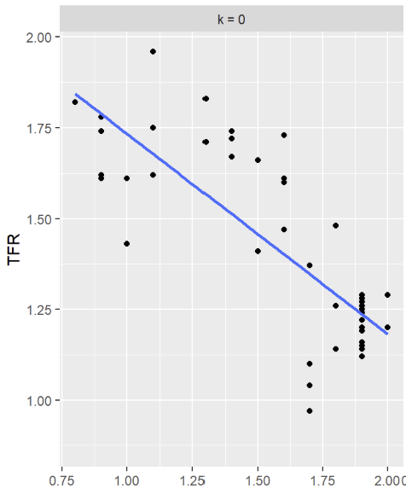
Use radio buttons to let users filter between Marriage, Divorce, or both (radioButtons())
Coeff
Use slider to let user filter (sliderInput())
Use slider to let user filter (sliderInput())
table for model regression result (tableOutput())
Apply
Updates according to selected regression specification. Eg: If one predictor is selected, one model result is shown. (plotOutput())
Update based on the selected predictors and lag values. If one predictor is selected, one scatterplot is shown. If both predictors are selected, two scatterplots are displayed side by side. (plotOutput())

