Slide 1
Digital Scholarship at NUL
Newly created small team of digital humanities and computational social sciences folks.
Goal = collaboration with researchers across campus using digital or computational methods to analyze or present their work.

Slide 2
What is tidyverse?
Tidyverse is a collection of R packages
Designed to make data manipulation and visualization easier
Follows the principles of tidy data:
Each variable is its own column
Each observation is its own row
Each value has its own cell
The advantage is consistency and readability across packages

Slide 3
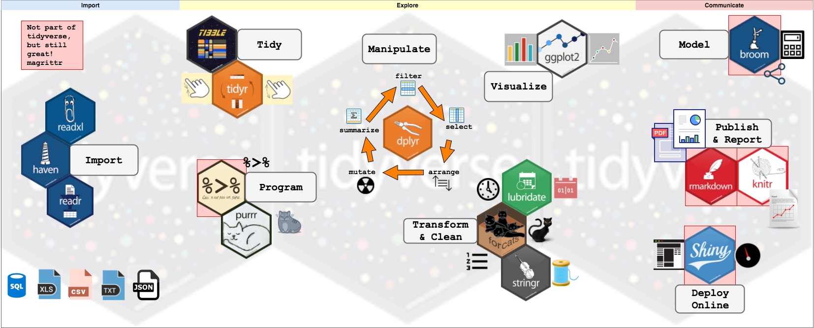
The tidyverse is vast

Slide 4
Today: key packages in tidyverse
readr: for data import
dplyr: for data manipulation
tidyr: for data tidying
forcats: for working with categorical variables
stringr: for manipulating strings
ggplot2: for data visualization

Slide 5
Thank you for your time and attention 🙂
Sarah Thorngate
Data Analysis Librarian
sarah.thorngate@northwestern.edu
Make an Appointment
Slides and materials: https://github.com/scthorn/NLSY97_majors

