Slide 1
DTLS for SCTP’ Overview solutions
https://datatracker.ietf.org/doc/draft-ietf-tsvwg-dtls-over-sctp-bis/
https://datatracker.ietf.org/doc/draft-westerlund-tsvwg-sctp-crypto-chunk/
https://datatracker.ietf.org/doc/draft-westerlund-tsvwg-sctp-crypto-dtls/
https://datatracker.ietf.org/doc/draft-westerlund-tsvwg-sctp-dtls-chunk/
https://datatracker.ietf.org/doc/draft-westerlund-tsvwg-sctp-dtls-handshake/
Magnus Westerlund
John Preuß Mattsson
Claudio Porfiri
IETF TSVWG Interim
2023-09-17

Slide 2
IPR Declarations
draft-ietf-tsvwg-dtls-over-sctp-bis
https://datatracker.ietf.org/ipr/5195/
https://datatracker.ietf.org/ipr/5218/
draft-westerlund-tsvwg-sctp-crypto-chunk
None
draft-westerlund-tsvwg-sctp-crypto-dtls
https://datatracker.ietf.org/ipr/6180/
https://datatracker.ietf.org/ipr/6179/
https://datatracker.ietf.org/doc/draft-westerlund-tsvwg-sctp-dtls-chunk/
Will be submitted
https://datatracker.ietf.org/doc/draft-westerlund-tsvwg-sctp-dtls-handshake/
Will be submitted (FRAND)

Slide 3
The Proposals: DTLS over SCTP
ULP
DTLS over SCTP (DTLS/SCTP)
https://datatracker.ietf.org/doc/draft-ietf-tsvwg-dtls-over-sctp-bis/
https://datatracker.ietf.org/doc/draft-tuexen-tsvwg-rfc4895-bis/
An Adaptation layer between Upper Layer Protocol (ULP)
Fragments user messages into multiple fragments
Each fragment protected by a DTLS record
Relies on SCTP-AUTH to ensure record order
DTLS keys the SCTP-AUTH
Uses parallel DTLS connection for rekeying
Use DTLS Connection IDs for identification
DTLS/SCTP Layer
SCTP Stack
Keys
SCTP AUTH
Plain Text
User Message
Fragmentation
m1
m2
m3
m4
DTLS Protect
Operation
m1'
m2'
m3'
m4'
Protected User Message
SCTP Authentication
SCTP Transmission

Slide 4
DTLS/SCTP
These slides assumes SCTP-AUTH is fixed:
Direction dependent keying of cipher
That DTLS/SCTP will rotate the SCTP-AUTH master key before 2^32 TSN has been protected by the same key
DTLS Replay Protection: Off
To prevent DTLS records being delivered to adaptation layer out of order from being dropped due being out of replay window
Normal SCTP stack implementation robustness against replay
SCTP User message limitations
With good SCTP APIs and message tracking
No Limit exists
Using RFC 6458 API
Message must not take longer time to transfer than time between re-keyings
The limitation in setting SCTP-AUTH key to use when sending causes this limit
Can’t rekey again until the message has concluded and the old DTLS connection is retired

Slide 5
DTLS/SCTP: Rekeying
When necessary to rekey, initiate a new DTLS connection. Using DTLS’s connection IDs to separate the old and new DTLS Connection
Use TLS Exporter to get a key from DTLS connection for SCTP-AUTH
Start using new DTLS connection for records and in SCTP-AUTH
RFC 6458 API if only enables setting SCTP-AUTH key on new SCTP messages
Old DTLS Connection can’t be closed until:
All DTLS records protected by that session have been decrypted
Data loss if not done correctly -> Need to abort SCTP Association
RFC 6458 API requires draining whole session to know when all has been delivered
To avoid draining, implementation needs to
track what DTLS session was used on which DTLS records
know which data offsets they represent in messages
And know when they been non-renegable ACKed

Slide 6
DTLS/SCTP: DTLS Key Update
KeyUpdate is forbidden
Requires the same coordination as a new DTLS connection to avoid loosing records
Same risk for dropping the key early due to encryption and delivery order are more disconnected and related to user message fragments
Key Update do not result in a new SCTP-AUTH key
Minor issue as HMAC-SHA 256 is strong and have a long lifetime

Slide 7
DTLS/SCTP
Necessary cipher operations:
Performs one set of DTLS cipher operations on each user message data fragment
Performs SCTP-AUTH cipher operations on each SCTP packet
SCTP Restart
SCTP-AUTH requires endpoints to maintain SCTP-AUTH’s crypto context to authenticate COOKIE-ECHO as only authenticated ones are accepted
Then one can negotiate a new DTLS connection to protect the new user message data

Slide 8
The Proposals: DTLS in Crypto Chunk
DTLS in SCTP (DTLS in Crypto Chunks)
https://datatracker.ietf.org/doc/draft-westerlund-tsvwg-sctp-crypto-dtls/
https://datatracker.ietf.org/doc/draft-westerlund-tsvwg-sctp-crypto-chunk/
Crypto Chunk is a new SCTP Chunk
Encapsulated all other chunks in a crypto envelope on per SCTP packet basis
DTLS is a protection engine
DTLS handshake messages sent as SCTP messages in DATA chunks using a specific PPID
After DTLS keys are established all future SCTP packet’s contents are protected
At rekeying perform handshake for a new DTLS connection
Fragmentation done by SCTP’s normal message fragmentation mechanism
ULP
DTLS Protection Engine Key-management
SCTP Chunk Handler
Keys
SCTP Crypto Chunk Handler
DTLS Record Processing
SCTP Header Handler
DTLS Handshake messages

Slide 9
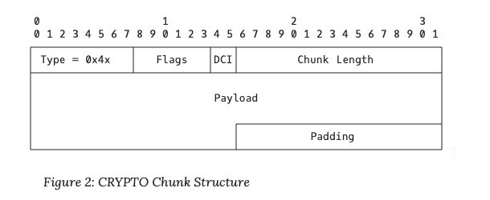
DTLS in Crypto Chunk Message Format
DCI
Identifies the DTLS connection used for keying this DTLS record
Payload:
Application Data DTLS record with protected chunks

Slide 10
DTLS in Crypto Chunk
Crypto Chunk is framework that do allow other protection engines to be defined in the future
DTLS per packet protection and key-management are still two components in the framework
Crypto Chunk requires integration of down grade attack prevention between protection engines
SCTP User Message limitations
No limitation exist as per normal SCTP
SCTP Packet size limitations
Per packet MTU limited by DTLS record size supported
Maximum: 16384 bytes of plaintext chunks
Performs a single pass of AEAD cipher operations on the plain text / cipher text for encryption / decryption per SCTP packet

Slide 11
DTLS in Crypto Chunk: Rekeying
When necessary to rekey, periodic or data limits initiate a new DTLS handshake as SCTP user messages with PPID
When keys have been derived install them for reception related to Crypto Chunk flag field DCID
When handshakes completes start using new keys
Leave old keys in place to drain network of SCTP packets protected by old key
A MSL (2 min) timer is sufficient
Close old DTLS connection
As soon as both sides have keys, i.e. after handshake acks one can switch
Will at worst induce some packet loss
DTLS Key Update
DTLS KeyUpdate message sent as user message between peers
When KeyUpdate is ACKed by DTLS peer start using it in send direction by installing traffic secret for the DCI + Epoch
When receiving KeyUpdate install keys for reception and ACK
Recommend to drop old keys one MSL after first packet with new Epoch seen.

Slide 12
DTLS in Crypto Chunk
Replay Protection
Should be used to improve replay robustness
DTLS can prevent any SCTP Packet from being delivered more than once
Prevents non-data replay
Packets outside of replay window (severely out of order) will be dropped

Slide 13
SCTP Association Restart
DTLS Chunk
Maintained protection engine crypto context and INIT protected by Crypto Chunk
Will work poorly due to IV construction
We will propose a better solution for secured restart

Slide 14
The Proposals: DTLS Chunk + DTLS Key Management
DTLS in SCTP (DTLS in Crypto Chunks)
https://datatracker.ietf.org/doc/draft-westerlund-tsvwg-sctp-dtls-chunk/
https://datatracker.ietf.org/doc/draft-westerlund-tsvwg-sctp-dtls-handshake/
DTLS Chunk is a new SCTP Chunk
Encapsulated all other chunks in a DTLS 1.3 record on per SCTP packet basis
Performs application data DTLS record processing
Need API to establish ciphers and traffic secrets on per DTLS Connection, Epoch and Direction
User level DTLS 1.3 used for authentication and key establishment, alerts, and Close_Notify etc.
These DTLS messages are sent as user message with PPID = DTLS-SCTP and a DCI preamble
Fragmentation done by SCTP’s normal message fragmentation mechanism
ULP
DTLS in SCTP Key-management
DTLS 1.3
SCTP Chunk Handler
API
SCTP DTLS Chunk Handler
DTLS 1.3 Record Processing
SCTP Header Handler
DTLS Handshake messages

Slide 15
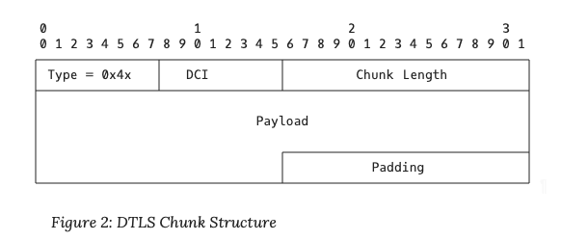
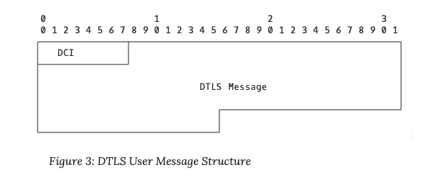
DTLS Chunk Message Format
DCI:
DTLS Connection ID pointing to traffic secret to use
Payload:
DTLS record with protected SCTP Chunks
DTLS record contains epoch indication
DCI = DTLS Connection ID
Identifies the DTLS connection this DTLS message is intended for or a new one when carrying handshake packets
DTLS message contains one or more DTLS records with non-application data type.

Slide 16
DTLS Chunk
Currently defines only a DTLS 1.3 based protection chunk of SCTP packet chunks
Includes a down-grade prevention mechanism for other future protection solutions for the initial SCTP negotiation
SCTP User Message limitations
No limitation exist as per normal SCTP
SCTP Packet size limitations
Per packet MTU limited by DTLS record size supported
Maximum: 16384 bytes of plaintext chunks
Performs a single pass of AEAD cipher operations on the plain text / cipher text for encryption / decryption per SCTP packet

Slide 17
DTLS Chunk: Rekeying
When necessary to rekey, periodic or data limits initiate a new DTLS handshake as SCTP user messages with PPID
When keys have been derived install them for reception related to Crypto Chunk flag field DCID
When handshakes completes start using new keys
Leave old keys in place to drain network of SCTP packets protected by old key
A MSL (2 min) timer is sufficient
Close old DTLS connection
As soon as both sides have keys, i.e. after handshake acks one can switch
Will at worst induce some packet loss
DTLS Key Update
DTLS KeyUpdate message sent as user message between peers
When KeyUpdate is ACKed by DTLS peer start using it in send direction by installing traffic secret for the DCI + Epoch
When receiving KeyUpdate install keys for reception and ACK
Recommend to drop old keys one MSL after first packet with new Epoch seen.

Slide 18
DTLS Chunk
Replay Protection
Should be used to improve replay robustness
Especially for non-DATA chunks
DTLS can prevent any SCTP Packet from being delivered more than once for SCTP chunk processing
Packets outside of replay window (severely out of order) will be dropped

Slide 19
DTLS Chunk Abstract API
Get Supported Ciphers
Set Traffic secrets
Per DTLS Connection ID set cipher
Per DTLS Connection ID (DCI), epoch and direction set traffic secret
Destroy Traffic Secrets
Remove secrets per DCI and epoch
Set DCI and Epoch to use for protection of SCTP packets sent
Configure Replay Protection window
Access information or configure alerts per DTLS Connection and epoch
Cipher Invocations
Failed verifications
Indication of first packets with new Epoch received

Slide 20
SCTP Association Restart
DTLS Chunk
Maintained protection engine crypto context and INIT protected by Crypto Chunk
Will work poorly due to IV construction
We will propose a better solution for secured restart

