Slide 1
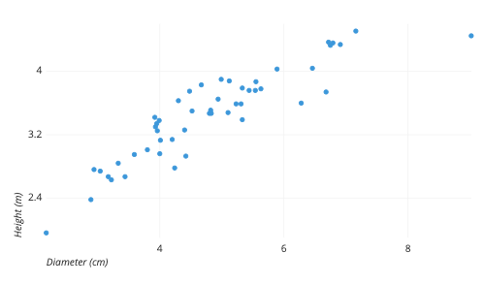
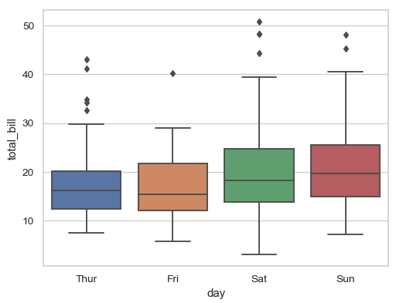
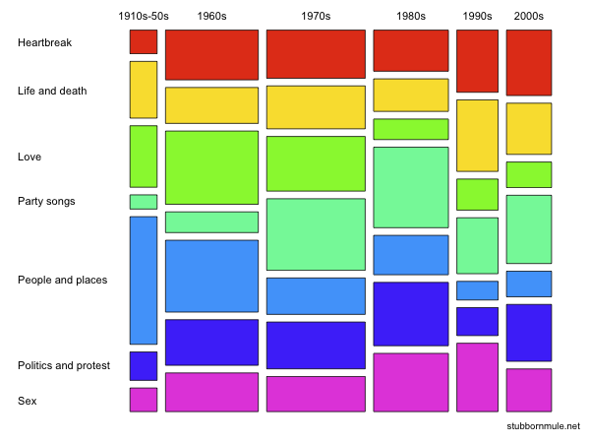
Numerical
Categorical
Numerical
Scatter plot (point)
2D binning (bin2d, hex)
Contour plot (density2d)
Quantiles (quantile, qq)
Lines (line, smooth)
Ribbons (ribbon, area)
Boxplot (boxplot, violin)
Counts (count, tile)
Error bars (errorbar)
Columns (col)
Categorical
Which ggplot2 data viz is right for your data?
(geoms in parentheses)
Mosaic
(ggmosaic::geom_mosaic)
Counts (count, tile)

