Slide 1
Rxjs Observables
An introduction TO REACTIVE EXTENSIONS
Notes:
Created by Microsoft.
Ben Lesh has been part of the development since with Netflix and now with Google.
Walk through slide deck, then show some trivial code examples.
Then, will show some marble tests in OIT POC.

Slide 2
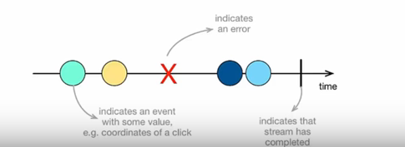
What is reactive programming?
Programming paradigm that works with async data streams
Data streams can be created from many things.
UI Events
Http Requests
File Systems
Memory / Cache
Array-like Objects
Notes:
Reactive programming is programming with asynchronous data streams.
In a way, this isn't anything new. Event buses or your typical click events are really an asynchronous event stream, on which you can observe and do some side effects. Reactive is that idea on steroids.
A Stream as a sequence of ordered events in timeline.
You are able to create data streams of anything, not just from click and hover events. Streams are cheap and ubiquitous, anything can be a stream: variables, user inputs, properties, caches, data structures, etc.
For example, imagine your Twitter feed would be a data stream in the same fashion that click events are. You can listen to that stream and react accordingly.

Slide 3
Observable example
import { Observable } from "rxjs/Observable";
const observable = Observable.create(function subscribe(observer) {
observer.next('Hey guys!')
})
// OR
const observable = Observable.create((observer:any) => {
observer.next('Hey guys!')
})
We're defining the subscribe function, and we're emitting a single value of 'Hey guys!' by calling observer.next().
Notes:
Observables are an array that gets built over time. Then, you can loop on this array by subscribing to it.
Observables help JavaScript integrate a proper "observer design pattern“
Observables are functions that tie an observer to a producer.
What’s a “Producer”?
A producer is the source of values for your observable. It could be a web socket, it could be DOM events, it could be an iterator, or something looping over an array. Basically, it’s anything you’re using to get values and pass them to `observer.next(value)`.
The .create() method accepts a single argument, which is a subscribe function. This subscribe function accepts an observer argument.
Typically, you can emit three different types of data: data payload, error and end of stream signal.
You can attach own handlers on each type of data, or just focus on data payload only.

Slide 4
Subscription
const observable = Observable.create((observer:any) => { observer.next('Hey guys!’)
setInterval(() => {
observer.next('I am good’)
}, 2000)
})
// To cancel a subscription
setTimeout(() => {
subscription.unsubscribe();
}, 6000);
Notes:
When you subscribe to an observable with an observer, you've created a subscription.
You're given the ability to cancel that subscription in the event that you no longer need to receive the emitted values from the observer. This is also important for performance issues.

Slide 5
Promises vs observables
Promise | Observable
Emits a single value 2 params with Promise (onfulfilled, onrejected) A promise represents the eventual result of an asynchronous operation. It is a placeholder into which the successful result value or reason for failure will materialize. | Emits multiple values over a period of time (stream) 3 params with Observable (next, error, complete) each item that is emitted calls, ‘next’ last item is handled, ‘complete’ handler is called
Not lazy – then is like subscribe method. (then method is commented out, still make api call unlike subscribe – no api call) | Lazy. An observable is not called until we subscribe to the observable using the subscribe method.
Cannot be cancelled | Can be cancelled by using the unsubscribe() method
…. | Observables provide many operators; map, forEach, filter, reduce, retryWhen, take, pluck, range, scan mergeMap, switchMap, do
Notes:
A Promise is simply an Observable with one single emitted value. Rx streams go beyond promises by allowing many returned values.
This is pretty nice, and shows how Observables are at least as powerful as Promises. So if you believe the Promises hype, keep an eye on what Rx Observables are capable of.

Slide 6
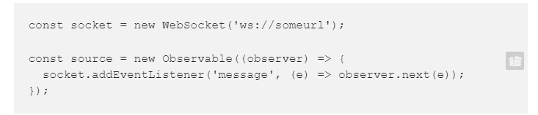
Hot Observables: Producers created *outside*
An observable is “hot” if its underlying producer is either created or activated outside of subscription.
shares a reference to a producer
starts listening to the producer
multicast (usually)
If we were to take our example above and move the creation of the WebSocket outside of our observable it would become “hot”:
Notes:
We can call an observable hot when it emits values before any consumer is subscribed. Each subscription could receive different values based on their registration time.
Heat up an Observable 🌞
RxJs provides methods to generate a variety of multicasted observables to have the best control over the underlying streams,
publish(): ConnectableObservable
publishReplay(): ConnectableObservable
This method allows us to specify a buffer that can be consumed by late subscribers.
There are many others but for this intro, we’re not going to dig deeper as this topic could take an hour on its own.

Slide 7
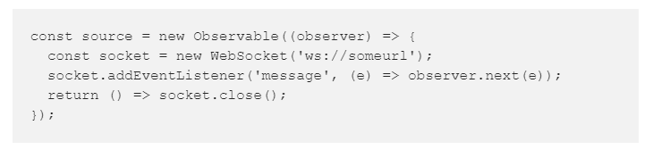
Cold Observables: Producers created *inside*
An observable is “cold” if its underlying producer is created and activated during subscription. This means, that if observables are functions, then the producer is created and activated by calling that function.
creates the producer
activates the producer
starts listening to the producer
unicast
The example below is “cold” because it creates and listens to the WebSocket inside of the subscriber function that is called when you subscribe to the Observable:
Notes:
Cold Observable ❄️
We can think of an Observable as cold or unicast when it starts emitting values after a subscriber is registered, under the hood it is creating a producer for each subscription

Slide 8
Rx Subjects
Before we can make our “cold” observable “hot”, we need to introduce a new type: The Rx Subject. It has a few properties:
It’s an observable. It’s shaped like an observable, and has all the same operators.
It’s an observer. It duck-types as an observer. When subscribed to as an observable, will emit any value you “next” into it as an observer.
It multicasts. All observers passed to it via `subscribe()` are added to an internal observers list.
When it’s done, it’s done. Subjects cannot be reused after they’re unsubscribed, completed or errored.
It passes values through itself. To restate #2, really. If you `next` a value into it, it will come out of the observable side of itself.
Notes:
Think of the subject as a middleman in a multicast observable. It relays data from the underlying observable and shares it among all the subscribers.
While Subjects are Observables, Subjects also implement an Observer interface. That is to say, they have next, error, and complete methods. These methods are used to notify their counterparts on observers in the subject’s internal observers list. This means a subject can be used as an observer to subscribe to any observable.
KEY POINT: Probably a more important distinction between Subject and Observable is that a Subject has state, it keeps a list of observers. On the other hand, anObservable is really just a function that sets up observation.
In general, once a subject completes, future subscribers to a subject will not receive more data.

Slide 9
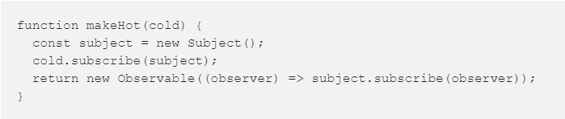
Making A Cold Observable Hot
Armed with our Rx Subject, we can use a bit of functional programming to make any “cold” observable “hot”:
Our new `makeHot` method will take any cold observable and make it hot by creating a subject that is shared by the resulting observable.
Note: not tracking our subscription to source, so how can we tear it down when we want to? We can add some reference counting to it to solve that:
Notes:
By default, observables are unicast. i.e. each subscriber causes the observable to be invoked independently. In contrast, a multicasted observable is one that emits the same data to all the subscribers.

Slide 10
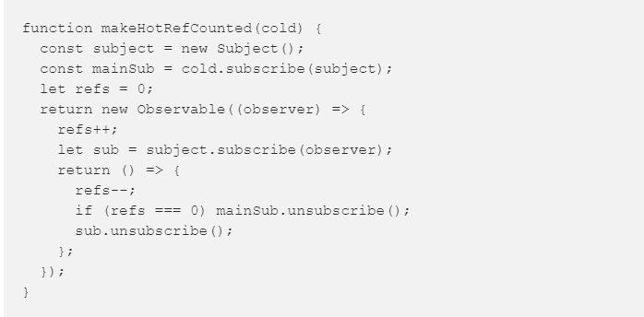
Making A Cold Observable Hot
Note: not tracking our subscription to source, so how can we tear it down when we want to? We can add some reference counting to it to solve that:
Now we have an observable that is hot, and when all subscriptions to it are ended, the `refs` we’re using to do reference counting will hit zero, and we’ll unsubscribe from our cold source observable.
Notes:
When should I use cold or hot?
It depends on your goal, usually you would need to create a hot observable to have a single source of truth, share side effects and final result to the subscribers.
For example in a web socket you really don’t want to create more then one connection and you could need to share the entire sets of values: Link.
Or for an REST Api call you would like to share the result without asking the server every time - You should chose the cold observable instead, when you need to create a producer and generate side effects for every subscribers.

Slide 11
There are 4 “Flattening (MAPPING) Strategies”
“Merge” Strategy — deciding not to do anything, basically, we just keep subscribing to every new observable that we return from the map.
Enhancing search results - Let’s say you show a live list of movies (via push notifications, like netflix). For each movie, you might want to also call a 3rd party service, like IMDB to show it’s “up to date” movie rank - enhance your movie cards with this additional data.
“Switch” Strategy — unsubscribing from the last mapped observable, when the new one arrives.
AutoComplete - If you google something, you press a key on the big input box, and then you get suggestions for things you might mean to write. So every new input triggers a new ajax request for that search term. If you just used mergeMap you’ll get suggestions for every key stroke (“m”, “my “, “my p” - switchMap will make sure that the ongoing http request is being canceled on every new search input, and only the newest http request is live.
“Concat” Strategy —Queuing up every new Observable, and subscribing to a new observable only when the last observable completed.
Top Ten List - Let’s say you have a live observable that emits a list of the top ten movies of all times. For each movie, we do the same thing as the mergeMap and issue another ajax request to IMDB to get his rank, but this time, the order of display matters. So by using concatMap we can block the next movie from finding out its IMDB rank until our current movie found out its rank, that way, we keep the original order of movies.
“Exhaust” strategy — the “don’t interrupt me” strategy, ignores (and never subscribe to) any new mapped Observable while the current Observable is still emitting values.
Login screen - Let’s say you have a login screen with a login button, where you map each click to an login ajax request. If the user clicks more than once on the login button, it will cause multiple calls to the server, and you probably don’t want that… So you can use exhaustMap to temporarily “disable” the mapping while the first http request is still on the go — this makes sure you never call the server while the current request is running.
Notes:
(CODE EXAMPLE - 275)
Note the difference between concatMap and mergeMap. Because concatMap does not subscribe to the next observable until the previous completes, the value from the source delayed by 2000ms will be emitted first.
Contrast this with mergeMap which subscribes immediately to inner observables, the observable with the lesser delay (1000ms) will emit, followed by the observable which takes 2000ms to complete.

Slide 12
rxjs-marbles
To write a test with marble diagrams you will need to stick to a convention of characters that will help visualize the observable stream:
During the tests, the schedule of time (when values are emitted) is handle by the RxJS TestScheduler
- (dash): simulate the passage of time, one dash correspond to a frame which can be perceived as 10ms in our tests, —--- is 40 ms a-z
(a to z): represent an emission, -a--b---c stands for “emit a at 20ms, b at 50ms, c at 90ms”
| (pipe): emit a completed (end of the stream), ---a-| stands for emit ‘a’ at 40ms then complete (60ms)
# (pound sign): indicate an error (end of the stream), —--a— # emit a at 40ms then an error at 70ms
( ) (parenthesis): multiple values together in the same unit of time, —--(ab|) stands for emit a b at 40ms then complete (40ms)
^ (caret): indicate a subscription point, —^-- subscription starting at ^
! (exclamation point): indicate the end of a subscription point, —^--! subscription starting at ^ and ending at !
These strings are a powerful syntax that will permit you to simulate the passage of time, emit a value, a completion, an error etc.. all that, without creating the observable yourself.

Slide 13
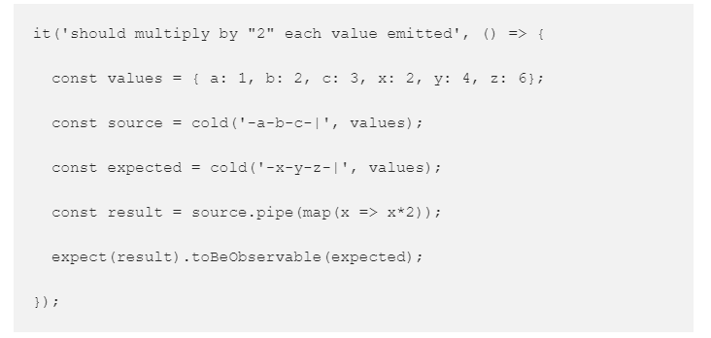
rxjs-marbles
rxjs-marbles is an RxJS marble testing library that should be compatible with any test framework. It wraps the RxJS TestScheduler and provides methods similar to the helper methods used the TestScheduler API.

Slide 14
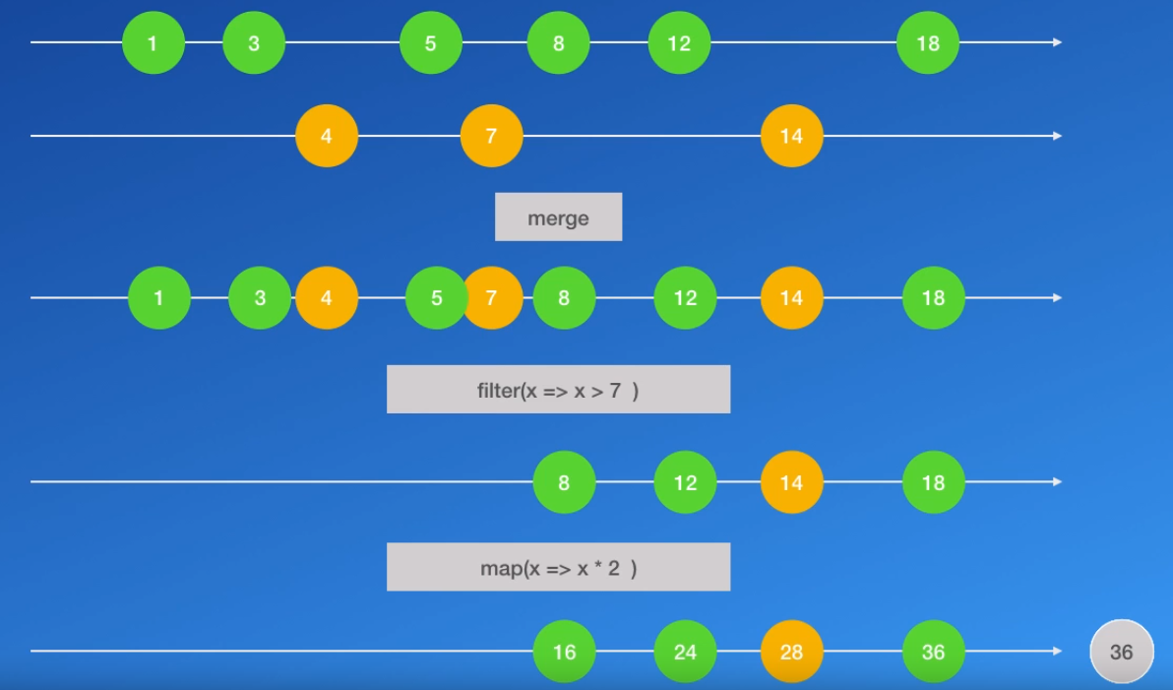
OBSERVABLE STREAM

Slide 15
BROWSER EVENT loop
Non-blocking I/O In JavaScript, almost all I/O is non-blocking. This includes HTTP requests, database operations and disk reads and writes; the single thread of execution asks the runtime to perform an operation, providing a callback function and then moves on to do something else. When the operation has been completed, a message is enqueued along with the provided callback function. At some point in the future, the message is dequeued and the callback fired.
JS runtime is multi threaded – e.g. Memory management, event loop, garbage collection, etc.
Only the written code is single threaded
V8 is just a Javascript engine, it doesn't have browser host methods like alert or host objects like setTimeout, XMLHttpRequest.
Visual Resource for Event Loop http://latentflip.com/loupe/

Slide 16
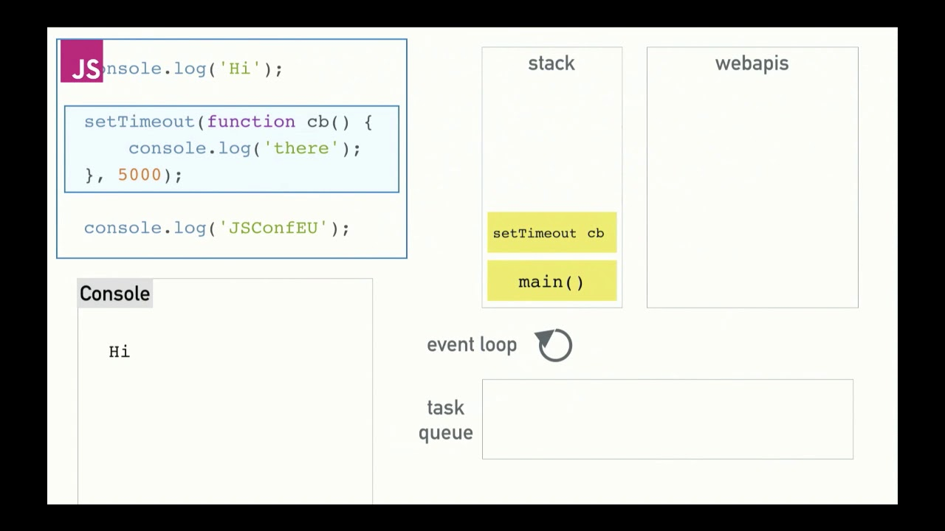
Browser Event loop cont.

