Slide 1
Rxjs Observables
An introduction TO REACTIVE EXTENSIONS FOR JAVASCRIPT

Slide 2
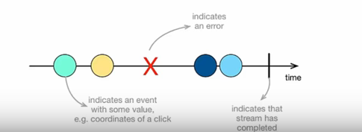
What is reactive programming?
UI Events
Http Requests
File Systems
Memory / Cache
Array-like Objects
Programming paradigm that works with async data streams
Data streams can be created from many things.

Slide 3
What is an observable?
An array that gets built over time. Then, you can loop on this array by subscribing to it.
Observables help JavaScript integrate a proper "observer design pattern“
Note: in pub/sub, messages are sent to subscribers w/o the publisher knowing directly who the subscribers are but with the observer pattern, the subject sends messages directly to the observers
Observables are functions that tie an observer to a producer.
What’s a “Producer”?
A producer is the source of values for your observable. It could be a web socket, it could be DOM events, it could be an iterator, or something looping over an array. Basically, it’s anything you’re using to get values and pass them to `observer.next(value)`.
Angular Documentation
“You can think of an observable as an array whose items arrive asynchronously over time. Observables help you manage asynchronous data, such as data coming from a backend service. Observables are used within Angular itself, including Angular’s event system and its http client service. To use observables, Angular uses a third-party library called Reactive Extensions (RxJS). Observables are a proposed feature for ES 2016, the next version of JavaScript.”

Slide 4
Promises vs observables
Promise | Observable
Emits a single value 2 params with Promise (onfulfilled, onrejected) A promise represents the eventual result of an asynchronous operation. It is a placeholder into which the successful result value or reason for failure will materialize. | Emits multiple values over a period of time (stream) 3 params with Observable (next, error, complete) each item that is emitted calls, ‘next’ last item is handled, ‘complete’ handler is called
Not lazy – then is like subscribe method. (then method is commented out, still make api call unlike subscribe – no api call) | Lazy. An observable is not called until we subscribe to the observable using the subscribe method.
Cannot be cancelled | Can be cancelled by using the unsubscribe() method
…. | Observables provide many operators; map, forEach, filter, reduce, retryWhen, take, pluck, range, scan mergeMap, switchMap, do

Slide 5
BROWSER EVENT loop
Non-blocking I/O In JavaScript, almost all I/O is non-blocking. This includes HTTP requests, database operations and disk reads and writes; the single thread of execution asks the runtime to perform an operation, providing a callback function and then moves on to do something else. When the operation has been completed, a message is enqueued along with the provided callback function. At some point in the future, the message is dequeued and the callback fired.
JS runtime is multi threaded – e.g. Memory management, event loop, garbage collection, etc.
Only the written code is single threaded
V8 is just a Javascript engine, it doesn't have browser host methods like alert or host objects like setTimeout, XMLHttpRequest.
Visual Resource for Event Loop http://latentflip.com/loupe/

Slide 6
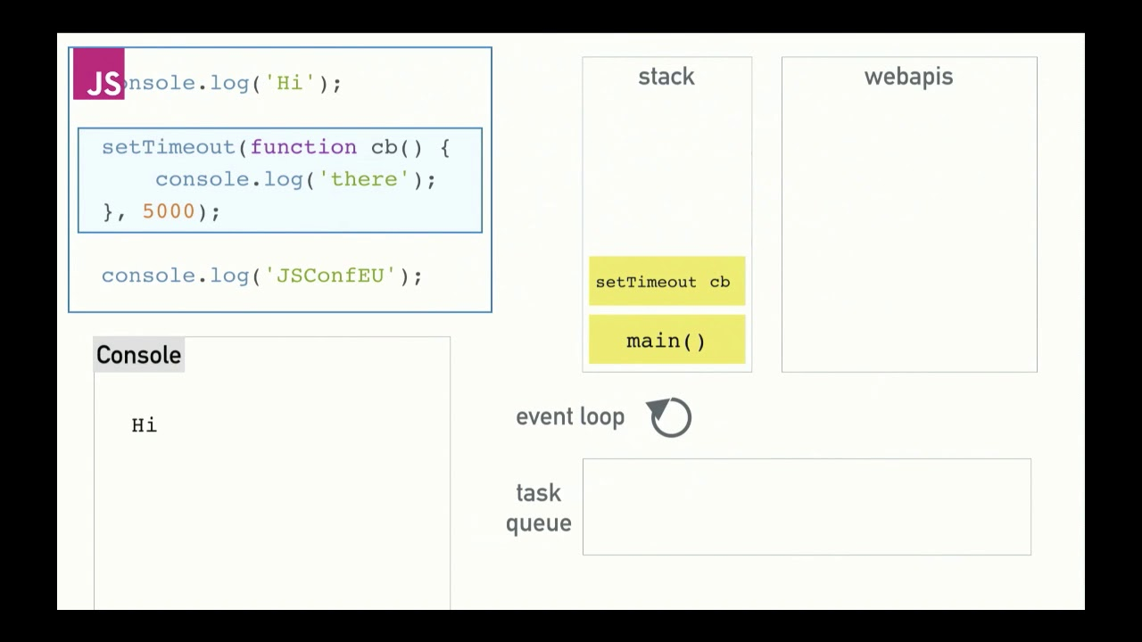
Browser Event loop cont.

