Slide 1


Nextcloud
SNAP
LIGHTNING TALK · 5–6 MIN
Nextcloud snap
A preconfigured default upstream Nextcloud deployed on any Ubuntu device within minutes with a single shell command
sudo snap install nextcloud
Sane presets
Fully configurable
Nextcloud groupware
Office, Mail, Talk included
SSL encryption included
1
10
0
command
years of focus
manual stack setup
Notes:
Hello everyone. Today I’m introducing Nextcloud Snap. Essentially, it is a preconfigured default upstream Nextcloud that can be deployed on any Ubuntu device in minutes with just a single shell command: sudo snap install nextcloud. It includes sensible presets but remains fully configurable. Unlike traditional manual stack setups which takes time to master, the Snap offers fully a functional Nextcloud including Office, Mail, Talk, and SSL encryption out of the box.

Slide 2
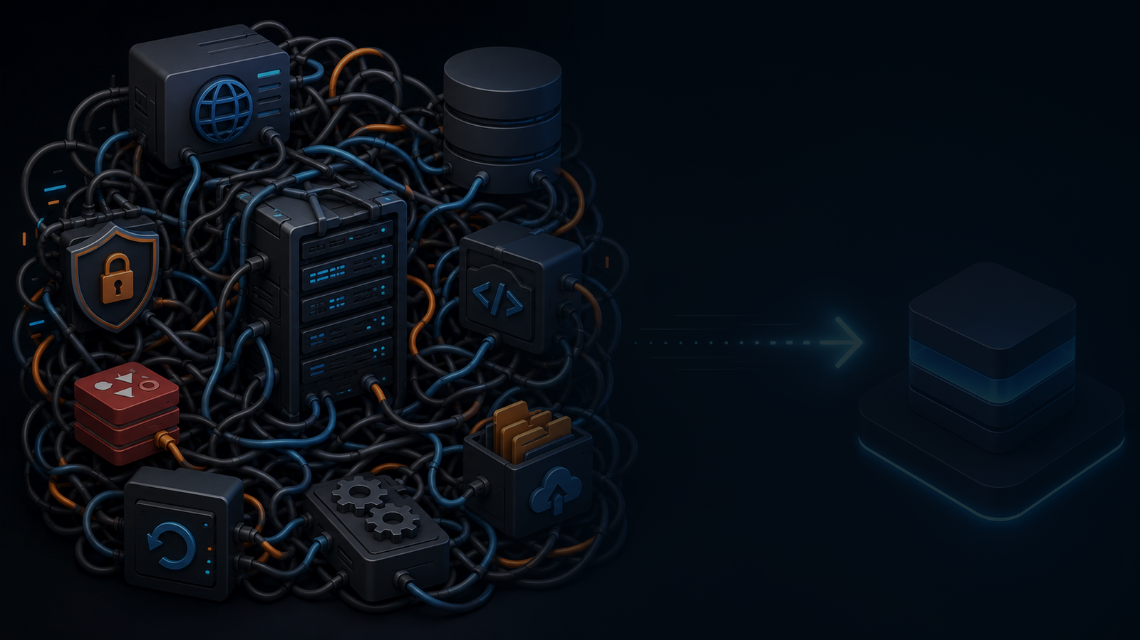
02
Nextcloud
SNAP
THE PROBLEM
Before collaboration,
there is infrastructure.
Traditional self-hosting can ask a new user to understand every layer before they can share one file.
01
Web server
02
Runtime
Apache or Nginx, ports, redirects and TLS.
PHP versions, modules, cron, limits.
03
Data layer
04
Lifecycle
Database, cache and storage paths.
Updates, backups and rollback thinking.
Notes:
The problem we are solving is infrastructure complexity. Before collaboration can happen, you usually need to build the infrastructure. For a new user, traditional self-hosting asks them to understand every layer before they can share a single file. This includes configuring web servers like Apache or Nginx and managing PHP modules, database layers, and lifecycle management for updates and backups. It is a heavy lift for simple collaboration.

Slide 3
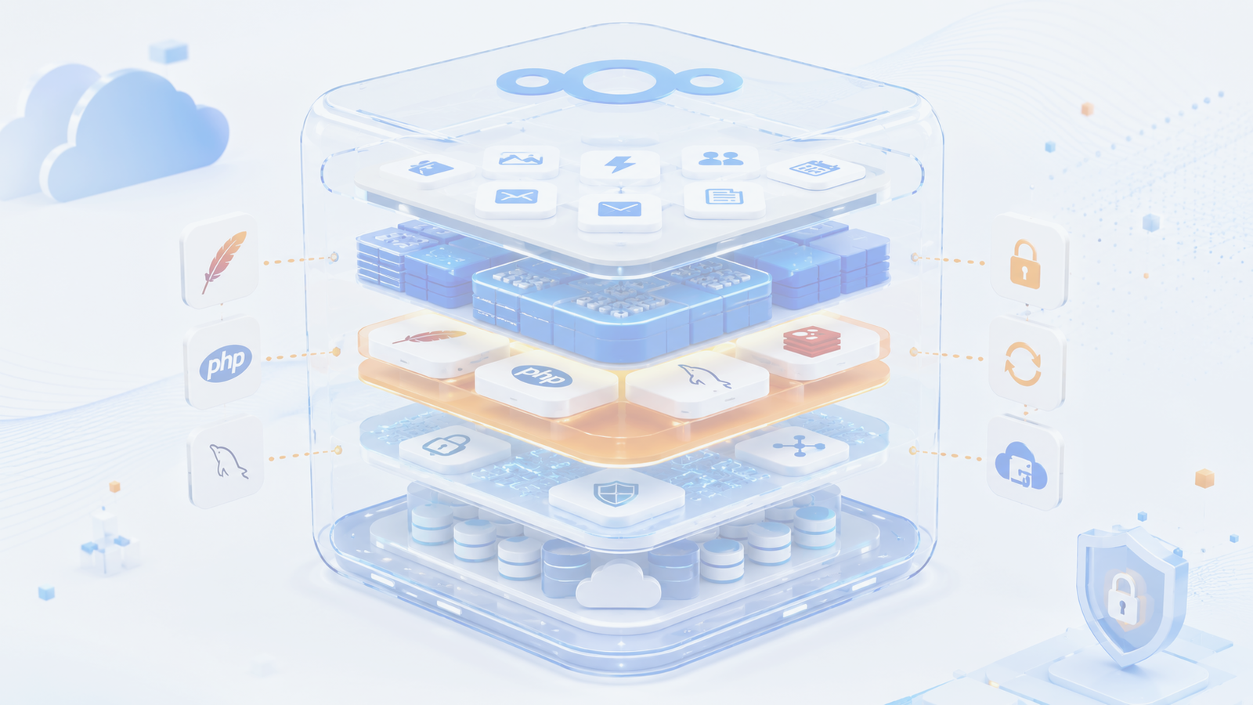


Nextcloud
SNAP
03
THE APPROACH
Peace of mind — KISS
Package default Nextcloud
Continuous integration
Automate testing
Release testing
Predictable releases
100% FOSS commitment
Secure confinement
Reproducible environment
Bare-metal, VPS, VM, LXC, SBC, IoT
Scalable environments
Upstream
Snap
Tested
Community
Nextcloud
packaging
release
support
Notes:
Our approach is built on peace of mind and the KISS principle. We package the default Nextcloud so users don't have to guess at configurations. To ensure quality, we utilize a rigorous process of continuous integration, automated testing, and release testing. The goal is to ship updates predictably, ensuring that what works in development works exactly the same for you.

Slide 4
Nextcloud
SNAP
04
INSIDE THE SNAP
A multi-component stack,
managed as one unit.
The goal is “install and forget” — keeping the deployment configurable and upgradeable
HTTPS
Integrated Let’s Encrypt workflow
Stack
Apache · PHP · MySQL · Redis
Snap is opinionated
Apache
MySQL
PHP
Redis
Refreshes
Automatic updates with configurable timing
Snapshots
Built-in snap snapshots and backup options
Docs
Wiki, FAQ and community forum support
Office
Nextcloud Office / Collabora CODE support
Notes:
Inside the Snap, we’ve grouped a multi-component stack into one unit. Our goal is 'install and forget'—keeping everything upgradeable while offering full customization. We use an integrated Let’s Encrypt workflow for HTTPS and recommend standard stacks like Apache, PHP, MySQL, and Redis. It is 100% FOSS with secure confinement, running anywhere from bare-metal to IoT devices. Crucially, it handles its own maintenance through automatic updates with configurable timing and built-in snapshots.

Slide 5

05
Nextcloud
SNAP
LIFECYCLE
Test
Updates should feel
like maintenance,
not drama.
fresh installs & upgrade paths
customisable updates
automatic snap refresh
automatic snapshots
scheduled snapshots
scheduled backup
revert, recover & migrate
Refresh
automatic by default
Control
timing is configurable
Recover
snapshots & backups
Snap auto refreshes, testing and snapshots turn routine upgrades into a predictable operating model.
Notes:
How do we handle the lifecycle? We want updates to feel like routine maintenance, not drama. The Snap auto-refreshes by default, though you can control the timing. It creates scheduled snapshots automatically, which allows for easy revert, recovery, and migration if needed.

Slide 6

06
Nextcloud
SNAP
POSITIONING
Who is the snap for?
no administration skills required
comprehensive documentation, Wiki and FAQ's
GitHub issues & community forum support
automatic integrated Lets Encrypt certificates
automatic customisable updates
automatic snapshots and customisable backups
Great fit
Personal - family servers · team servers · small businesses · labs · IoT/edge · demos · low-maintenance instances.
Not ideal
Highly customized enterprise stacks, unusual policies, or teams that require full manual control of every component.
Notes:
"So, who is Nextcloud Snap for? It is perfect for personal or family servers, team hubs, small businesses, and labs where you want automatic Lets Encrypt certificates but zero administration skills. However, it is not ideal if you are a large enterprise needing highly customized stacks or full manual control of every component."

Slide 7

07
Nextcloud
SNAP
COMMUNITY STORY
A decade of continuous focus on
the Nextcloud experience
2016 - Kyle Fazzari built the first Nextcloud snap
2019 - snap Team formation
2020 - documentation & Wiki
2025 - call for developer support
2026 - plugin migration & snap core upgrade
Incredible community with over 70k snap installations
2016
docs
tests
2026
next
first release
knowledge base
release confidence
renewed support
more contributors
Notes:
Finally, the history of this project. It started in 2016 when Kyle Fazzari released the first Nextcloud snap (still available today), in 2019 a small friendly team was formed. In 2020 extensive documentation and our Wiki appeared and semi-automated release testing evolved. Moving into 2026, we migrated plugins and upgraded the core, thanks to amazing community developers, who helped us get rid of some technical debt, giving the project high release confidence ensuring continuous focus on the Nextcloud experience!
We are proud to report over 70,000 active installations today.
Thank you.

