Slide 1
AIM/AutoPilot
Market Adapter
July 17
Notes:
This template can be used as a starter file for presenting training materials in a group setting.
Sections
Right-click on a slide to add sections. Sections can help to organize your slides or facilitate collaboration between multiple authors.
Notes
Use the Notes section for delivery notes or to provide additional details for the audience. View these notes in Presentation View during your presentation.
Keep in mind the font size (important for accessibility, visibility, videotaping, and online production)
Coordinated colors
Pay particular attention to the graphs, charts, and text boxes.
Consider that attendees will print in black and white or grayscale. Run a test print to make sure your colors work when printed in pure black and white and grayscale.
Graphics, tables, and graphs
Keep it simple: If possible, use consistent, non-distracting styles and colors.
Label all graphs and tables.

Slide 2




AIM
Automated, Repeatable Deployments
GFS
Global File Distribution
Composer
Configuration File Generation
Deploying a distributed application typically involves a number of common tasks:
Distribute application artifacts (libraries, scripts, executables) to where instances of the application need to run
Configure instances of the application for a target environment
Start instances of the application according to a defined schedule
Orchestrate multiple deployment steps in sequence or in parallel
AIM helps solve these problems by providing a data model for describing deployments and a standard toolset for automating those deployments across enterprise infrastructure.
AIM
Application Infrastructure Model
Maestro
Process Execution & Scheduling
AIM Director
Job Automation & Orchestration

Slide 3
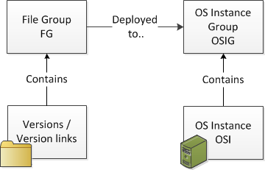
AIM Details: Core Concepts
  AIM is a declarative model of the environment, and AIM infrastructure enforces that model
    The AIM process creates rich metadata that both describes our environment but also drives deployment activities.
  AIM Commands
    Initial Deployment
      aim deploy filegroup myApplication/prod --osinstancegroup application-cluster/prod
    Version Upgrade
      aim update link quad:/myApplication/tools/prod --target quad:/myApplication/tools/2.0
3

Slide 4
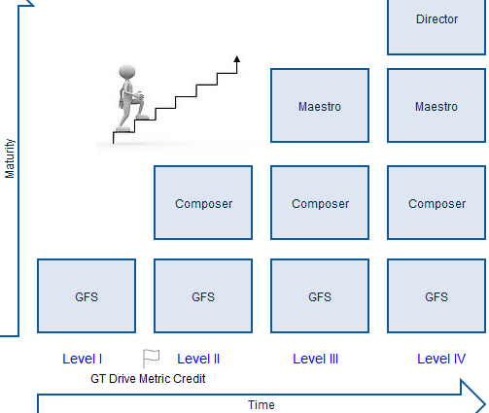
AIM Maturity Model
Level I: GFS to manage distribution of app binaries and associated content
Level II: GFS + Composer to manage application configuration
Level III: GFS + Composer + Maestro to manage process execution
Level IV: GFS + Composer + Maestro + AIM Director to automate the 'installation run book‘, i.e. multiple AIM commands run in sequence
Notes:
aim create entry quad:/lma/test/ --sealid=83293
aim create entry quad:/lma/test/test1.0/ --sealid=83293
aim create entry quad:/lma/test/test1.0/aimtest --sourcepath aimtest/ --property type=binary --property custom=sit --property custom=dev
aim create link quad:/lma/test/dev --target quad:/lma/test/test1.0 --entitleadmin lma-admin
aim create entry quad:/lma/test/test1.1/ --sealid 83293
aim create entry quad:/lma/test/test1.1/aimtest/ --sourcepath aimtest/ --property type=binary
aim create filegroup testaim/testaim --entry quad:/lma/test/dev --entitleadmin lma-admin
aim deploy filegroup testaim/testaim –-osinstancegroup ma_bil/sit

Slide 5

Your complete automated deployment solution from development to production.
AutoPilot is a generic deployment engine which automates Application and Database deployments. A single intuitive interface is employed to deploy to all environments with the necessary parameters for specific deployments. AutoPilot runs by using stored configuration structure that can express complex environmental differences in a simple and efficient manner.
It is a complete deployment solution which orchestrates your application needs by:
    shutdown of components or services
    deployment of payloads (database and application payloads)
    startup of components or services
    Utilizes AIM GFS as an underlying method to store and pull artifacts

Slide 6
Terminology
AutoPilot is built on the configuration of payloads and components.
A payload is defined as files or objects that will be deployed onto a host node. Payloads are the main deployment items of the job.
  There are fourtypes of payloads:
    Binary- This type of payload deploys a binary or single file to the host node. Binaries are located on the Central Authority Server (CAS).
    Branch- This type of payload deploys checks out a branch from SVN and deploys it to the host node.
    DBADD- This type of payload deploys a deltas to specified databases that are located in a branch in SVN
    AIM - This type of payload deploys AIM content from GFS or Composer.
A component is defined as any service that needs to be actioned before and after a deployment
    A component has two distinct actions: before (ie. stop) and after (ie. start)
    Components do not deploy any files, but rather run scripts on the host node such as stopping tomcat or cleaning up a filesystem. This container is used to surround the deployment with an action.
AutoPilot has many features that make it easy to deploy the correct payloads and components onto the environment!

Slide 7
AIM Maturity Model
Level I: GFS to manage distribution of app binaries and associated content
Level II: GFS + Composer to manage application configuration
Level III: GFS + Composer + Maestro to manage process execution
Level IV: GFS + Composer + Maestro + AIM Director to automate the 'installation run book‘, i.e. multiple AIM commands run in sequence
Notes:
aim create entry quad:/lma/test/ --sealid=83293
aim create entry quad:/lma/test/test1.0/ --sealid=83293
aim create entry quad:/lma/test/test1.0/aimtest --sourcepath aimtest/ --property type=binary --property custom=sit --property custom=dev
aim create link quad:/lma/test/dev --target quad:/lma/test/test1.0 --entitleadmin lma-admin
aim create entry quad:/lma/test/test1.1/ --sealid 83293
aim create entry quad:/lma/test/test1.1/aimtest/ --sourcepath aimtest/ --property type=binary
aim create filegroup testaim/testaim --entry quad:/lma/test/dev --entitleadmin lma-admin
aim deploy filegroup testaim/testaim –-osinstancegroup ma_bil/sit

Slide 8
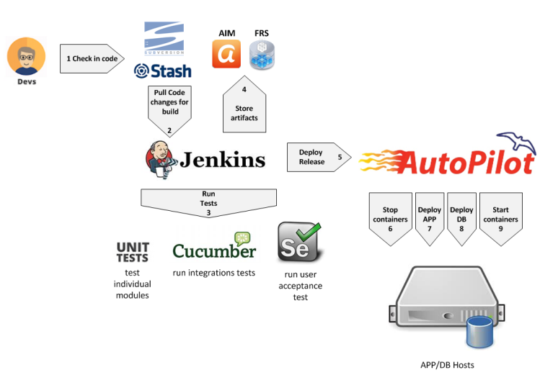
AutoPilot Pipeline

Slide 9
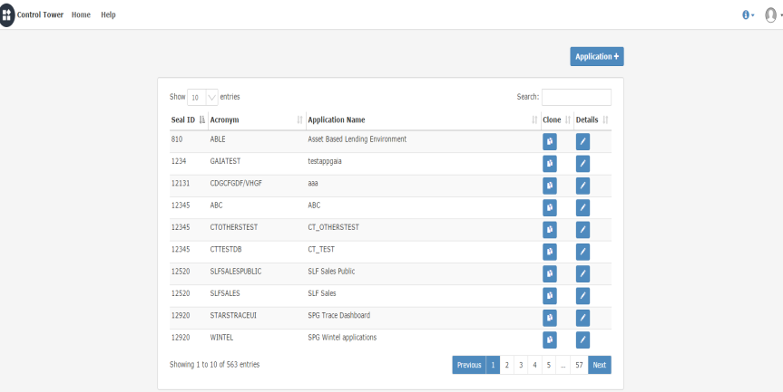
Control Tower
What Control Tower will do:
    CT will generate the deploy.cfg files and store the data in the database.
    CT will generate all the required AIM entries to onboard an application to AIM.
    CT will execute all the required AIM commands.
    Users will have the ability to review the AIM commands prior to executing.
    Once an application is onboarded, users will have the ability to make changes if necessary.

Slide 10
Jenkins – Build and deploy
Build Job:
Build code
Execute unit and integration tests
Code Scan: Black duck, Sonar, etc
Package code
Upload to FRS
Deploy Job:
Information is populated with Control Tower configuration
ITSM is required for PROD environments
Email notification
Deploy and Rollback

Slide 11
AutoPilot Metrics
http://tsacistvmtst23.svr.us.jpmchase.net:8080/metrics-dashboard-ui-web/pages/landing.jsp
For the software delivery process, the most important global metric is cycle time.
Cycle Time - the time between deciding that a feature needs to be implemented and having that feature released to users
How long would it take your organization to deploy a change that involves just one single line of code?
Do you do this on a repeatable, reliable basis?
Think about - Automated deployment engine refactoring (AAD and ADD)
Cycle time can be reduced by addressing the biggest constraints in getting the code change to be released to users - think automated deployment (code, db, env props) and automated testing!
Metrics that can be measured
- Automated test coverage - SONAR (API) pull coverage data (To be researched- is it feasible?)
- Properties of the codebase such as the amount of duplication, cyclomatic complexity, coupling, style problems
- Number of defects (N/A)
- Velocity, the rate at which your team delivers working, tested, ready for use code (N/A right now)

Slide 12
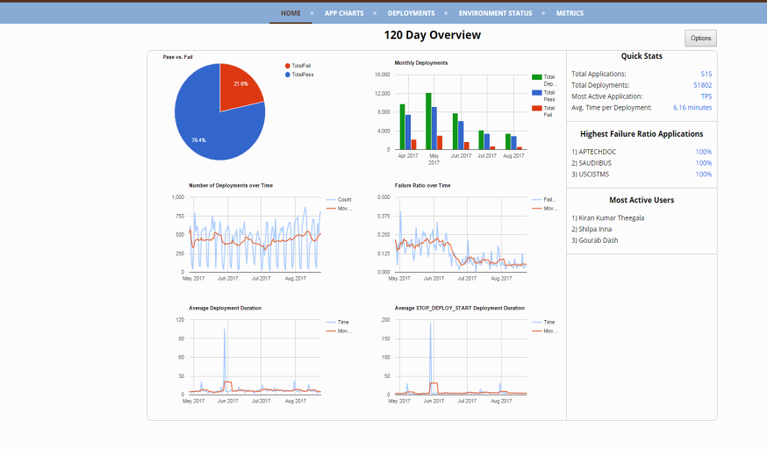
AutoPilot Metrics
http://tsacistvmtst23.svr.us.jpmchase.net:8080/metrics-dashboard-ui-web/pages/landing.jsp

Slide 13
Resources
AutoPilot Wiki
https://confluence.uk.jpmorgan.com/confluence/display/CIBDEVOPS/Autopilot+Onboarding+Portal
ControlTower
https://controltower.jpmchase.net:8443/controltower/
AIM Wiki
https://confluence.uk.jpmorgan.com/confluence/display/AIMSUPPORT/Home

Slide 14
Questions?

