Slide 1

Predicting Fraudulent Clicks
TalkingData AdTracking Fraud Detection Challenge
By Aaron Scull - sculla scull.dev

Slide 2
Bringing users to your platform
Paying for search results
Traffic = More profit
Notes:
Lets think about the problem as though we were a startup. How would we get users to our platform?
Lets pay google to direct traffic our way and build a marketing plan around moving traffic to us via google.

Slide 3
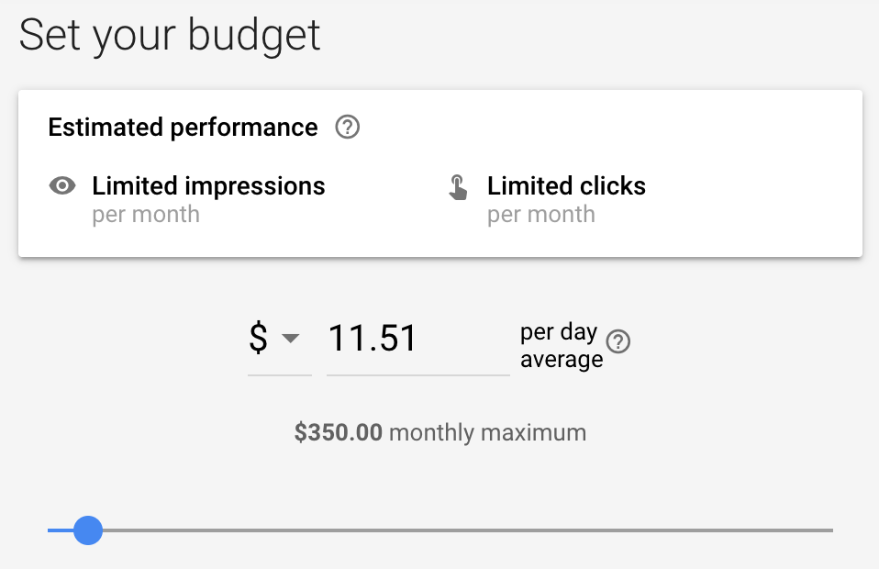
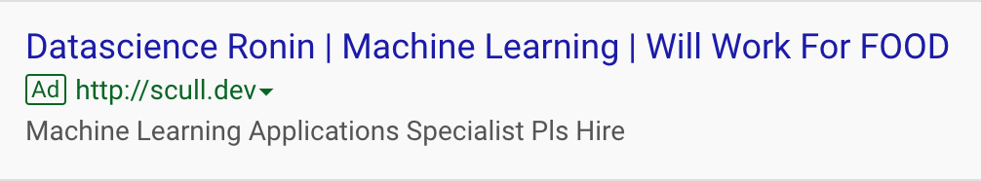

Buying Ad clicks $≡$ traffic, right?

Slide 4
What this set is, and isn’t…
Is - Predicting download of app
Not ‘is robot’

Slide 6

Lets dive into the data
Fraud or Not

Slide 7
Lets dive into the data
By click analysis of if click results in download
Is the click human?
what is the chance of download?
Is the click robot?
what is the chance of download?

Slide 8
Build a model – Gradient Boost Classifier
Is the click human?
what is the chance of download?
??
Is the click robot?
what is the chance of download?
0%

Slide 9
Recommendations
Allow predicted humans
Redirect Predicted bots with reCAPTCHA v3
Notes:
reCAPTCHA v3 allows you to verify if an interaction is legitimate without any user interaction. It is a pure JavaScript API returning a score, giving you the ability to take action in the context of your site: for instance requiring additional factors of authentication, sending a post to moderation, or throttling bots that may be scraping content.

