Slide 1
Forensic Linguistics: Authorship Prediction
Prediction of Murakami Translators
By Aaron Scull - sculla scull.dev

Slide 2

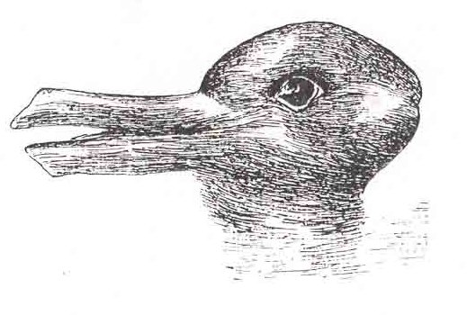
Describe this in 4 words
Notes:
Lets say that there was a test where two people described this picture, and only one person was able to see it. the first would describe it to the second person. the second person would only be able to paraphrase the description when asked, using much the same words, right?

Slide 3
A Simple model would have an easy time recognizing this
Original
Plagiarism
rabbit with long ears
Half Duck Half Rabbit
A long eared rabbit
Duck with Rabbit Head
Notes:
When placed side by side it would be obvious that these are plagiarized, ordering

Slide 4
A more complicated Model would look at…
Original
Plagiarism
A furry Rabbit head
Duck/Rabbit mutant head
Really soft rabbit head
Half-Breed Rabbit/Duck
Notes:
What I am proposing is a model that could use common syntax of the author to find phrases that are normally used.
If a new representation is widely off base in the way things are described, such as the descriptor comprised above, we could see consistent trends, and be able to flag a whole document by decomposing the overall usage of words, and the difference in pattern of usage.

Slide 5

Enter Murakami:
How could we use the interpretation of language as a key to find the signature of the translator?
Notes:
My project goal was to use 4 different murakami books, two from each translator, and predict based on their own unique authorship signature who translated a particular paragraph in the book. The corpus consisted of roughly 12,000 different paragraphs

Slide 6
What is Forensic Linguistics?
Examine sequences of adjacent words
Tally most common words, and phrases, and common idioms
Preference for length of words
Filter out uncommon Phrases
Authorship prediction

Slide 7

Notes:
Scraped the paragraphs from the HTML chapters of the books, feed the data frame into Cross Validated Grid Search pipeline of TF-IDF Word vectorizer with 1-4n-grams that were then fed into a Singular Value Decomposition to find relevant topics, which was then fed into a Gradient Boosted Classifier Prediction of authorship

Slide 8
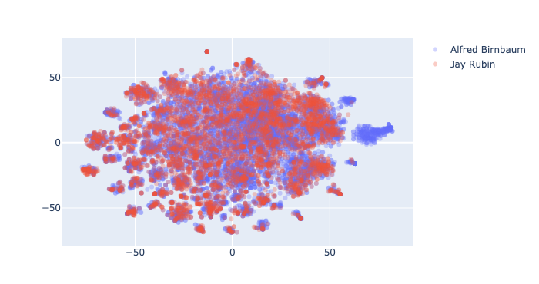
Notes:
Easy to get lost in the fray of the space, but we were able to see a difference in the authors.

Slide 9
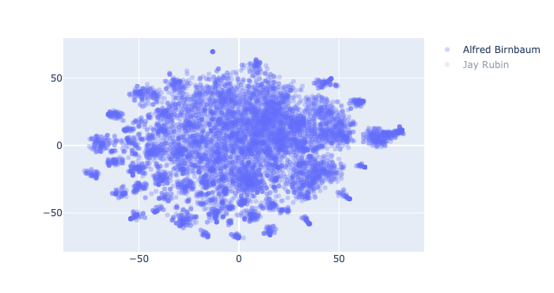
Notes:
While I cant quite tell the difference between the two, my Model can.

Slide 10
Found Unique Signatures for both authors
Predicted with 71% Accuracy

Slide 11
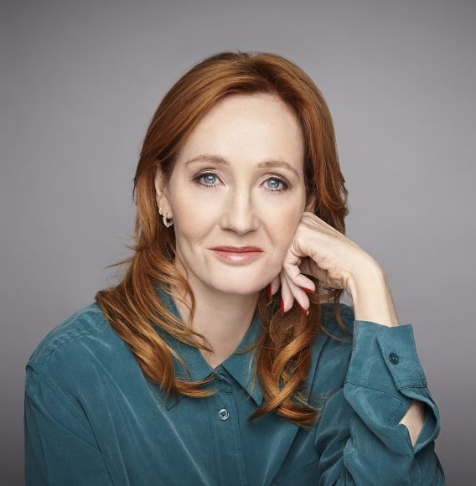
Forensic linguistics like this were used to Identify Robert Galbraith as J.K. Rowling
Notes:
My project was to be able to see 4 different books, and be able to figure out who the translator was based on their own unique authorship signature

Slide 12
Ways to Expand this: add more Authors!!
Feed many different authors into this pipeline to give it diversity
Test on documents with unknown, or many authors
Red Flag ’Model Bill’ legislation which has been pushed by a special interest by showing common authorship

Slide 13
Thank You
By Aaron Scull - sculla scull.dev

