Slide 1
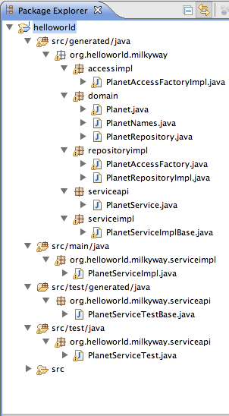
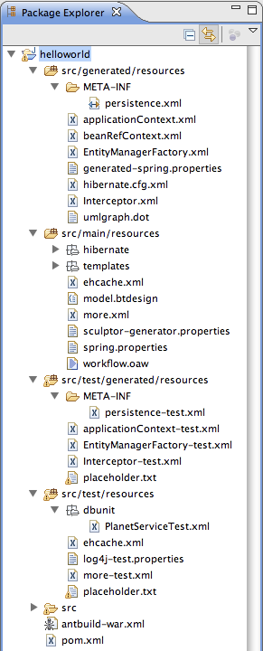
Java Files
Resource Files
Domain objects
JPA annotations
Service
Repository & Data access
JPA configuration
Spring configuration
JUnit tests

