Slide 1

B2B Information System for Agents’ Retail Stores
Nguyen Hoang Phuc
521H0511

Slide 2
Introduction
Nowadays, a Point-of-sale (POS) system holds an important role in business operations. Especially for enterprises that housing multiple agents’ retail stores, the POS system’s importance went even further. It offers a solution to oversee facets of a company’s retail activities.
2

Slide 3
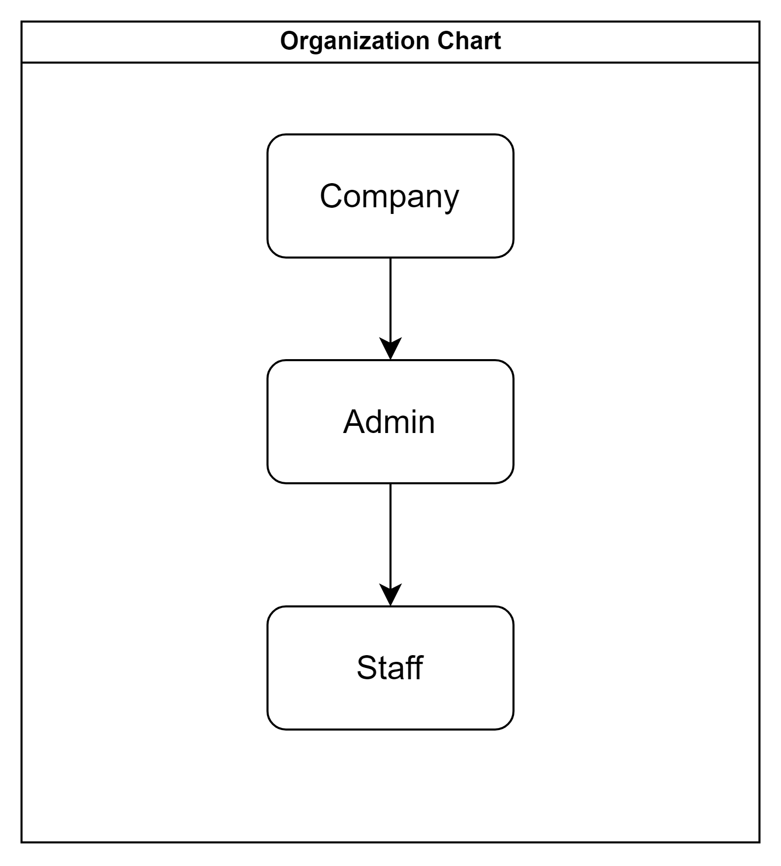
Business Requirements
Organization Chart
3

Slide 4
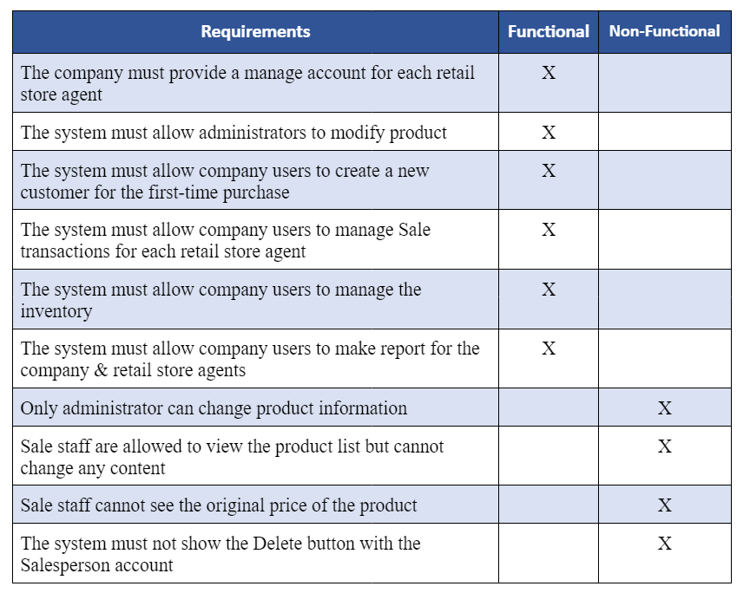
Business Requirements
List of Requirements
3

Slide 5
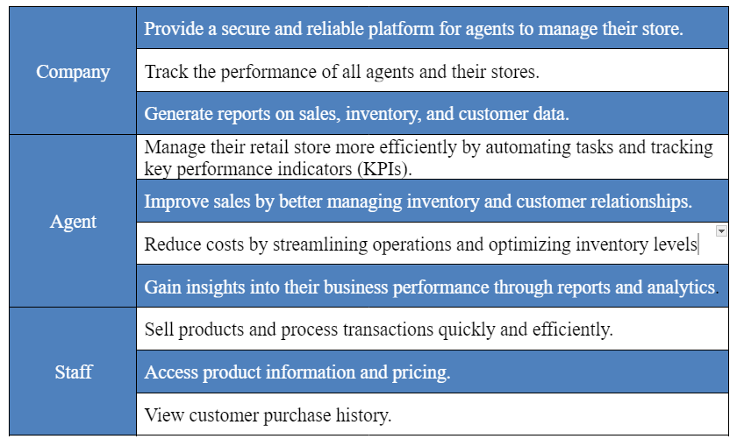
Business Requirements
Users and their goals
3

Slide 6
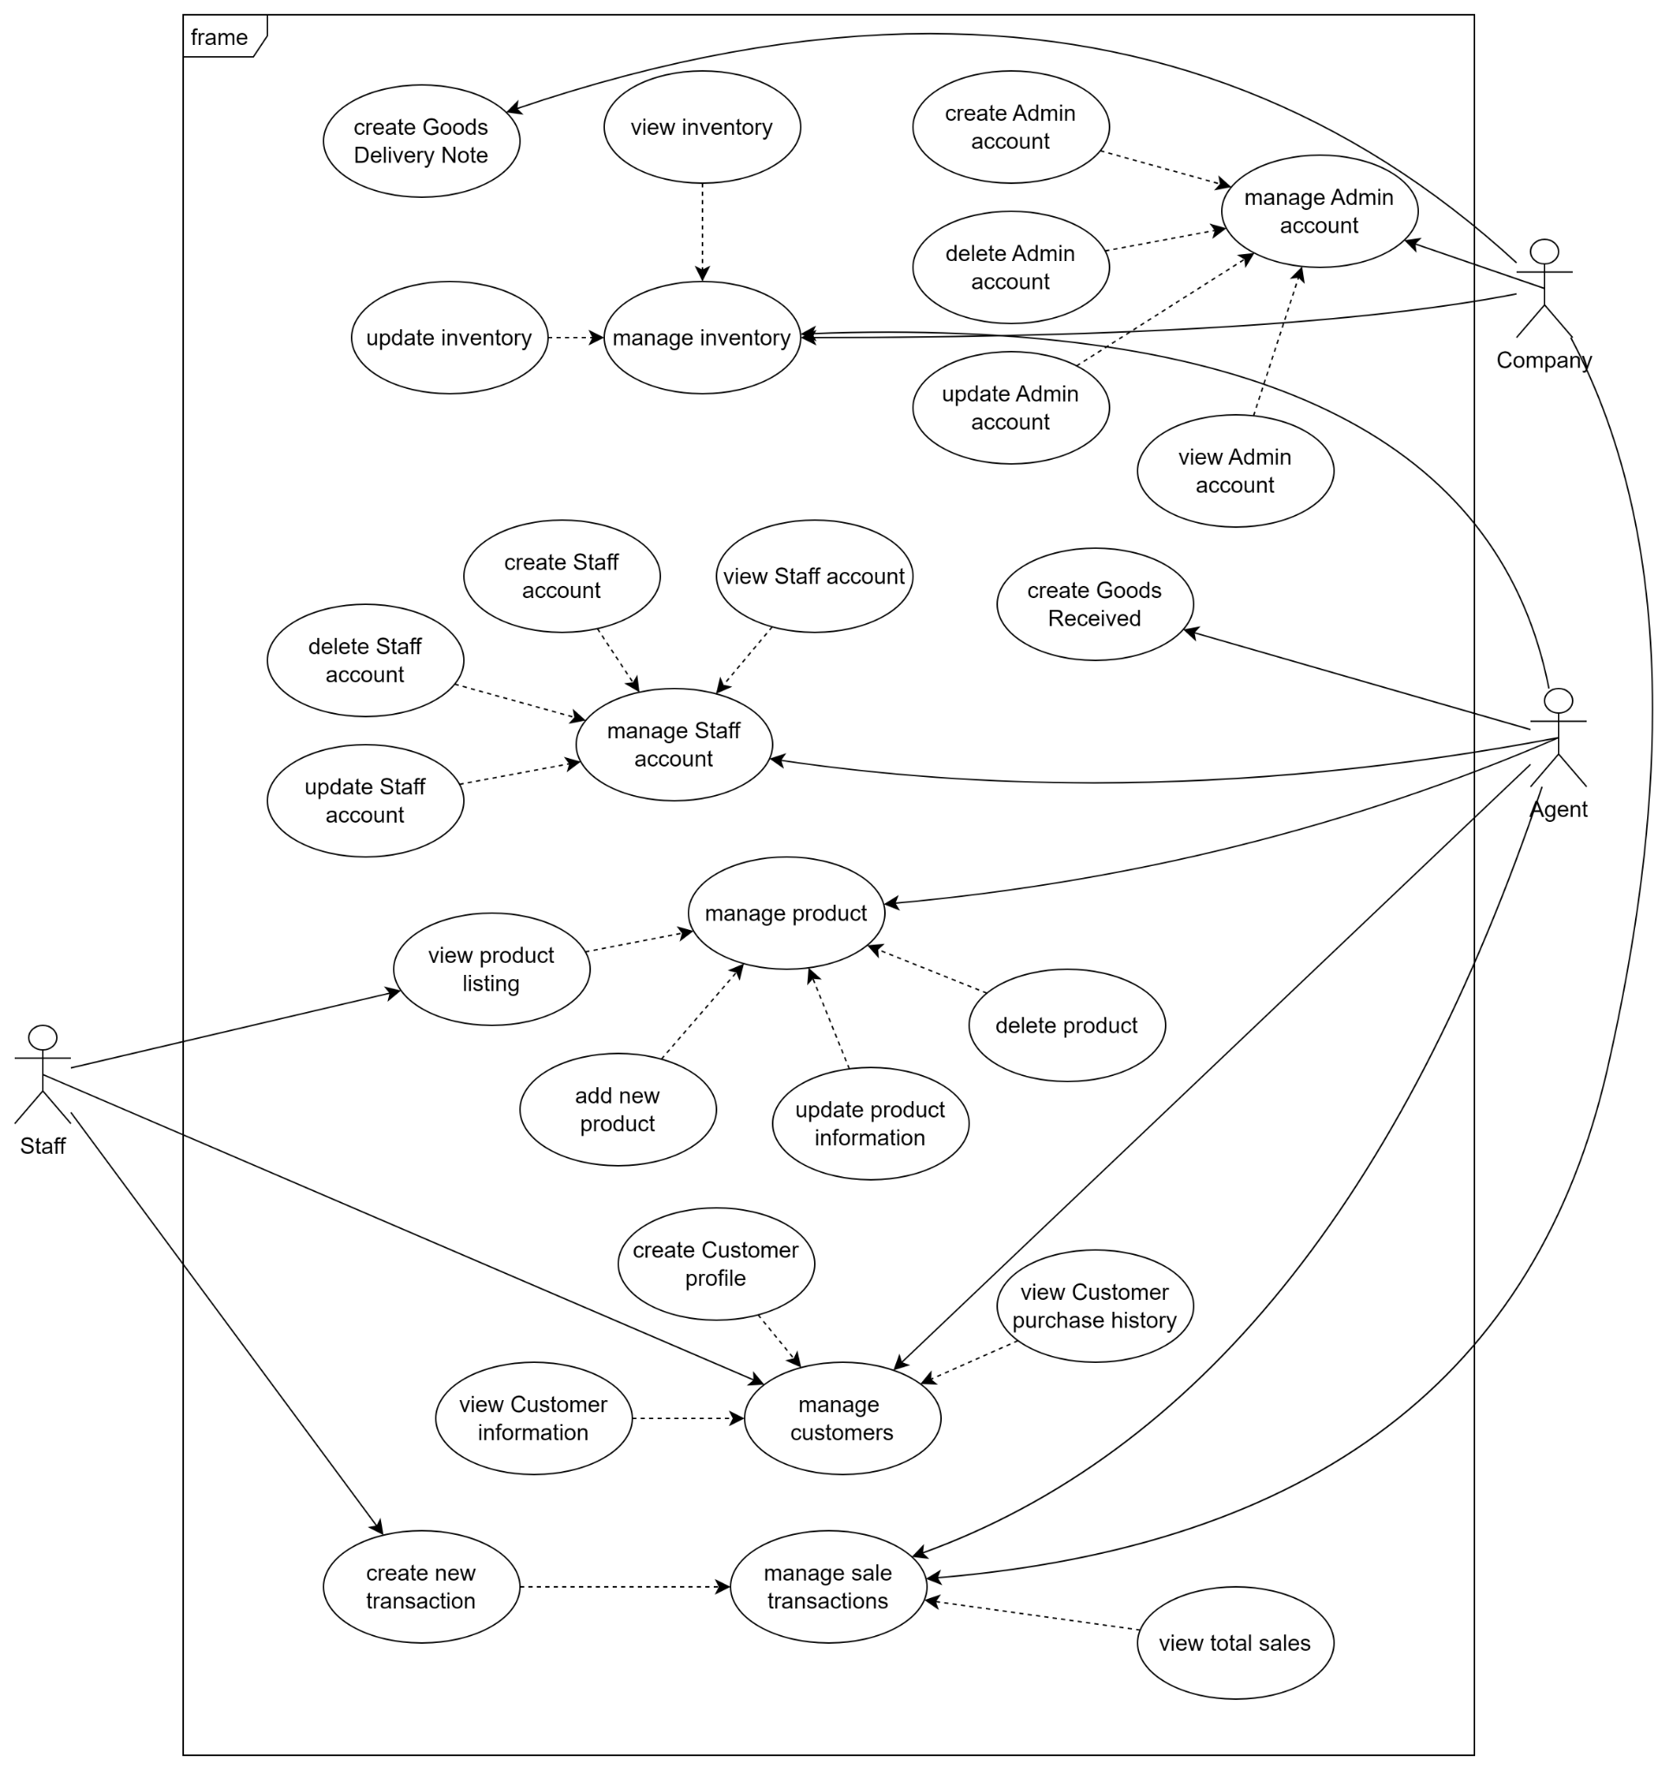
Business Requirements
Use case diagram
3

Slide 7
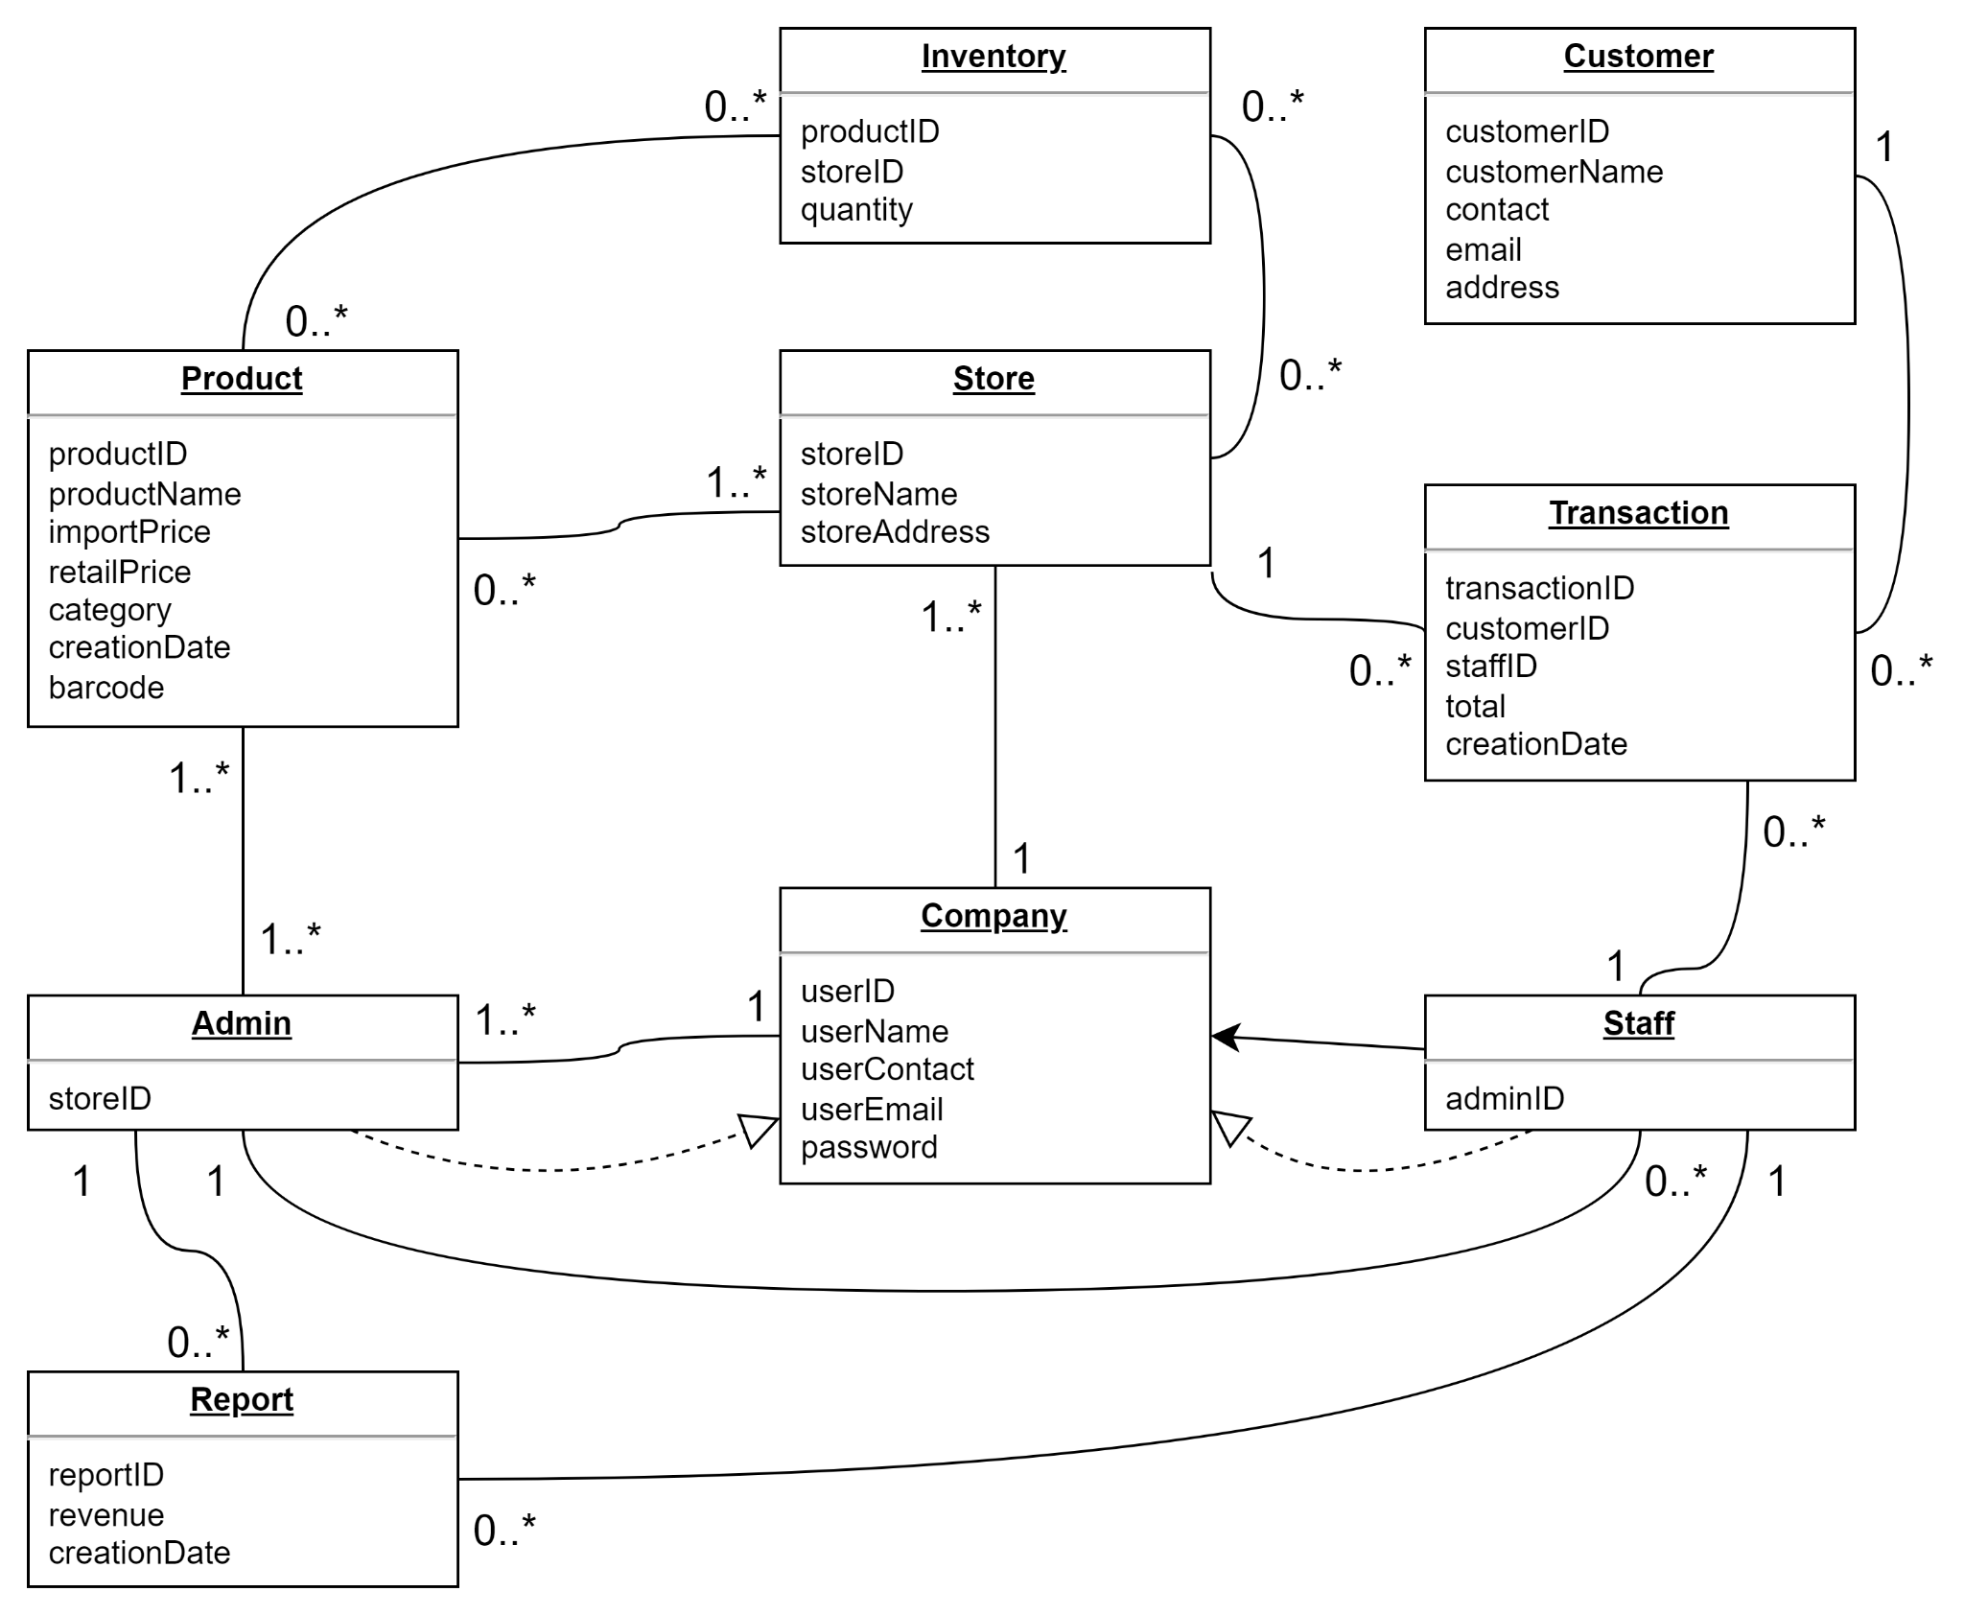
Business Requirements
Domain class diagram
3

Slide 8
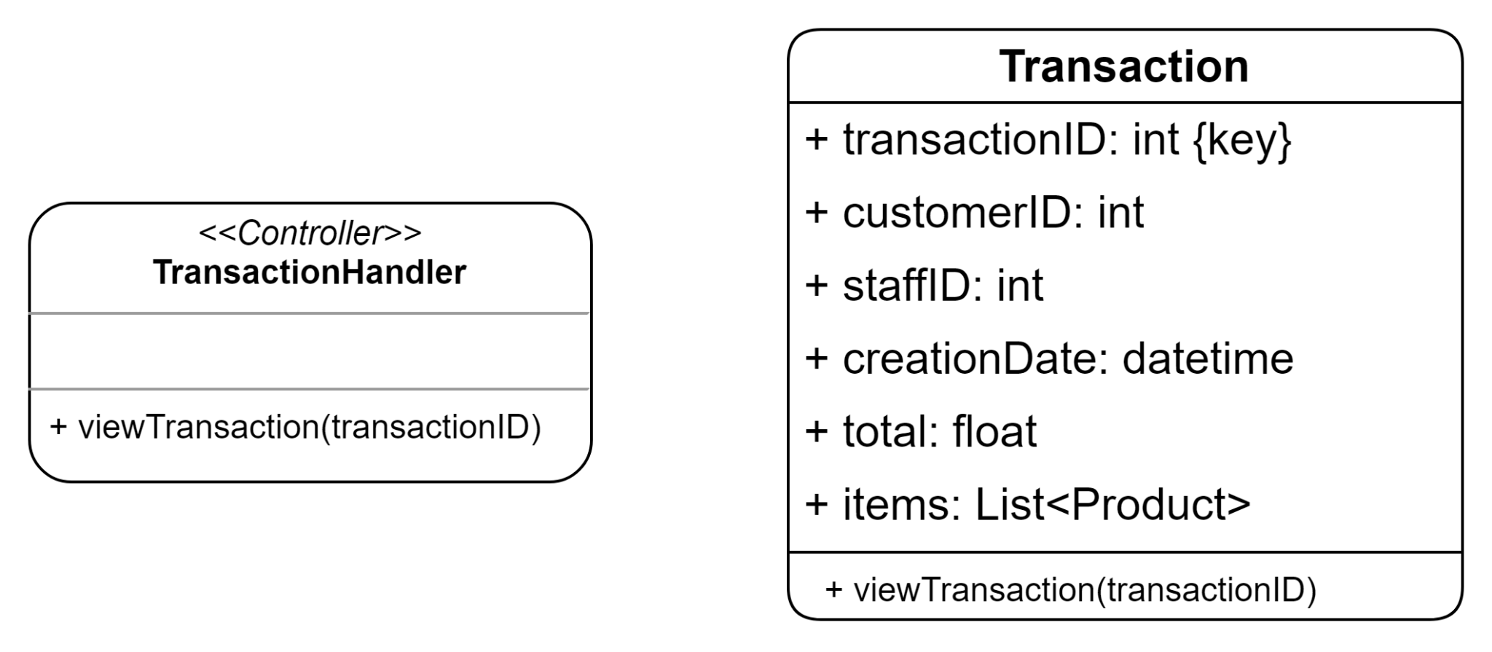
System Requirements Design
Use case: view total sales
4

Slide 9
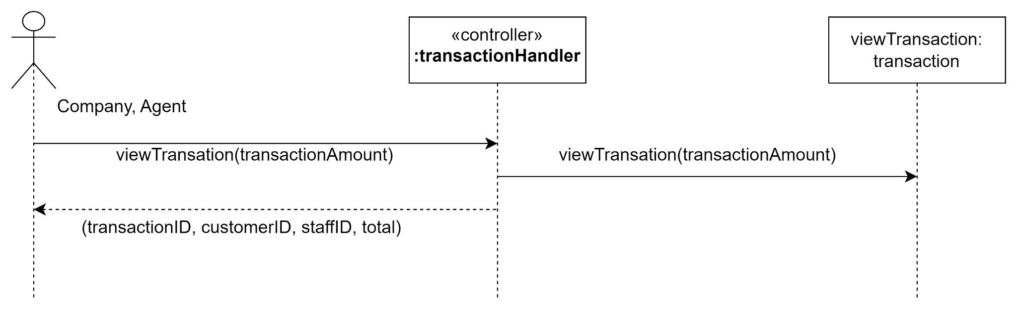
System Requirements Design
Use case: view total sales
4

Slide 10
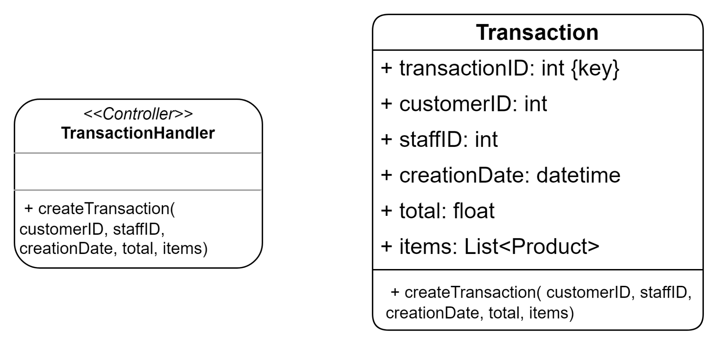
System Requirements Design
Use case: create new transaction
4

Slide 11
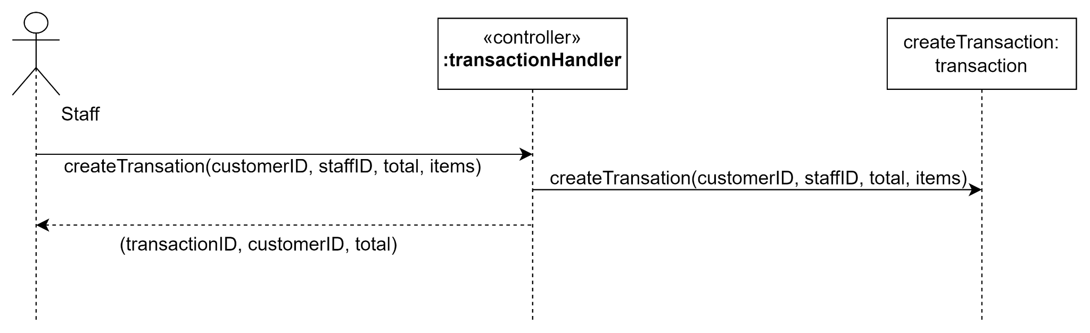
System Requirements Design
Use case: create new transaction
4

Slide 12
Thank you
for listening!
Nguyen Hoang Phuc
2023 Dec 21

