Slide 1
The Impact of Machine Learning on Econometrics and Economics
Susan Athey
The Economics of Technology Professor, Stanford GSb
Two-day course on machine learning and causal inference with videos and scripts: https://www.aeaweb.org/conference/cont-ed/2018-webcasts
Survey paper: https://www.nber.org/chapters/c14009.pdf
Links to papers: https://athey.people.stanford.edu/research

Slide 2
Questions
What are challenges in using and regulating ML and AI in practice, e.g. in financial services?
How does a causal inference framework help solve AI/ML challenges?
How can ML techniques be combined with econometrics to improve causal inference for both treatment effect estimation and structural models?
Will the types of AI used to play board and video games change economics?
How can the AI/ML tools from active learning be used to solve economic, business, and social problems?

Slide 3







Machine Learning
Advances in Supervised ML dramatically improve quality of image classification
Notes:
Start at minute 3

Slide 4

Supervised Machine Learning
X_{i}
Labelled data (X,Y)
Objective: use X to predict Y in a test set
Used to classify images without using any structure or prior knowledge
$$\operatorname{Pr}\left(Y_{i}=CAT | X_{i}\right)=.95$$
$$\operatorname{Pr}\left(Y_{i}=DOG | X_{i}\right)=.05$$

Slide 5
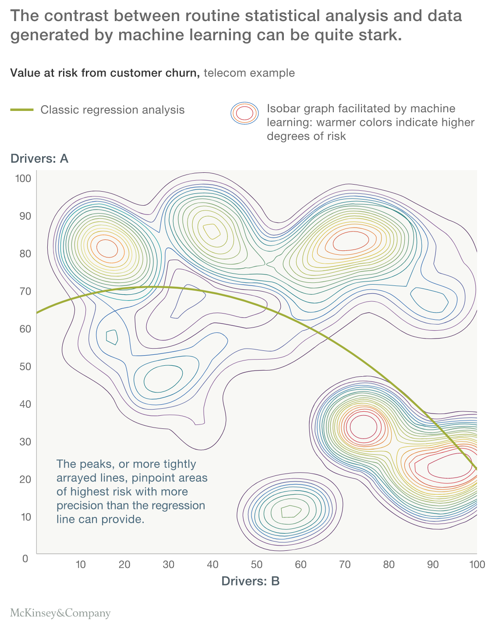
What’s New About ML?
Flexible, rich, data-driven algorithms select from a family of models to optimize goodness of fit
Computational tricks/engineering
Methods (e.g. cross-validation) to avoid over-fitting
Increase in personalization and precision

Slide 6
What’s New About ML?
Do we really think this relationship is plausible? Stable, robust, causal?
Flexible, rich, data-driven algorithms select from a family of models to optimize goodness of fit
Computational tricks/engineering
Methods (e.g. cross-validation) to avoid over-fitting
Increase in personalization and precision

Slide 7
Machine Learning and AI
Off-the-shelf methods do not separate out context that may change (or protected classes) but are correlated with labels, from structural features of items
Advances in ML dramatically improve quality of image classification

Slide 8
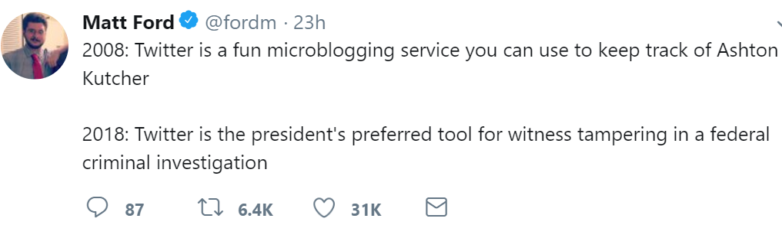
Stability of Black-Box ML

Slide 9
Challenges for Management/Regulation of ML in Financial Services
Credit Scoring Example
Instability of joint distribution of outcomes, novel features
Poor performance when extrapolating
Manipulation of novel features
Discrimination and Fairness
Ever-changing adverse selection problem as competing firms change models, marketing strategies
When are results more or less reliable?
Equilibrium effects
Agents using ML interact
Collusion (airline prices)
Instability (financial market crashes, correlated mistakes across firms)
Google maps examples
Need models of individual behavior and eqm selection to study eqm changes
Why existing AI/ML is a long way from solving “harder” problems
Algorithms have demonstrable errors
Engineers build black-box algorithms, but are not trained to evaluate
Need “best practices” to analyze the black box

Slide 10
Artificial Intelligence/Machine Learning Desired Properties for Applications
Desired properties
Causal inference FRAMEWORK
Interpretability
Stability/Robustness
Transferability
Fairness/Non-discrimination
“Human-like” decision-making
Reasonable decisions in never-experienced situations
Goal: learn model of how the world works
Impact of interventions can be context-specific
Model maps contexts and interventions to outcomes
Formal language to separate out correlates and causes
Ideal causal model is by definition stable, interpretable
Transferability: straightforward for new context dist’n
If you estimate treatment effect heterogeneity
Fairness: Many aspects of algorithmic discrimination relate to correlation v. causation
Gender and race may be correlated with factors that shift distributions of characteristics like test scores or credit scores, relatively limited direct causal effects
Notes:
Start at minute 12

Slide 11
My own work on ML/Causal Inference
Pitfalls of Pure Prediction
“Beyond Prediction: Using Big Data for Policy Problems,” Science, 2017
“The Impact of Machine Learning on Economics,” forthcoming in The Economics of Artificial Intelligence, NBER volume
Stable/robust prediction and estimation
“Stable Prediction across Unknown Environments,” (with Kun Kuang, Ruoxuan Xiong, Peng Cui, Bo Li), Knowledge Discovery & Data Mining, 2018.
“Estimating Average Treatment Effects: Supplementary Analyses and Remaining Challenges,” (with Guido Imbens, Thai Pham, and Stefan Wager), American Economic Review, May 2017
“A Measure of Robustness to Misspecification” (with Guido Imbens), American Economic Review, May 2015, 105 (5), 476-480
Surrogates
“Estimating Treatment Effects using Multiple Surrogates: The Role of the Surrogate Score and the Surrogate Index” (with Raj Chetty, Guido Imbens, Hyunseung Kang), 2016
Combining ML and Structural Models of Consumer Behavior
“Estimating Heterogeneous Consumer Preferences for Restaurants and Travel Time Using Mobile Location Data,” (with David Blei, Robert Donnelly, Francisco Ruiz, and Tobias Schmidt), American Economic Review Papers and Proceedings, May, 2018
“SHOPPER: A Probabilistic Model of Consumer Choice with Substitutes and Complements,” 2017, (with Francisco Ruiz and David Blei).
“Counterfactual Inference for Consumer Choice Across Many Product Categories” (with David Blei, Rob Donnelly, Francisco Ruiz)
Causal Panel Data Models
Athey, Bayati, Duodechenko, Khosravi, Imbens: “Matrix Completion Methods for Causal Panel Data Models” 2018
Treatment Effects, Assignment Policies
“Recursive Partitioning for Heterogeneous Causal Effects” (with Guido Imbens), PNAS 2016
“Estimation and Inference of Heterogeneous Treatment Eﬀects using Random Forests” (with Stefan Wager), Journal of the American Statistical Association, 2018.
“Generalized Random Forests,” with Julie Tibshirani and Stefan Wager, forthcoming, Annals of Statistics.
“Efficient Policy Learning,” with Stefan Wager, 2017.
“Offline Multi-Action Policy Learning: Generalization and Optimization,” (with Zhengyuan Zhou and Stefan Wager)
“Local Linear Forests,” (with Rina Friedberg, Julie Tibshirani, and Stefan Wager), 2018.
Contextual Bandits
“Balanced Linear Contextual Bandits,” with Maria Dimakopoulou, Zhengyuan Zhou, and Guido Imbens, Association for the Advancement of Artificial Intelligence (AAAI), forthcoming.

Slide 12
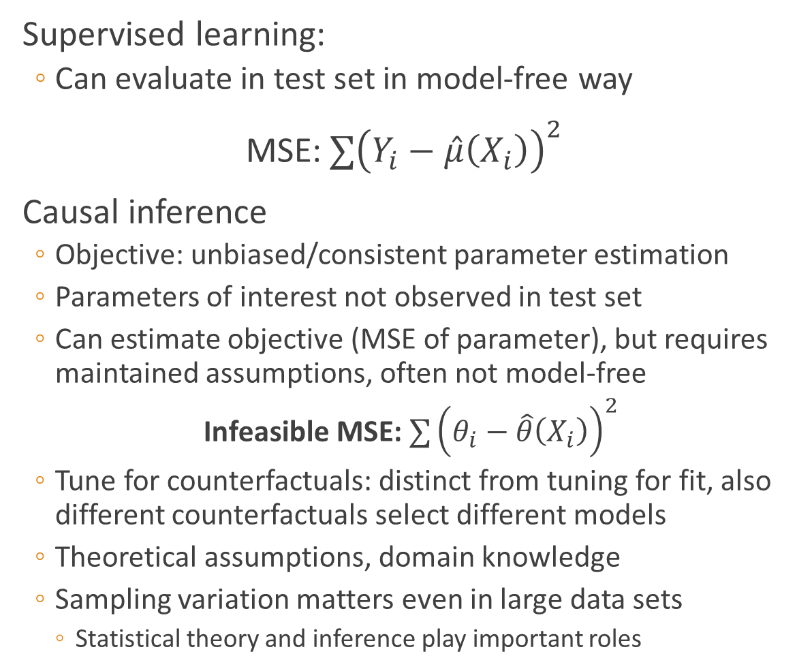
ML and Econometrics
Supervised learning:
Can evaluate in test set in model-free way
MSE:$∑{\left(Y_{i}−\hat{μ}\left(X_{i}\right)\right)}^{2}$
Causal inference
Objective: unbiased/consistent parameter estimation
Parameters of interest not observed in test set
Can estimate objective (MSE of parameter), but requires maintained assumptions, often not model-free
Infeasible MSE: $∑{\left(θ_{i}−\hat{θ}\left(X_{i}\right)\right)}^{2}$
Tune for counterfactuals: distinct from tuning for fit, also different counterfactuals select different models
Theoretical assumptions, domain knowledge
Sampling variation matters even in large data sets
Statistical theory and inference play important roles
Causal inference vs. Supervised ML

Slide 13
ML and Econometrics
Consider identification, then estimation
Could you solve problem with infinite data?
Design-based approach determines objective function
What parts of problem need flexible functional form?
Semi-parametric efficiency theory brings insights not commonly exploited in traditional ML
ML methods replace kernels/sieves in semi-parametric estimation
Orthogonal moments/double robustness
Important since hard to estimate flexible functions well
Regularization induces omitted variable bias
Optimizing for goodness of fit (MSE) prioritizes predictive covariates
Choose objective fn carefully, e.g. prioritize control for confounders
Omitted variables challenge causal inference, interpretability, fairness
Sample splitting, cross-fitting restore statistical guarantees
Different data for model selection and model estimation
Cross-fitting/out of bag estimation of nuisance parameters
Exploit structure of problem carefully for better counterfactual predictions
Black-box algorithms reserved for nuisance parameters, parameter heterogeneity
Insights from statistics/
econometrics
Recent work delivers methods that outperform traditional causal inference approaches

Slide 14
Causal Inference Approaches
Goal: estimate the causal impact of interventions or treatment assignment policies
Low dimensional intervention
Desire confidence intervals
Estimands
Average effect
Heterogeneous effects
Optimal policy
Designs that enable identification and estimation of these effects
Randomized experiments
Unconfoundedness
“Natural” experiments (IV)
Regression discontinuity
Difference-in-difference
Longitudinal data
Randomized and natural experiments in social network/settings w/ interference
“Program evaluation”, “Treatment effect estimation”
For each
Estimand X Design
New ML-based method, theory, confidence intervals
Notes:
Minute 18

Slide 15
Selected References: Treatment Effect Estimation and Machine Learning
Average Treatment Effect
Propensity score: McCaffrey et al. [2004]
Doubly robust: van der Laan and Rubin [2006], Athey, Imbens and Wager [2018], Belloni et al. [2013], Chernozhukov et al. [2016, 2017, 2018]
Instrumental Variables for ATE/LATE
Chernozhukov et al [2016]
Goldman and Rao [2017], Peysakhovich & Eckles [2018]: experiments as instruments
Heterogeneous Treatment Effects
Imai and Ratkovic, 2013: LASSO
Zeiles et al [2008], Athey and Imbens [2016]: Subgroups
Wager and Athey [2018], Athey, Tibshirani, and Wager [2018]: Causal forests and generalized random forests for instrumental variables and GMM/ML models
Friedberg et al. [2018]: Local linear forests
Kunzel et al [2017]: Meta-learners
Hartford et al [2017]: Deep IV
Chernozhukov et al [2018]: Testing top CATEs
Optimal Policy Estimation
Dudik et al [2011], Li et al [2012], Dudik et al [2014], Li et al [2014], Thomas and Brunskill [2016], Kallus [2017]
Kitagawa and Tetenov [2016], Swaminathan and Joachim [2015], Zhao et al [2014]-IPW
Athey and Wager [2017] (doubly robust, includes IV case), Zhou, Athey, and Wager [2018], CAIPW (doubly robust)
Contextual Bandits
Li et al [2010], Chapelle and Li [2011], Li et al [2017], Bastani and Bayati [2015]
See Agarwal et al [2016] for a survey; John Langford tutorials and articles
Bakshy et al-Bayesian optimization perspective
Dimakopoulou, Zhou, Athey and Imbens [2018]
Causal Panel Data Models
Athey et al [2018]: Matrix Completion methods
Survey: Athey, “The Impact of Machine Learning on Economics,” NBER, 2018

Slide 16
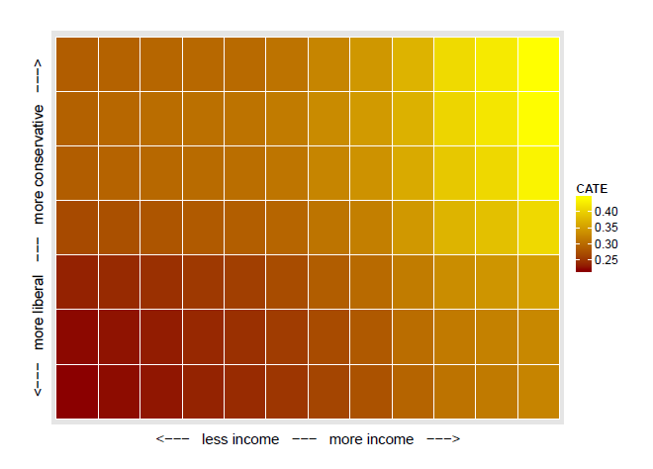
General Social Survey Experiment
Are you in favor of
“Assistance to the poor” vs. “Welfare”
Data-driven search for heterogeneity; confidence intervals
Methods: Causal forest (Wager and Athey (JASA 2018), Athey, Tibshirani, and Wager (AOS forthcoming))

Slide 17
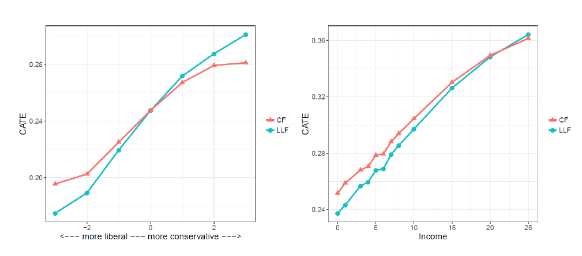
Causal forest v. Local linear forest (Friedberg, Athey, Tibshirani and Wager (2018))
Improve ML methods bringing in ideas from stats/econ (bias correction at boundaries) and allow modeling mixed structure (linear effects and more complex interactions)

Slide 18
Machine Learning Examples
Using “causal forests” (Wager and Athey, 2018; Athey, Tibshirani and Wager, 2018) to estimate heterogeneous treatment effects from training program
Athey, Campbell, Chyn, Hastings and White (in progress) using data from RIPL

Slide 19
Machine Learning Examples
Using “causal forests” (Wager and Athey, 2018; Athey, Tibshirani and Wager, 2018) to estimate heterogeneous treatment effects from training program
Athey, Campbell, Chyn, Hastings and White (in progress) using data from RIPL

Slide 20
Causal Inference Approaches “Structural estimation”, “Generative Models” & Counterfactuals
Goal: estimate impact on welfare/profits of participants in alternative counterfactual regimes
Counterfactual regimes may not have ever been observed in relevant contexts
Need behavioral model of participants
Still need designs that enable identification and estimation, now of preference parameters
E.g. need to see changes in prices to learn price sensitivity
Use “revealed preference” to uncover preference parameters
Rely on behavioral model to estimate behavior in different circumstances
Also may need to specify equilibrium selection
Use ML methods in combination with structural models, e.g. for semi-parametric versions of structural estimators
Notes:
Minute 25

Slide 21
ML and Structural Models: Shopping Application
Scanner data from supermarket
Product hierarchy (category, class, subclass, UPC)
Prices change Tuesday evening
Study 123 high-frequency categories with 1263 UPCs
Multiple UPCs per category
Typically purchase only one UPC per trip in categroy
Independent price changes
Not too much seasonality
333,000 shopping trips for ~2000 consumers over 20 months
Economic Goals:
Optimal pricing
Benefits of personalization versus simpler segmentation
Methodological Goals:
Contrast off-the-shelf ML, off-the-shelf econometrics with combined models
Tune and test models for counterfactual performance
Joint work with Rob Donnelly, David Blei, Fran Ruiz
Combine structural model with matrix factorization techniques and computational methods from ML

Slide 22


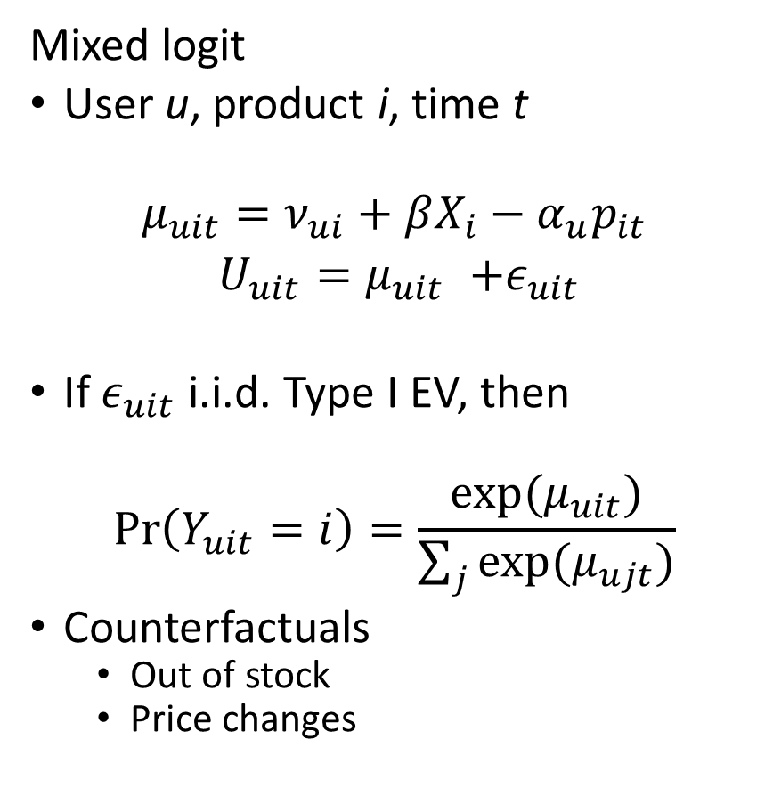



Structural Model Matrix Factorization
Mixed logit
User u, product i, time t
$$μ_{uit}=ν_{ui}+βX_{i}−α_{u}p_{it}$$
$U_{uit}{=μ}_{uit} +ε_{uit}$
If $ε_{uit}$ i.i.d. Type I EV, then
$$\operatorname{Pr}\left(Y_{uit}=i\right)=\frac{exp⁡(μ_{uit})}{\sum_{j}{exp⁡(μ_{ujt})}}$$
Counterfactuals
Out of stock
Price changes
Items
Users
$$U×I$$
$$≈$$
$$×$$
$$K×I$$
$$U×K$$

Slide 23
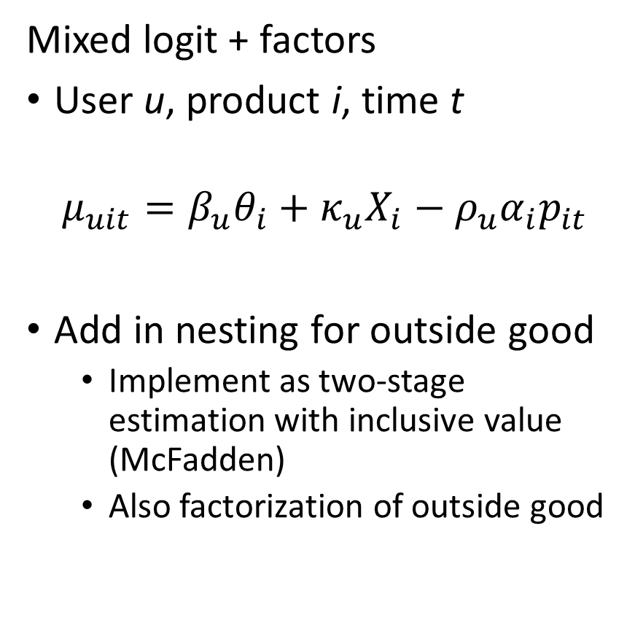
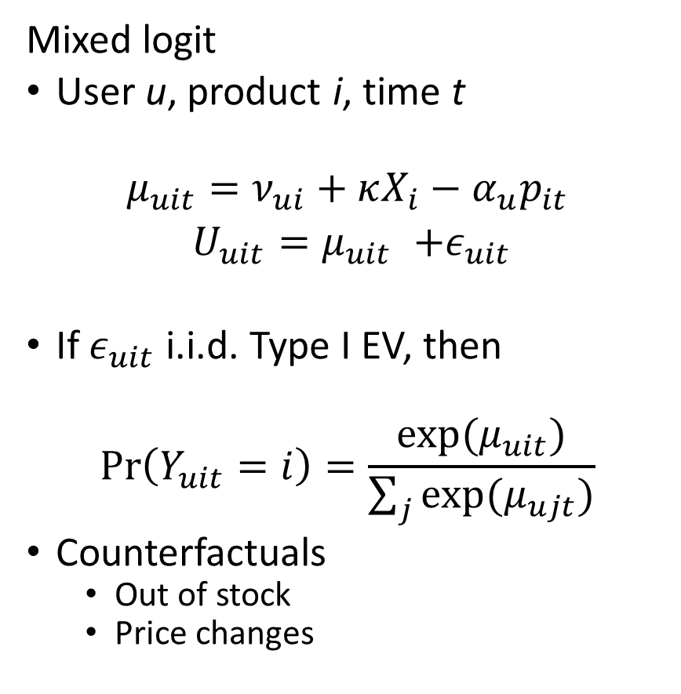
Structural Model + Factorization
Mixed logit
User u, product i, time t
$$μ_{uit}=ν_{ui}+κX_{i}−α_{u}p_{it}$$
$U_{uit}{=μ}_{uit} +ε_{uit}$
If $ε_{uit}$ i.i.d. Type I EV, then
$$\operatorname{Pr}\left(Y_{uit}=i\right)=\frac{exp⁡(μ_{uit})}{\sum_{j}{exp⁡(μ_{ujt})}}$$
Counterfactuals
Out of stock
Price changes
Mixed logit + factors
User u, product i, time t
$$μ_{uit}=β_{u}θ_{i}+κ_{u}X_{i}−ρ_{u}α_{i}p_{it}$$
Add in nesting for outside good
Implement as two-stage estimation with inclusive value (McFadden)
Also factorization of outside good

Slide 24
Computational Approach
MCMC based Bayesian approaches
Difficult scaling
Variational Bayes
Choose parameterized family of distributions to approximate posterior
Find parameters that minimize KL-divergence to true posterior
Challenges for our problem
Nonlinear form of choice probabilities
Time-varying prices and availability
Tricks
Approximations and bounds
Stochastic gradient descent (SGD)
Predict: lots of applications of SGD!!

Slide 25
Model Comparisons
Nested Factorization
All categories estimated in single model
Items substitutes within category, independent across
Tuned on held-out validation set
Hierarchical Poisson Factorization (HPF)
All items in single model, each item independent of others
A form of matrix factorization allowing for covariates
Ignores prices
Scales easily
Category by category logits
Mixed logit (random coefficients)
Nested Logit
With various controls (demographic, etc.)
Logits with HPF Factors
Include user-item prediction from HPF model

Slide 26
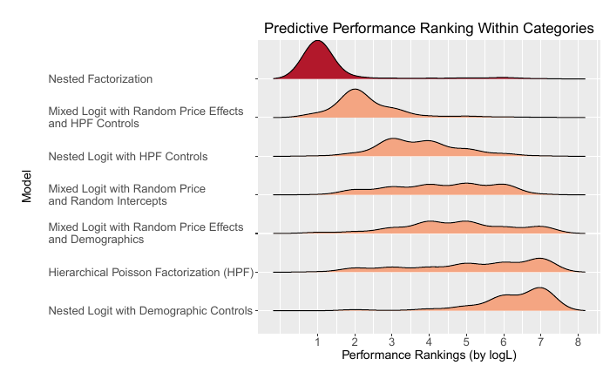
Goodness of Fit (Tuned for CF) Weeks where another product in category changed prices

Slide 27
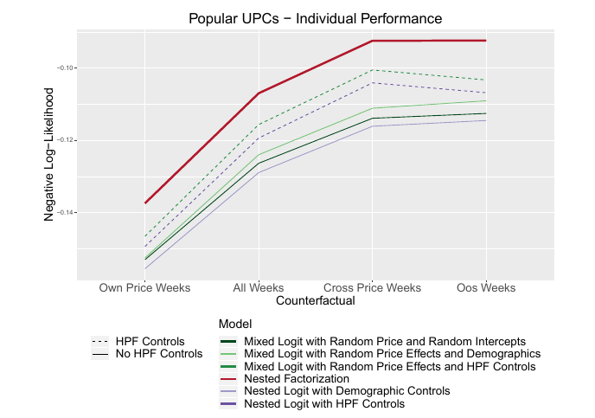
Performance by Scenario (Counterfactual)
Traditional logits improve with HPF
(ML-based user-item predictions)
Evaluate log-likelihood only in weeks where an item falls into specified scenarios:
Price changed for the item this week
Price changed for another item in the same category this week
Another item in the same category is out of stock at least one day this week

Slide 28
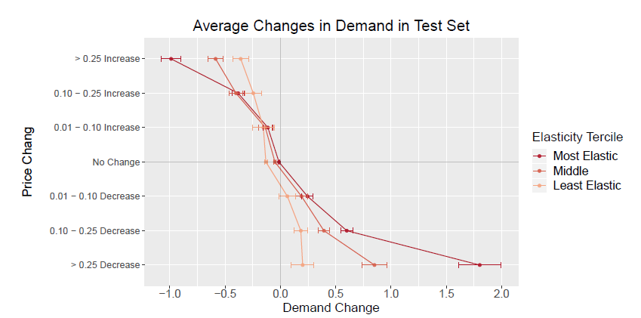
Validation of Structural Parameter Estimates
Compare Tues-Wed change in price to Tues-Wed change in demand, in test set
Break out results by how price-sensitive (elastic) we have estimated consumers to be

Slide 29
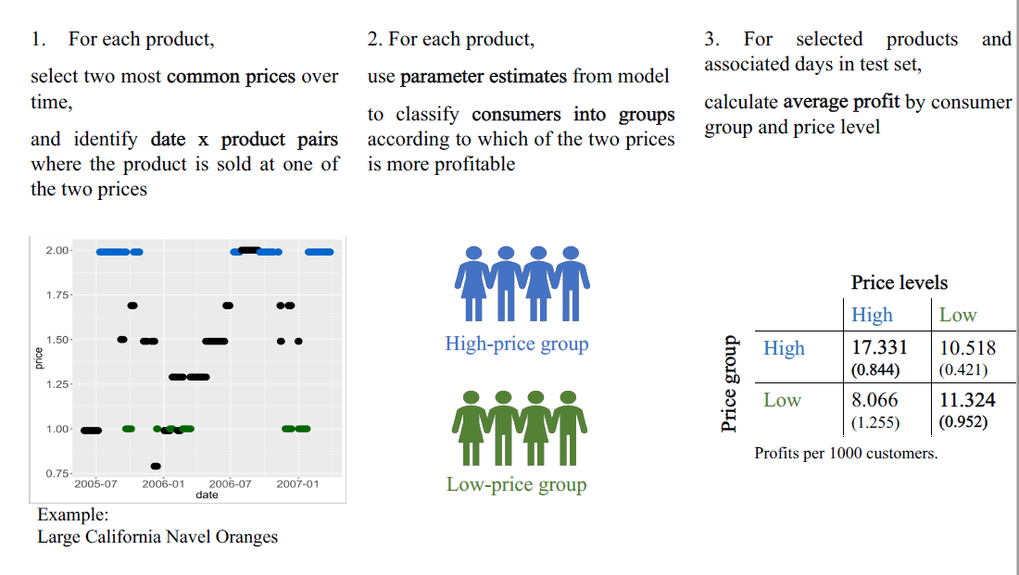

Slide 30
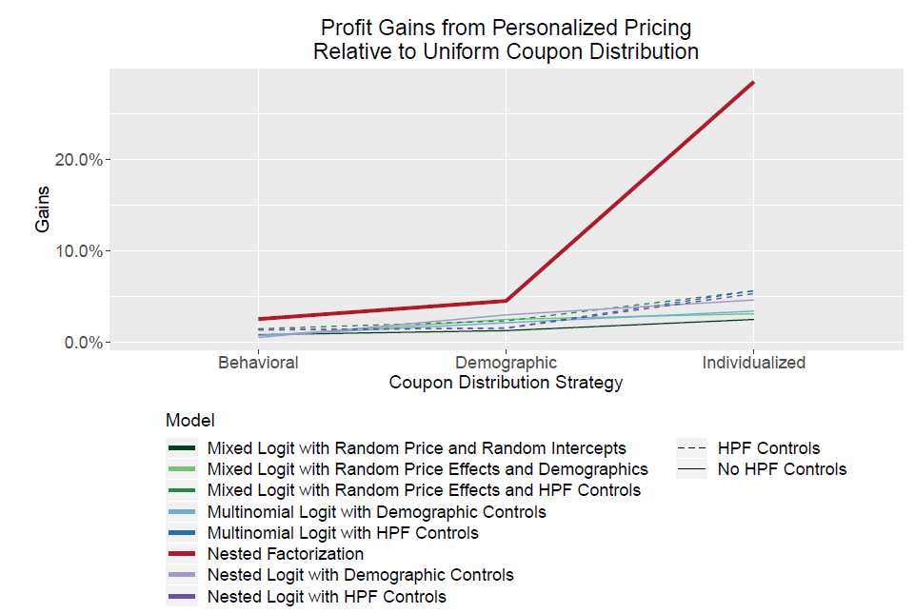
ML Approach Improves Ability to Profit from Customer Targeting
How much profit can be made by giving a 30% off coupon for a single product to a targeted selection of 30% of the shoppers in the store?
Compare:
Random allocation, demographic targeting, or individual targeting

Slide 31
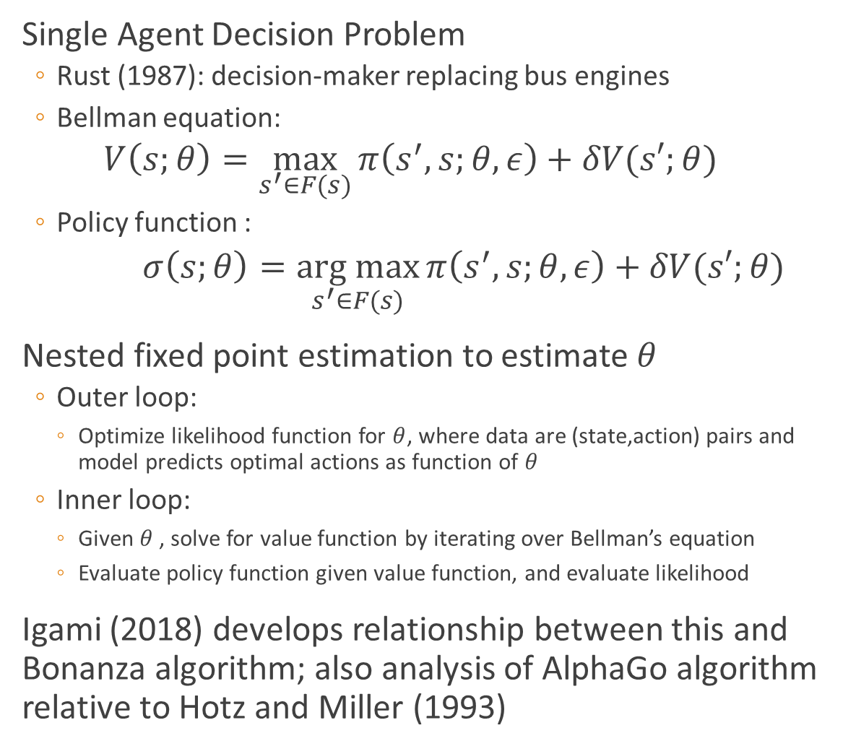
Causal Inference Approaches Dynamic Structural Estimation
Single Agent Decision Problem
Rust (1987): decision-maker replacing bus engines
Bellman equation:
$$V\left(s;θ\right)=\max_{s^{′}∈F(s)}{π\left(s^{′},s;θ,ε\right)+δV(s′;θ)}$$
Policy function :
$σ\left(s;θ\right)=\underset{s^{′}∈F(s)}{arg max}{π\left(s^{′},s;θ,ε\right)+δV(s′;θ)}$
Nested fixed point estimation to estimate $θ$
Outer loop:
Optimize likelihood function for $θ$, where data are (state,action) pairs and model predicts optimal actions as function of $θ$
Inner loop:
Given $θ$, solve for value function by iterating over Bellman’s equation
Evaluate policy function given value function, and evaluate likelihood
Igami (2018) develops relationship between this and Bonanza algorithm; also analysis of AlphaGo algorithm relative to Hotz and Miller (1993)
Use ML methods to approximate value function and policy function
Notes:
Minute 33

Slide 32
Will “board game AI” be useful for economics? Can applied econometrics contribute to this type of AI?
Applications to human or firm behavior are challenging
Conceptual framework clear from 80s and 90s
Computational advances helpful, but those were not biggest problems
Biggest impediments
Not enough training data
Identification problems
Insufficient observable exogenous variation
Unobserved heterogeneity
Not enough knowledge about game payoffs to create artificial training data
In data-poor environments…
Use as much structure as is known, carefully examine functional forms for how they extrapolate
Consider biases that might arise
See Igami (2018) for some more discussion

Slide 33
What recent advances in AI can directly help solve economic, business and social problems?
Active learning can be very useful in environments where analyst can intervene
Incremental improvement is key to tech firm success
Digital interaction with ability to use dynamic experimentation
RCT’s 3.0: iteratively optimize across many alternatives, with targeting and customization
Examples/Applications
Nudges for financial health (Ideas42)
Targeted application of training programs (e.g. RIPL)
Digital tutors/training (e.g. 17Zuoye)
Decision-making applications
Information for first-generation college students (Ideas42)
Contraception selection in developing countries (World Bank)
Charitable giving
Contextual bandits to learn best prompt and charity (IPA/Gates/PayPal)
Advice/nudge app for newly released prisoners (Ideas42)
Worker relocation, job search (Facebook)
Stanford Initiatives:
Shared Prosperity and Innovation
Human-Centered Artificial Intelligence
Notes:
Minute 35

Slide 34
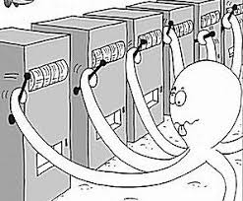
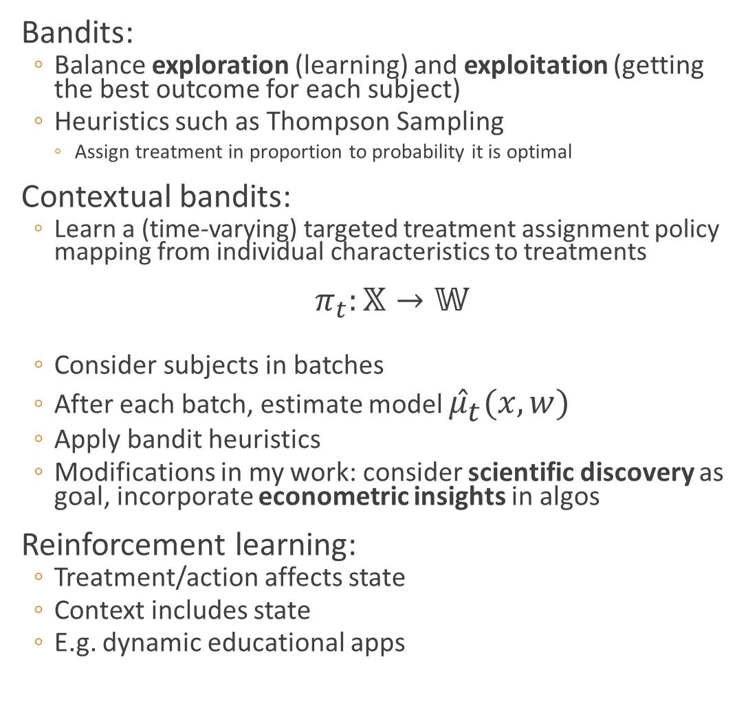
Active Learning
Bandits:
Balance exploration (learning) and exploitation (getting the best outcome for each subject)
Heuristics such as Thompson Sampling
Assign treatment in proportion to probability it is optimal
Contextual bandits:
Learn a (time-varying) targeted treatment assignment policy mapping from individual characteristics to treatments
$π_{t}:𝕏→𝕎$
Consider subjects in batches
After each batch, estimate model ${\hat{μ}}_{t}(x,w)$
Apply bandit heuristics
Modifications in my work: consider scientific discovery as goal, incorporate econometric insights in algos
Reinforcement learning:
Treatment/action affects state
Context includes state
E.g. dynamic educational apps
System interacts with its environment, taking actions or assigning treatments

Slide 35
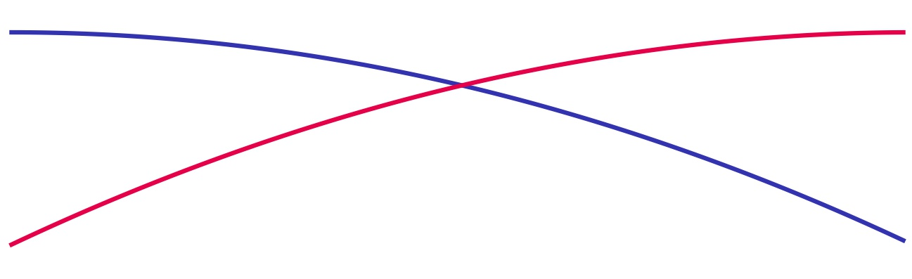
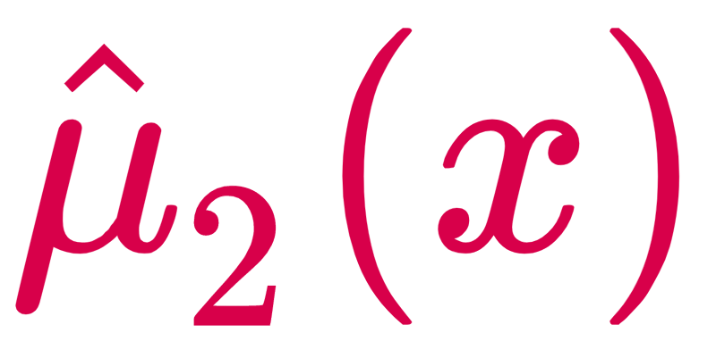
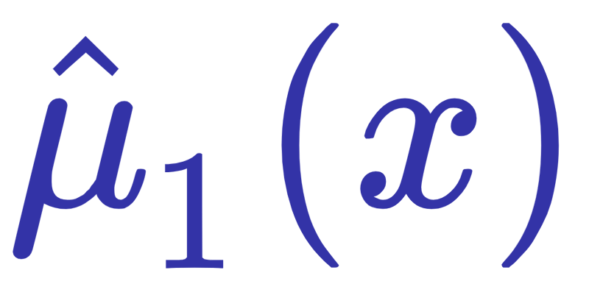
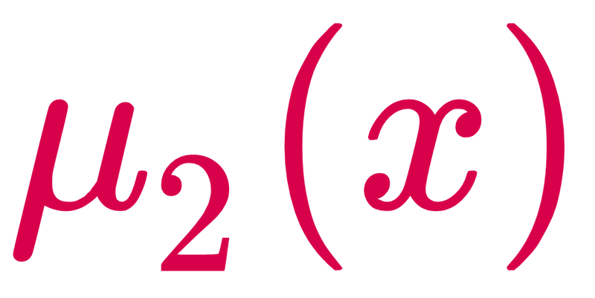
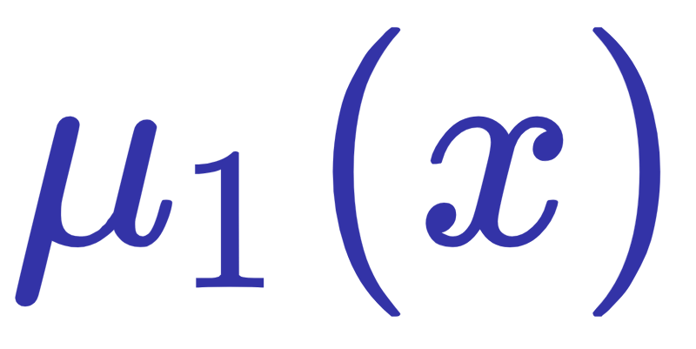
Estimation is challenging: Contextual Bandit example
Inherent bias in estimation due to adaptive assignment of contexts to arms.
context more likely assigned to high-performing arm
creates systematically unbalanced data
Algorithmic selection (on observables) similar to selection biases from agent optimization
See Diamakopoulou, Zhou, Athey and Imbens (2019, AAAI) who provide regret bounds for doubly robust approaches

Slide 36
Economists as Engineers: A New Chapter
AI and econometric theory needs work but not the main constraint
Instead, success will depend on:
Understanding broader context
Social science to identify opportunities to intervene
Defining measures of success that are measurable in the short term and related to long term outcomes
Non-manipulable
Don’t let the AI “teach to the test”
Reaching target audience
Finding partners with access to individual time and attention
Distributing digital services
Making engaging and effective content (treatments)
Social scientists key contributors to multi-disc. teams
Evaluation is embedded in system and not separable from system design
Services, education, training, advice delivered digitally by firms, governments, and philanthropy

Slide 37
Conclusions
Causal inference is key to using machine learning and artificial intelligence to make decisions
This is a tautological statement: but not fully appreciated
Black box algorithms come with risks and challenges
AI/ML in causal framework has desirable properties (stability, fairness, robustness, transfer, ….)
Enormous literature on theory and applications of causal inference in variety of design settings
Conceptual framework for both static and dynamic settings
Structural models enable counterfactuals for never-seen worlds
ML can greatly improve practical performance, scalability
With careful modifications, attention to objective functions, cross-fitting/sample splitting
Challenges: data sufficiency, finding sufficient/useful variation in historical data
Recent advances in computational methods in ML don’t help with this
But tech firms conducting lots of experiments, running bandits, and interacting with humans at large scale can greatly expand ability to learn about causal effects and solve societal problems

Slide 38
References

Slide 39
Selected Overview Articles: Econometrics and ML
Survey
S. Athey, “The Impact of Machine Learning on Economics.”
Prediction v. Estimation
Mullainathan, Sendhil, and Jann Spiess. "Machine learning: an applied econometric approach." Journal of Economic Perspectives 31.2 (2017): 87-106.
Prediction policy
Kleinberg, Jon, Jens Ludwig, Sendhil Mullainathan, and Ziad Obermeyer. “Prediction policy problems.” The American Economic Review 105, no. 5 (2015): 491-495.
Prediction v. Causal Inference
S. Athey. Beyond prediction: Using big data for policy problems. Science, 355 (6324):483-485, 2017.
A. Belloni, V. Chernozhukov, C. Hansen: “High-Dimensional Methods and Inference on Structural and Treatment Effects,” Journal of Economic Perspectives, 28 (2), Spring 2014, 29-50. https://www.aeaweb.org/articles?id=10.1257/jep.28.2.29

