Slide 1
Investigation of high-performance packet capture using commodity hardware.
By Simon Curtis
ENGG4802 Semester 2 2019

Slide 2
Contents of seminar
Overview of Topic & what is the problem
Background information
Kernel bypass libraries
Similar solutions / Other work
Progress / Results so far
Setup
Example code / output
Whats next
Questions

Slide 3
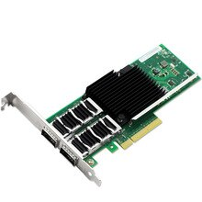
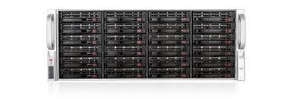
Overview of Topic
Network speeds of 10-40Gbps in businesses and data centres.
Commodity hardware and software unable to keep up with network speeds.
Performance critical applications are now requiring special hardware to operate at these speeds, which can be expensive.
Default Linux network stack often does not provide the required performance.
40 Gbps Network Interface Card
EndaceProbe 9200 Series

Slide 4
Project Idea
Several software libraries exists to provide “kernel bypass” so packets can be read directly from the NIC by a user application. For example:
  DPDK
  Netmap
  PF_RING_ZC
This project will create a Netflow table from incoming data using the different frameworks.
The goal is to manage 10Gbps rate.
Data visualisation feature for a use case.
Investigate and compare the performance and suitability of these three frameworks.

Slide 5
Background Topics

Slide 6
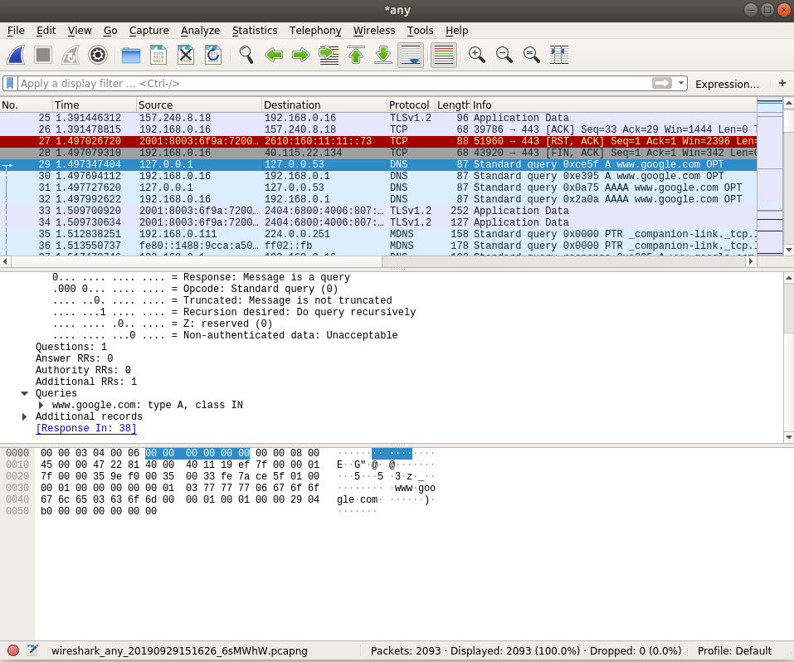
What is Packet Capture?
Packet capture is the process of collecting the raw packets straight off a network interface. Usually for inspection and analysis or forwarding.
Wireshark packet capture

Slide 7
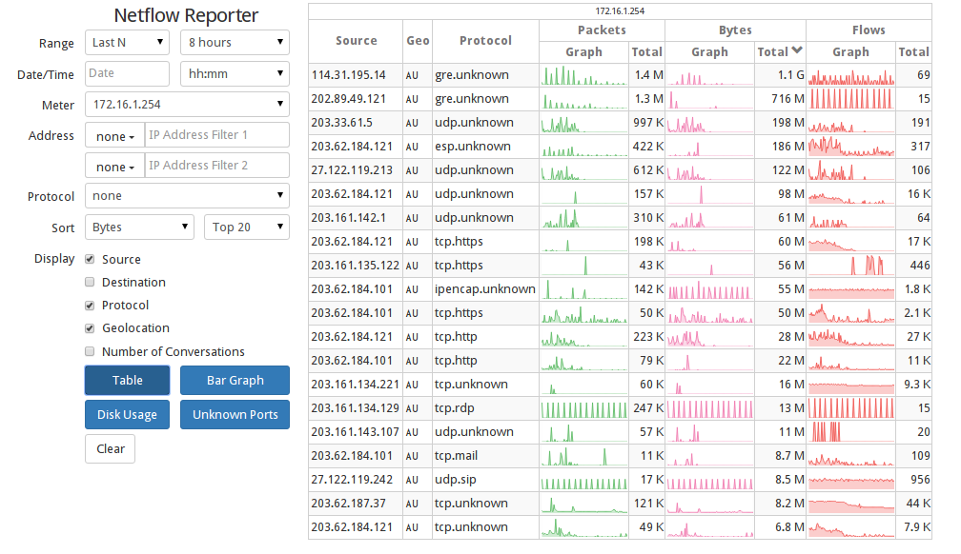
What is NetFlow?
NetFlow is a service provided to network administrators to view traffic information or “flows” that occur on the network.
Analysing NetFlow can help identify network performance issues, as well as identify any suspicious or unusual network activity.
Akips NetFlow reporter

Slide 8
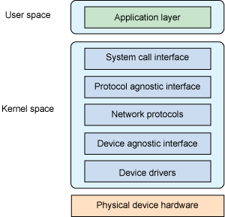
Linux Networking Stack
Kernel Network Layers:
System call Interface
Protocol Agnostic Interface
Network Protocol layer
Device Agnostic Interface
Device Drivers
Services Provided.
Checksum handling
Routing
Transport, network & link-layer protocols
Interfacing to hardware
Networking APIs such as sockets
However, the kernel network stack is not well suited to high performance operations.
Linux kernel network stack

Slide 9
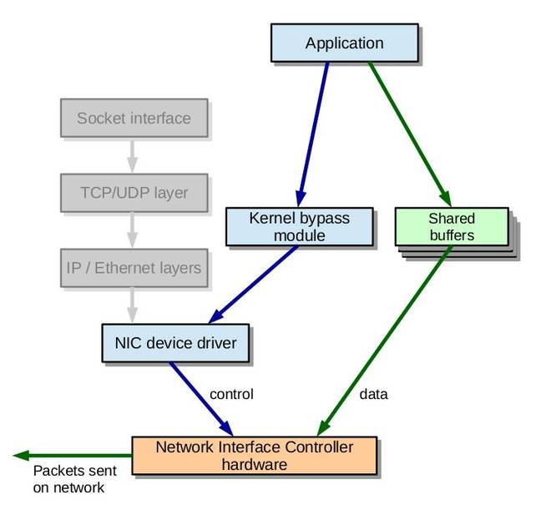
Kernel Bypass
Kernel Bypass is the process of circumventing the kernel networking stack.
Techniques include:
Polling for packets instead of interrupts
Preallocating packet buffers
Direct Memory Access
Batch processing
RSS (Receive Side Scaling) or multi-queue support.
GPUs for packet processing
Kernel bypass technique

Slide 10
Kernel Bypass Frameworks

Slide 11

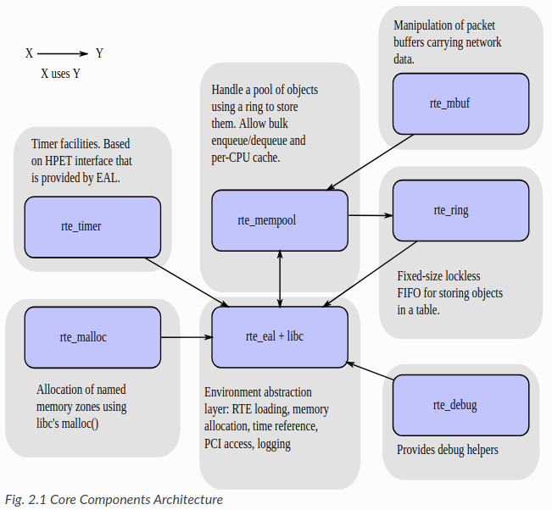
A collection of libraries to accelerate packet processing.
Open-source software platform, developed by Intel.
DPDK supports most CPU architectures and NICS.
It works using a ring buffer. Incoming packets are placed onto the buffer, and the application checks regularly for new packets.
DPDK also has many features and libraries
DPDK is a highly configurable framework.
DPDK Core component architecture

Slide 12

PF_RING_ZC
Kernel module built by Ntop.
Offers performance into the 10Gb/s.
It is a mostly free software although some features are paid for.
The zero-copy API is application and developer focussed, rather than hardware focussed.
Its network driver has a feature where you can switch between kernel bypass mode, and then back to the network stack when required.

Slide 13
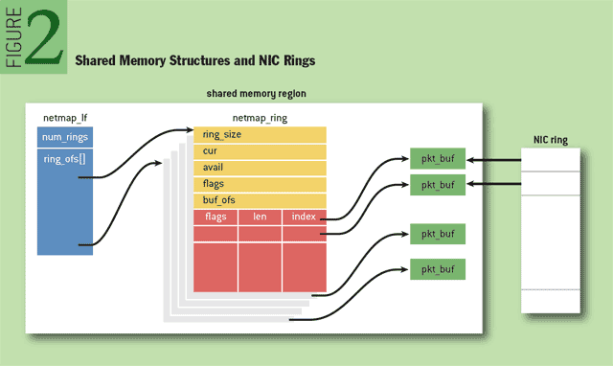
NetMap
Netmap, is a system to give user space applications very fast access to network packets.
Unlike the previous frameworks, netmap still uses a partial operating system network stack for low-level operations.
Efficiency is still provided by features such as:
  Lightweight metadata representation
  Linear preallocated packet buffers
  Direct, protected access to packet buffers by applications
  Supporting common hardware features
  Multiplexing hardware queues
Netmap attempts to make its API simple, and abstracts away hardware and specific details.
Netmap data structures

Slide 14
Other solutions
S. Gallenmüller, P. Emmerich, F. Wohlfart, D. Raumer and G. Carle, "Comparison of Frameworks for High-Performance Packet IO", Technische Universität München, München, 2019
Compares the three frameworks on their ability to forward packets. This paper also gives insight into the various techniques that fast packet capture frameworks employ to achieve performance.
Sand, "Comparing Ring-buffer–based Packet capture solutions", 2019
Compares lost packets at speed between NETMAP, PF_RING_ZC and vanilla Linux. The report also compares NETMAP on BSD vs Linux. T
H. Wang, D. He and H. Wang, "Comparison of High-Performance Packet Processing Frameworks on NUMA", Beijing Laboratory of Advanced Information Network, Beijing, 2019
Compares the multi-queue abilities of PF_RING_ZC and DPDK using the NUMA interface.
T. Barbette, C. Soldani and L. Mathy, "Fast Userspace Packet Processing", University of Liege, Belgium, 2019
Uses NETMAP and DPDK to produce a faster version of click (a software IP router).

Slide 15
Progress & Results so far
Acquired and setup test machines, hardware, ethernet connections, required software.
Started work with DPDK framework and can successfully read and decode packets in real time using multiple cores.
Started work with Netmap and can successfully read and decode packets.
Setup packet generation tool to generate 10Gbps network traffic
Created flow hashtable to decode and store flow records from incoming traffic, able to display flow statistic.
Started documentation & report write up

Slide 16
Materials
Intel X540-T1 x2
PC x2
Switch x1
Cat 5e/6 cable x3
Monitor(s) 1-2
Keyboard & Mouse 1-2
Power cables x2
Monitor cables x2

Slide 17
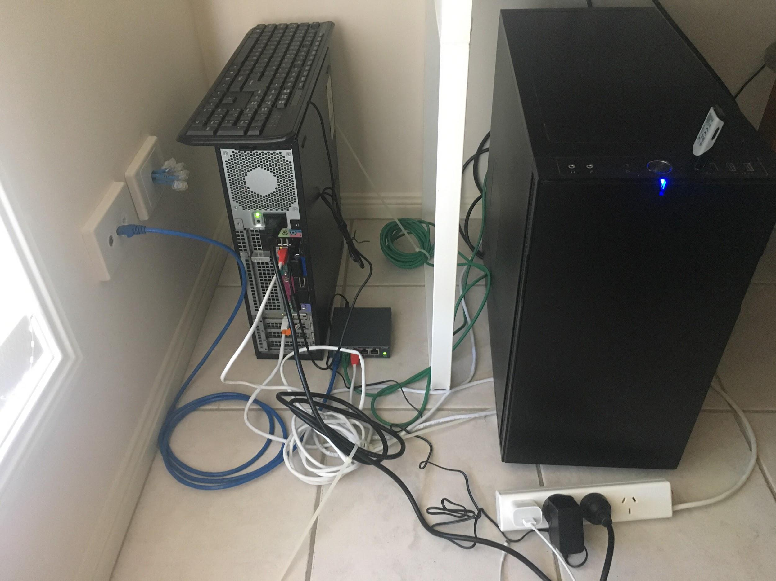
Setup
Test Setup

Slide 18
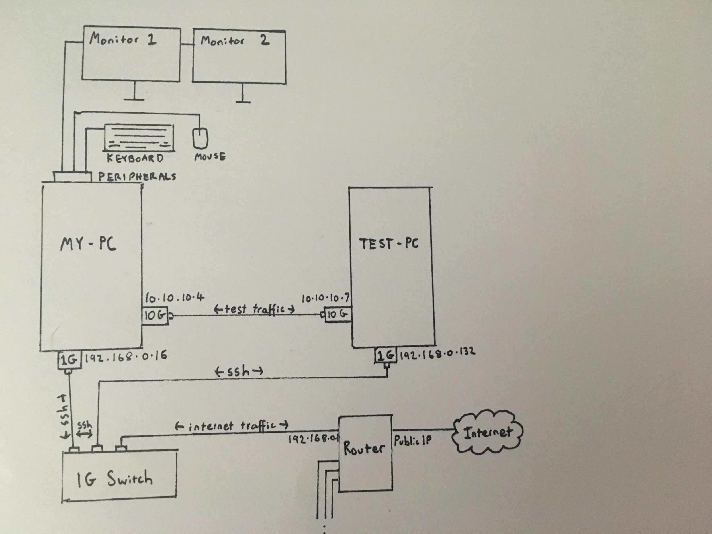
Setup

Slide 19
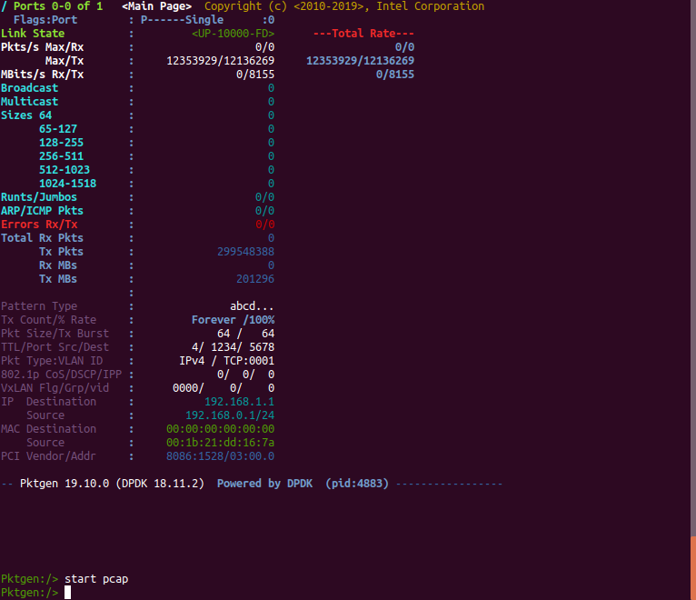
Traffic Generation
Turns out that generating 10Gb/s traffic is actually quite a difficult problem
In reality, this traffic would be generated from multiple sources all using the same switch
Switch would port mirror traffic to our server running the netflow packet capture application
Most packet generation tools were either not able to generate at 10 Gbps or expensive.
Eventually went for dpdk-pktgen, which was written using the dpdk libraries.
  Able to generate 10Gbps
  Allows for single packets to be generated
  Can read from a pcap file

Slide 20
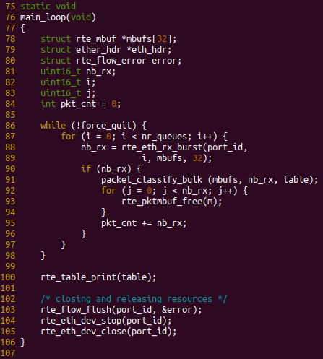
Main Program loop

Slide 21
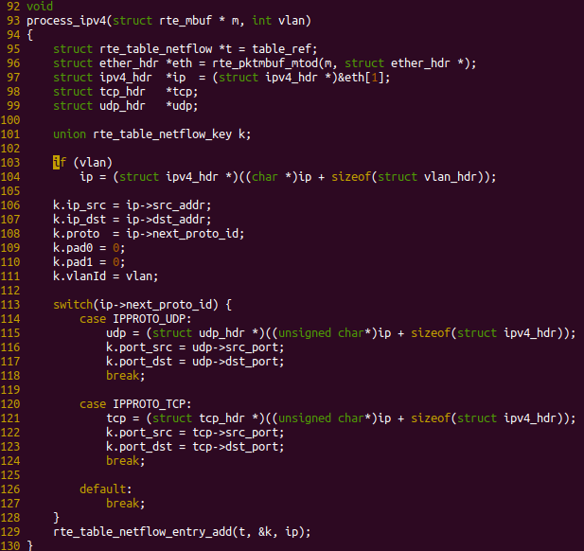
Reading packet info

Slide 22
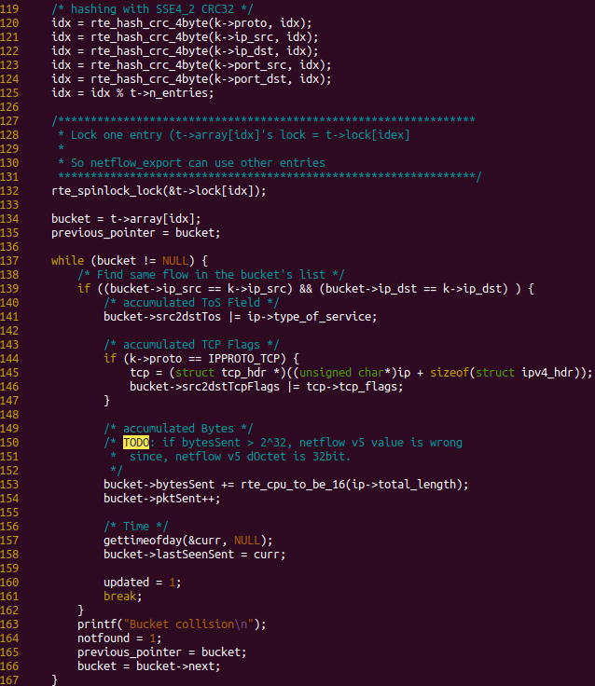
Inserting Into Hash Table

Slide 23
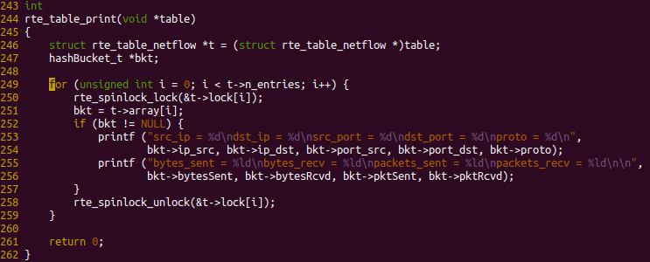
Printing Table

Slide 24
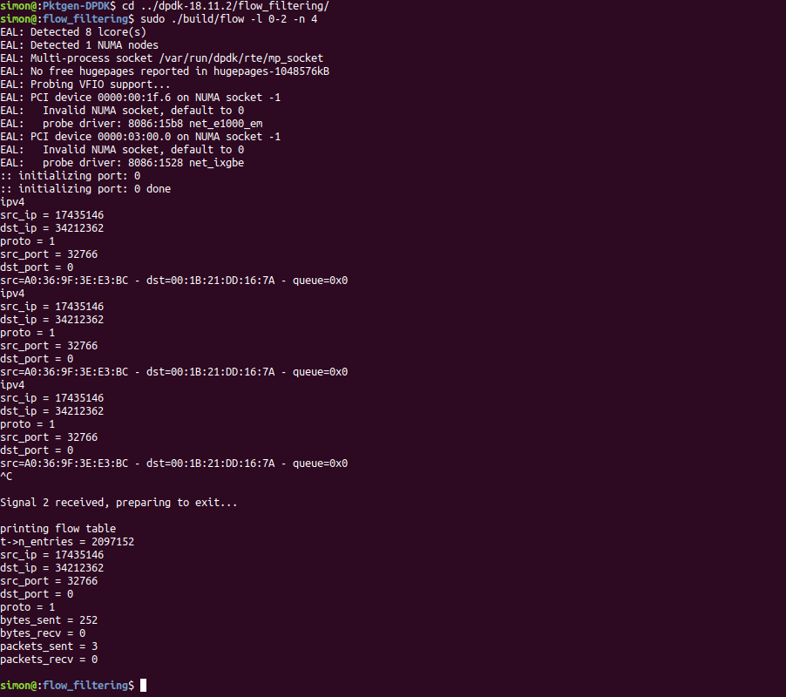

Sample Output

Slide 25
Problems
Supported Hardware
  Had to find Network Card that was supported by all three frameworks.
  Cost limitations
  Supported architecture and cpu instructions
Compilation Issues
  Third party dependencies
  Required BIOS and OS settings
    High precision timers
    Huge page tables
    NIC drivers
Packet Generation
  Not many packet gen tools support 10Gbps
  Cost
  Supported hardware issues

Slide 26
What’s Next?
Start work with 3rd Library (PF_RING_ZC) 1st November 2019
  Initial “hello world” implementation
  High performance
Identify bottlenecks & increase speed.
  Current hardware issues 1st November 2019
  Optimise hyperparameters. Mid March 2020
  RSS Mid March 2020
  What else can I do with the data. Mid March 2020
Comparison testing of the different frameworks April 2020
  Resource utilisation
  Packet loss
  With / without flow tables
  Compare against base rate of using the OS.
Netflow-visualisation Early May 2020
  Tool to see flows in real time
  Probably via http (brower)
  Records updated periodically (e.g. per second)
Poster & Demonstration 22nd May 2020
Final report write-up 8th June 2020

Slide 27
Questions

