Slide 1

Data Analysis Report for Fond Rouge
Speaker’s Name, SAP
Month 00, 2021

Slide 2
Agenda
Insights
Revenue vs Refund
Stacked Bar Chart
Donut chart
Geo-Map
Problems and Solutions
Conclusions

Slide 3
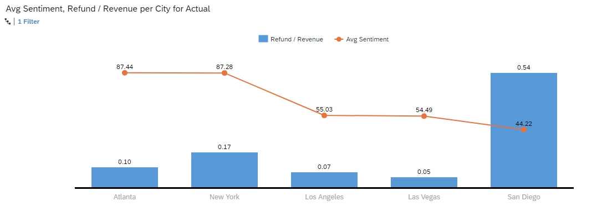
Insights

Slide 4
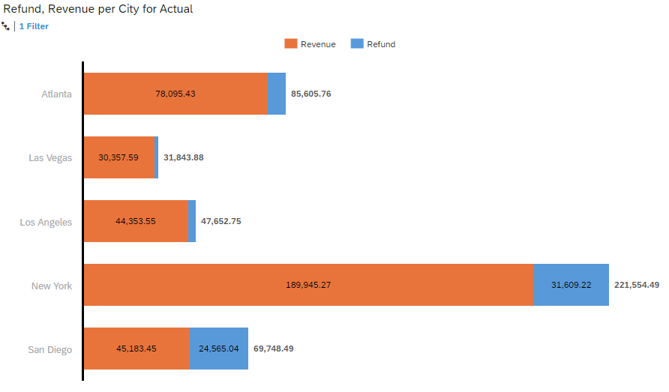
Insights

Slide 5
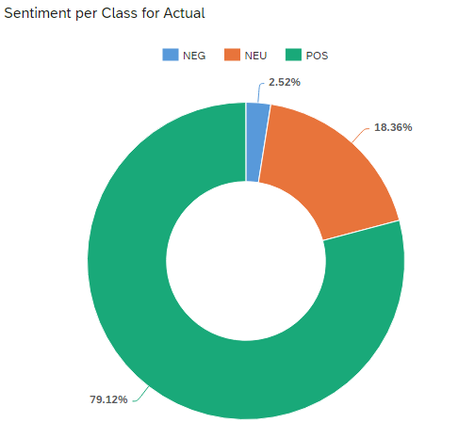
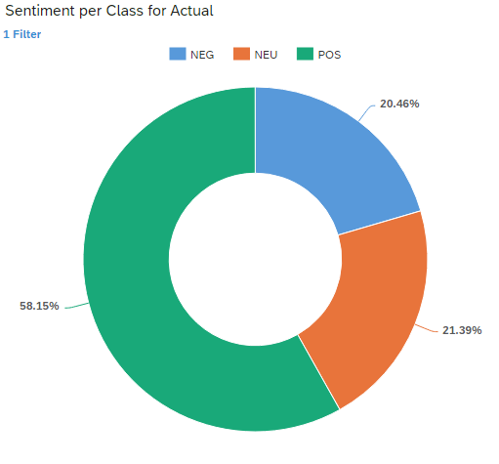
Insights

Slide 6
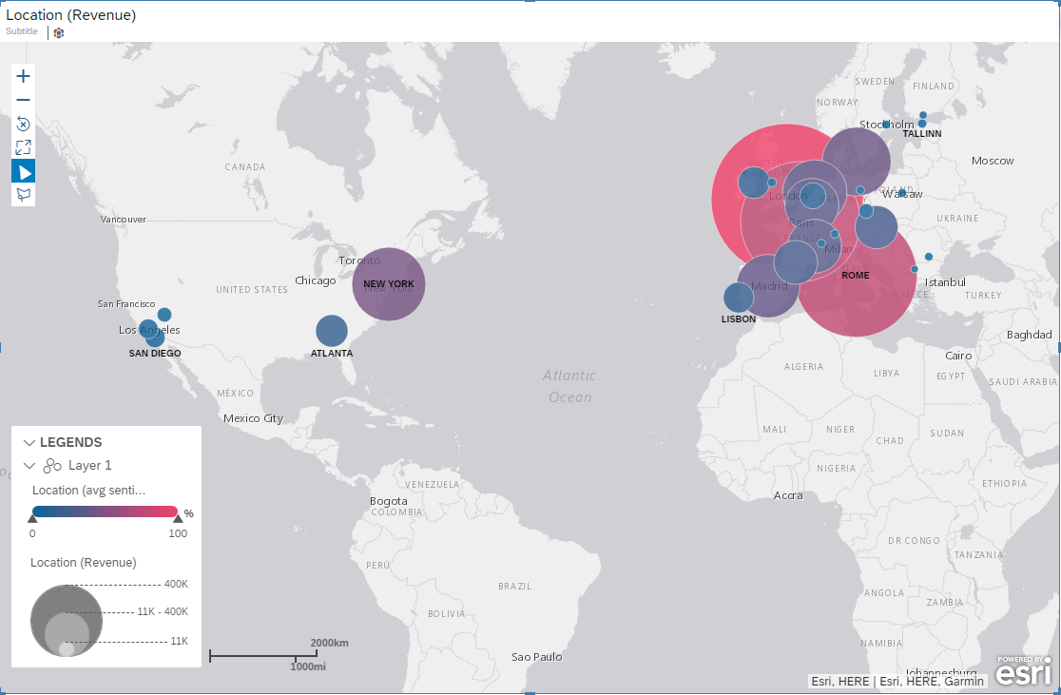
Insights

Slide 7
Problems and Solutions
San Diego loses more percentage of revenue due to returns of the products. Maybe the products being delivered are faulty, have to be pre checked before shipping.
Globally the sales are going on well with 79.12% positive sentiment and 18.36% neutral sentiment.
The problem in USA because the negative sentiment is around 20.4% which is bad.
Counterfeiting may be happening in Los Angeles and Las Vegas because these two cities are having less returns and less sentiment score is less than 65 on average.

Slide 8
Conclusions
London, Paris, Rome are the three major areas where sales are going on very good with good sentiment score.
Counterfeiting is happening in Los Angeles and Las Vegas, Need to be careful.
San Diego sales are to be checked because it has less average sentiment and also loses highest percentage of revenue due to returns.

Slide 9

Thank you.
Contact information:
F name L name
Title
Address
Phone number

