Slide 1

XCT data workshop 2026
September 23, 2026
Field Museum
S.M. Smith

Slide 2
what am I gonna learn?
By the end of this workshop, you will:
Understand the basic structure of FMNH XCT Lab data
Feel comfortable with navigating the 3D Slicer interface and be able to install, open, and update modules
Be able to import and visualize 3D data
Know the basics of segmentation and model generation
Understand how to expand your CT data skills moving forward, and become familiar with the many Slicer community resources

Slide 3
the schedule (subject to change)
September 23, 8:30am-11:45am
8:30-9:15am: Welcome, setup, introduction to the course and 3D data types
9:15-10am: Slicer basics: where are the important buttons? and how do I get my data in there?
10am-11am: Segmentation: intro and demonstration, discussion of tools
11-11:30am: Production of meshes
11:30-11:45am: Wrap up and discussion of additional resources
11:45am: End - break for lunch!

Slide 4
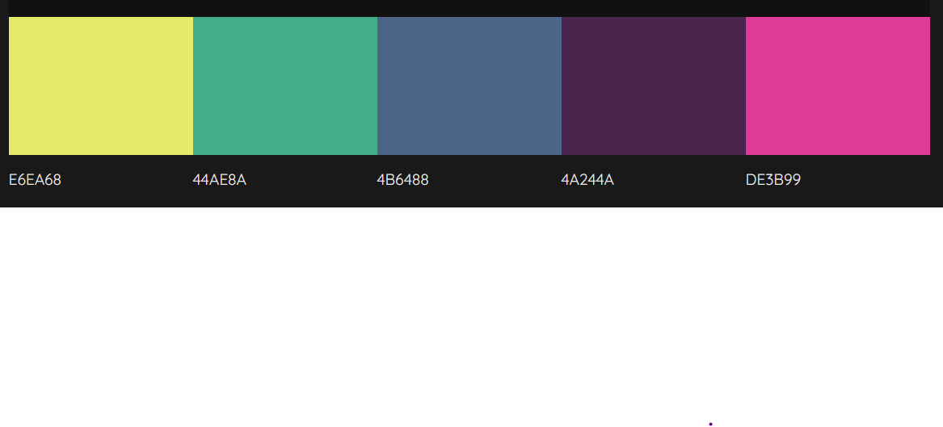
FMNH XCT lab data: an overview
volume data:
CT and µCT image stacks

Slide 5
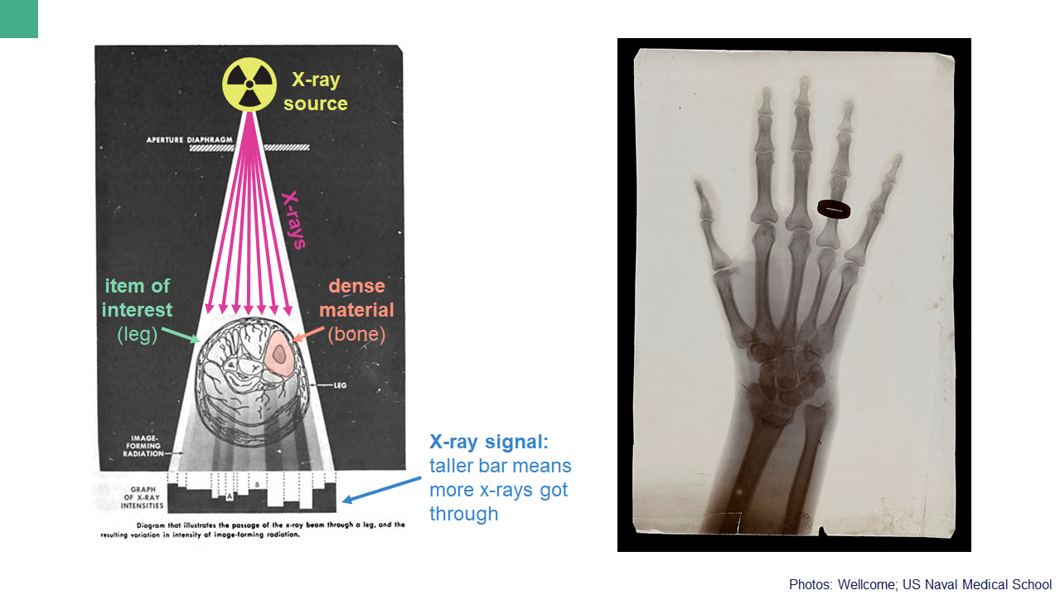

Slide 6
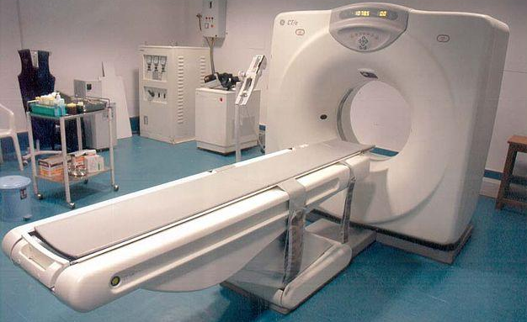
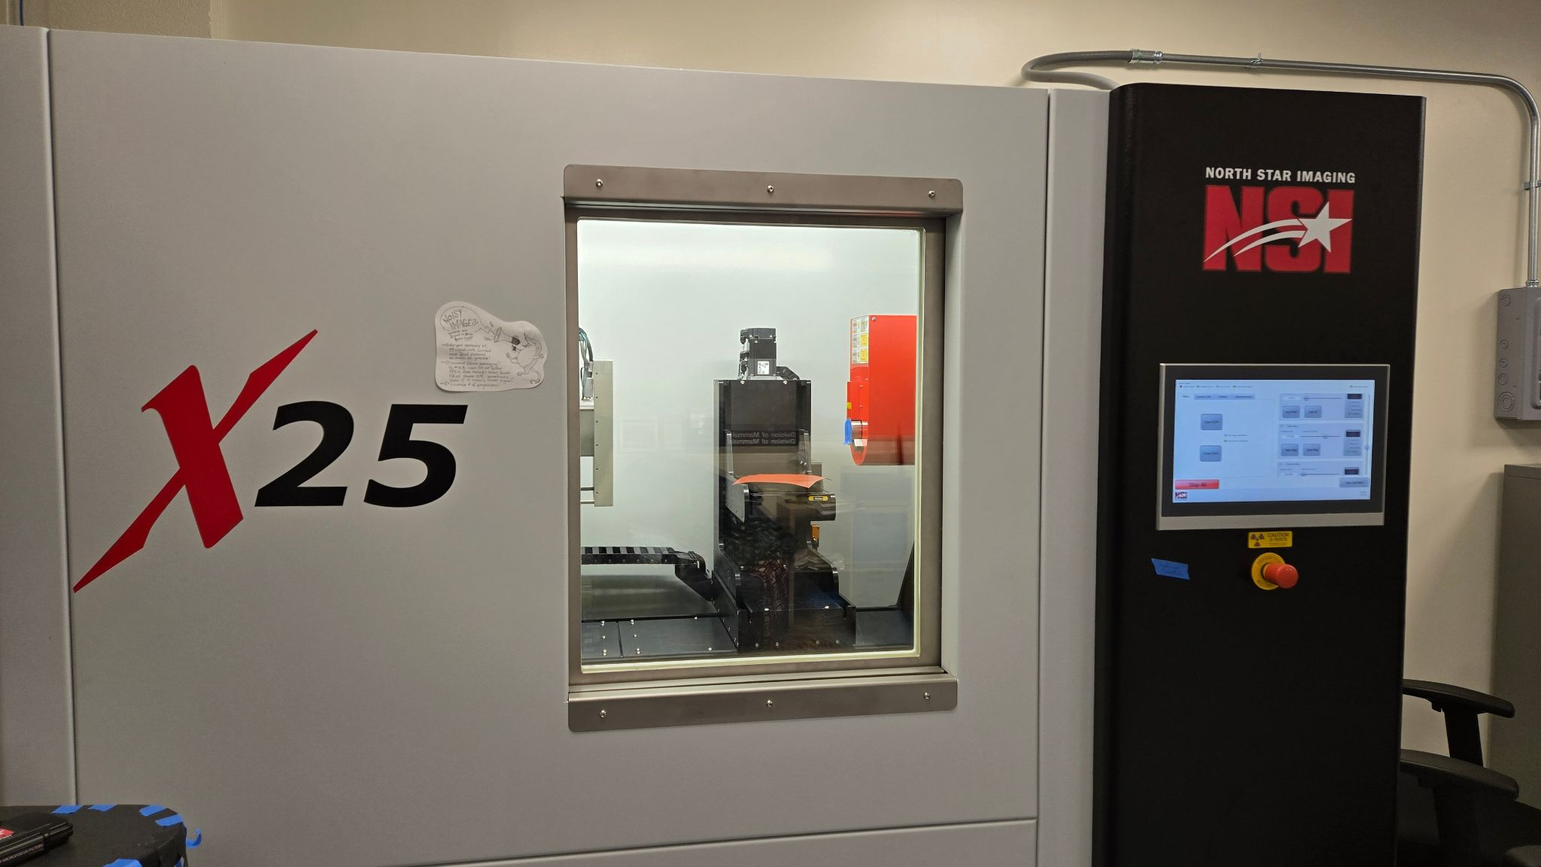

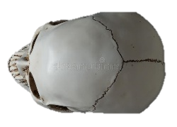
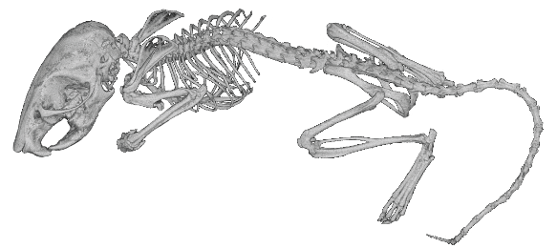
X-ray source
X-ray source
X-rays
X-rays
X-ray detector
Notes:
The answer is pretty straightforward: you take a lot of xrays and put them all together
In medical CT machines, the patient stays still and the xray apparatus spins around
In smaller CT machines like I will discuss today, the specimen rotates instead.
Either way you get a series of Xrays of your object from every angle

Slide 7
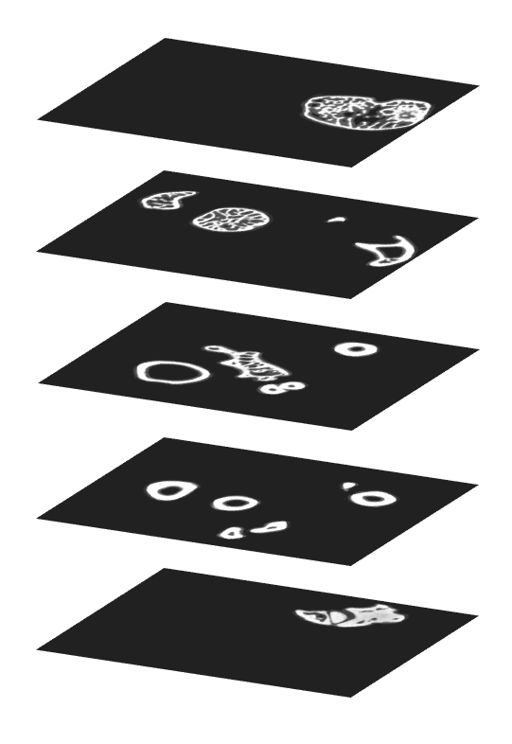
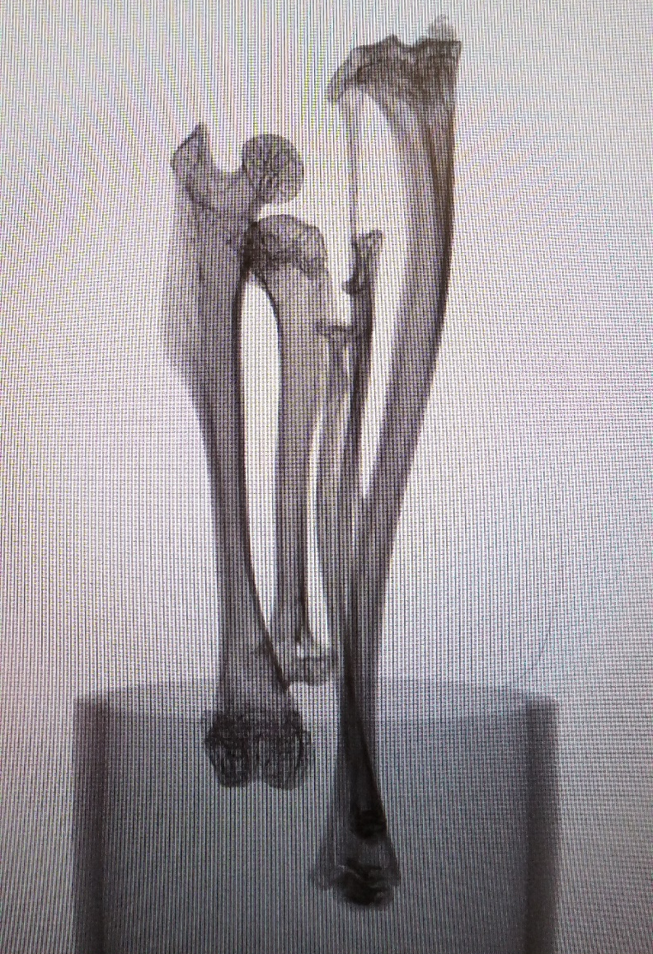
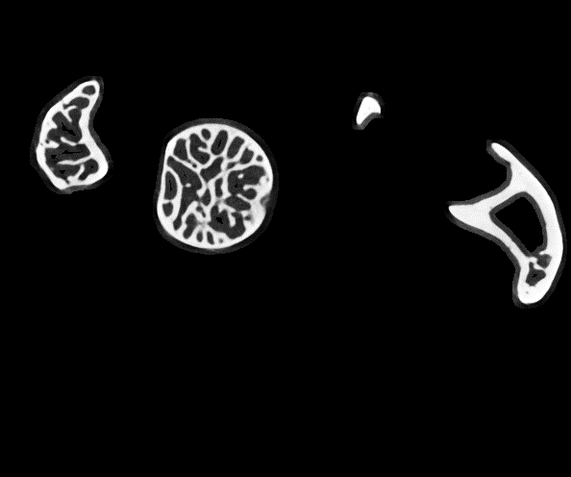
images: smsmith
Notes:
This is where the “computed” part really starts to become apparent:
You take your xrays from every angle (projections), and you give them to a piece of software that puts them all together to make a series of slices through the object
This is based on the density information it gets from the individual xrays, and the number of xrays you take as you spin it around
So then your slices look like this: showing the dense parts of the image, here the skull.
Denser things are brighter on the scan (whiter), less dense things are less bright)

Slide 8
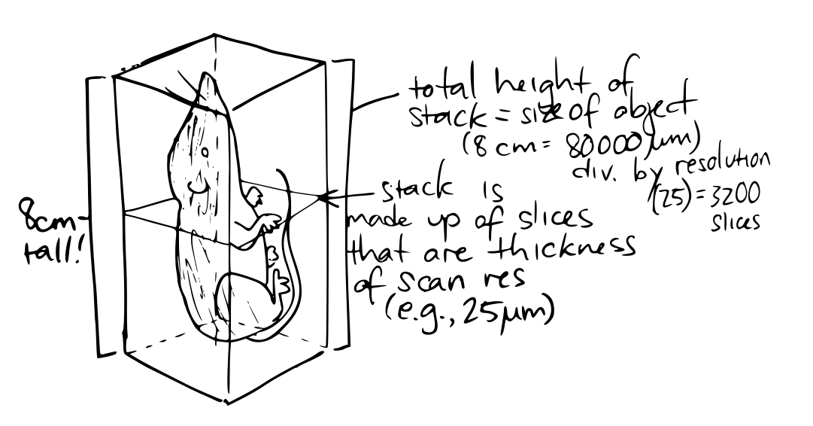
image: smsmith

Slide 9
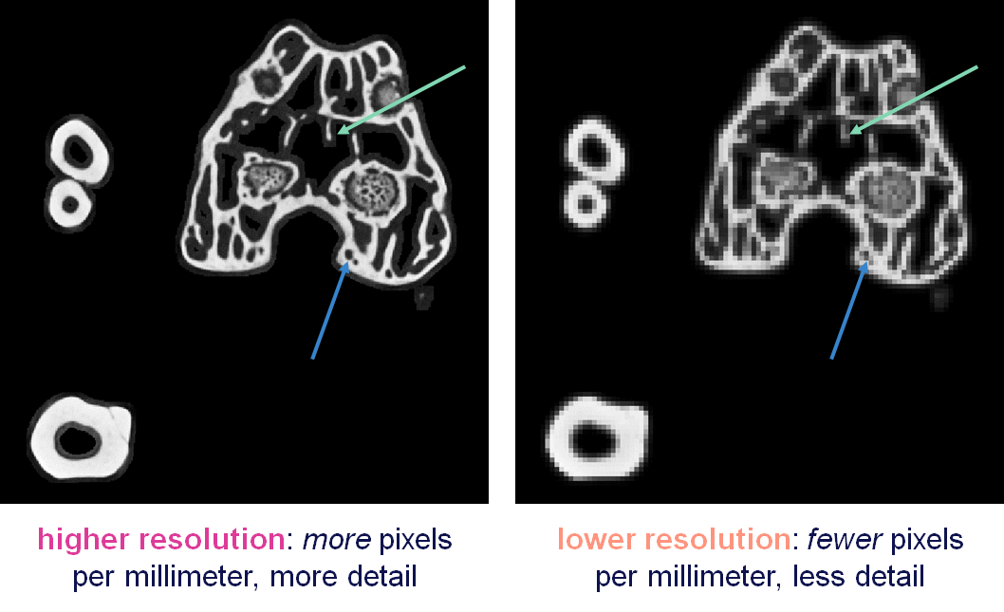
images: smsmith

Slide 10
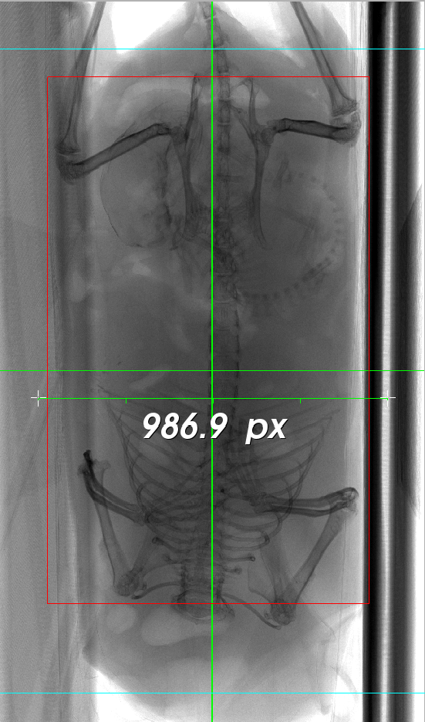
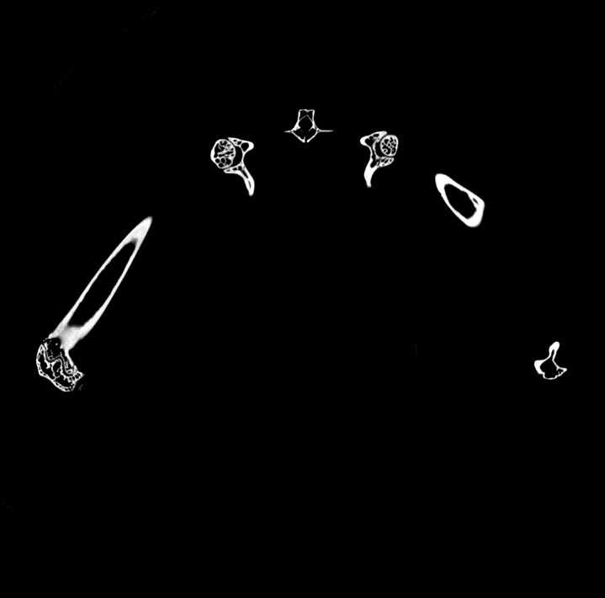
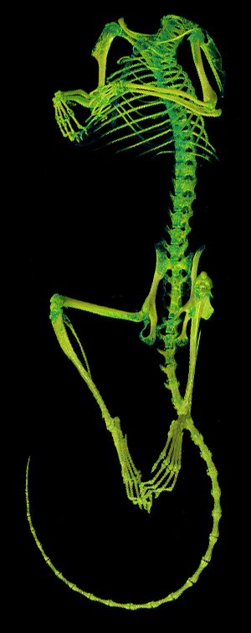
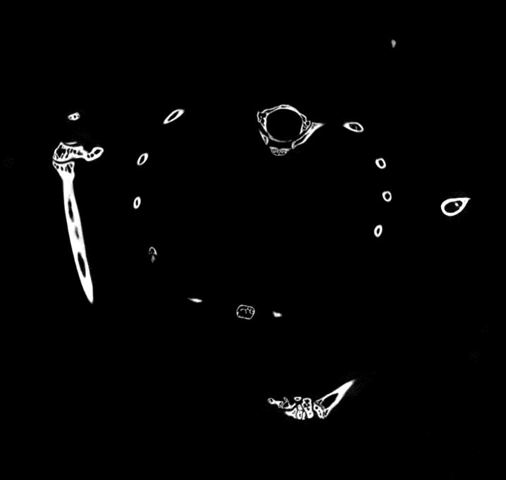
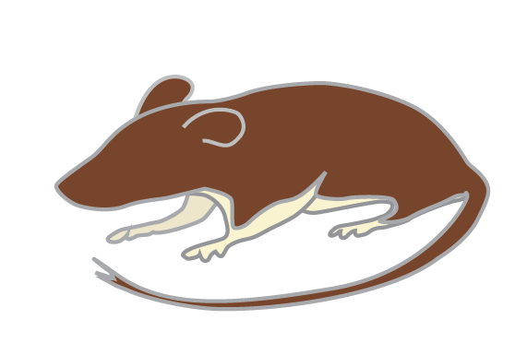
images: smsmith
Notes:
Those slices go into another program that takes them and makes a 3d model!
You can tell this program to show you only the bright/dense things (e.g., skeleton), or only the dimmer/less dense things (e.g., furry outside).
You can take get a qualitative sense of an internal structure, take measurements, make 3D models, cut out parts that you want to measure or inspect… there are any number of uses for a scanned object!

Slide 11

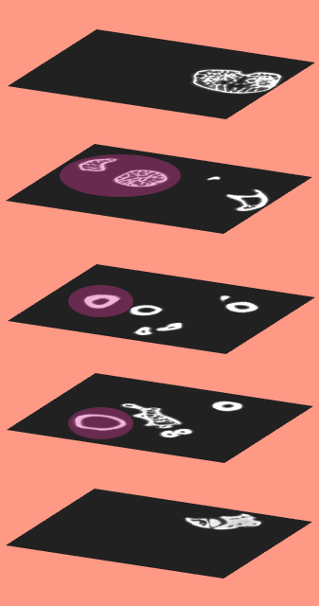
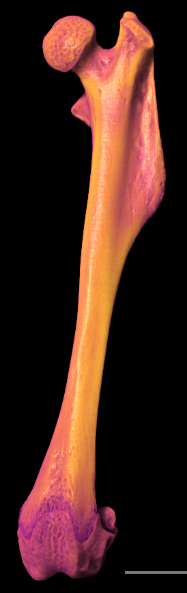
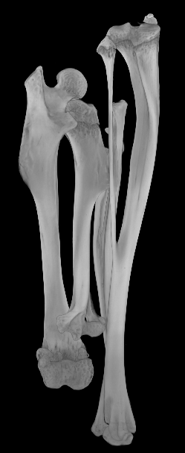
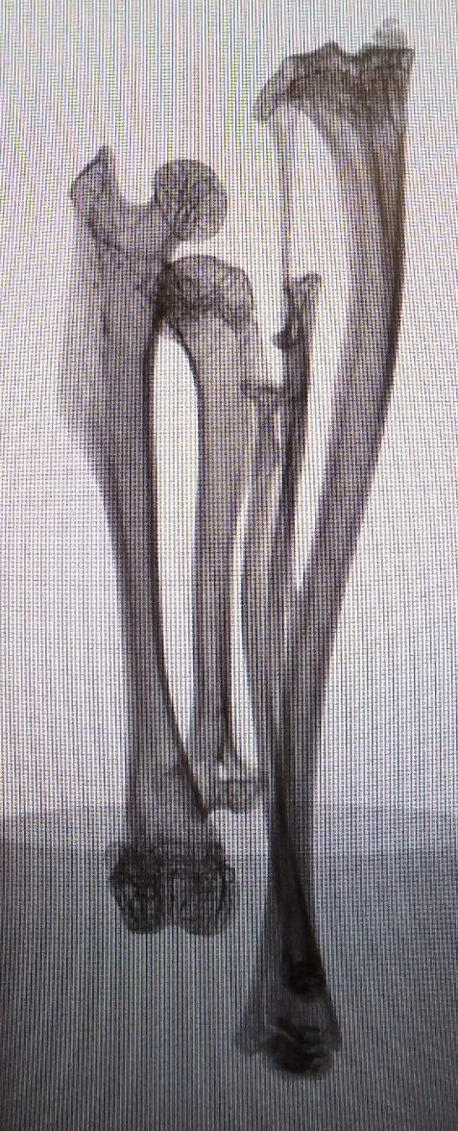
scanning
reconstruction
segmentation
3D rendering
images: smsmith

Slide 12
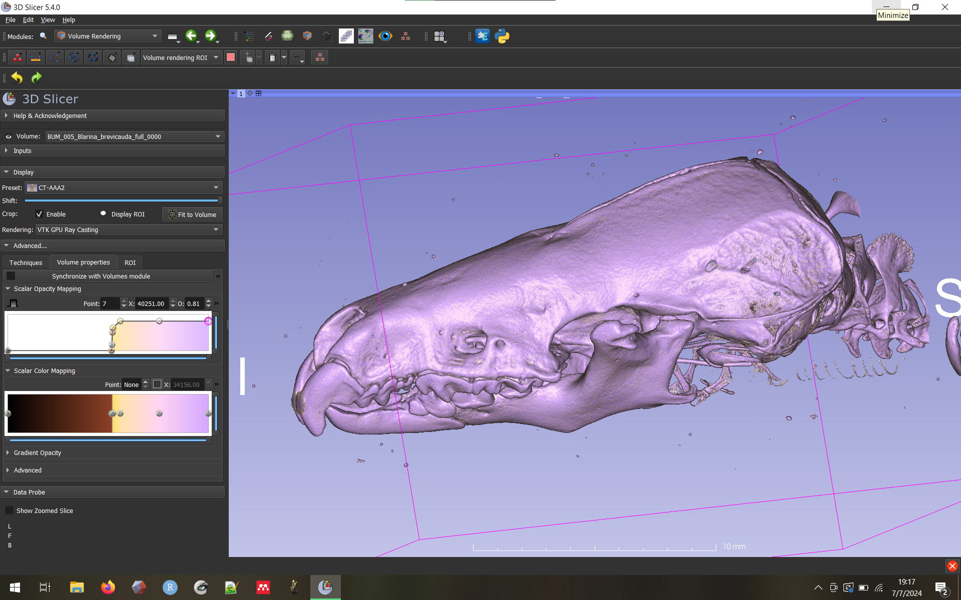

tell me a little about 3D Slicer
“3D Slicer is a free, open source software for visualization, processing, segmentation, registration, and analysis of medical, biomedical, and other 3D images and meshes; and planning and navigating image-guided procedures.” –The Slicer Website
images: smsmith
Notes:
It is also a machine for making beautiful 3D models of shrews, which should be considered its primary purpose

Slide 13
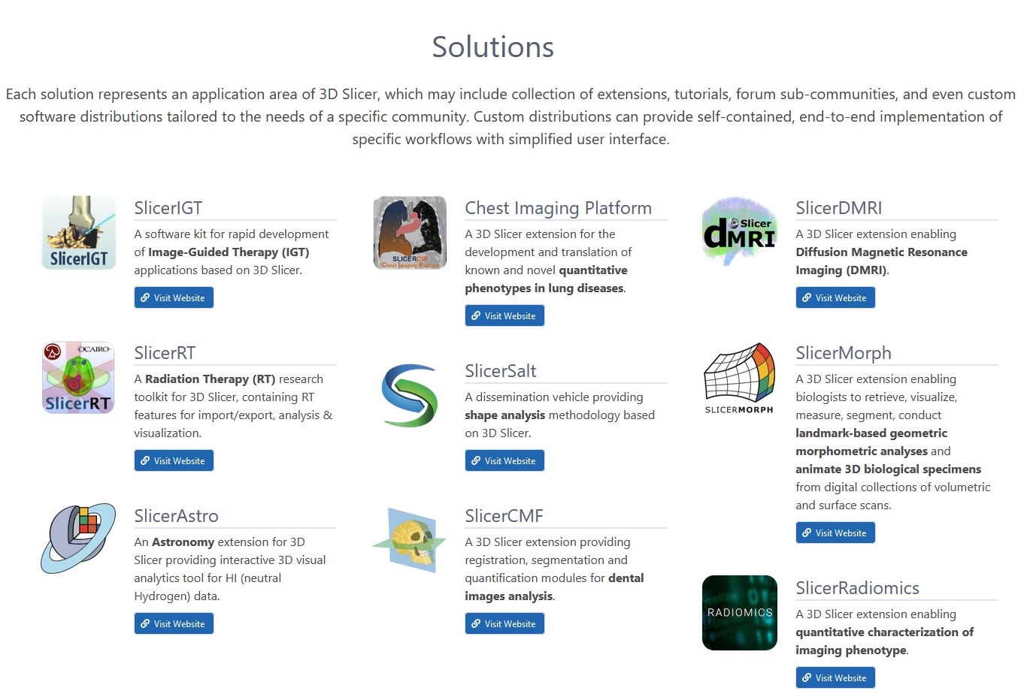

Slide 14
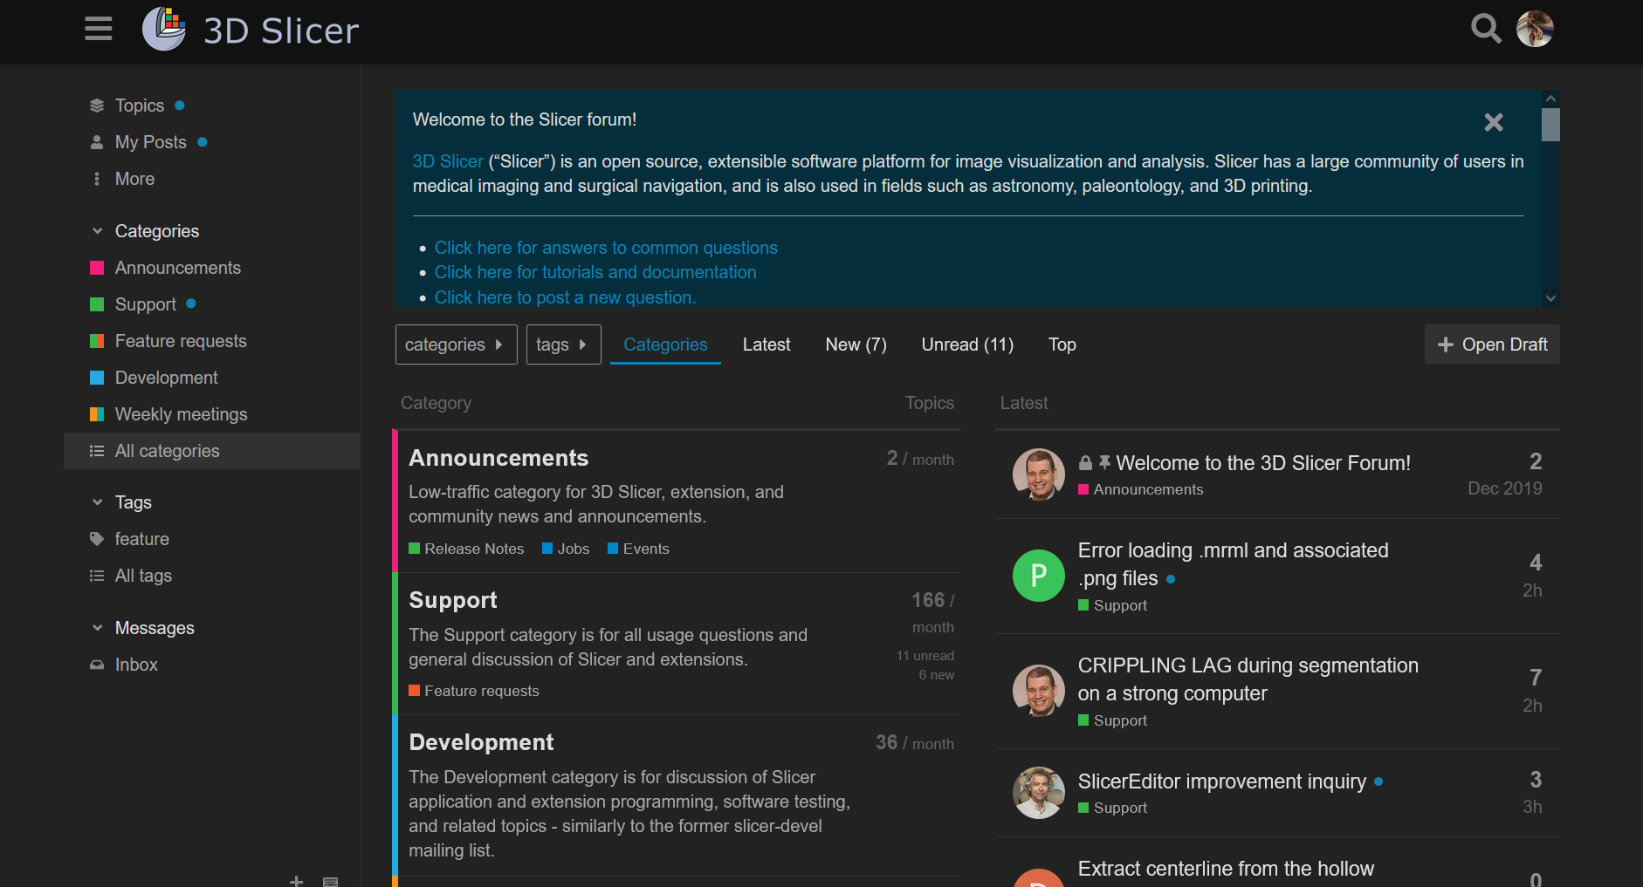

Slide 15
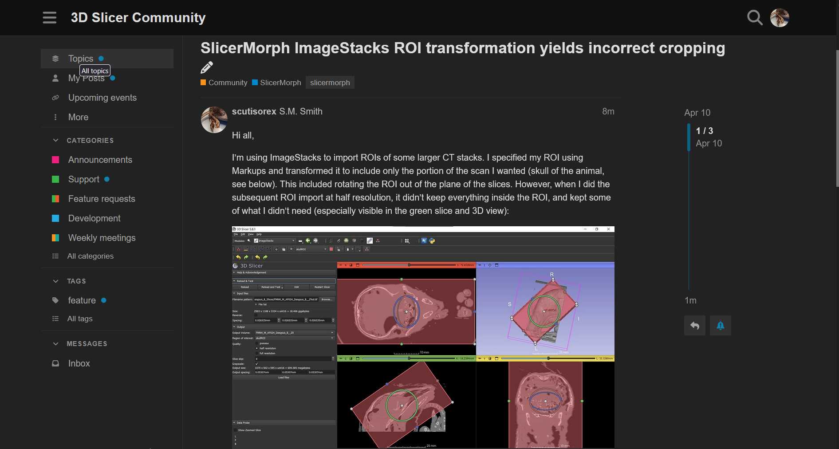

Slide 16
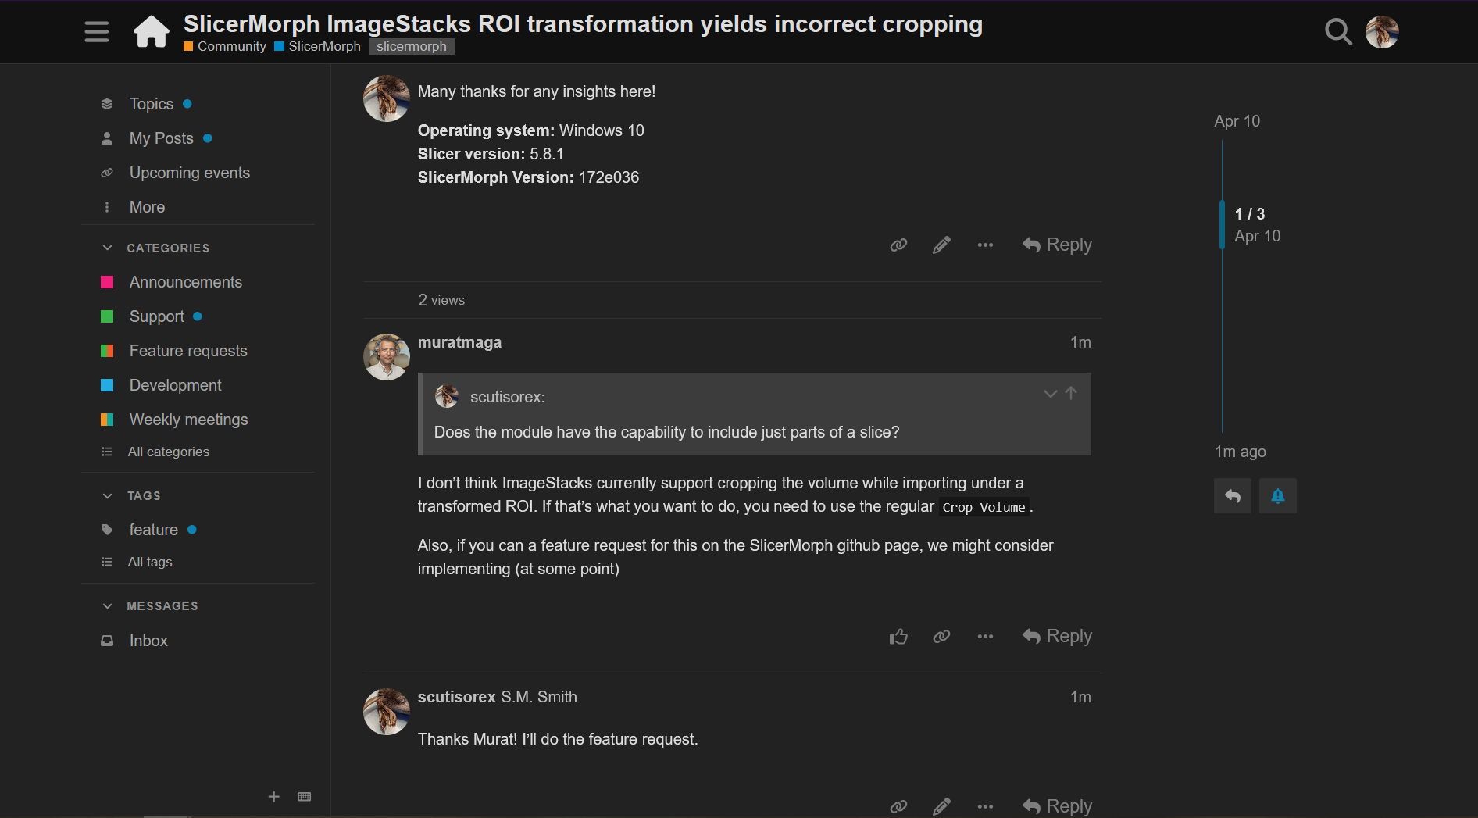

Slide 17
what do XCT data look like in Slicer, and what can you do with them in there?

Slide 18
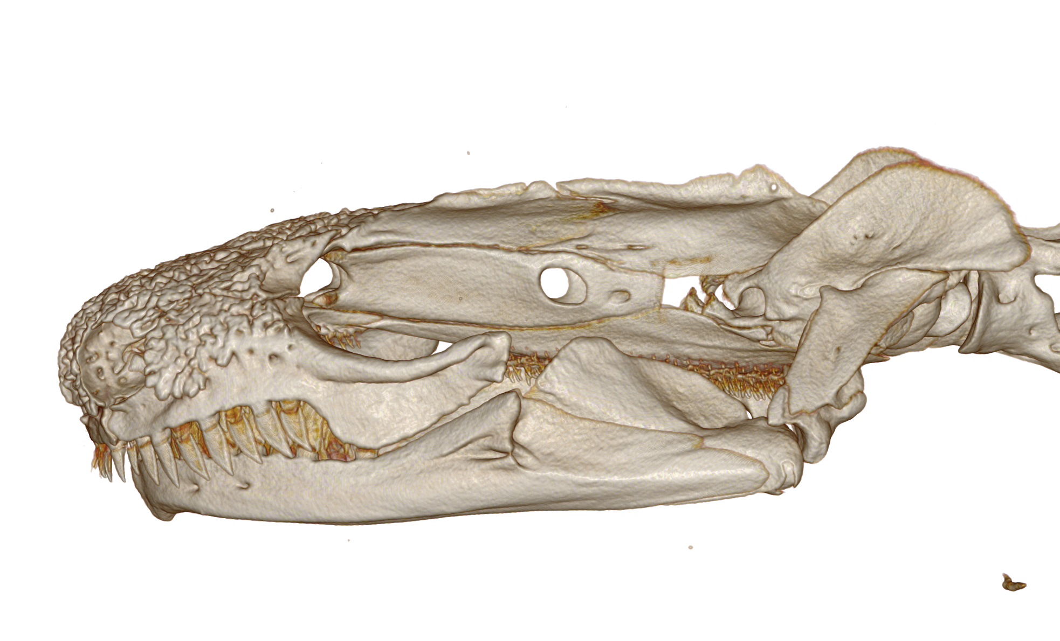

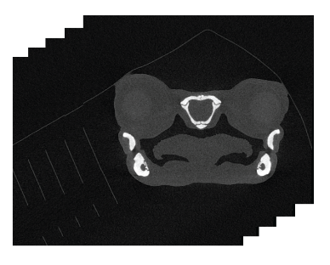
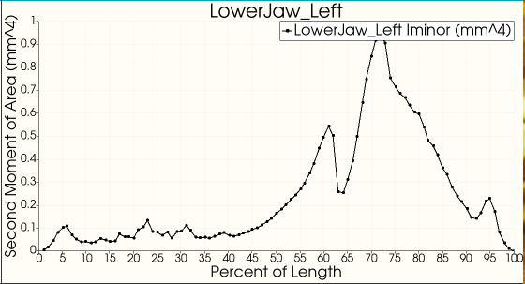
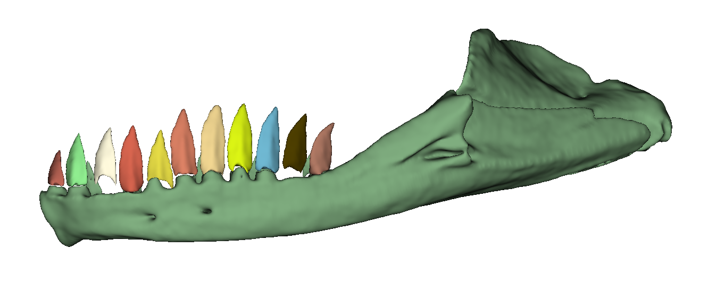
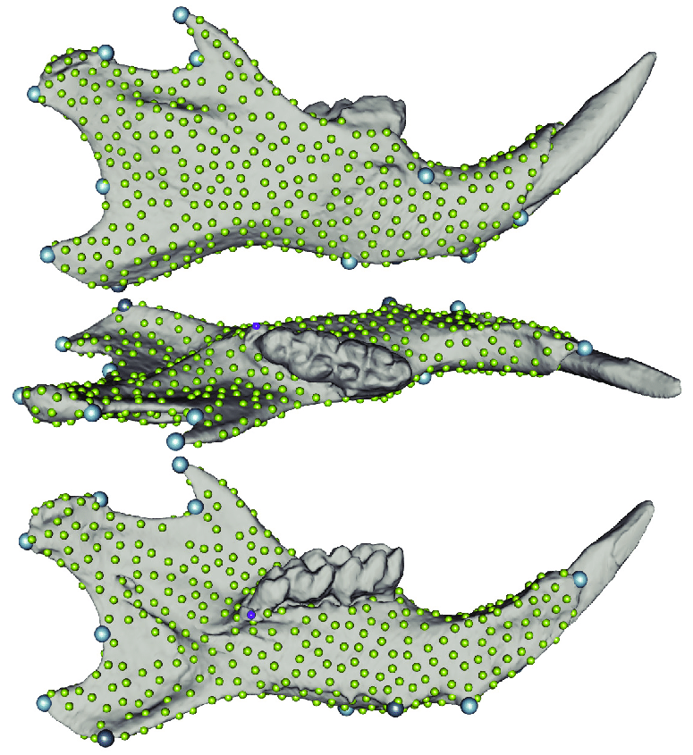
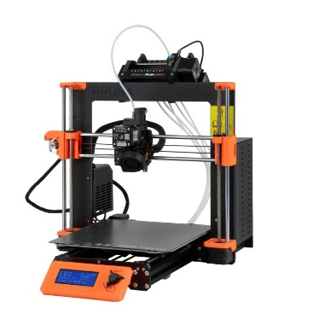
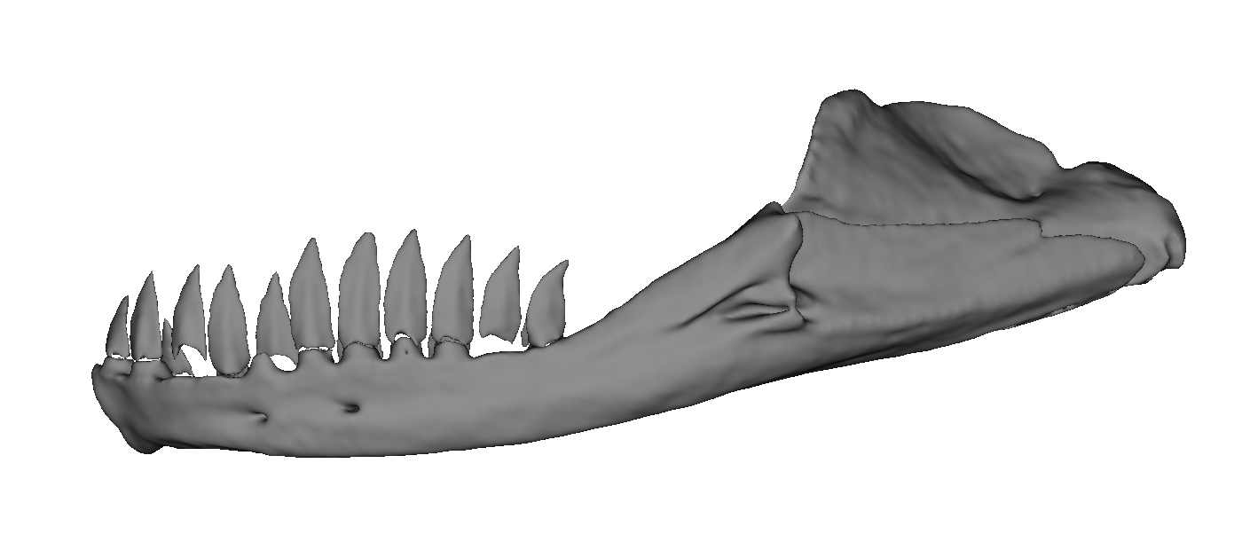
workflow for computed tomography (CT) data
Volume Rendering
Linear Measurements
Markups
Image Stack
3D Slicer
Segment Statistics
Volume Rendering
ImageStacks
Segmenting
Markups
Segment Editor
Segment Statistics
Markups
SlicerMorph;
Markups
Landmarking for GMM
3D Printing
Segmentations;
Data
Export to Model
This slide shamelessly stolen from J.M. Huie! Thank you Jonathan!!
(https://github.com/jmhuie/SlicerWorkshop_GWU_2024/blob/main/Day_1/GWU_Slicer_Workshop_Day_1.pptx)

Slide 19

time to do some slicing!!
https://github.com/scutisorex/SlicerWorkshop-04-2025

