Slide 1
Artificial Intelligence
Class 1: Joshua Durso-Finley

Slide 2
Professors
Joshua Durso-Finley
TBD:
TAs:TBD

Slide 3
Topics
Python (Background)
Search
Uninformed
Informed
Game playing
Uncertainty
HMMs
Planning
Classical Planning
MDPs
Learning
RL
Supervised
Unsupervised

Slide 4
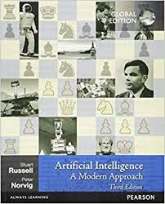
Recommended Text
Artificial Intelligence, A Modern Approach
Russel and Norvig.

Slide 5
Course Logistics
https://github.com/Jddursof/YCBSFAI
Turn in Assignments to MyCourses
Questions through Slack:

Slide 6
Grading
50% In class work
10% Out of Class work
20% Final Exam
20% Final Project

Slide 7
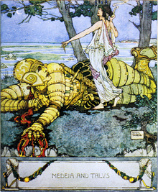
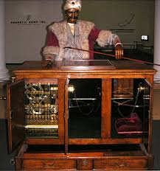

AI: People have always wondered if machines can be intelligent?

Slide 8
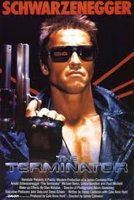
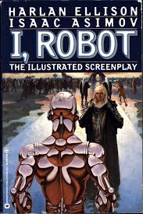
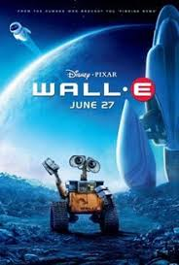
And wondered about the implications of Automation

Slide 9
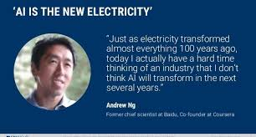

Slide 10
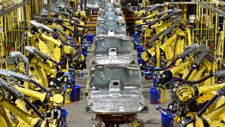
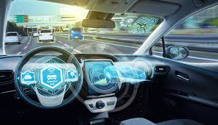
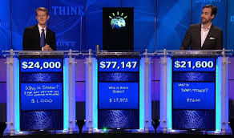
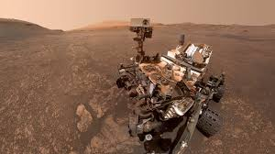
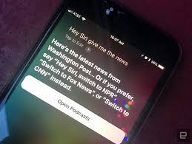
Modern AI

Slide 11
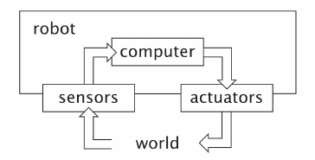
What is AI?
Optimal? Rational? Take actions? Do machines think?

Slide 12
What is intelligent?
Jelly fish?
Dogs?
Thermostat?
Roomba?
AlphaZero?
Algorithm which mimics a human? (Turing Test)

Slide 13
Proposal
Intelligence is a mix of general and special purpose algorithms.
General: Learning, Memory
Specific: Recognizing voices, Learning a skill

Slide 14
Rational Agents
A rational Agent:
Acts in its environment
Senses in the environment
Maximizes a given performance objective

Slide 15
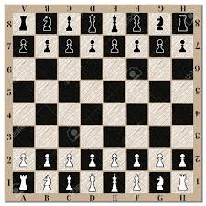
Example Chess
Performance measure?
Environment?
Knowledge?
Sensing?
Actions?

Slide 16
Chess
Environment:
Fully Observable
Deterministic
Episodic
Static
Discrete

Slide 17
Mars Rover
Environment:
Partially Observable
Stochastic
Continuing
Dynamic
Continuous

Slide 18
Example: Poker
Partially Observable
Stochastic
Episodic
Static
Discrete (Arguably)

Slide 19
AI is really a collection of subfields
Perception
Robotics
Reasoning(Generally what people mean by AI)
Optimization

Slide 20
Progress
Atari
Go
Poker
Translation
Paragraph construction
https://thispersondoesnotexist.com/

Slide 21
Topics
Python and CS (Background)
Search
Uninformed
Informed
Game playing
Uncertainty
Planning
Classical Planning
MDPs
Learning
RL
Supervised
Unsupervised

Slide 22
Python basics
Everyone should have started the introduction to python module on datacamp or be familiar with python
To make things simple we will do most of the work on colab which is a google service.
Alternatively it may be easier to work in a jupyter notebook.
pip install jupyter

Slide 23
https://colab.research.google.com/drive/1tjB8pWAAtPleQ-0VrseNiFlU34_6h71u#scrollTo=dHJgn9JXRGoB

Slide 24
Datacamp
Please complete: Logic, Control Flow and Filtering in
Intermediate Python for data science

Slide 25
Computer Science Fundamentals
Analysis of algorithms: O(n), worst-case analysis, Runtime
Dynamic Programming, Recursive algorithms, Induction
Data Structures
Graph Algorithms

Slide 26
What makes an algorithm good?
Wall time?
Memory Usage?
Power Consumption?

Slide 27
Runtime
acc=0
k=20
for i in range(k):
acc+=i
print(acc)
What is the runtime? For k=30? For k=10000?

Slide 28
Why is this important?
Runtime is critical for AI systems that act in real time
Even in static environments we may want to know when a solution is possible in a reasonable amount of time

Slide 29
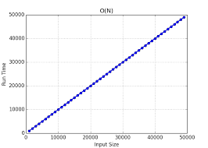
Experiment
Run the Algorithm on different values of k and plot the time

Slide 30
Experiment
Which values should we test and on what scale?
Which hardware should we test on?
Which OS?
Which Compilier?

Slide 31
Alternatives
We want a measure which is independent of the hardware, OS, compiler....

Slide 32
For a simple algorithm
acc=0
k=20
for i in range(k):
acc+=i
print(acc)

Slide 33
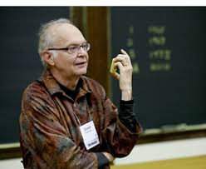
Knuth’s Observation
Experimental running time can be determined using the time of each operation & frequency of each operation
Count the number of operations
for a computer independent runtime

Slide 34
Knuth’s Observation
How do we ignore time?
Assume each operation takes one unit of time
For our simple algorithm how many operations do we perform for k=20?
Assume each operation takes one unit of time

Slide 35
Problem
We no longer have to worry about the hardware because we assume all operations take 1 unit of time but…
The number of operations changes with different size inputs in two ways: 1. Conditional statements may change runtime
2. Different size inputs may require different amount of computations

Slide 36
Sum of numbers 1 to n
acc=0 (1op)
k=20 (1op)
for i in range(k): (1 op per loop)
acc+=i (1 op per loop)
print(acc) (1op)
How many times does the inner loop execute?

Slide 37
Worst case upper bound: O(N)
Worst case lower bound: Ω(N)
Equivalence relation: θ(N)

Slide 38
Examples
Def first(array)
Return array[0]
How many operations if len(array) is 10,100,1000?
Runtime?

Slide 39
Example 2:
Def argmax(array):
max=0
amax=None
For i in range(len(array)):
If array[i]>max :
max=array[i]
amax=i
Return amax
What is the total number of operations?

Slide 40
Runtime
Def argmax(array):
max=0 (1op)
amax=None (1op)
For i in range(len(array)): (1 op)
If array[i]>max : (2ops)
max=array[i] (2ops)
amax=i (1op)
Return amax
What is the total number of operations?
6n+2

Slide 41
Example 3:
Def possible_products(array)
possible_prods=[]
For i in range(len(Array)):
For j in range(len(array)):
possible_prods.append(array[i]*array[j])

Slide 42
Example 3:
Def possible_products(array)
possible_prods=[]
For i in range(len(Array)):
For j in range(len(array)):
possible_prods.append(array[i]*array[j])
n^2 operations

Slide 43
Formal definition of runtime
Upper bound: O(n),O(n^2)
An algorithm is O(n) if there is an n1 and a constant c s.t.
The number of operations <=c*n for all values of n>n1.
An algorithm is lower bounded: Ω(n)
If there is an n1 and a constant c s.t.
The number of operations > c*n for all values of n>n1

Slide 44
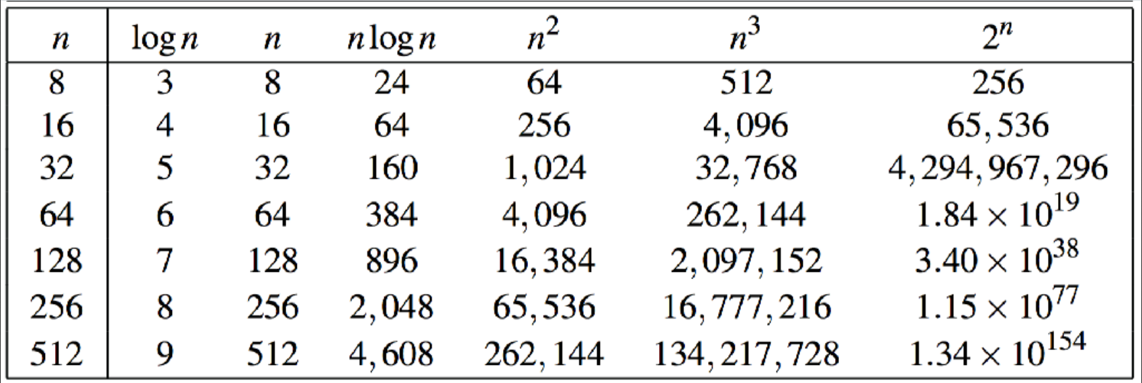

Slide 45
