Slide 1

Uninformed Search
Joshua Durso-Finley
Notes:
‹#›

Slide 2

Table of Contents
What is a search problem?
  Definitions
  Search problem formalization
Using search trees to solve search problems
Search algorithms in practice
  Depth-First Search
  Breadth-First Search (if there is time!)
Notes:
‹#›

Slide 3
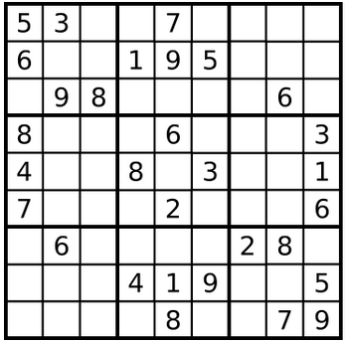
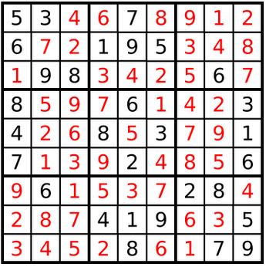
Core of Problem Solving
How can I take actions to reach a goal?
Notes:
‹#›

Slide 4
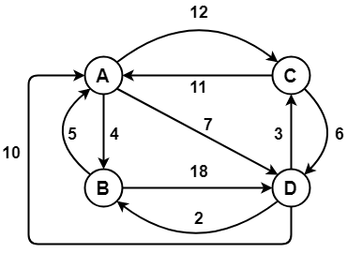
Defining the search problem
The problem exists in a set of states
Starts in an Initial state
There are available actions
Actions change the state
Actions have a cost
We want to find the goal
Notes:
‹#›

Slide 5
Defining the search problem
Set of States S, Set of actions A
Start state s∈S
Transitions a(s)->s’
Goal test g(s)->{0,1}
Cost function C(s,a,s’)
Notes:
‹#›

Slide 6
Generic Search Algorithm
Find a sequence of actions (a₁,...,a_{n}) and states (s₁,...,s_{n})
Such that:
s₀ =s, s_{i}=a_{i}(s_{i-1}) for i=1..n, g(s_{n})=1
While minimizing the cost function:
                Σ_{i} C(s_{i-1},a_{i},s_{i})
Notes:
‹#›

Slide 7
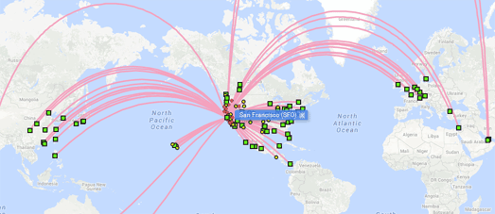
Example
States: Airports, times
Start State: PET airport at 7pm
Actions: Take an available flight
Goal: reach Moscow within 24 hours
Cost function: Money/time
Notes:
‹#›

Slide 8
How would we solve this problem?
Start State: PET airport at 7pm.
Goal: Reach Moscow within 24 hours with the smallest cost
Build up a search tree with airports and times as nodes
Notes:
‹#›

Slide 9
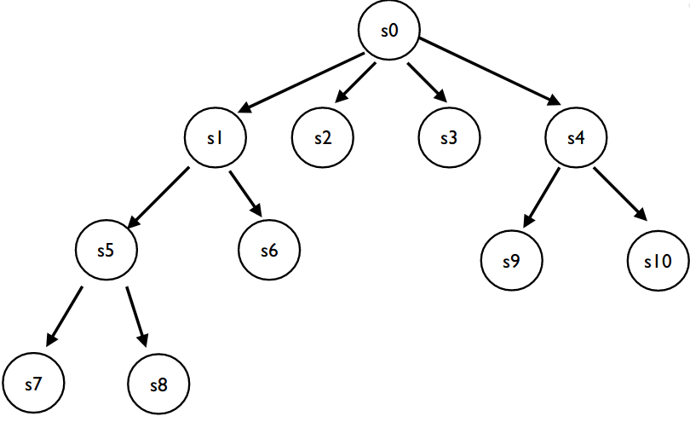
The Search Tree
A search tree has each state as a node
Each action moves to a child of the current state
We want to find a solution by looking through the tree
Notes:
‹#›

Slide 10
Important Quantities of Trees
Branching Factor b i.e How wide are the branches
Depth
    Depth of minimum solution m
    Maximum Depth d
Number of states/nodes: O(b^{d})
Notes:
‹#›

Slide 11
Search in General
Keep track of visited states
Take states from a set of unvisited states until the goal state is found
How we take states from the set of unvisited states determines the algorithm
    Breadth first search: Using a Queue
    Depth first search: Using a Stack
    A*: Using a heap
Notes:
‹#›

Slide 12
How to pick unvisited nodes?
Uniformed strategies:
    Explore the deepest node(DFS)
    Explore closest node(BFS)
Only consider reachable nodes
Keep track of those with a frontier (set of unvisited, but reachable nodes)
Notes:
‹#›

Slide 13
Depth first search (Using a Stack)
Expand deepest state
Start State: s₀
Add children to the set of unexplored nodes
Set of visited {S₀}
Set of unexplored {S₁,S₄}
s₀
s₁
s₄
Notes:
‹#›

Slide 14
Depth first search
Expand deepest state: s1
Set of visited {s_{0,}s₁}
Set of unexplored {s₂,s₄}
s₀
s₁
s₄
s₂
Notes:
‹#›

Slide 15
Depth first search
Expand deepest state: s₂
Set of visited {s_{0,}s_{1,}s₂}
Set of unexplored {s₃,s₄}
s₀
s₁
s₄
s₂
s₃
Notes:
‹#›

Slide 16
Depth first search
Expand deepest state: s₃
Set of visited {s_{0,}s_{1,}s_{2,}s₃}
Set of unexplored {S₄}
s₀
s₁
s₄
s₂
s₃
Notes:
‹#›

Slide 17
Depth first search
Expand deepest state: s₄
Set of visited {s_{0,}s_{1,}s_{2,}s₃,s₄}
Set of unexplored {s₅,s₆}
s₀
s₁
s₄
s₂
s₅
s₆
s₃
Notes:
‹#›

Slide 18
Depth first search
Expand deepest state: s₅
Set of visited {s_{0,}s_{1,}s_{2,}s₃,s_{4,}s₅}
Set of unexplored {s₆}
s₀
s₁
s₄
s₂
s₅
s₆
s₃
Notes:
‹#›

Slide 19
Depth first search
Expand deepest state: s₆
Set of visited {s_{0,}s_{1,}s_{2,}s₃,s_{4,}s_{5,}s₆}
Set of unexplored {}
s₀
s₁
s₄
s₂
s₅
s₆
s₃
Notes:
‹#›

Slide 20
Depth first search
Recap of DFS algorithm:
1. Expanded deepest state
2. Added children to the set of unexplored nodes
3. Selected next node to expand
How do we evaluate search algorithms?
1. Space complexity: O(b*d)
2. Time complexity: O(b^{d})
3. Completeness (Will find a solution if one exists)?:
For finite trees
4. Optimal (Will find a solution at minimum depth)?:
No!
s₀
s₁
s₄
s₂
s₅
s₆
s₃
Notes:
‹#›

Slide 21
Breadth first search
Expand closest state
Start State: s₀
Add children to the set of unexplored nodes
Visited {S₀}
Unexplored {S₁,S₄}
s₀
s₁
s₄
Notes:
‹#›

Slide 22
Breadth first search
Expand closest state: s1
Visited {s_{0,}s₁}
Unexplored {s₂,s₄}
s₀
s₁
s₄
s₂
Notes:
‹#›

Slide 23
Breadth first search
Expand closest state: s₄
Visited {s_{0,}s_{1,}s₄}
Unexplored {s_{2,}s_{5,}s₆}
s₀
s₁
s₄
s₂
s₅
s₆
Notes:
‹#›

Slide 24
Breadth first search
Expand closest state: s₂
Visited {s_{0,}s_{1,}s_{4,}s₂}
Unexplored {s_{3,}s_{5,}s₆}
s₀
s₁
s₄
s₂
s₅
s₆
s₃
Notes:
‹#›

Slide 25
Breadth first search
Expand closest state: s₅
Visited {s_{0,}s_{1,}s_{4,}s_{2,}s₅}
Unexplored {s₃,s₆}
s₀
s₁
s₄
s₂
s₅
s₆
s₃
Notes:
‹#›

Slide 26
Breadth first search
Expand closest state: s₆
Visited {s_{0,}s_{1,}s_{4,}s_{2,}s_{5,}s₆}
Unexplored {s₃}
s₀
s₁
s₄
s₂
s₅
s₆
s₃
Notes:
‹#›

Slide 27
Breadth first search
Expand closest state: s₃
Visited {s_{0,}s_{1,}s_{4,}s_{2,}s_{5,}s_{6,}s₃}
Unexplored {}
s₀
s₁
s₄
s₂
s₅
s₆
s₃
Notes:
‹#›

Slide 28
Breadth first search
Recap of BFS algorithm:
1. Expanded closest state
2. Added children to the set of unexplored nodes
3. Selected next node to expand
How do we evaluate search algorithms?
1. Space complexity: O(b^m)
2. Time complexity: O(b^m)
3. Completeness (Will find a solution if one exists)?:
Yes
4. Optimal (Will find a solution at minimum depth)?:
Yes
s₀
s₁
s₄
s₂
s₅
s₆
s₃
Notes:
‹#›

Slide 29
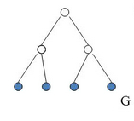
Breadth first search (Space)
Space complexity: O(b^{m})
At most we need to store the children of the level of the solution
All the nodes are stored at the deepest level
Notes:
‹#›

Slide 30
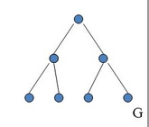
Breadth first search (Time)
Time complexity: O(b^{m})
At most we need to explore every single node in the tree up to the solution depth which has O(b^{m}) nodes
Notes:
‹#›

Slide 31
Recap of Concepts Covered
The goal of uninformed search is to find a goal node without any information about transitions or states.
Depth-First Search is implemented with a stack, has O(b^d) time complexity, O(b*d) space complexity
Breadth-First Search is implemented with a queue, has O(b^m) time complexity, O(b^m) space complexity.
Notes:
‹#›

Slide 32
Next time
More complex searches:
  Iterative deepening search, Bidirectional Search
Informed search
Notes:
‹#›

Slide 33

Notes:
‹#›

