Slide 1
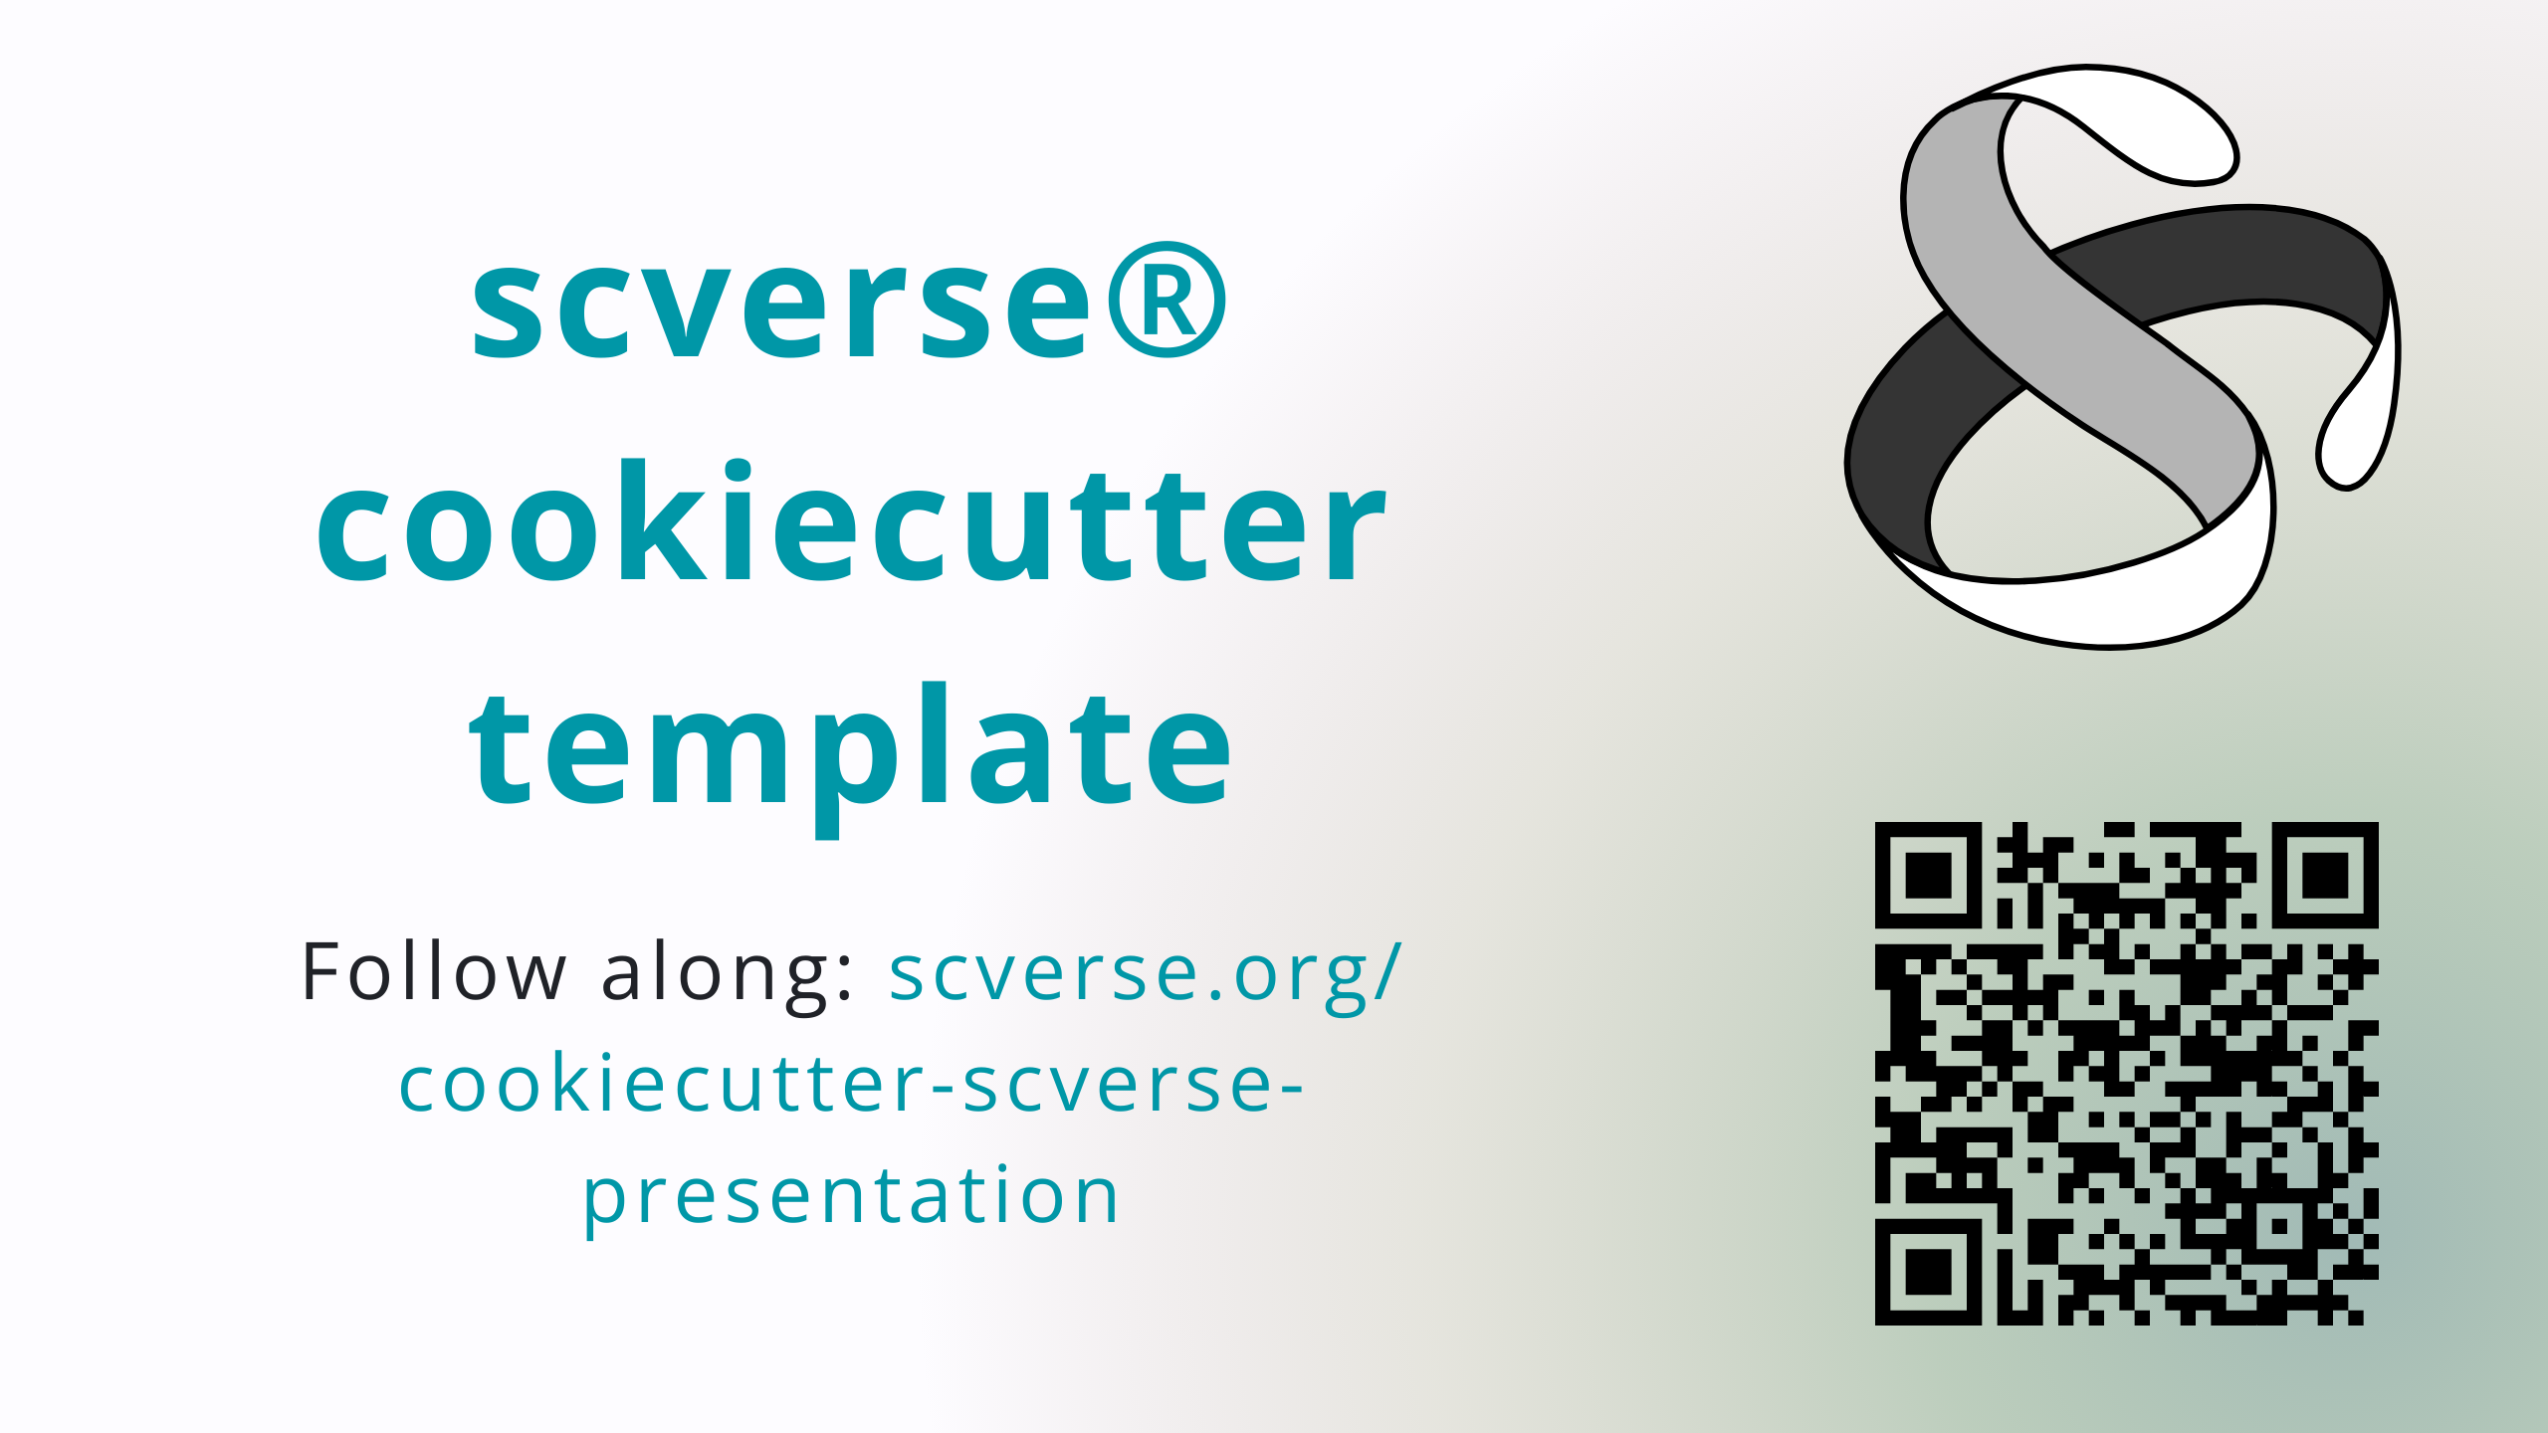
Notes:
Header link: important!
Follow along if you’re quick, later interactive
QR URL: https://api.qrserver.com/v1/create-qr-code/?format=svg&data=https://scverse.org/cookiecutter-scverse-presentation/

Slide 2
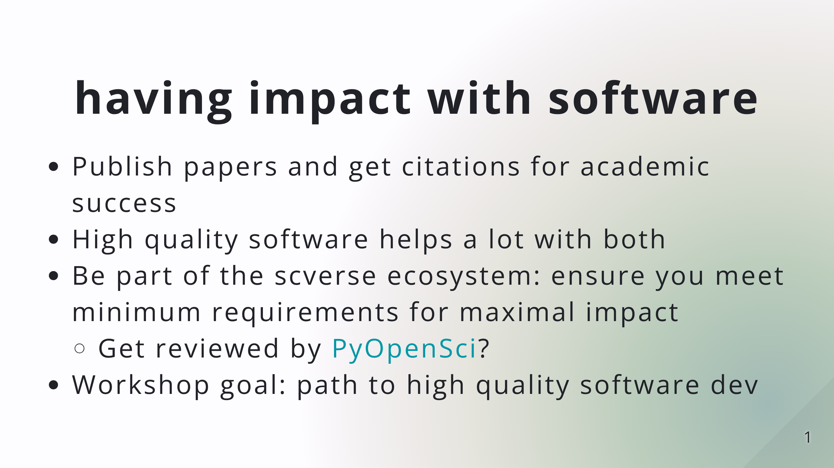

Slide 3
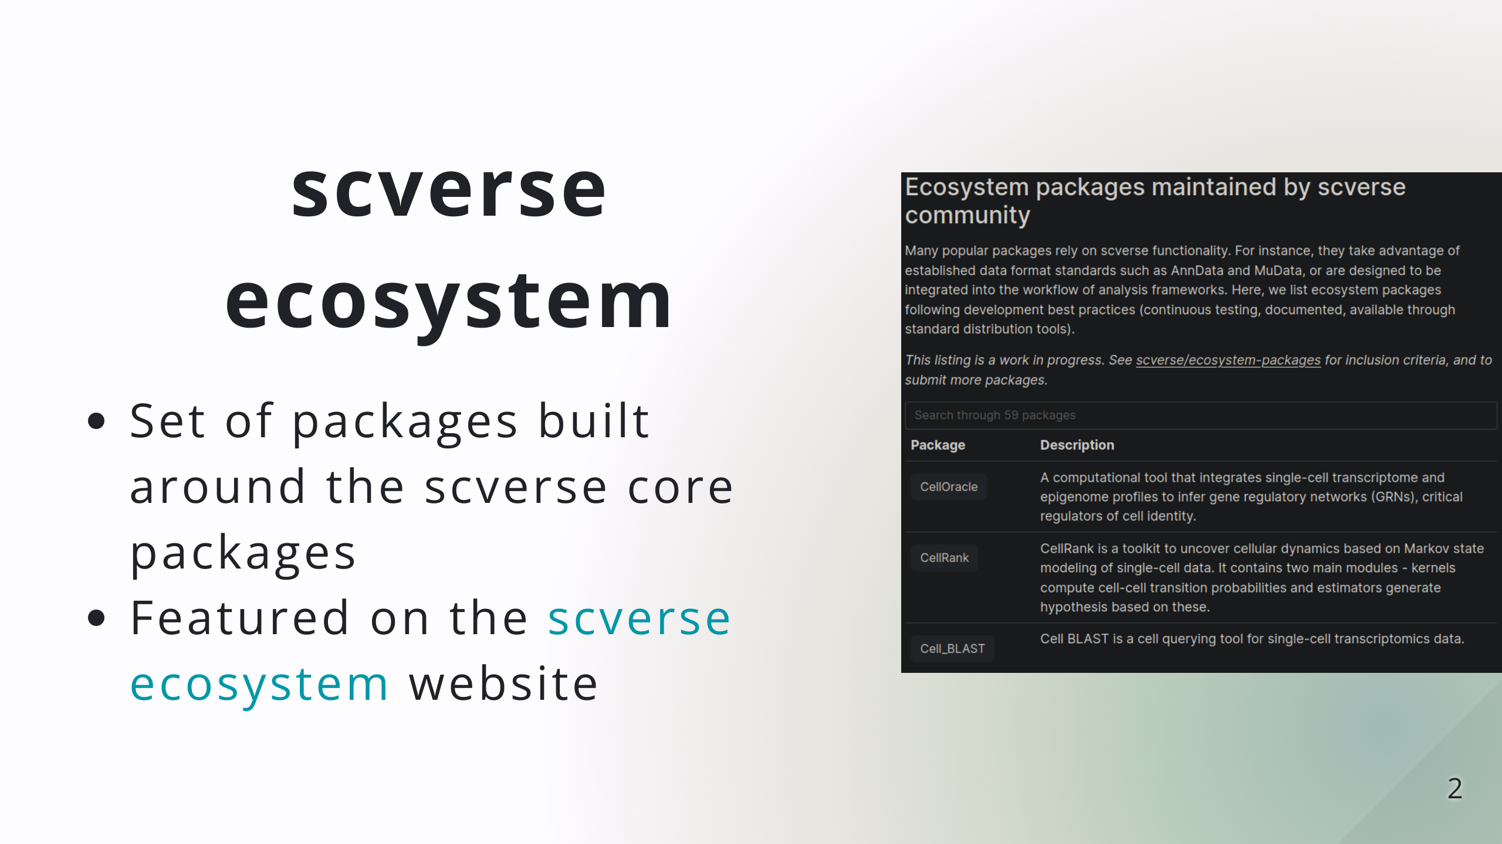

Slide 4
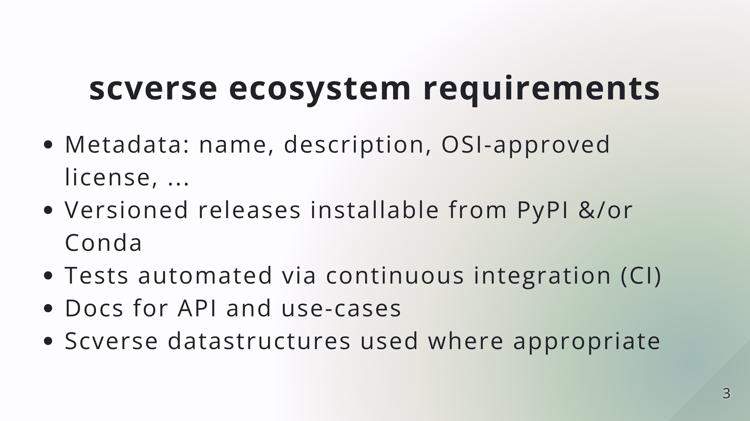

Slide 5
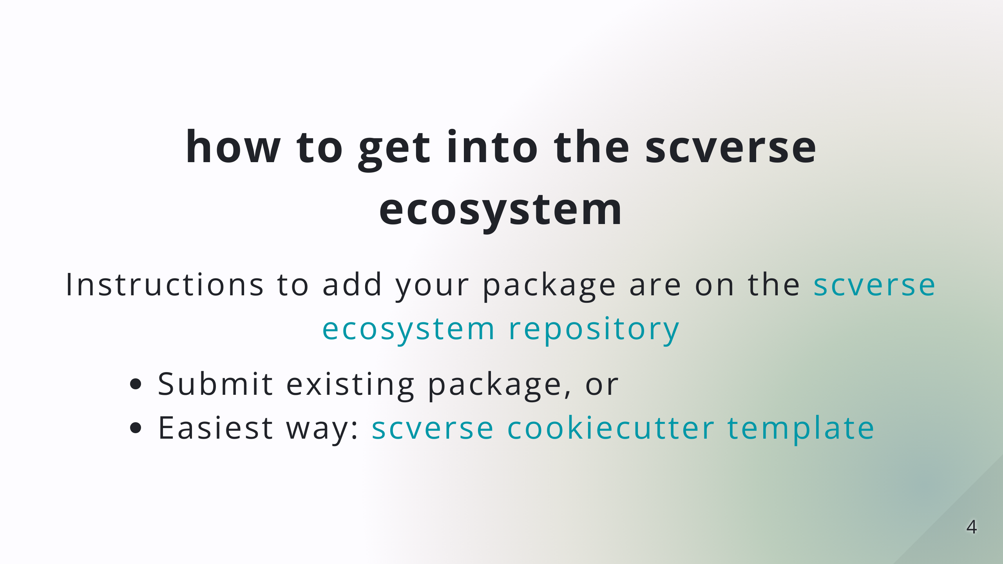

Slide 6
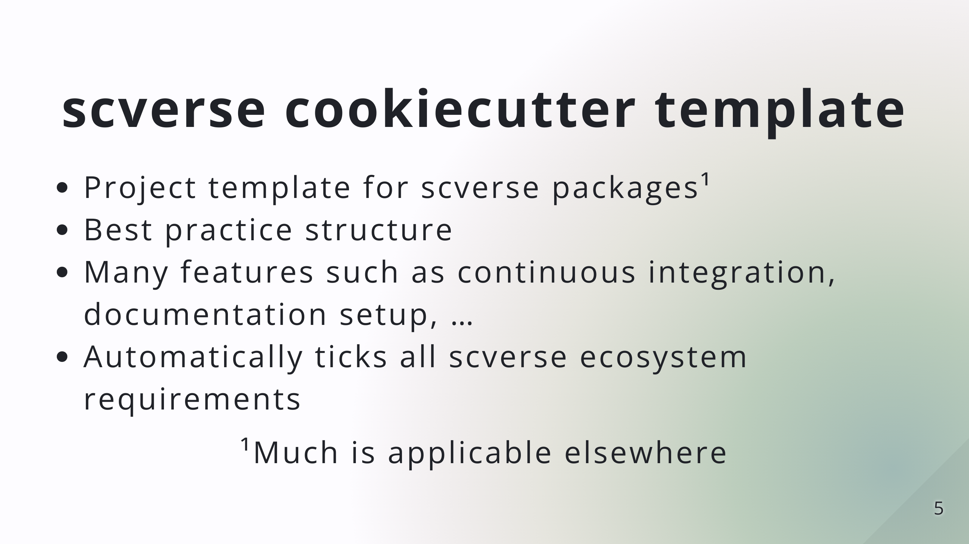

Slide 7
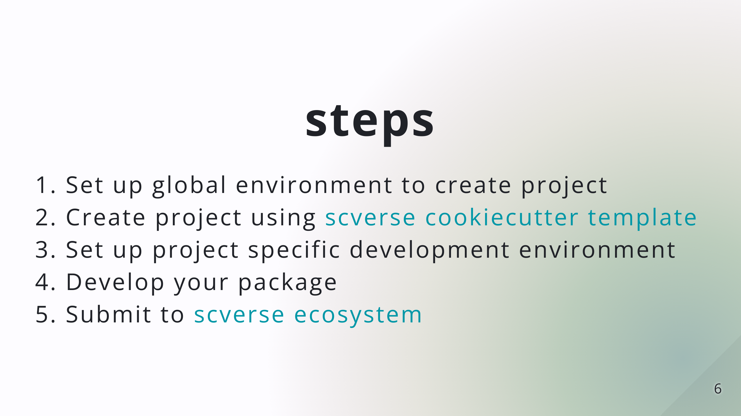

Slide 8
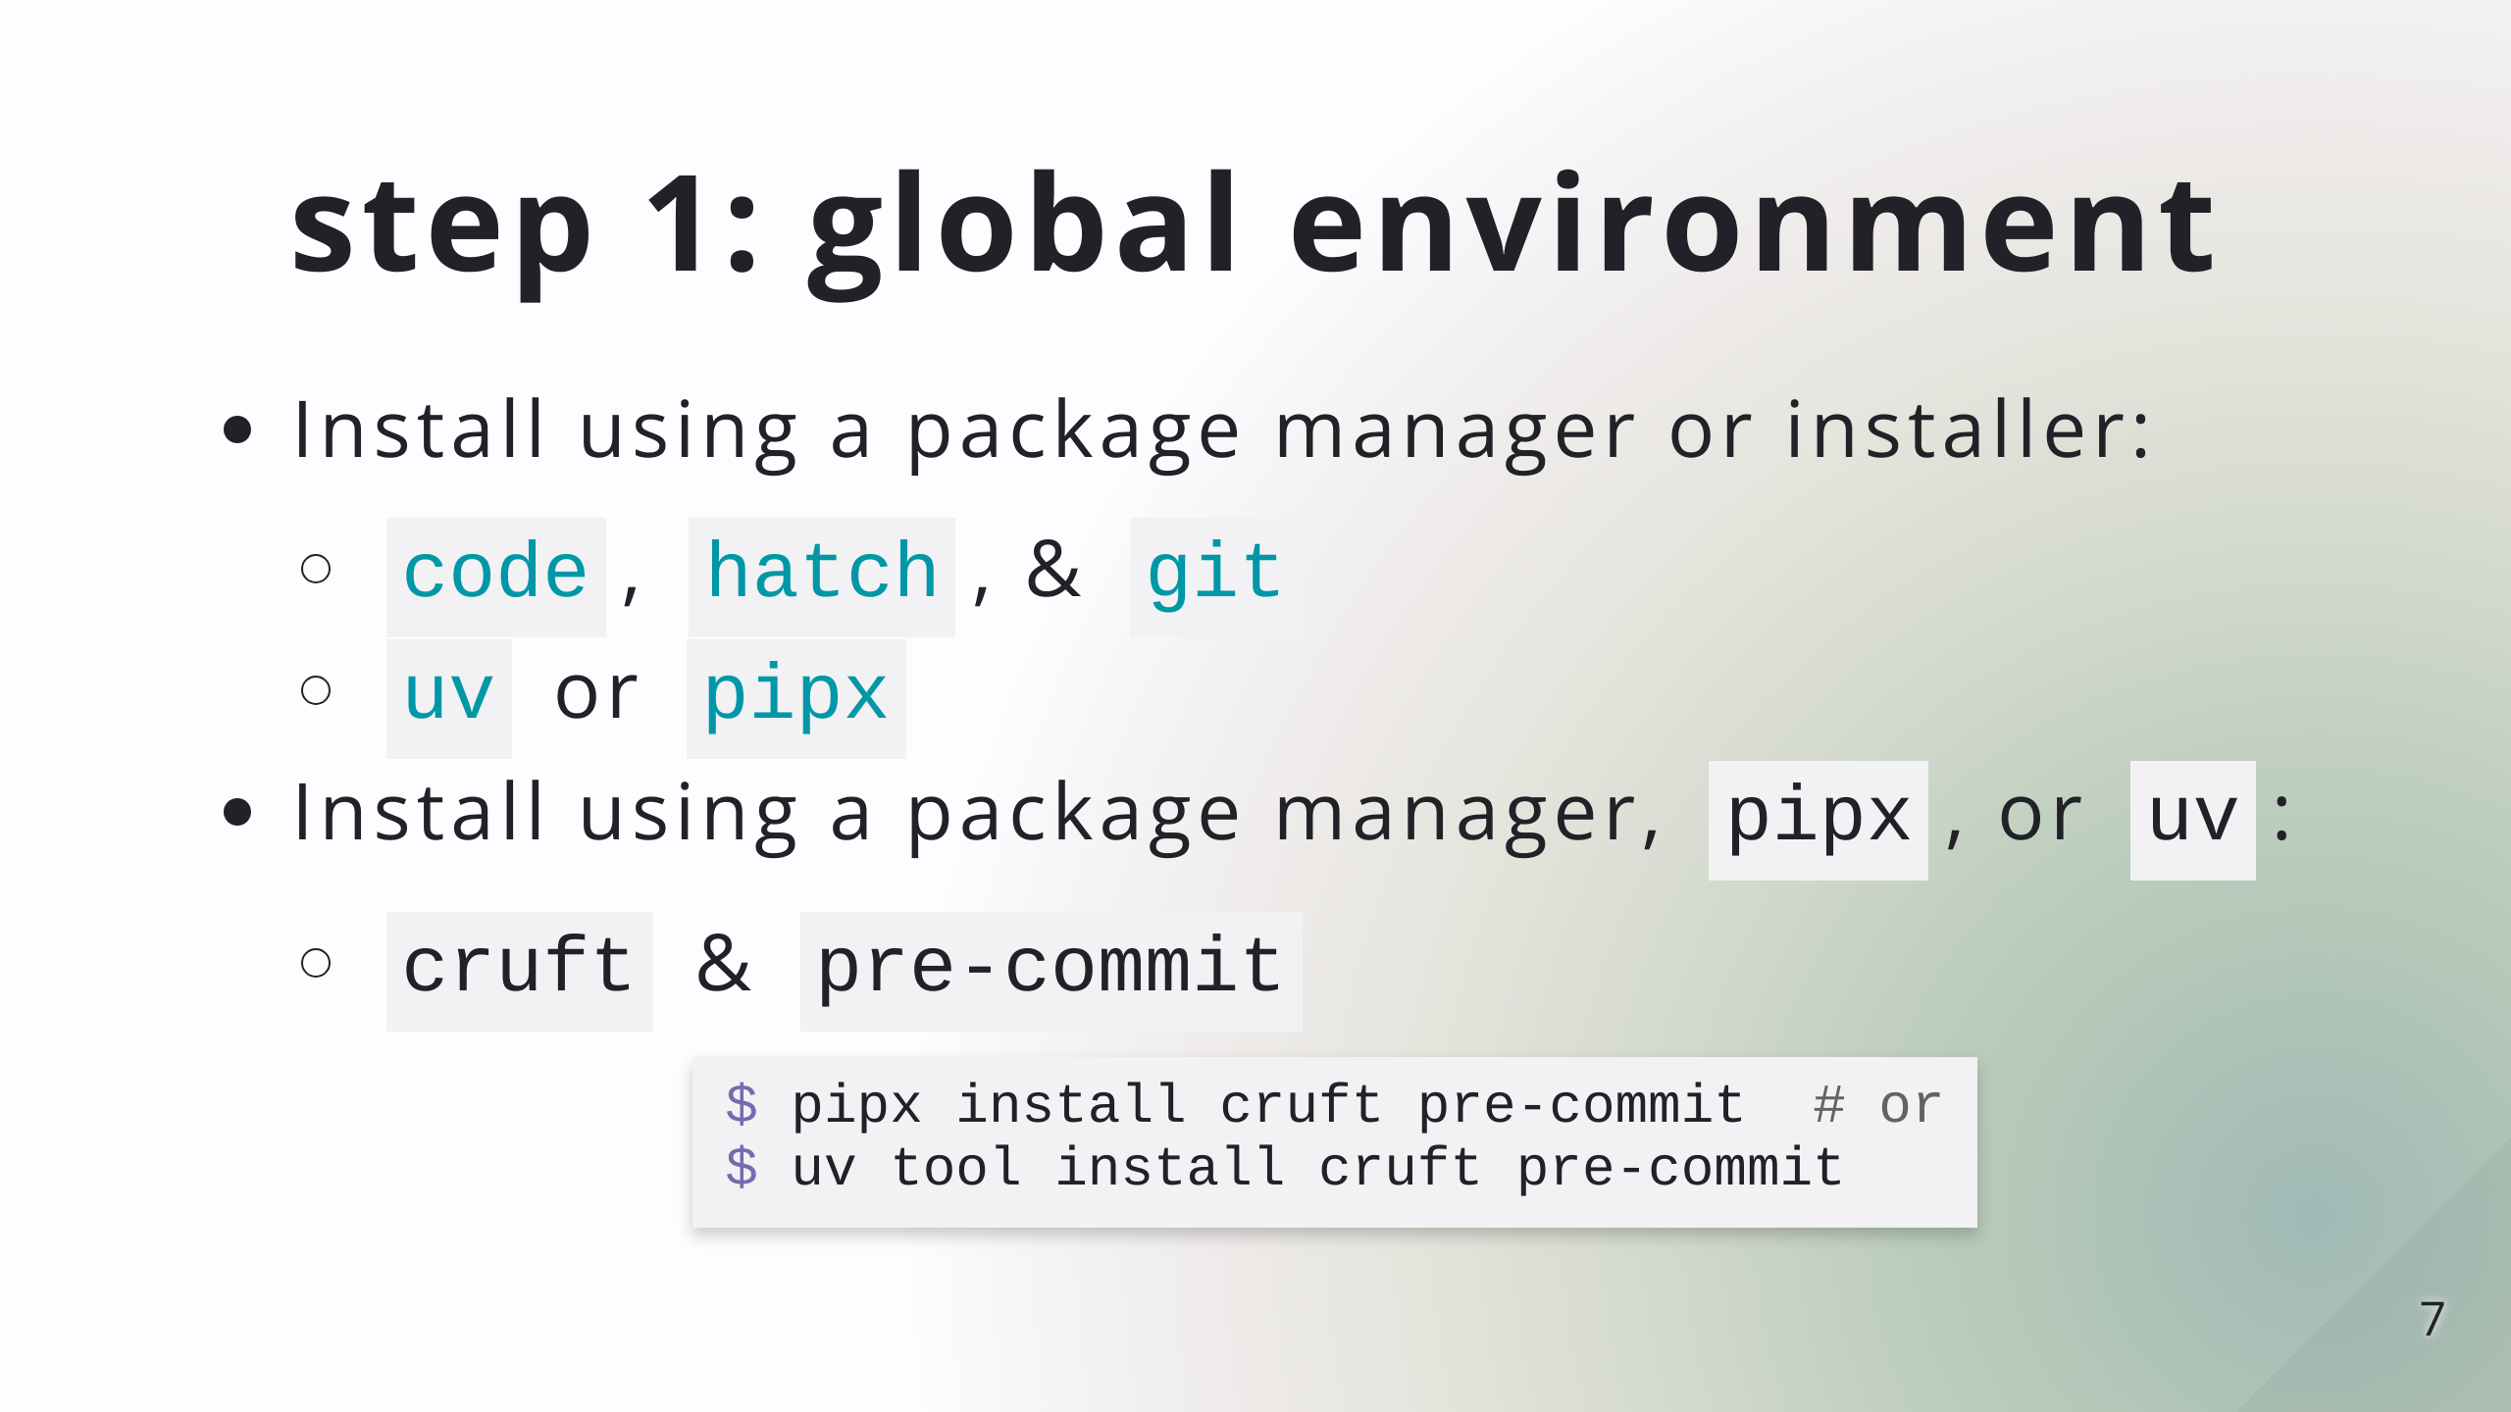

Slide 9
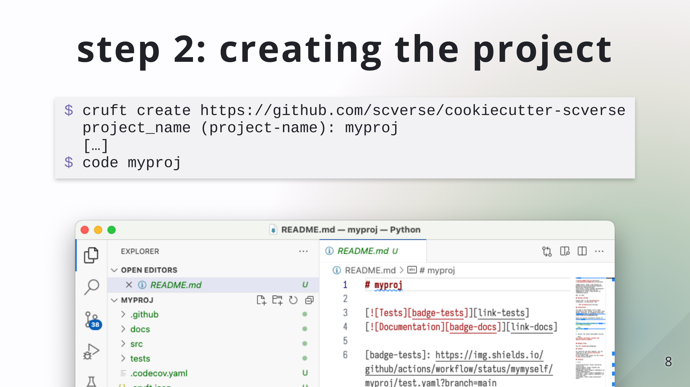

Slide 10
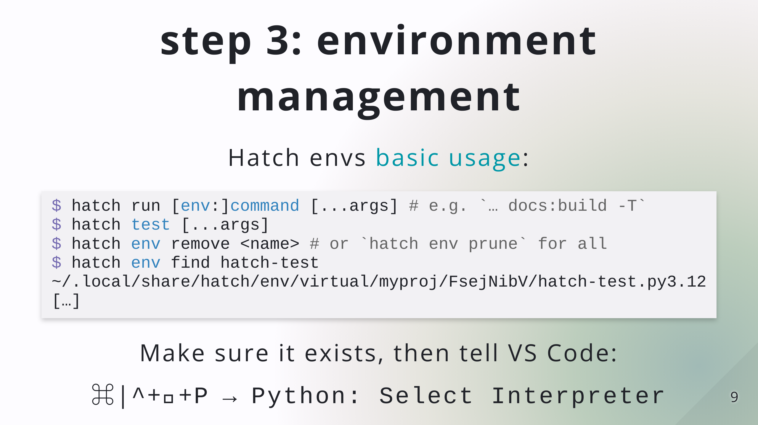

Slide 11
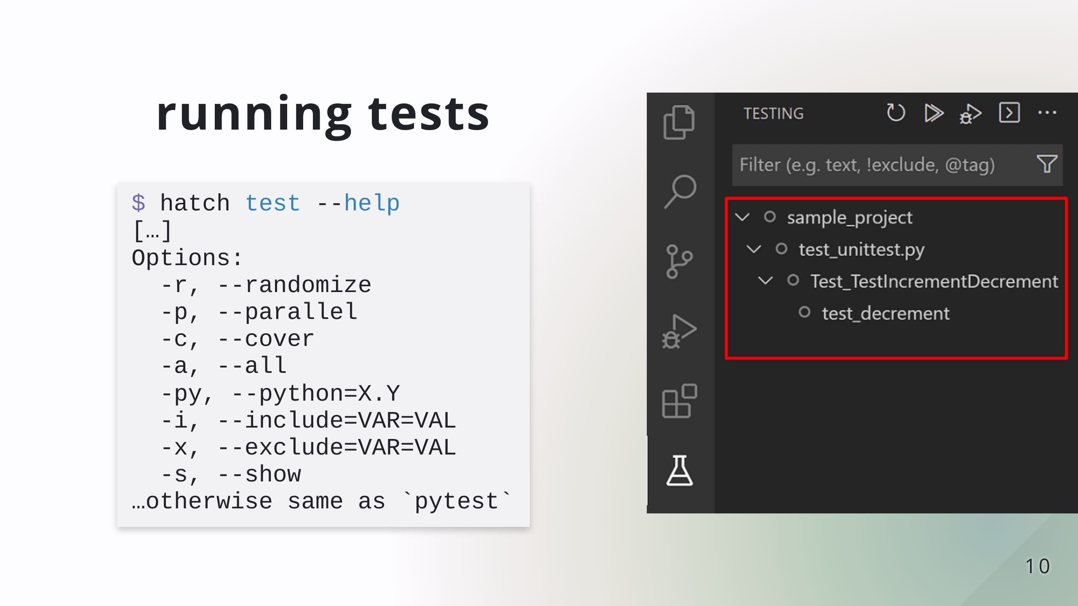

Slide 12
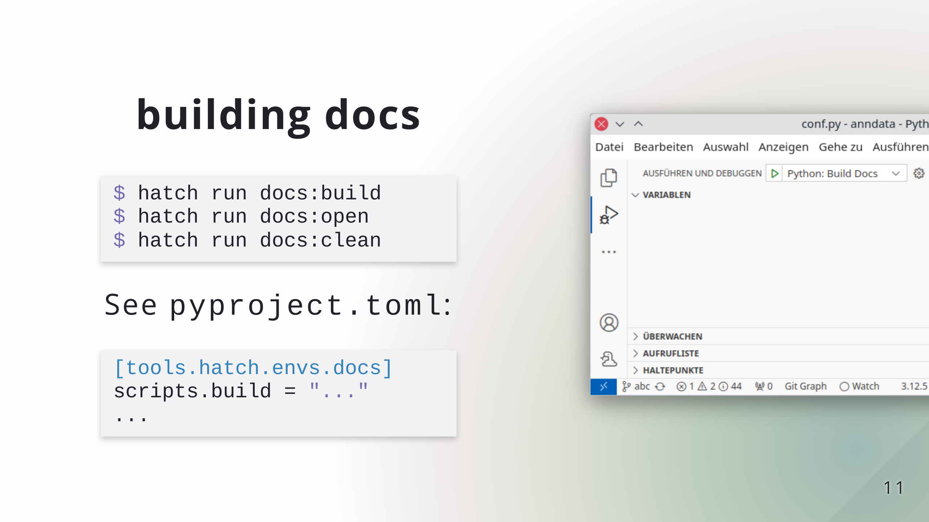

Slide 13
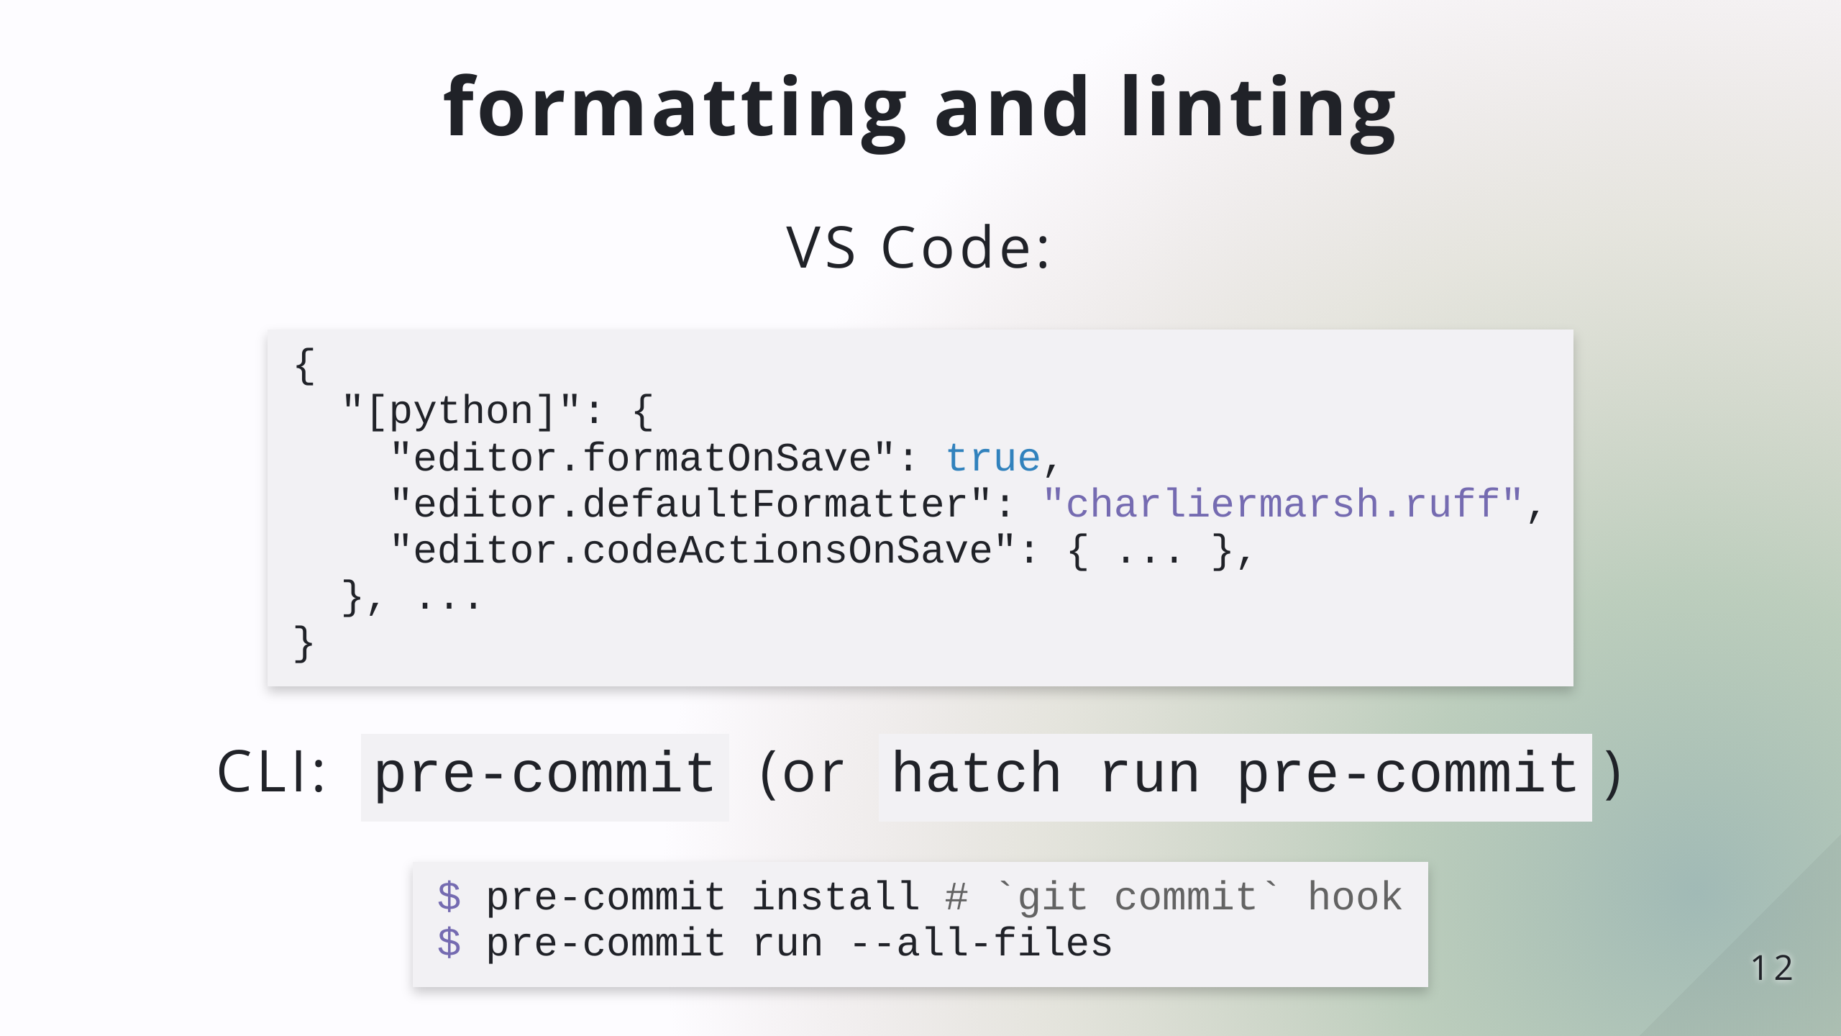
Notes:
Installing pre-commit globally is preferred

Slide 14
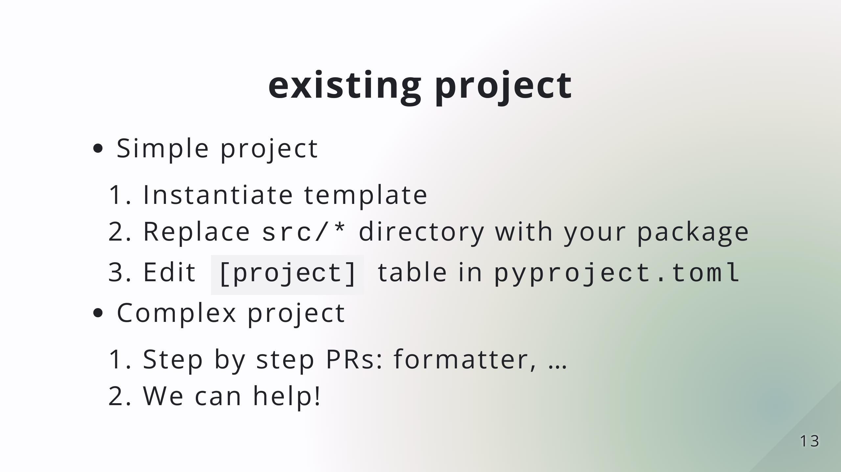
Notes:
simple: pure-python, one package

Slide 15


Slide 16
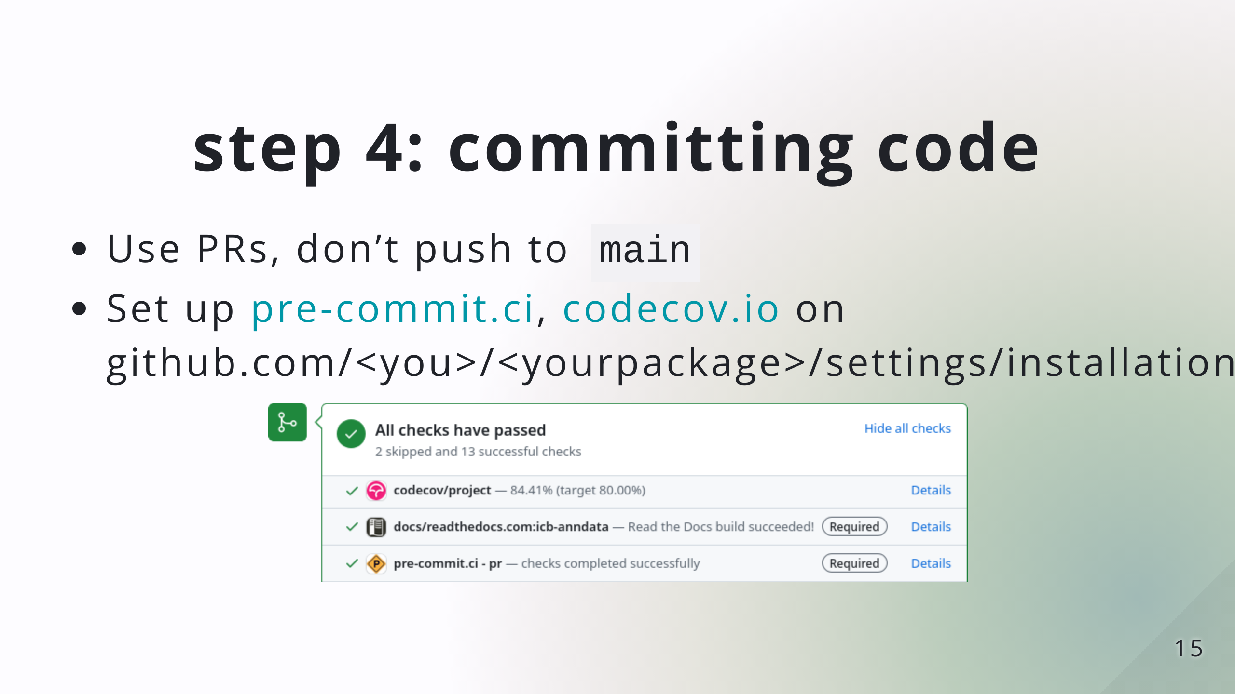
Notes:
No need to do this live, time should be mostly up here

Slide 17
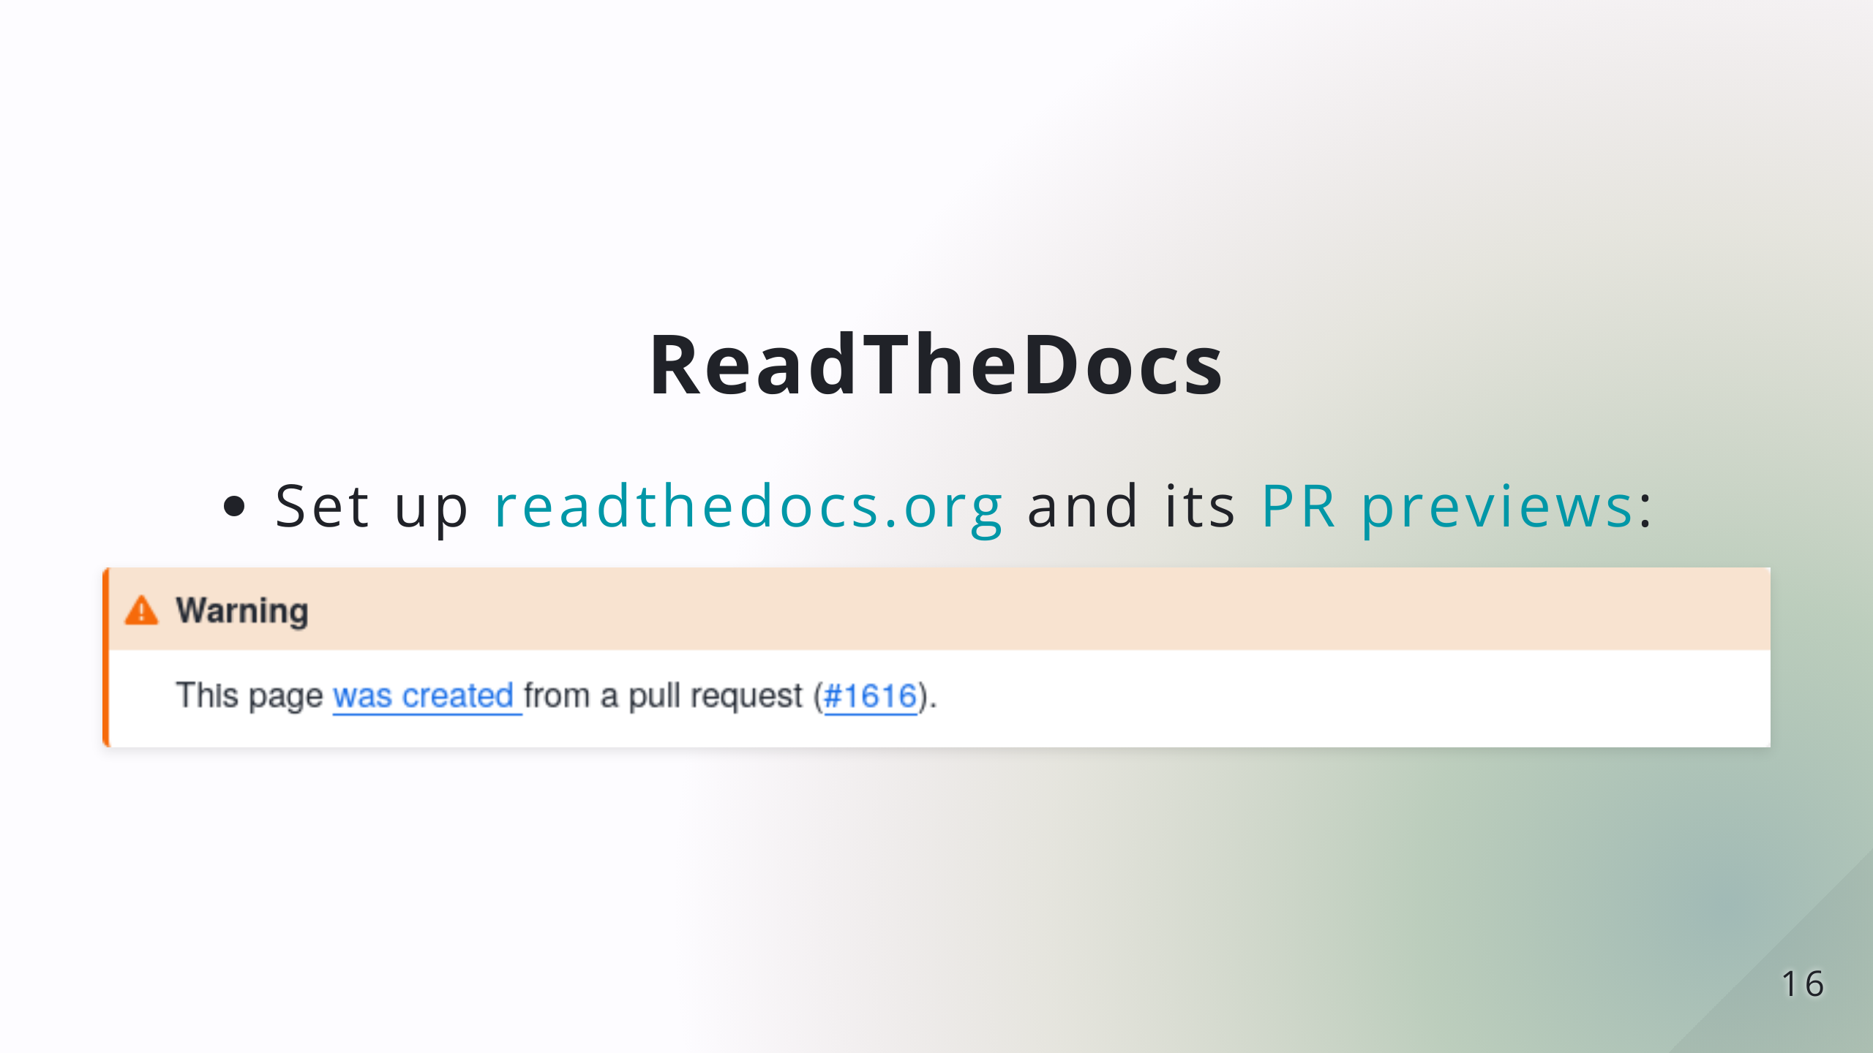

Slide 18
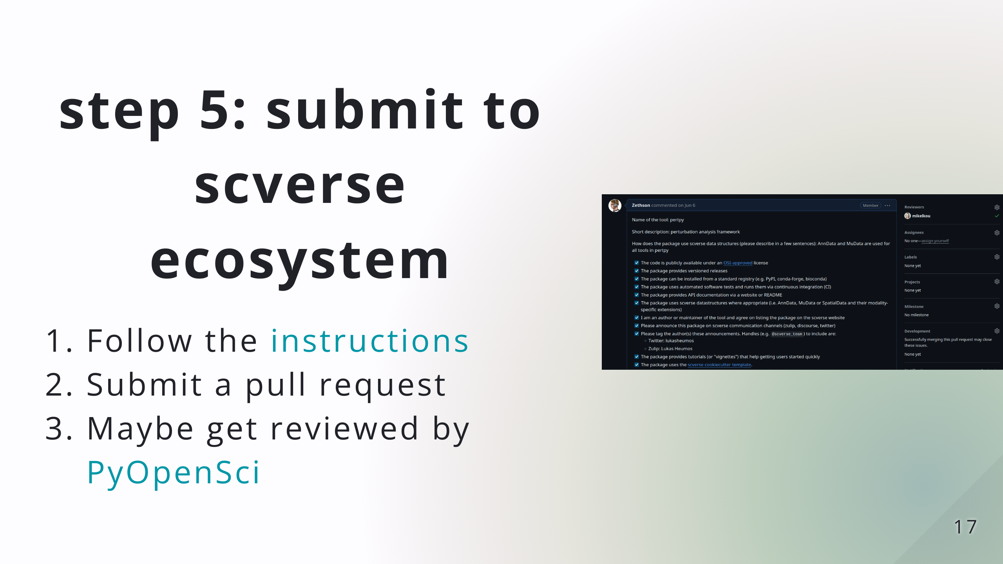

Slide 19


