Slide 1
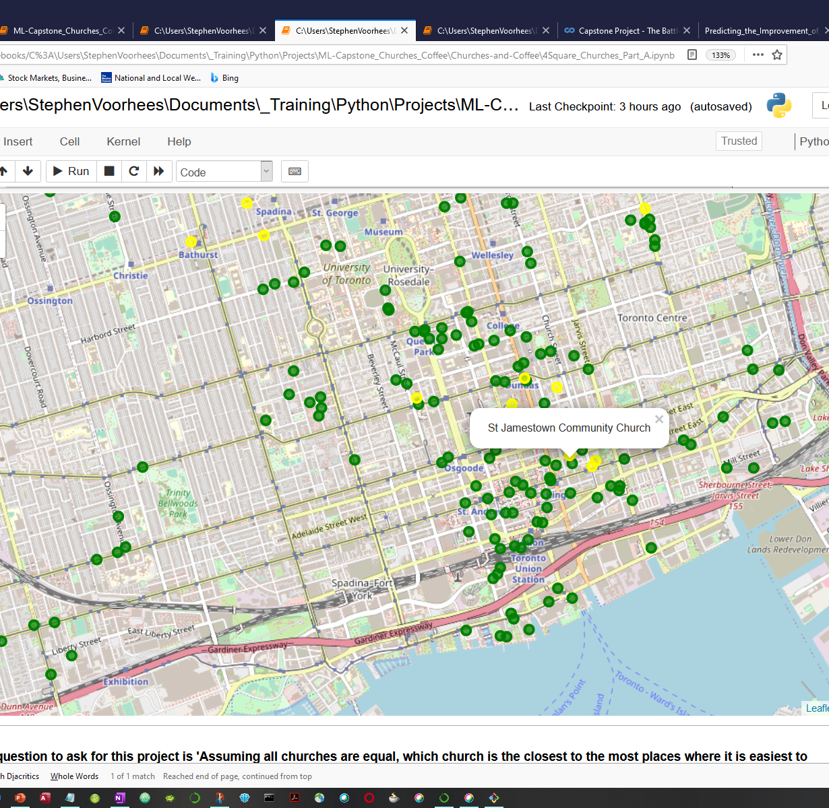
Churches and Coffee: The Best Geographically positioned churches

Slide 2
This project seeks the answer to two questions:
A. Given existing churches, which church is best located to take advantage of venues (cafes and coffee houses) to meet and discuss spiritual topics in order to share the gospel of Jesus Christ.
B. If a group of Christians were interested in starting a new church, what neighborhood would be an optimal choice in terms of nearby venues (cafes and coffee houses) that facilitate conversation and relationship building.

Slide 3
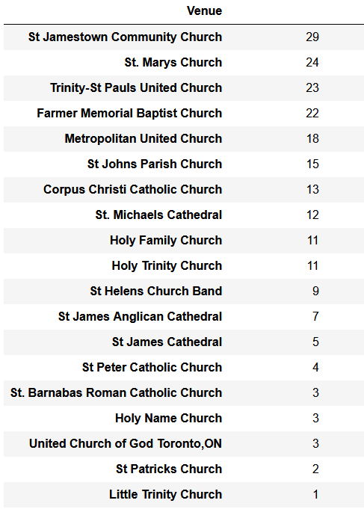
Part A
Define and apply a function that returns the closest centroid (church) for each point(venue or cafe/coffee house). We will use 'numpy broadcasting' to do this. Refer to the blog https://flothesof.github.io/k-means-numpy.html for an explanation of how numpy is used to identify which venue is assigned to which centroid.
Create a table of churches, sorted, in descending order, with the church having the most cafes/coffee houses nearby at the top.
No. of Nearby Cafes/Coffee Houses

Slide 4
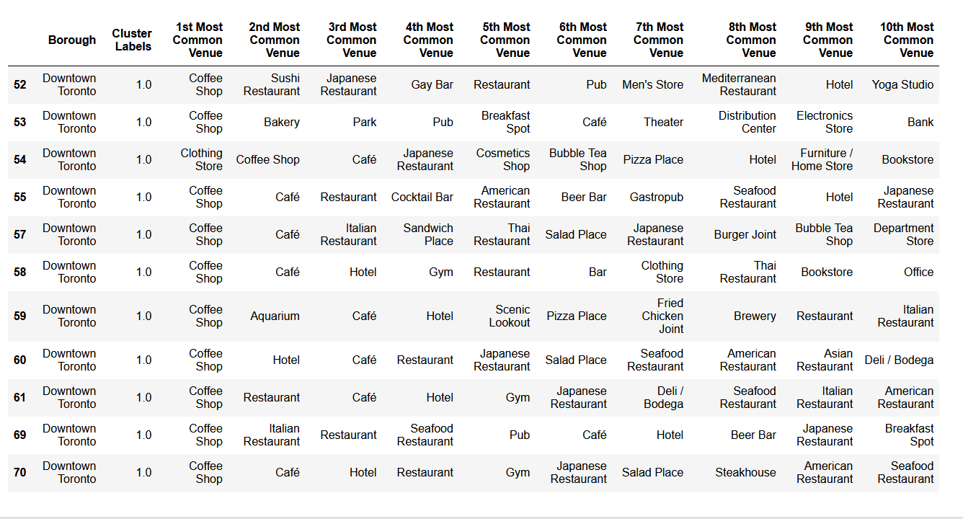
Part B
This part of the project that deals with answering the question of where to locate a new church, uses steps 1. - 4. above as well as applying K-Means cluster analysis to the data in order to find the neighborhood with the attribute of having many cafes / Coffee Houses. This is the same analysis as done in the assignment for Week 3 of this Capstone Project.
Most Common Venue of Coffee Shops is in Downtown Toronto

