Slide 1



Sage FlashPoint
Multi-node lightning localization
& wildfire ignition watch on the Sage fleet
range = Δt × 343 m/s
Cameras catch the flash. Microphones catch the thunder. Weather decides when to listen.
Samuel Watson · University of Hawaiʻi at Mānoa · Sage Summer Camp 2026 hackathon
This work was supported in part by the National Science Foundation under Awards No. 2331263 and 2436842.
Notes:
[15 s] Sage FlashPoint turns the fleet's existing cameras, microphones and weather stations into a lightning-detection and wildfire ignition-watch system. Every result shown was built and validated during camp week, on real archived fleet data.

Slide 2
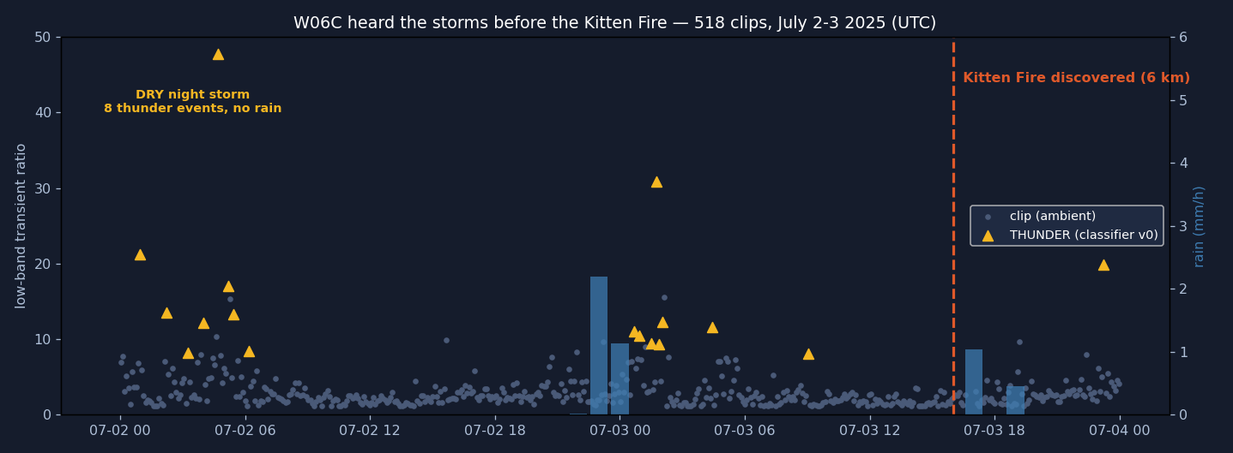
THE CASE
A Sage node heard the fire start. Nobody was listening.
Kitten Fire — Grand Teton WY, natural cause, discovered midday July 3 2025, six kilometers from node W06C.
The node recorded straight through both suspect storms: audio snapshots, PTZ (pan-tilt-zoom) camera frames, full weather telemetry.
Holdover fires smolder for hours or days before flaring. The strike is the earliest possible warning — and today nothing connects strikes to a follow-up watch.
6 km
779
51k
Across 518 classified clips: a DRY night storm (0.0 mm rain) and a second storm the next evening — then the discovery line.
node to fire point
audio clips, July 1–4
weather records
Notes:
[40 s] The flagship case. The Kitten Fire started six kilometers from a Sage node that was recording the whole time — audio, imagery, weather. The timeline shows what its microphone heard: a bone-dry night storm, a second storm the next evening, and the fire discovered midday after. All the evidence was there. Nothing was listening for it. That's the gap FlashPoint closes.

Slide 3
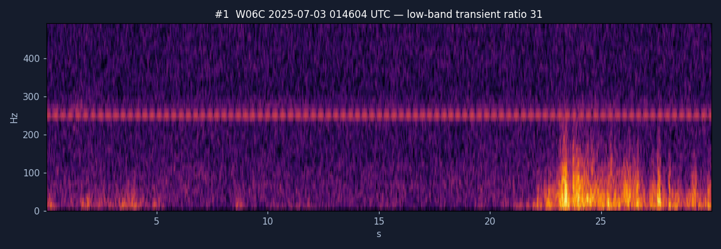
THE FALSIFICATION
17 confident detections. Two satellites. Zero survivors.
0 / 17
Audio-only detector v0 flagged 17 thunder events across the storm nights — all confident, none wind-vetoed.
Cross-checked against BOTH GOES-18 and GOES-19 (Geostationary Operational Environmental Satellites) lightning sensors — ±90-second window: not one flash within 50 km of any of them.
Single-modality detection false-alarms confidently.
That result became the architecture: standalone detections are nominations — never confirmations.
The strongest candidate of the 17 — low-band transient ratio 31 — of undetermined origin per two independent satellites.
Notes:
[45 s] First result: a negative one, and the most important. The audio-only detector found 17 thunder events and was confident about every single one. Two independent satellite lightning sensors falsified all seventeen — zero flashes within fifty kilometers. The raw recording lives in the repository — it fools human ears too. Hence FlashPoint's rule: no single sensor ever confirms a strike on its own.

Slide 4
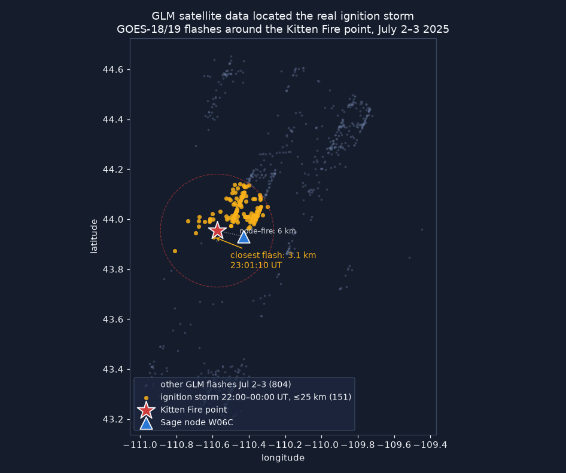
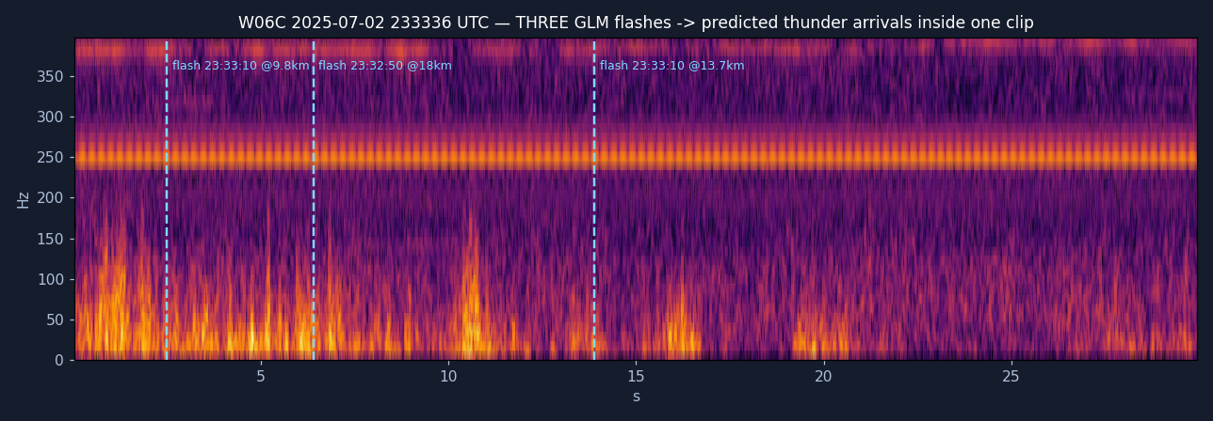
THE RECOVERY
Anchor on the flash, and the buried thunder appears
Each satellite flash gives a time-zero. Sound needs ~3 s per kilometer — so re-listening is confined to each flash's predicted arrival window.
22 real flash→bang arrivals surfaced from clips the rain noise had blinded — including three flashes ranged in a single 30-second clip:
The real ignition storm, located by satellite scan: closest flash 3.1 km from the fire point, ~3 h before discovery. Data: NOAA (National Oceanic and Atmospheric Administration) GLM (Geostationary Lightning Mapper) via AWS (Amazon Web Services) Open Data.
22
20/22
0.7 km
arrivals recovered
detector recall
median range error
Notes:
[45 s] The recovery: a satellite scan found the real ignition storm — closest flash 3.1 kilometers from the fire point. Knowing exactly when each flash happened, the detector re-listened in the narrow window where its thunder had to arrive — and 22 real arrivals surfaced from under the rain noise. The rebuilt noise-adaptive detector recovers 20 of the 22 with sub-kilometer range error. The volley recording in the repository holds three separate strikes — three rumbles, each at its predicted delay.

Slide 5
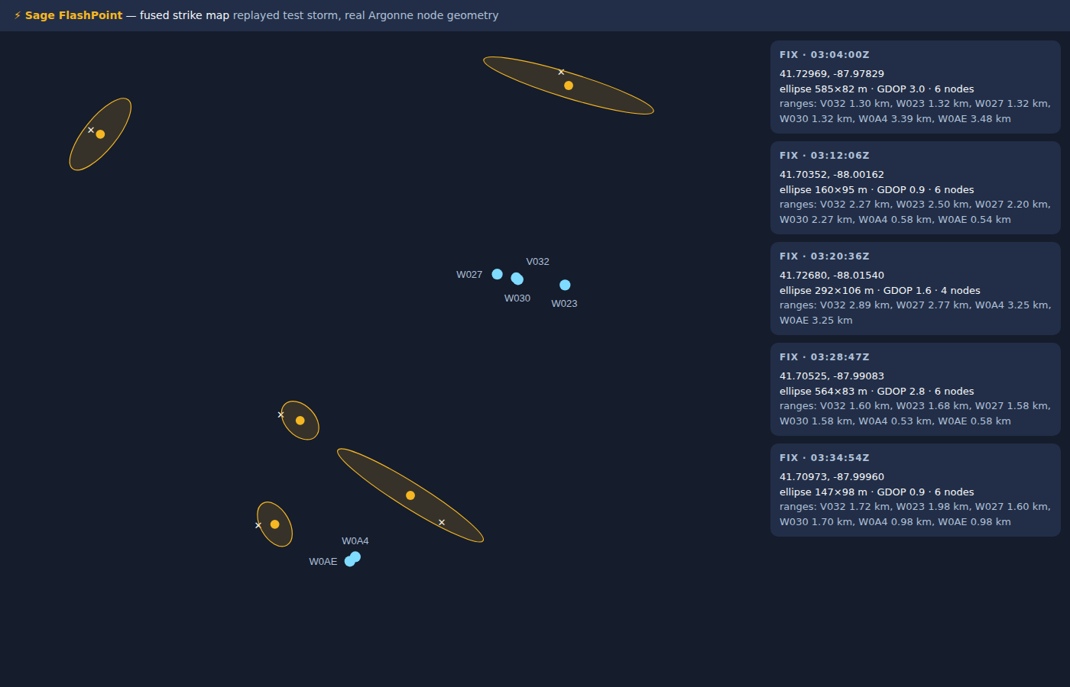
LOCALIZATION
Range without clocks, fixes without over-claiming
Light arrives instantly — a camera flash is a free, absolute time-zero at every node. No cross-node clock sync needed.
range = Δt × 343 m/s, per node; several nodes' ranges triangulate the strike.
Cross-node consistency (RANSAC — random sample consensus) picks the one candidate set that agrees; a geometry gate labels every solution fix, ambiguous, or range-only — the system never over-claims.
96 m
5/5
fix with no satellite, no sync (integration test)
strikes fixed in the replayed test storm, 70–273 m
Fused strike map: a replayed test storm over the real Argonne node geometry (cameras + microphones only).
Notes:
[40 s] How localization works with zero new hardware: light is effectively instant, so the flash gives every node its own clock. Time-to-thunder gives range; ranges from several nodes give a position with an honest uncertainty ellipse. The integration test localizes a strike to 96 meters with no satellite and no synchronization. The map shows the full engine fusing a replayed test storm over real Argonne geometry — five for five, all clean fixes.

Slide 6
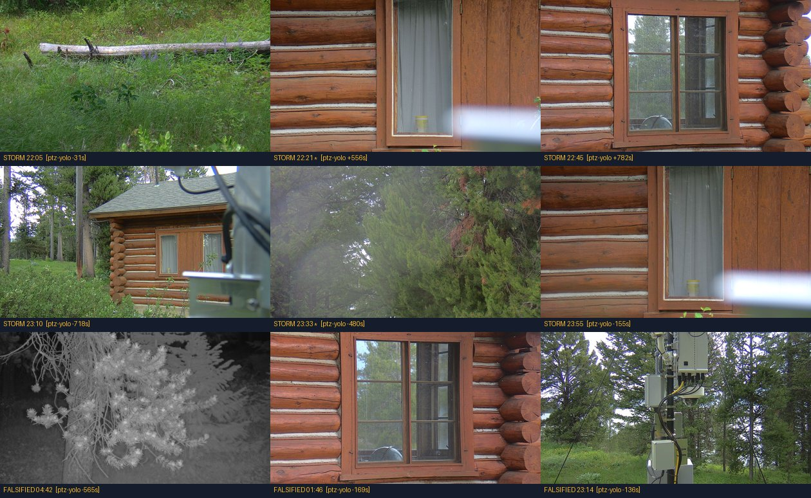
THE CONTROLLER
Storm mode armed 145 minutes before the first flash
IDLE
→
OUTLOOK
→
APPROACH
→
STORM
→
AFTERMATH
Free NWS (National Weather Service) outlooks arm it cheaply; radar cell tracks and local sensors escalate it; every action is budget-capped, hysteresis-damped, and audit-logged.
Replayed against the real Kitten storm feeds, it armed 145 minutes before the first local flash — then scheduled the holdover watch and expired cleanly. 19/19 tests.
Why it matters → the frame on the right: through the entire ignition storm, the node's steerable camera pointed at a cabin wall.
Two failures, honestly separated: tasking (fixed by this controller) and siting — W06C sits low in forest, so smoke confirmation needs elevated partner cameras or better-sited nodes. Both remedies are recommended.
W06C's PTZ camera during the ignition storm (top rows) and the falsified events (bottom row).
Notes:
[45 s] Detection only matters if the fleet is actually listening when the storm comes. The storm-mode controller escalates through tiers — free forecasts arm it, local evidence escalates it, everything is budget-capped and audit-logged. Replayed on the real Kitten storm it armed two hours and 25 minutes before the first local flash. And here's the motivation frame: during the ignition storm the node's steerable camera was pointed at a cabin wall. Storm mode fixes the tasking. Equally important is the honest half: siting. That camera may never have had a sightline at all — a fleet-design recommendation now returned to Sage.

Slide 7
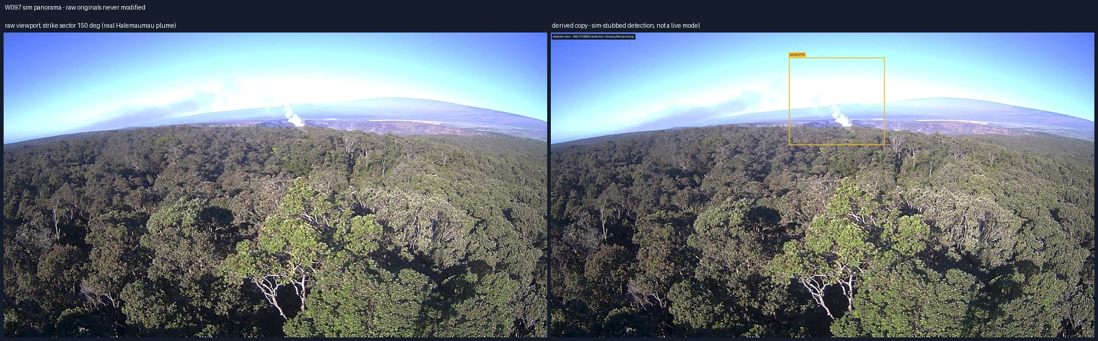
HOLDOVER WATCH + HUMAN REVIEW
Every strike becomes a 72-hour watchpoint
Evidence ships as an untouched raw frame plus a labeled derived copy. The boxed detection here is a test-harness placeholder — in live gateway runs, Gemma 4 captions each frame and YOLO11 draws detection boxes; SmokeyNet is the planned smoke detector (W097 panorama; the plume is a real Halemaʻumaʻu gas plume).
PTZ patrols strike sectors by risk, dwelling to the smoke model's needs — validated through the real sage-agent gateway on the camp node (test-mode PTZ, live Gemma 4 captions).
Ignition-risk score with per-factor provenance: node rain gauge, NASA (National Aeronautics and Space Administration) POWER (Prediction of Worldwide Energy Resources) dryness, fuel, detection confidence.
Alerts land in Slack: one glanceable summary line, evidence strip inline, full forensic audit in-thread.
Reviewers click Confirm / False positive / Keep watching — decisions flow back to the node AND become labeled training data. No automated dispatch, ever.
Notes:
[40 s] After a strike, the watch: the camera patrols strike sectors on a risk-ranked schedule, and evidence always ships as raw plus annotated pairs — detection boxes are never burned into the only copy, a lesson learned from this very archive. The boxed detection on this slide is a test-harness placeholder; the smoke model itself is future work. Alerts go to Slack scored and explained, and a human clicks confirm or reject. Those clicks flow back to the node and double as labeled training data. Nothing is ever auto-dispatched.

Slide 8
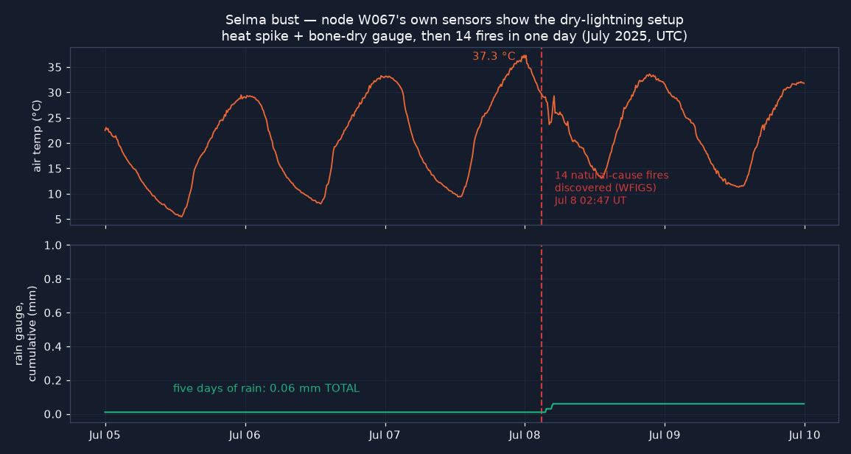
THE SECOND CASE
Fourteen fires. Five days. 0.06 millimeters of rain.
Selma, Oregon: 14 natural-cause fires logged in ONE day, 14–34 km from node W067.
The node's own gauge: 0.06 mm across five days, under a 37 °C spike. Its only movement — a 0.05 mm trace — lands exactly on the fire line: the ignition storm itself, essentially dry.
Risk score v0.1 back-test — separation is already clean:
87
Kitten dry night storm → fire next day
84
Selma bust → 14 fires next day
Queried live during camp week from W067's public weather streams. Fire records: NIFC (National Interagency Fire Center) WFIGS (Wildland Fire Interagency Geospatial Services), agency-determined cause.
41
wet-storm control → low risk, correct
0
no-strike day → no card, correct
Notes:
[35 s] Case two proves the risk side with met data alone. Near Selma, Oregon, fourteen natural-cause fires were discovered in a single day. The node's own rain gauge: six hundredths of a millimeter across five days, under a 37-degree heat spike — and its only uptick lands exactly on the fire line. That's the ignition storm passing, essentially dry. The transparent risk score already separates cleanly: both real ignition storms score hot, both controls score low.

Slide 9
THE HONEST LEDGER
What was built, what was found, and the limitations
BUILT THIS WEEK
FOUND FOR SAGE
LIMITATIONS
Noise-adaptive thunder + flash detectors (anchored listening)
Sage/Waggle edge plugin — built and RUN on a Sage node; candidates published to the cloud API (application programming interface)
Audio classifier probe v0 — YAMNet + logistic regression, AUC (area under the curve) 0.95 vs 0.70 for the DSP (digital signal processing) score, same labels (first neural result)
Storm-mode controller — 19/19 tests, real-storm replay
Fusion engine + strike maps with GDOP (geometric dilution of precision) gating
Risk cards + Slack human-review loop, live end-to-end
Forensic dashboard used to build all of the above
No soil / fuel-moisture sensor publishes anywhere on the fleet
The manifest is not the archive: 97 nodes list microphones, only 64 ever recorded — and W021 (Colorado) records audio with none listed
The fleet's #2/#3 most fire-exposed recording nodes (V040/V041, Oregon) ran their microphones only in autumn–winter: 0 of their 35 storm days captured
Camera siting caps the smoke leg — recommend ridge-top “sentinel” placement or cueing partner networks (ALERTWildfire, HPWREN)
Node liveness is task-level: W096's imagesampler silent 24+ h while met + audio kept flowing
Case-node file ACLs (access-control lists; W067 et al.) — access requests filed
One real storm validates the audio chain (Kitten)
Fusion + flash validated in replay tests — real multi-node captures need storm mode running
Ground truth (satellite pixels 8–14 km) is coarser than the sub-km claims — Vaisala research-data request submitted Jul 24, not yet approved
Read access to key fire-country node archives (W067, W084/W06F, W019) was requested but not granted — additional storm/fire cases went unexamined
Live PTZ control untested: the W0A4 sandbox camera's web interface was reached over an SSH (Secure Shell) tunnel, but control permissions were not granted — re-aim runs in test mode only
One hackathon week: v0.1 weights, dry-run job control
Notes:
[40 s] The ledger. Built this week: the full chain — detectors, an edge plugin that already ran on a Sage node and published candidates to the cloud, a first neural probe at 0.95 AUC, the controller, fusion, and the human-review loop, all tested. Found for Sage: real fleet gaps, including zero soil moisture sensors anywhere, and the camera-siting constraint. The fleet-history catalog behind two of the middle-column findings read seven million satellite lightning granules and ranks 448 fire-and-node pairs for follow-up — the Kitten Fire lands at number four, which validates the ranking. And the limitations, stated plainly: one real storm behind the audio numbers, replay-test-only validation for fusion, ground truth coarser than the precision claims — hence the Vaisala research request, submitted July 24 and still awaiting approval — several fire-country node archives that likely hold more storm and fire cases stayed closed to read access, and live PTZ control still untested: the sandbox camera was reachable over an SSH tunnel, but control permissions were not granted, so re-aim runs in test mode only.

Slide 10
The fleet already hears the storms.
Sage FlashPoint makes it listen — and watch what happens next.
FUTURE DIRECTIONS
NLDN (National Lightning Detection Network) ground truth research request submitted July 24
Neural classifier probe v0 landed: AUC 0.95 vs 0.70 DSP — next, reviewer-click labels
Smoke leg SmokeyNet plugin on watch cadence
RF (radio frequency) time-zero SDR (software-defined radio) sferic anchor — daytime parity
Hawaiʻi variant wind-trigger controller on HCDP (Hawaiʻi Climate Data Portal) feeds
Live PTZ actuation camera-control credentials on the W0A4 sandbox unblock real re-aim
Data sources: NIFC WFIGS (fire records, agency-determined cause) · NOAA GOES-18/19 GLM via AWS Open Data · NASA POWER & SMAP (Soil Moisture Active Passive), via Earthdata · NWS · Vaisala Xweather · Sage data & storage APIs · Models: YAMNet, YOLO11 (You Only Look Once), Gemma 4 (SmokeyNet planned) · Maps: Leaflet, © OpenStreetMap contributors, © CARTO
code, data, audio & writeup: github.com/scwatson4/sage-summer-camp-2026 → flashpoint/ · thank you
Notes:
[25 s] The fleet already hears the storms — FlashPoint makes it listen. Next: NLDN ground truth is already requested, reviewer clicks are already accumulating as training labels, and the same controller re-armed on wind triggers becomes the Hawaiʻi deployment on HCDP mesonet feeds. Everything — code, data, and the actual thunder recordings — is in the repo. Thank you.

Slide 11
TARGET OPERATING CONCEPT
Flow of state: from quiet skies to a verified alert
Beehive cloud — orchestrator agent
1
Quiet watch Normal snapshot schedules; the orchestrator tracks forecasts and radar for every node's neighborhood.
A more capable LLM (large language model) agent runs where Sage already connects every node — it moves nodes between states; the nodes stay deterministic.
↓ weather conditions suggest lightning near a group of nodes
2
Always-on capture Cameras, microphones, and the SDR (software-defined radio) lightning sensor record continuously on the affected nodes.
Sees every node telemetry, detections, camera frames, health — via the Beehive pipeline
↓ SDR registers a positive strike AND enough nodes sit within listening range
3
Strike triangulated The strike's radio pulse gives every node the same start-of-clock; thunder delays give distances that cross at the strike.
Sees the outside world NASA Earthdata · Vaisala Xweather · National Weather Service · GOES satellites
↓ location fixed — the orchestrator picks the best-placed camera
4
Smoke watch A PTZ (pan-tilt-zoom) camera with a horizon view aims at the strike sector; the smoke agent revisits through the holdover window.
Directs, never dispatches chooses node states and cameras; every action logged
↓ smoke confirmed at the sector · no smoke by window's end → return to 1
5
Notify emergency personnel Before-and-after pictures plus the conditions leading up to the strike — soil moisture, rainfall, wind.
The orchestrator supervises every state at right and can advance or reset the flow at any time.
SDR sensing is planned hardware — the camera flash is the start-of-clock today. Notifications are human-reviewed before anything reaches responders. Soil moisture currently comes from NASA data; an on-node probe is the planned upgrade.
Notes:
[Optional / Q&A] The operating picture this grows into: a fleet-level orchestrator at Beehive with whole-board visibility moves nodes through five states — quiet watch, always-on capture, triangulation, smoke watch, notify — with every transition condition explicit and every action logged. The footnote separates what runs today from planned hardware.

Slide 12









TARGET OPERATING CONCEPT — SIMPLIFIED
Sage FlashPoint — flow of state
The Beehive-level orchestrator supervises every step; each arrow fires only when its condition is met.
Beehive Cloud Orchestrator Agent — LLM (large language model)
Every node
External data
Directs, never dispatches
telemetry · detections · frames
NASA · Xweather · National Weather Service · GOES
every action logged
lightning weather forecast near nodes
SDR strike + enough nodes in range
location fixed → best camera chosen
smoke confirmed (else back to 1)
1 · Quiet watch
2 · Always-on capture
3 · Strike located
4 · Smoke watch
5 · Notify responders
Normal snapshot schedules; the orchestrator tracks the weather
Cameras, microphones, and the SDR (software-defined radio) sensor record continuously
The radio pulse is the shared clock; thunder delays cross at the strike
A horizon-view PTZ (pan-tilt-zoom) camera aims at the sector; the smoke agent revisits for days
Before-and-after pictures plus soil moisture, rainfall, and wind before the strike
SDR lightning sensing is planned hardware — the camera flash serves as the start-of-clock today. Notifications are human-reviewed before anything reaches responders. Soil moisture comes from NASA satellite and model data; an on-node probe is the planned upgrade.
Notes:
[Optional / Q&A] The same five-state flow as the previous slide, drawn in the Sage documentation style: the Beehive cloud container on top, the node states left to right beneath it. Content is identical — use whichever version reads better for the audience. The footnote again separates what runs today from planned hardware.

Slide 13
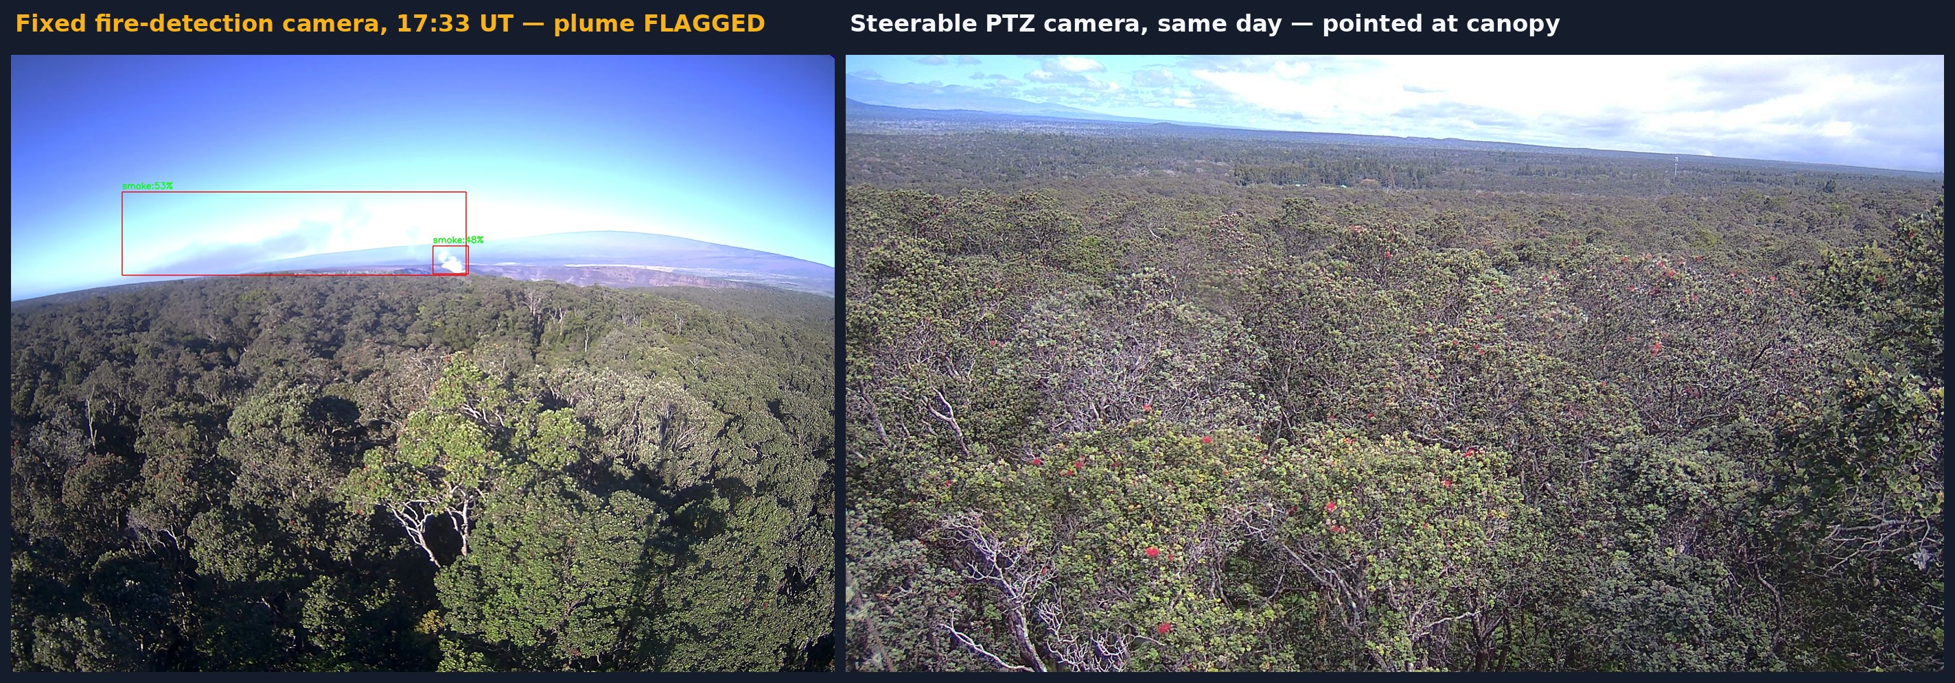
BACKUP — FOR Q&A
The pattern repeats on a second node
W097, Hawaiʻi Volcanoes National Park, 2025-10-05. Left: the node's fixed fire-detection camera flagged the persistent Halemaʻumaʻu gas plume — the detection boxes were drawn by the node's production detector, not by this project. Right: the steerable PTZ camera the same day, pointed at canopy.
Camera capability was never the gap — watch tasking is. The same lesson as the cabin wall, on a different node and hazard.
Notes:
[Backup — show only if siting or tasking questions come up in Q&A. Second, independent example: this node's fixed camera flagged the plume with its production detector while the steerable camera studied canopy the same day. Tasking, not camera capability, is the gap the storm-mode controller closes.]

