Slide 1
RedDog and Nextflow

Slide 2
Reddog

Slide 3
High level overview
Input
Mapping
SNP calling and filtering
Mapping stats
Allele matrices
Phylogeny
Consequences

Slide 4
Why use Nextflow as pipeline framework
Stability and portability
Task caching
Job retry/resubmission
Pipeline progress
Dynamic QoS and partition allocation
Generally good error messages and debug information

Slide 5
Typical run
# Create persistent screen session
screen –R rr_haemophilus
# Clone the reddog-nf repository and activate conda environment
git clone https://github.com/scwatts/reddog-nf.git && cd reddog-nf/
conda activate /projects/js66/software/conda_envs/reddog-nf/
# Set input reads, reference, and output directory in configuration file
vim nextflow.config
# Launch pipeline
./reddog.nf -profile massive
File: nextflow.config
// Input and output
reads = ‘reads/*fastq.gz’
reference = ‘data/reference.gbk’
output_dir = ‘output/’

Slide 6
The work/ and output directories
All task output files are stored in the work/ directory
Only final output files are copied to the output directory
This allows job caching and
resuming pipeline execution
Once the pipeline is complete, you
must delete the work/ directory
[stephen@stretchy ~/working/nextflow_tutorial/]$ tree –L 2 work/
work/
├── 00
│ └── 9e93d3933223ca392200763d07d352
├── 01
│ └── 637164b54fc2d79f80271fa32cf884
├── 04
│ ├── 084bb5780c66ce8303f9da33d8b1b4
│ └── 878b07d1a55f623ec13b90c7ad9dda
├── 05
│ └── 1d23d93d200f355a3ada5b2ec26163
├── 06
│ └── eaed690a3acb1063b3d6ed7d04fbd3
├── 07
│ ├── 6eff89e0d440ec495ea5068c892d96
│ ├── b833d2688260697204c26c9b4a8cdd
│ └── f3e4b7be40a7747b4897af6b087e05

Slide 7
Resuming a run
# Reconnect to screen
screen -R rr_haemophilus
# Resume run
./reddog-nf –profile massive –resume --force

Slide 8
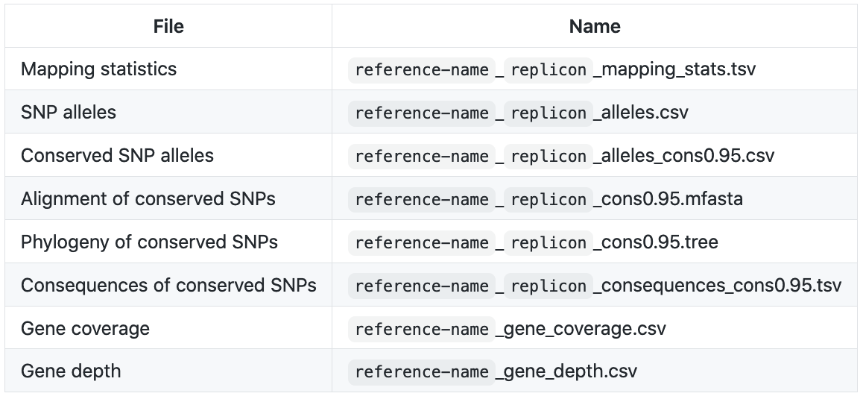
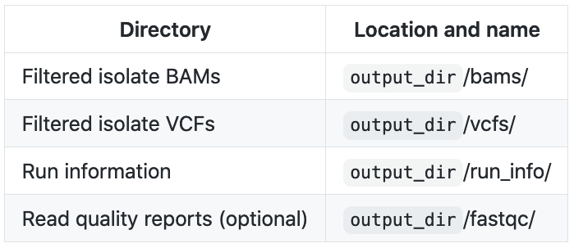
Outputs
Files
Directories
At completion of a RedDog run, you must remove the work/ directory

Slide 9
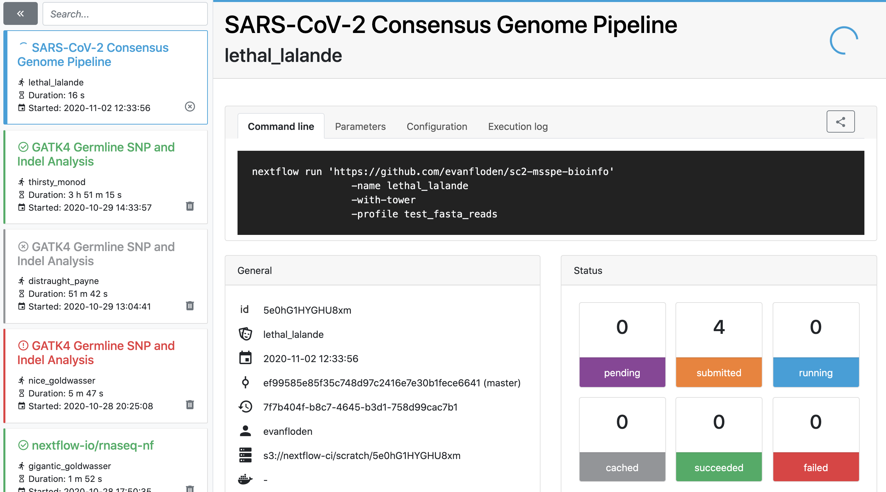
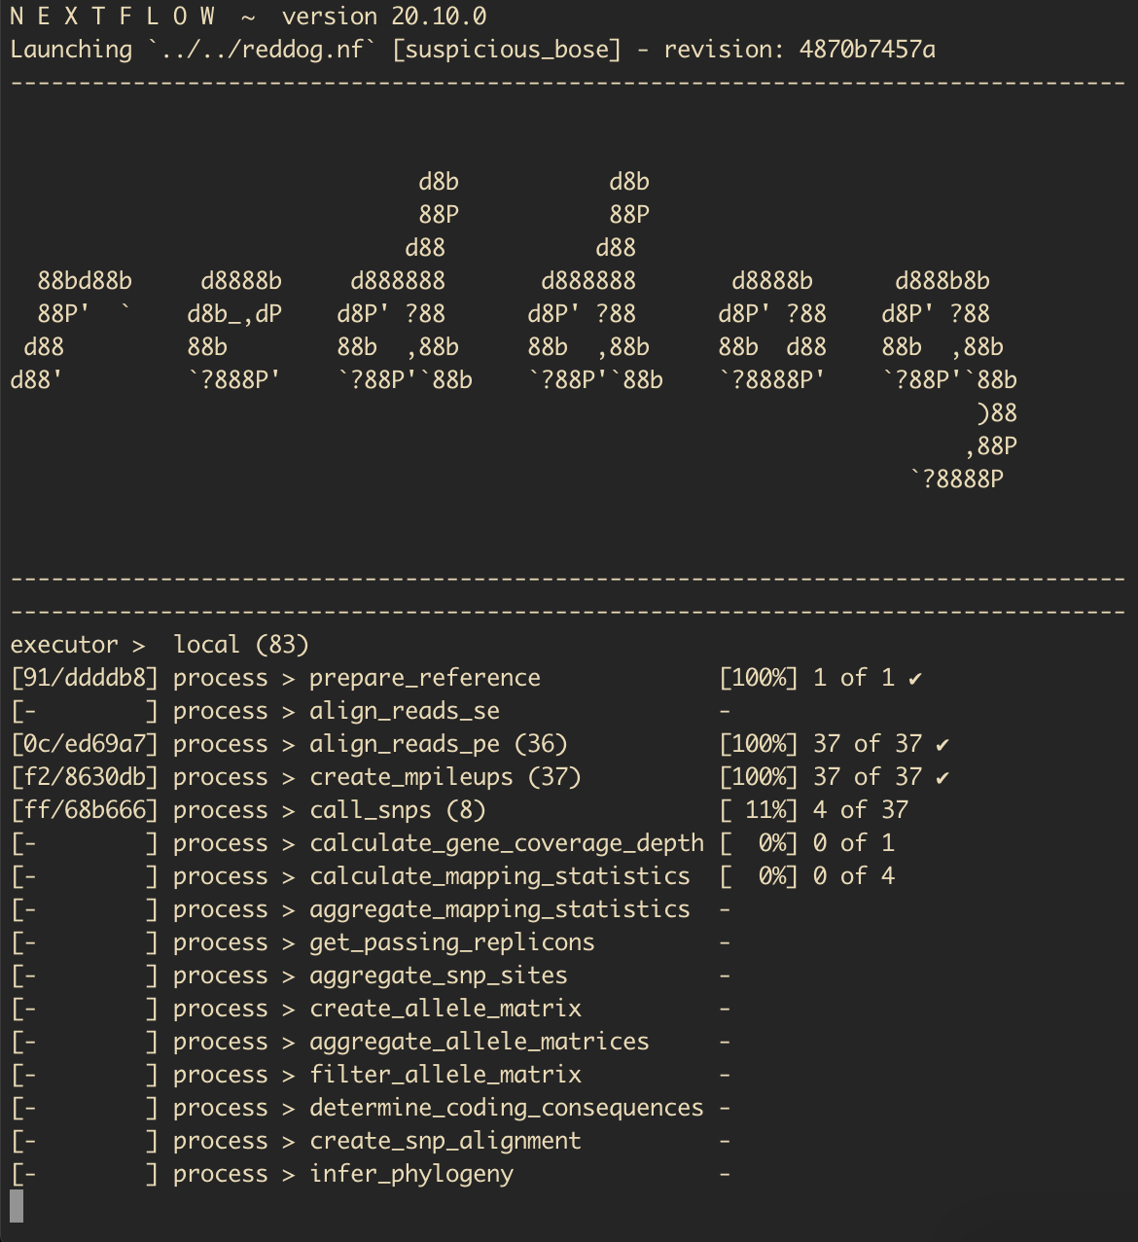
Terminal
SSH into M3
Open screen
Nextflow tower
Nextflow progress in the terminal

Slide 10
Merge run
Read set 1
Read set 2
Input
Read set 1
RedDog output
Mapping
SNP calling and filtering
Mapping stats
Allele matrices
Phylogeny
Consequences

Slide 11
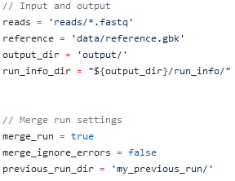
Merge run
Data handling
File: nextflow.config
New readset
Previous run directory
Merge run output
Data copied; user must delete previous run directory

Slide 12
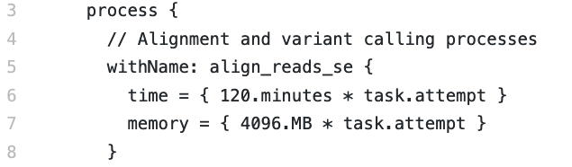
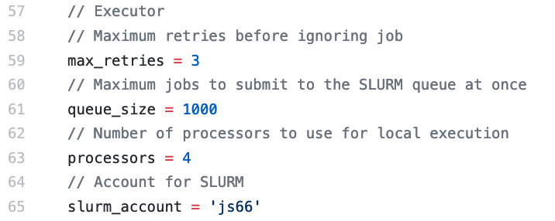
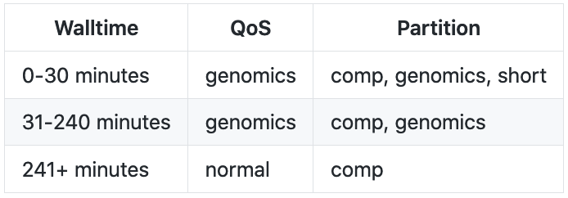
Other notes
Default resource allocation requests
config/slurm_jobs.config
Queuing limit
nextflow.config
QoS and partition
Current SLURM genomics queue limit: 1,000

Slide 13
Testing RedDog
# Create persistent screen session
screen -R rr_tut
# Clone the reddog-nf repository and activate reddog-nf conda environment
git clone https://github.com/scwatts/reddog-nf.git && cd reddog-nf/
conda activate /projects/js66/software/conda_envs/reddog-nf/
# Run unit tests
python3 –m unittest
# Run end-to-end test; prepare data
cd tests/simulated_data/
mkdir -p reads/
./scripts/generate_reference.py > data/reference.gbk
./scripts/simulate_reads.py \
--reference_fp data/reference.gbk \
--spec_fp data/dataset_specification.tsv \
--output_dir reads/
# Launch end-to-end test and compare output
../../reddog.nf -profile standard --force
./scripts/compare_data.py \
--run_dir output/ \
--spec_fp data/dataset_specification.tsv \
--test_data_dir data/run_data/
Notes:
* Delete work/ directory at conclusion of run

Slide 14
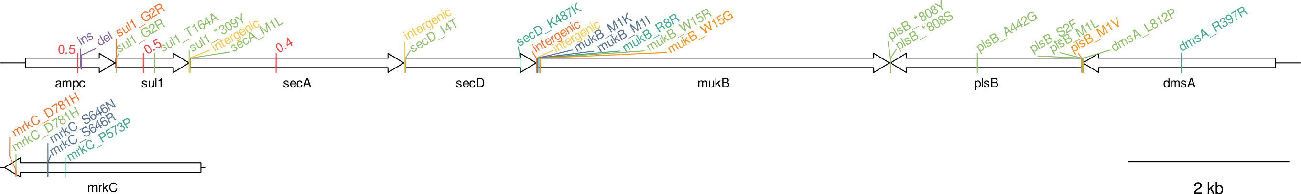
Reference and SNPs tested
Contig 1
Contig 2
Homozygous SNPs
Synonymous, nonsynonymous, intergenic
Same variants across isolates
Same position different consequence
Multiple variants in same codon
Start and stop codons
Forward and reverse genes
Heterozygous SNPs
Simulated at specific ratios
Both alleles differing from reference
One allele different from reference
INDELs SNPs
Insertion and deletions

Slide 15
Nextflow

Slide 16
Overview
Channel 1
Channel 2
Data
Process A
Process B
Output directory

Slide 17
Overview
Channel 1
(short reads)
Channel 2
(assemblies)
Data
short reads
Process A
Read assembly
Process B
Assembly stats
Stats
Assemblies
Processes with input and outputs (channels)
Channels connect tasks
Nextflow implicitly handles job dependencies
Data flows through channels and processes run as needed
Output directory

Slide 18
Allele matrices
Prepare reference
Alignment process(es)
Reference FASTA
BAM (mapped)
SNP calling
SNP sites
aggregate_sites
allele_matrix
aggregate_matrices
filter_matrices
Combine SNP sites
List of Q30 site in present in >=1 passing isolate
For each isolate
Get respective SNP sites
Site-specific consensus
bcftools mpileup
-q20, -Q20
bcftools call
No INDELS
ploidy 1 (haploid)
Print cons allele where:
ALT != ‘.’
Q>=20
Support>=0.9
Either ref or alt printed
See below for def
Else, allele is unknown (‘-’)
For each replicon
Get list of expected sites
Read all isolate matrices
Fill in missing data (‘-’)
Remove sites with many unknown alleles
allele_matrix_cons
Mapping stats
Mapping stats
passing_replicons
Create simple list of passing isolates
Very fast, local executor
Allele matrix
Allele matrix cons
Position support
Ratio of reads supporting ref and alt
Information extracted from DP4
support_ref = ref_reads / total_reads
support_alt = alt_reads / total_reads
Where REF has support >= 0.9, it is printed
Or, if support_alt >= 0.9, ALT is printed instead

Slide 19
Creating a pipeline
Channel 1
(short reads)
Channel 2
(assemblies)
Data
short reads
Process A
Read assembly
Process B
Assembly stats
Stats
Assemblies
Processes with input and outputs (channels)
Channels connect tasks
Nextflow implicitly handles job dependencies
Data flows through channels and processes run as needed
Output directory

Slide 20
Input
Channel 1
(short reads)
Channel 2
(assemblies)
Data
short reads
Process A
Read assembly
Process B
Assembly stats
Stats
Assemblies
Output directory

Slide 21
Input
Nextflow code:
// Create paired read channel
ch_reads = Channel.fromFilePairs('data/*_R{1,2}.fastq.gz', flat: true)
Channel 1
(short reads)
Channel 2
(assemblies)
Data directory contents:
Data
short reads
Process A
Read assembly
Process B
Assembly stats
[stephen@stretchy ~/working/nextflow_tutorial/data]$ ls -1
isolate_a_R1.fastq.gz
isolate_a_R2.fastq.gz
isolate_b_R1.fastq.gz
isolate_b_R2.fastq.gz
isolate_c_R1.fastq.gz
isolate_c_R2.fastq.gz
Stats
Assemblies
Output directory
ch_reads contains:
isolate_a, data/isolate_a_R1.fastq.gz, data/isolate_a_R2.fastq.gz
isolate_b, data/isolate_b_R1.fastq.gz, data/isolate_b_R2.fastq.gz
isolate_c, data/isolate_c_R1.fastq.gz, data/isolate_c_R2.fastq.gz

Slide 22
Processes
Nextflow code:
process read_assembly {
publishDir path: {"${output_dir}"}, mode: 'copy'
input:
tuple val(isolate_id), path(reads_fwd), path(reads_rev)
output:
tuple val(isolate_id), path('*.fasta')
script:
"""
skesa \
--reads ${reads_fwd},${reads_rev} \
--cores 1 \
> ${isolate_id}.fasta
"""
}
Channel 1
(short reads)
Channel 2
(assemblies)
Data
short reads
Process A
Read assembly
Process B
Assembly stats
Stats
Assemblies
Output directory

Slide 23
Processes
Nextflow code:
process assembly_stats {
publishDir path:{"${output_dir}"}, mode: 'copy'
input:
tuple val(isolate_id), path(assembly_fasta)
output:
path('*_stats.tsv')
script:
"""
assembly_stats.py \
-a ${assembly_fasta} \
> ${isolate_id}_stats.tsv
"""
}
Channel 1
(short reads)
Channel 2
(assemblies)
Data
short reads
Process A
Read assembly
Process B
Assembly stats
Stats
Assemblies
Output directory

Slide 24
Connecting processes
Nextflow code:
Channel 1
(short reads)
Channel 2
(assemblies)
Data
short reads
Process A
Read assembly
Process B
Assembly stats
ch_reads = Channel.fromFilePairs('data/*_{1,2}.fastq.gz', flat: true)
<processes code (hidden)>
workflow {
ch_assemblies = read_assembly(ch_reads)
assembly_stats(ch_assemblies)
}
Stats
Assemblies
Output directory

Slide 25
All together
ch_reads = Channel.fromFilePairs('data/*_{1,2}.fastq.gz', flat: true)
output_dir = 'output/'
process read_assembly {
publishDir path: {"${output_dir}"}, mode: 'copy'
input:
tuple val(isolate_id), path(reads_fwd), path(reads_rev)
output:
tuple val(isolate_id), path('*.fasta')
script:
"""
skesa --reads ${reads_fwd},${reads_rev} --cores 1 > ${isolate_id}.fasta
"""
}
process assembly_stats {
publishDir path:{"${output_dir}"}, mode: 'copy'
input:
tuple val(isolate_id), path(assembly_fasta)
output:
path('*_stats.tsv')
script:
"""
assembly_stats.py -a ${assembly_fasta} > ${isolate_id}_stats.tsv
"""
}
workflow {
ch_assemblies = read_assembly(ch_reads)
assembly_stats(ch_assemblies)
}
Channel 1
(short reads)
Channel 2
(assemblies)
Data
short reads
Process A
Read assembly
Process B
Assembly stats
Stats
Assemblies
Output directory

Slide 26
Common debugging approach
Something went wrong
Locate work directory
e.g. work/6e/d17675835da6f944b91730a0812cc8/
Log files (display using ls –a):
.command.err
.command.log
.command.out
Investigate logs
Manually re-run task
activate conda environment
add bin/ to PATH: export PATH=../../bin:$PATH"
run task command (located in .command.sh)
???
Squash bug

Slide 27
Helpful resources
Official documentation: nextflow.io/docs/latest/dsl2.html
Common design patterns: nextflow-io.github.io/patterns
Real-world examples: github.com/nextflow-io/awesome-nextflow

