Slide 1
ACF Public Supply SWUDS disaggregation
Work out relational fields and missing data based on Nancy and Jamie’s recommendations from the emails with Scott (Almost Finished)
10,712 entries from SWUDS (ga-permits.csv, aggregate and individual sources/locations)
11,881 entries from NWIS (ga_nwis.csv, volumes)
Subset to the ACF area of interest
Build well clouds for each aggregate source
Have several disaggregation scenarios (multiple HUC12s for each aggregate site)
Calculated disaggregated WU volume by HUC12

Slide 2
ACF Public Supply SWUDS disaggregation
Work out relational fields and missing data based on Nancy and Jamie’s recommendations from the emails with Scott (Almost Finished)
10,712 entries from SWUDS (ga-permits.csv, aggregate and individual sources/locations)
11,881 entries from NWIS (ga_nwis.csv, volumes)
Which aggregate sites are missing geo-referenced information
NWIS
SWUDS
Site No
Volumes
Site No
Permit_TX
AG
GW x N
Lat/Lon
HUC
Address/City
County
Zip

Slide 3
ACF Public Supply SWUDS disaggregation
Work out relational fields and missing data based on Nancy and Jamie’s recommendations from the emails with Scott (Almost Finished)
10,712 entries from SWUDS (ga-permits.csv, aggregate and individual sources/locations)
11,881 entries from NWIS (ga_nwis.csv, volumes)
Duplicate date/volume entries are requiring us to use an extensive unique identifier containing multiple NWIS codes. Looking into some of these codes may help us reduce the number of entries.
Which aggregate sites are missing geo-referenced information\
Address – 65 permits have addresses
City - 74
Zip code - 29

Slide 4
ACF Public Supply SWUDS disaggregation
Work out relational fields and missing data based on Nancy and Jamie’s recommendations from the emails with Scott (Almost Finished)
10,712 entries from SWUDS (ga-permits.csv, aggregate and individual sources/locations)
11,881 entries from NWIS (ga_nwis.csv, volumes)
Which aggregate sites are missing geo-referenced information
Remaining Sites
Address information (what if it is a PO Box, PPI?)
Build well field of other sites associated with the AG
Identify HUC12s that the well field coincides with

Slide 5
ACF Public Supply SWUDS disaggregation
Work out relational fields and missing data based on Nancy and Jamie’s recommendations from the emails with Scott (Almost Finished)
10,712 entries from SWUDS (ga-permits.csv, aggregate and individual sources/locations)
11,881 entries from NWIS (ga_nwis.csv, volumes)
Which aggregate sites are missing geo-referenced information
Remaining Sites
Address information – does not seem to be viable
Build well field of other sites associated with the AG
Identify HUC12s that the well field coincides with

Slide 6
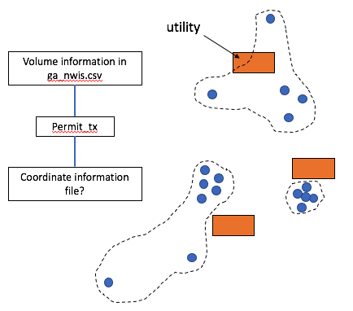
ACF Public Supply SWUDS disaggregation
(GW or other)
(AG)
(AG)
(AG)

Slide 7
ACF Public Supply SWUDS disaggregation
Looking at the permits database (“ga-permits.csv”) and follow recommendations in Nancy’s 11/26 email and Jamie’s 1/19 email
Find Master Permit number for an AG Site and find associated wells and intakes (GW sites) with same initial master permit number
First 7 digits of the master permit number should be identical between AG and GW Sites, the last two digits are the sequence number
All GW sites have lat longs
Some AG Sites may have no GW sites
Some GW Sites may have not AG Sites
There are two different site types we are targeting for GW sites
ALLC – these are the “USGS” Sites
EPDS – Georgia drinking water permits
The format of the master permit number will differ based on whether it is a USGS or GA sites

Slide 8
ACF Public Supply SWUDS disaggregation
Subset by sites that are not Permit_CD “NPDES” and are site type “AG” and “GW”
2025 Aggregate (AG) Sites
1911 unique sites based on Permit_TX (master permit number)
Includes EPWS (Georgia drinking water permits GAXXXXXX) and ALLC (USGS sites nnn-nnnn)
637 AG sites have no GW (421 of these are GA EPWS Sites)
4398 Individual Wells/Sites (GW)
1029 ALLC sites (USGS permit ID)
24 only have HUC8
All have Lat/Long
3368 EPWS sites (GA permit ID)
924 same lat/lon as ALLC sites
37 only have HUC8
All have Lat/Long

Slide 9
ACF Public Supply SWUDS disaggregation
Subset to the ACF area of interest (2/15)
Build well clouds for each aggregate source
Have several disaggregation scenarios (multiple HUC12s for each aggregate site)
(GW or other)
(AG)
(AG)
(AG)

Slide 10
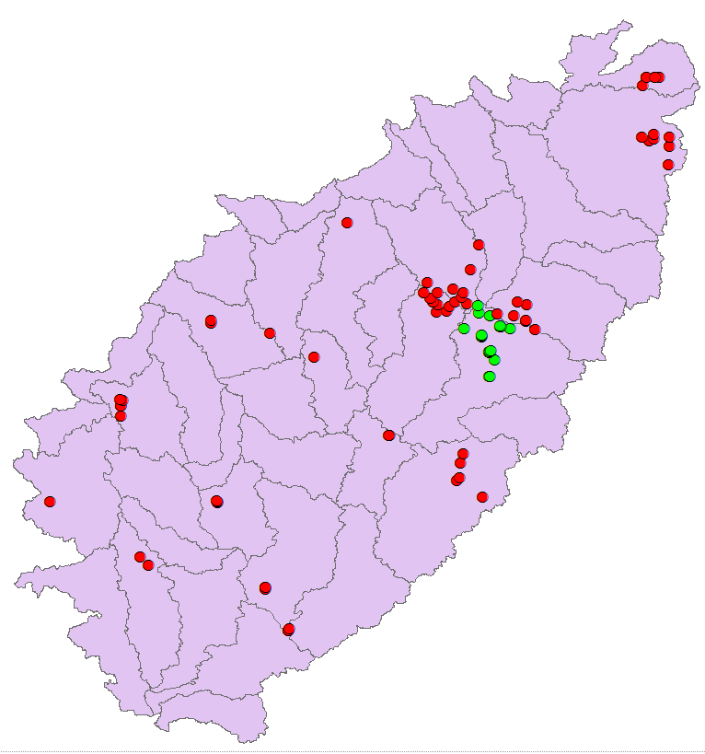
Breakdown in the Study Area – ALLC Wells
ACF Public Supply SWUDS disaggregation
86 ALLC sites in the ACF
22 ALLC w/ Spatial Huc10 != Tabular Huc10
Attribution Error, either wrong huc10 in the
attribute table, or there was a HUC code
re-assignment
Spatial Huc10 != Tabular HUC10
Spatial Huc10 == Tabular HUC10

Slide 11
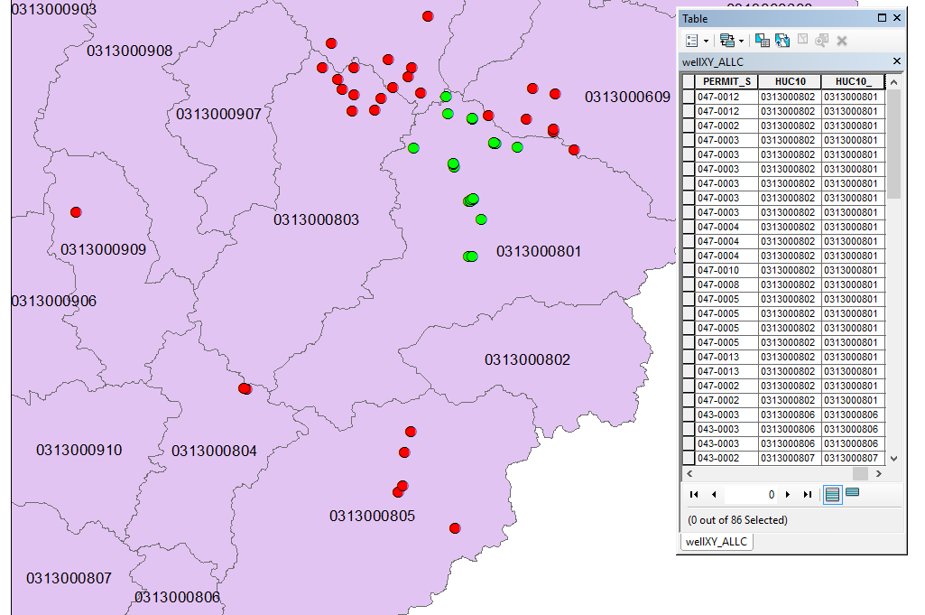
ACF Public Supply SWUDS disaggregation
86 ALLC sites in the ACF
22 ALLC w/ Spatial Huc10 != Tabular Huc10
Attribution different
from spatial location
Spatial Huc10 != Tabular HUC10
Spatial Huc10 == Tabular HUC10

Slide 12
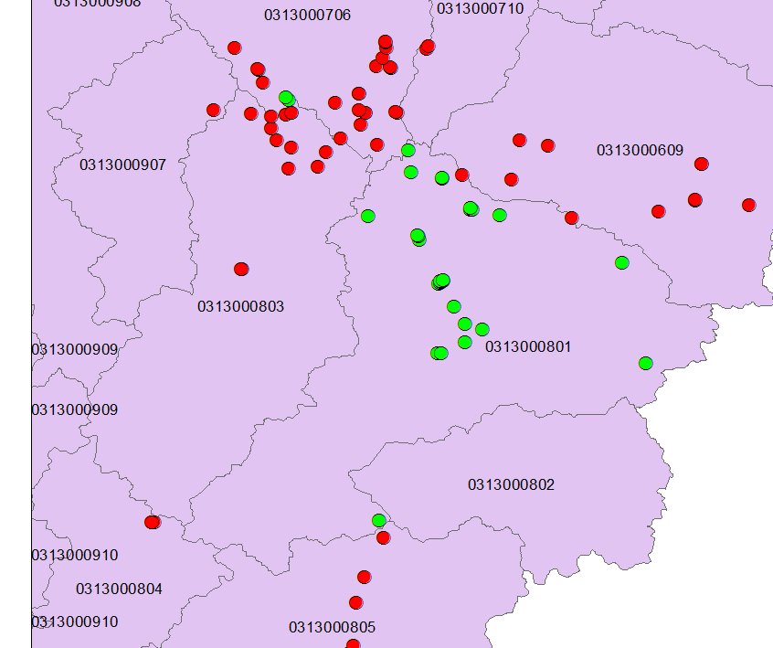
ACF Public Supply SWUDS disaggregation
122 EPWS sites in the ACF
9 EPWS w/ Spatial Huc10 !=
Tabular Huc10
Attribution Error/
HUC Update
Same area affected as ALLC
sites
2 w/only HUC8 attribution –
within 031300706
Spatial Huc10 != Tabular HUC10
Spatial Huc10 == Tabular HUC10

Slide 13
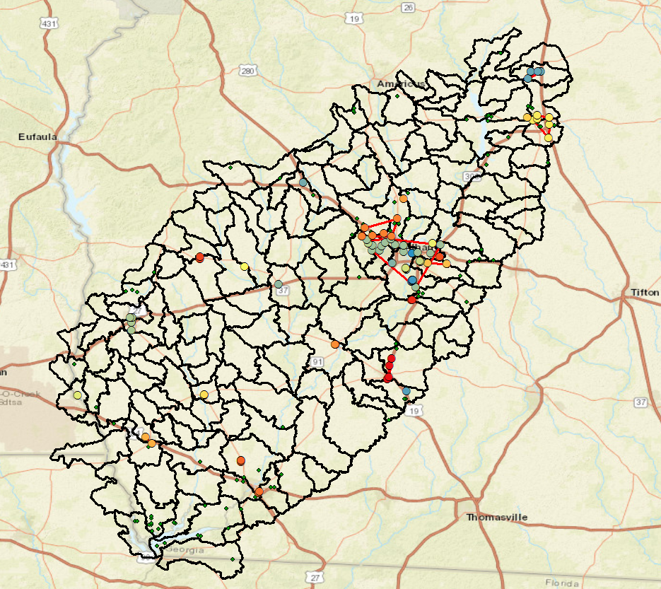
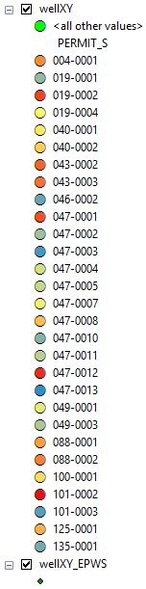
Some initial hacks
at well clounds at the
HUC12 level
Not sure there is enough
Spatial dispersion and/or
enough GW Sites per AG
to make it work
After meeting with Scott
on 3/8
Aggregate to HUC10
Just reference well
location, skip point
clouds for now

Slide 14
ACF Public Supply SWUDS disaggregation
ACF_WaterUse18 folder
Data –
HUC
HUC8, HUC10, HUC12 shapefiles, source HUC Shapefiles
WU
ga_nwis.csv
Ga_nwis.shp
Ga_permits.csv
Ga_permits.shp
Ga-permits-nwisra-20171122.xlsx – original pull from Nancy
Results
Sites
AG_sites.csv/feather
ALLC_sites_SU.csv/feature/wellXY_ALLC.shp
EPWS_sites_SU.csv/feature/wellXY_EPWS.shp

Slide 15
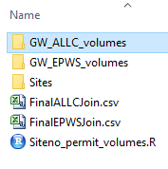
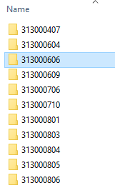
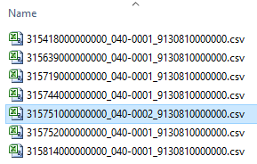
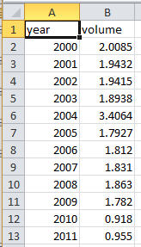
ACF Public Supply SWUDS disaggregation
ALLC GW sites in ACF
86 sites joined with NWIS annual volume data (Microsoft Access)
Join created from from_station_nm in NWIS file and permit_short in SWUDS file
Used R to create individual site files from joined data
New site identifiers given site_no (SWUDS) + permit _short + site_no (NWIS) format
Site data sorted by 10-digit HUC code at \\igskahcwgsdeli2\studies\ACF_WaterUse18\results

Slide 16
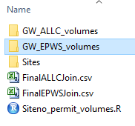
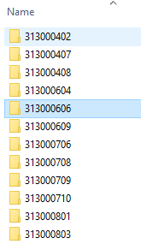
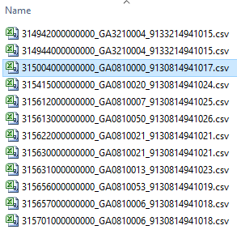

ACF Public Supply SWUDS disaggregation
EPWS GW sites in ACF
204 sites joined with NWIS annual volume data (Microsoft Access)
Join created from from_station_nm in NWIS file and permit_tx in SWUDS file
Used R to create individual site identifiers from joined data
New site identifiers given site_no (SWUDS) + permit _tx + site_no (NWIS) format
Site data sorted by 10-digit HUC code at \\igskahcwgsdeli2\studies\ACF_WaterUse18\results

Slide 17
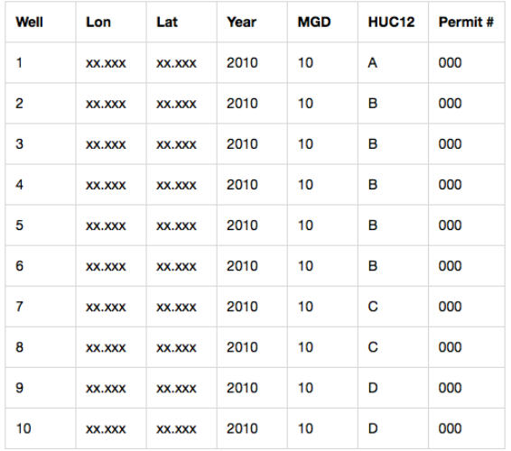
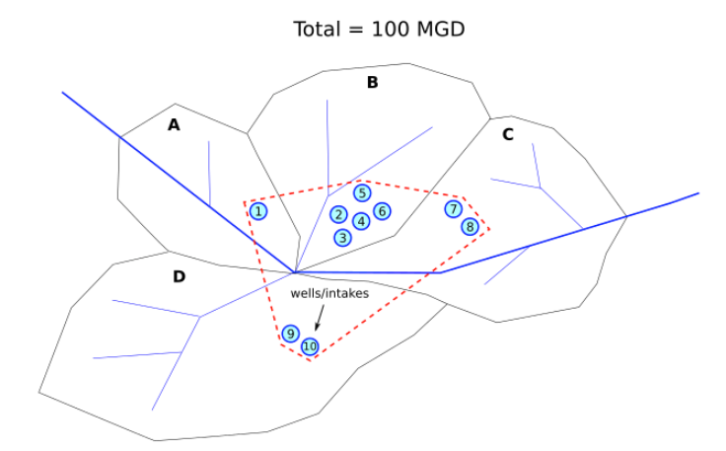
Next Steps
Include the GA Drinking Water Permits (EPWS)?
Format data retaining well coordinates into table with total volume dived by number of wells

Slide 18
Notes
To link SWUDS Georgia withdrawal permits (ALLC) to NWIS data:
First 8 characters of SWUDS.PERMIT_TX matches first 8 characters of NWIS.from_station_nm
To link SWUDS drinking water permits (EPWS) to NWIS data:
First 9 characters of SWUDS.PERMIT_TX matches first 9 characters of NWIS.from_station_nm
To tie aquifer data into results use NWIS codes:
from_aqfr_cd
from_aqfr_nm

