Slide 1
MQM ALU Core A: 16-bit 10 GHz Method-B Circuit Block Diagram
Method-B: 1st DATA(50ps) -> NC(50ps) | 2nd DATA(50ps) -> NC(50ps) | 3rd DATA(50ps) -> NC(50ps) 50:50 ratio — Max Reliability
(1) INPUT
(2) FA SYNTH
(3) DIFF. OUTPUT
(4) WIRE 12mm
(5) DATA READ @9mm
(6) NC SHORT @12mm
W1 (2 Byte) F1(8b)+A1(8b)
+W3 Synth Wave
Wire 1 (+W3)
1st DATA t+50ps
NC-1 t+100ps
FA SYNTH W3=W1+W2 F(8b)+A(8b) 16bit/cycle
2nd DATA t+150ps
NC-2 t+200ps
SHORT
W2 (2 Byte) F2(8b)+A2(8b)
-W3 Inv. Phase
Wire 2 (-W3)
3rd DATA t+250ps
NC-3 t+300ps
0mm
3mm
6mm
OUTPUT 16bit x3=48bit
+W3+(-W3)=0 SIGNAL FLAT OK
9mm DATA READ
12mm NC SHORT
9mm (3x3mm)
12mm (4x3mm)
(7) TIMING DIAGRAM Method-B 10GHz | 1 cycle=100ps | 3 cycles=300ps for 3 data
Cycle 1 (0~100ps)
Cycle 2 (100~200ps)
Cycle 3 (200~300ps)
1st DATA 50ps (50/100GHz)
NC 50ps (50/100GHz)
2st DATA 50ps (50/100GHz)
NC 50ps (50/100GHz)
3st DATA 50ps (50/100GHz)
NC 50ps (50/100GHz)
0ps
10ps
20ps
30ps
40ps
50ps
60ps
70ps
80ps
90ps
100ps
110ps
120ps
130ps
140ps
150ps
160ps
170ps
180ps
190ps
200ps
210ps
220ps
230ps
240ps
250ps
260ps
270ps
280ps
290ps
300ps
Method-B 50:50 — Each DATA(50ps) gets immediate NC(50ps) | Max reliability | Implementable with current electronics | 3x100ps=300ps / 3data
(8) TRAVEL DISTANCE during 50ps (DATA Window)
Light (vacuum): c = 3x10^8 m/s --> 3x10^8 x 50ps = 15 mm
Light: 15 mm
Electron (wire): ~1%c = 3x10^6 m/s --> 3x10^6 x 50ps = 0.15 mm
Electron: 0.15 mm (x100 smaller)
KEY: 50ps DATA window | Light travels 15mm | Wire 12mm < 15mm --> Signal fully arrives | 20GHz electronics sufficient ✓
MQM | Free Open Source | No Patent | Inventor: Sungtae Park (scwpark) | Co-inventors: Hyunuk Pak, EunHwan Park | github.com/scwpark/MQM-PAM_OFDM_Phase-superposition_3D-mapping

Slide 2
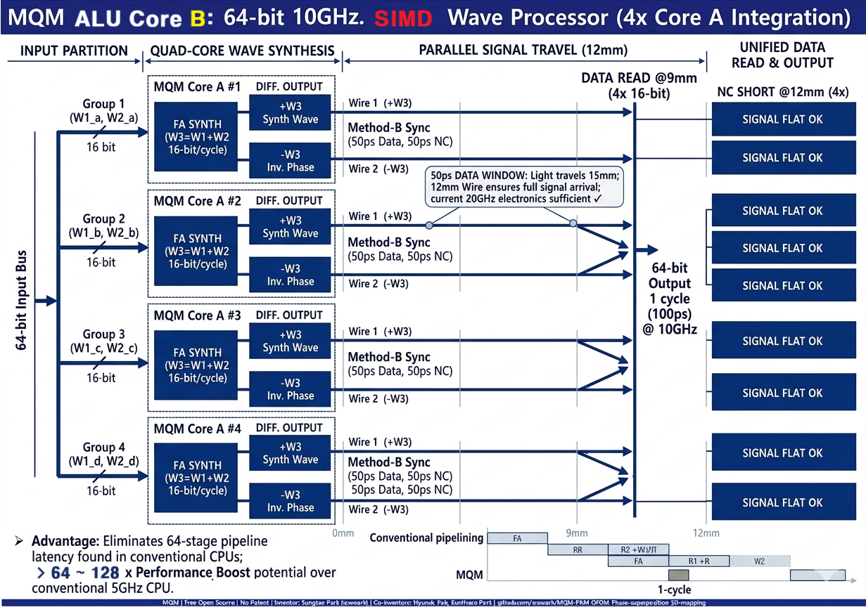

Slide 3
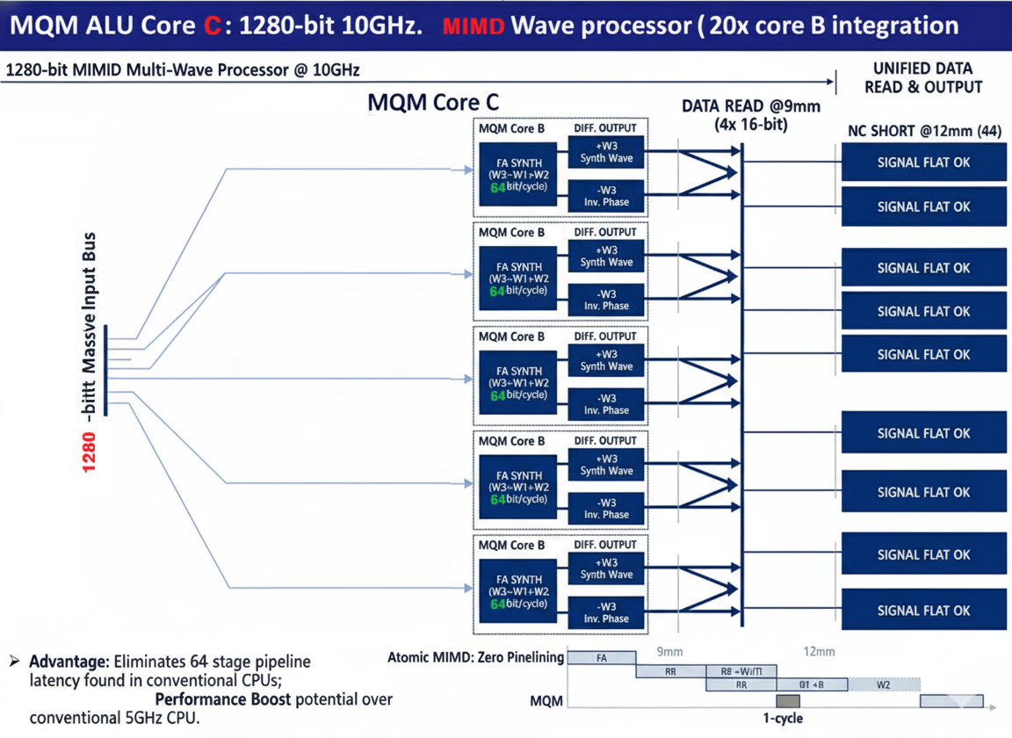
#1
#2
#3
1,280-bits output
1cycle (100ps)
@ 10GHZ
#20

