Slide 1
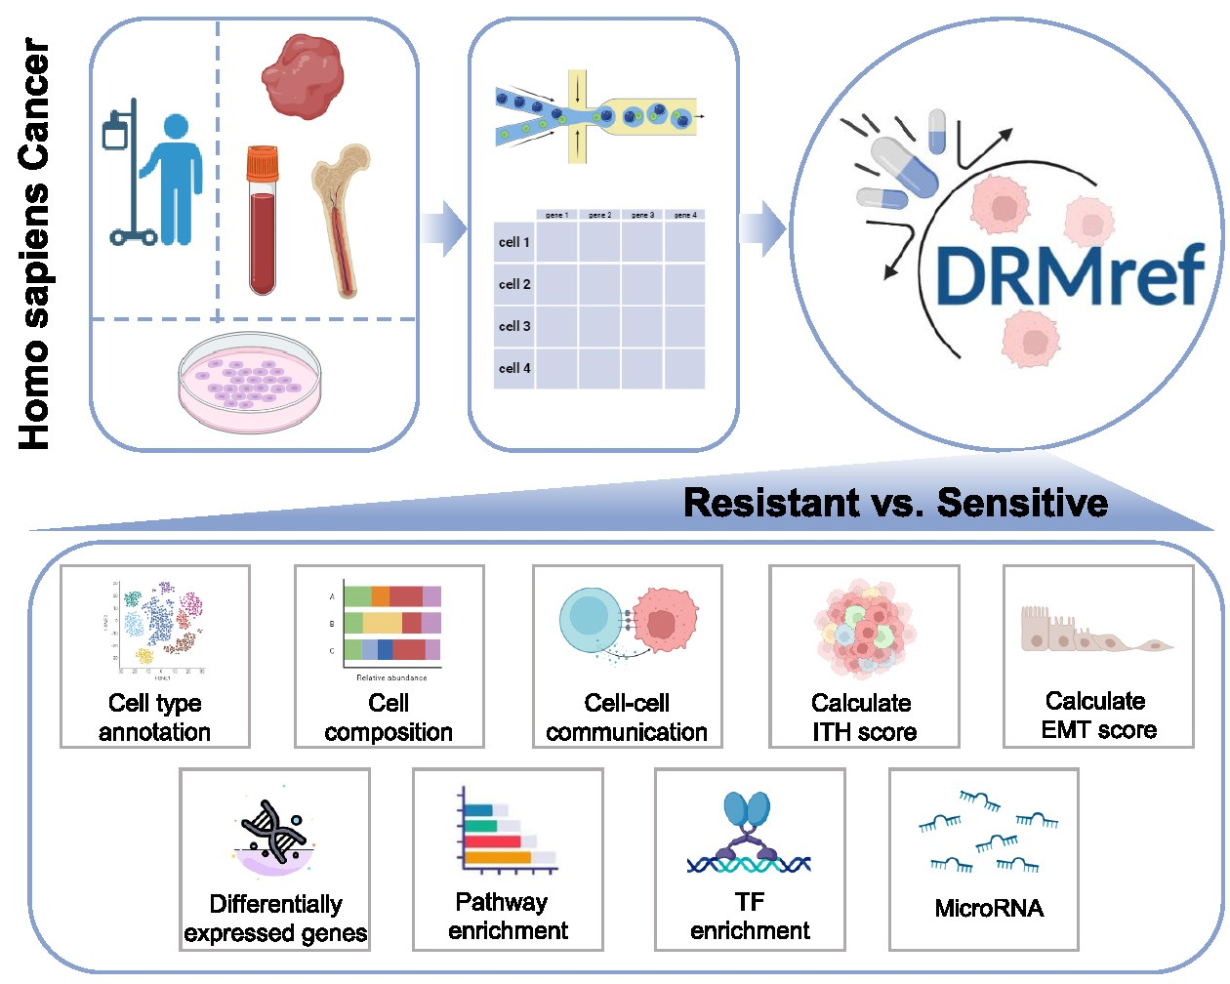

Graphical Abstract
Notes:
Graphical Abstract
Unless provided in the caption above, the following copyright applies to the content of this slide: © The Author(s) 2023. Published by Oxford University Press on behalf of Nucleic Acids Research.This is an Open Access article distributed under the terms of the Creative Commons Attribution-NonCommercial License (https://creativecommons.org/licenses/by-nc/4.0/), which permits non-commercial re-use, distribution, and reproduction in any medium, provided the original work is properly cited. For commercial re-use, please contact journals.permissions@oup.com

