Slide 2
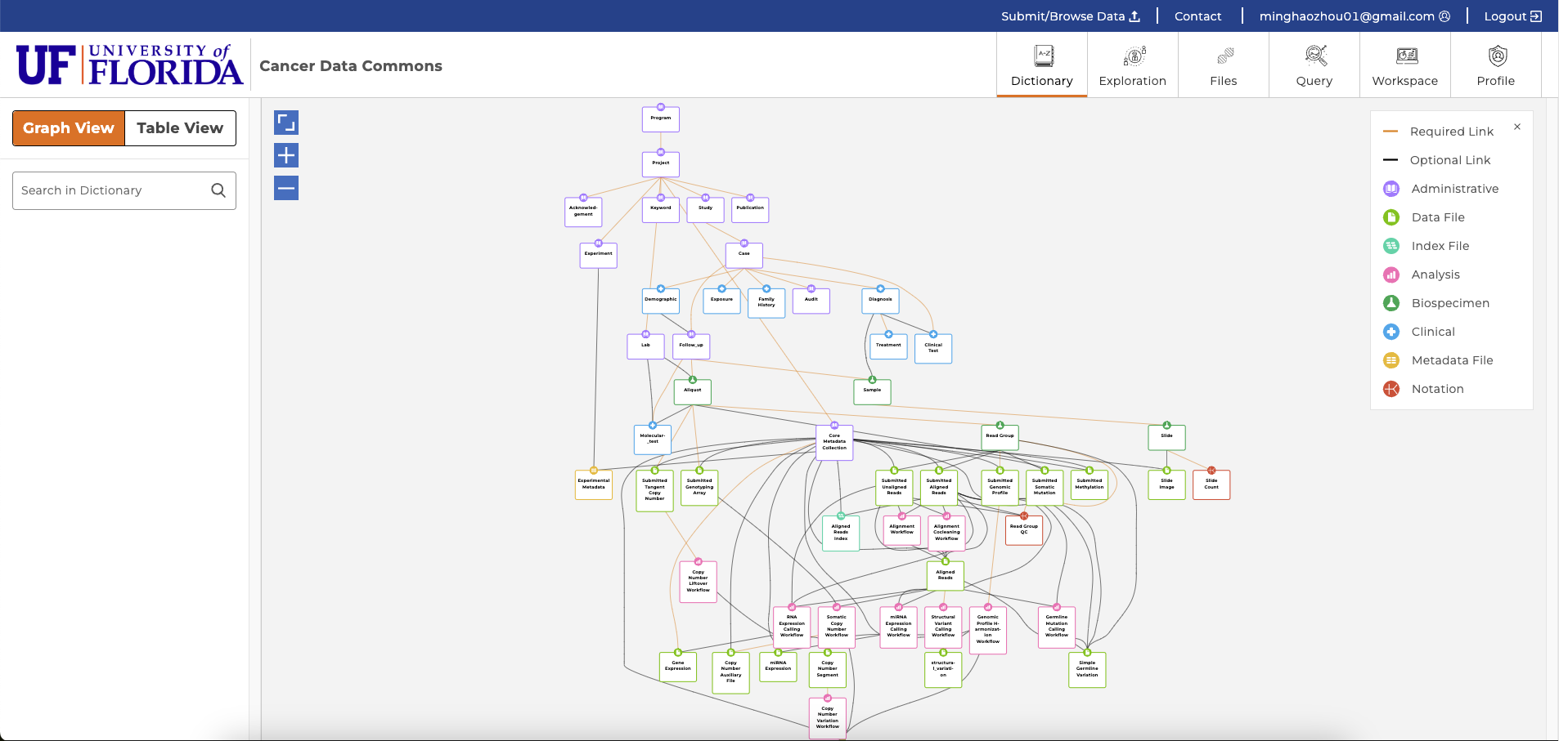
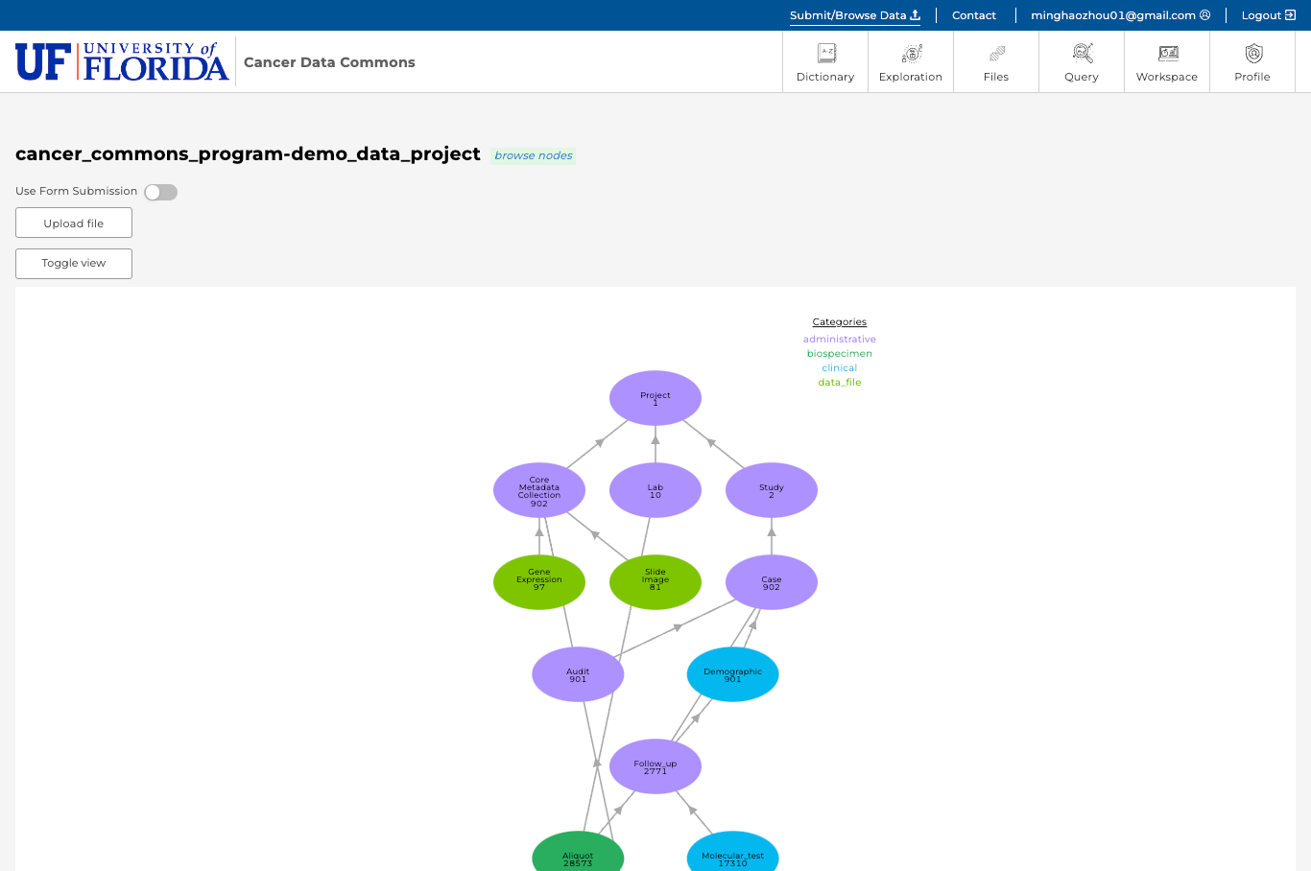
UFCDC: Data Model and Data Submission

Slide 3
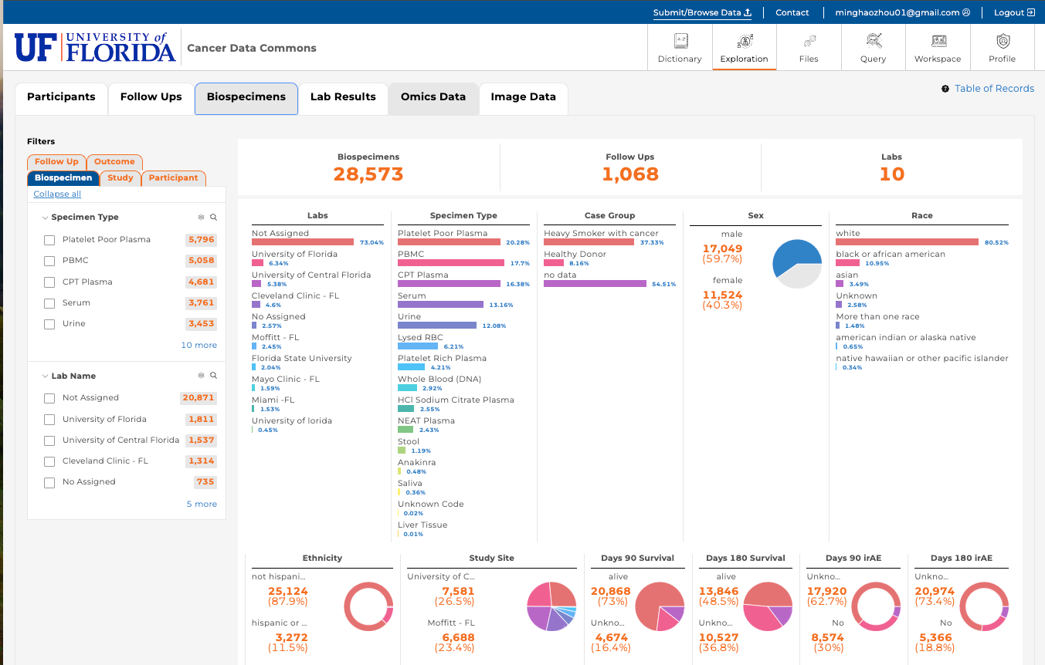
UFCDC: Filtering, Visualization, And Exporting
Filtering
visualization

