Slide 1
Introduction to
Automated Theorem Proving
CS5209

Slide 2
Outline
What is an automated theorem prover?
Advantages and disadvantages
Introduction to Coq
Design of theorem provers

Slide 3
Automated Theorem Provers
Computer program that can generate and check mathematical theorems
Theorems are expressed in some mathematical logic, such as predicate logic, first-order logic, …
Many different theorem provers out there: Isabelle/HOL, TWELF, Coq, Metamath, Nuprl, …

Slide 4
What does the user provide?
Depends on which prover!
All provers: statement of theorem expressed in the logic of the prover
In addition, one provides hints to guide the prover (often in the same file)

Slide 5
Hints
Least useful hint: “A proof exists – search forever until you find it”
Most useful hint: “Here is the proof: …”
Many provers take a middle path and require hints between the two extremes
  Statement of key lemmas (useful intermediate results)
  Proof outline (how the lemmas connect)
  Key idea in proof (“prove by induction on n”)
  Proof script (list of medium-sized steps in the proof)

Slide 6
Theorem Prover Overview
Statement of Theorem
Provided by user
(not to scale)
Hints
Theorem Prover
Provided by
developer
(not to scale)

Slide 7
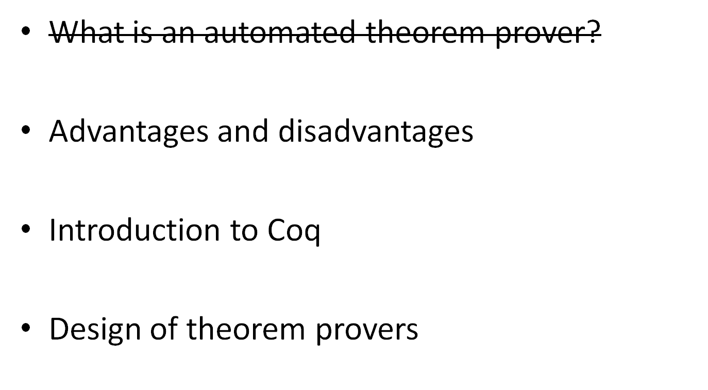
Outline

Slide 8
Why are theorem provers used?
Very high assurance due to mechanical checking
When possible, fully-automatic proof generation can significantly improve program development
  Earlier detection of bugs
  Better code coverage than testing
  Frequently tools can locate errors faster than debugging

Slide 9
High assurance
In general, highest assurance that there are no mistakes in proof
  Mechanical proof checkers are very through: don’t get tired, don’t get bored, don’t make mistakes
  If anything, the problem is the opposite – trying to convince a checker that a true thing is true can be frustrating.
Used in areas where correctness is critical
  Aerospace
  Defense
  etc.

Slide 10
Right tool for the job…
Better at kinds of tasks than others
Best: proving behavior of real programs
Bad:
  Cryptography: often we rely on guesses (P = NP ?)
  Pure math: Tools and libraries are not practical yet
  Design: How to prove one user interface better than another?

Slide 11
Uses for proof generation
For problems that are simpler, proof generation
is very useful as well
Type inference & checkers
Safety of web applications (e.g., Java)
Static analysis tools
  Buffer overrun analysis
  Safety property analysis

Slide 12
Disadvantages of
Automated Theorem Proving
For proof generation:
Only useful for certain kinds of “simple” problems
Tools are frequently very difficult to develop
Often can have very bad worst-case running time
  e.g., Hindley-Milner type inference is O(2^{2n})
  Sometimes the average running time is much better

Slide 13
Disadvantages of
Automated Theorem Proving
For proof checking:
Developing the hints / proof by hand can be very labor-intensive
It can be very difficult to formalize correctness
  “correct” operating system?
  “correct” web browser?
  “correct” compiler?
Learning curve to use systems can be steep

Slide 14
One more advantage… they are fun to use!
A bit like writing software in a scripting language
“Building such scripts is surprisingly addictive,
in a videogame kind of way…”
- Xavier Leroy
The advantage of never having to worry about bugs in the finished product
Can work on math at 3 AM without fear

Slide 15
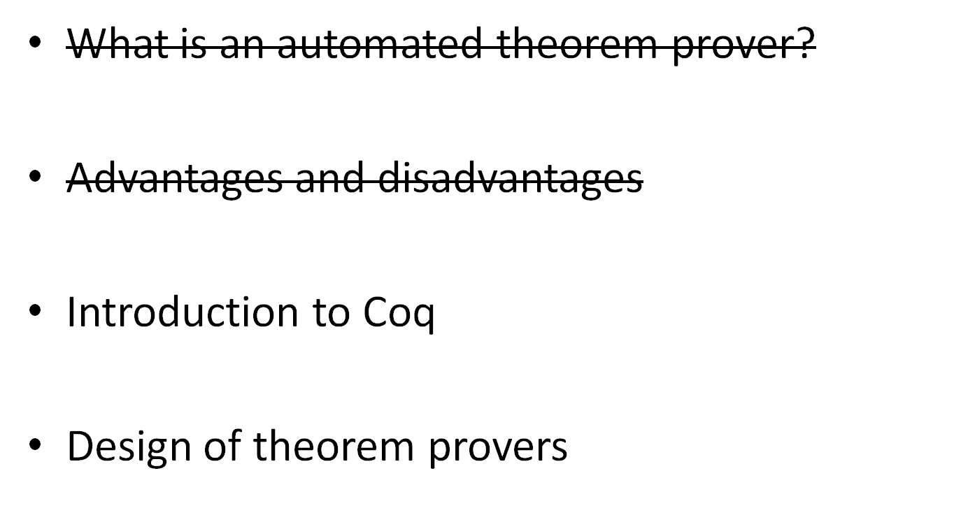
Outline

Slide 16

Coq
Theorem prover developed in France
  Name is the French word for rooster
  Lots of library & tool support
  Large user base
Calculus of (Co-)Inductive Constructions (CiC)
  We will just use a small portion (first-order logic)
Available on the web at http://coq.inria.fr/
  Windows, MacOS, Linux/UNIX

Slide 17
Tactic-based system
CiC is quite powerful, so automatic proof generation is quite limited
Instead, a user provides hints in the form of proof scripts
Proof scripts are lists of tactics, which guide Coq in generating the proof

Slide 18
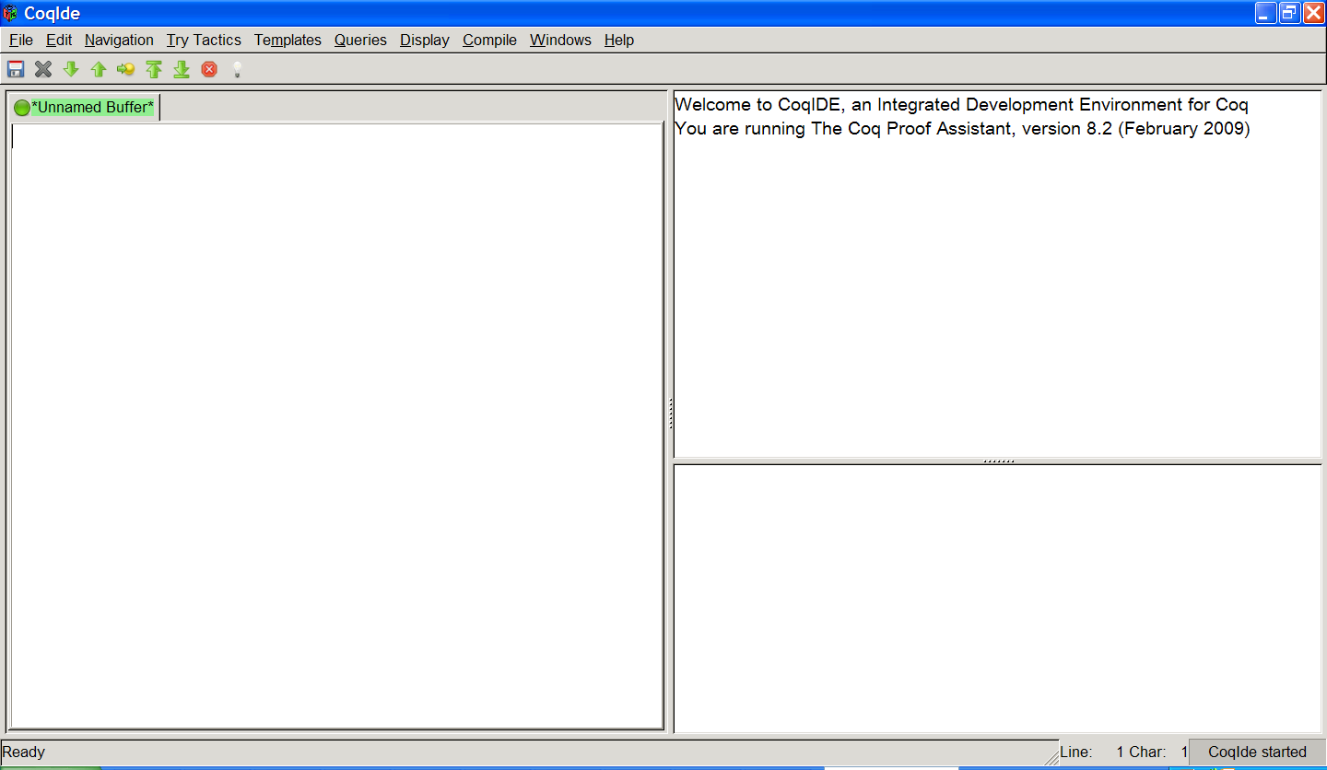
CoqIDE

Slide 19
CoqIDE
Current Goal
Proof Script
Error Reporting

Slide 20
Demonstration
Note: this presentation as well as the script file we
will go over now will be available to you online.

Slide 21
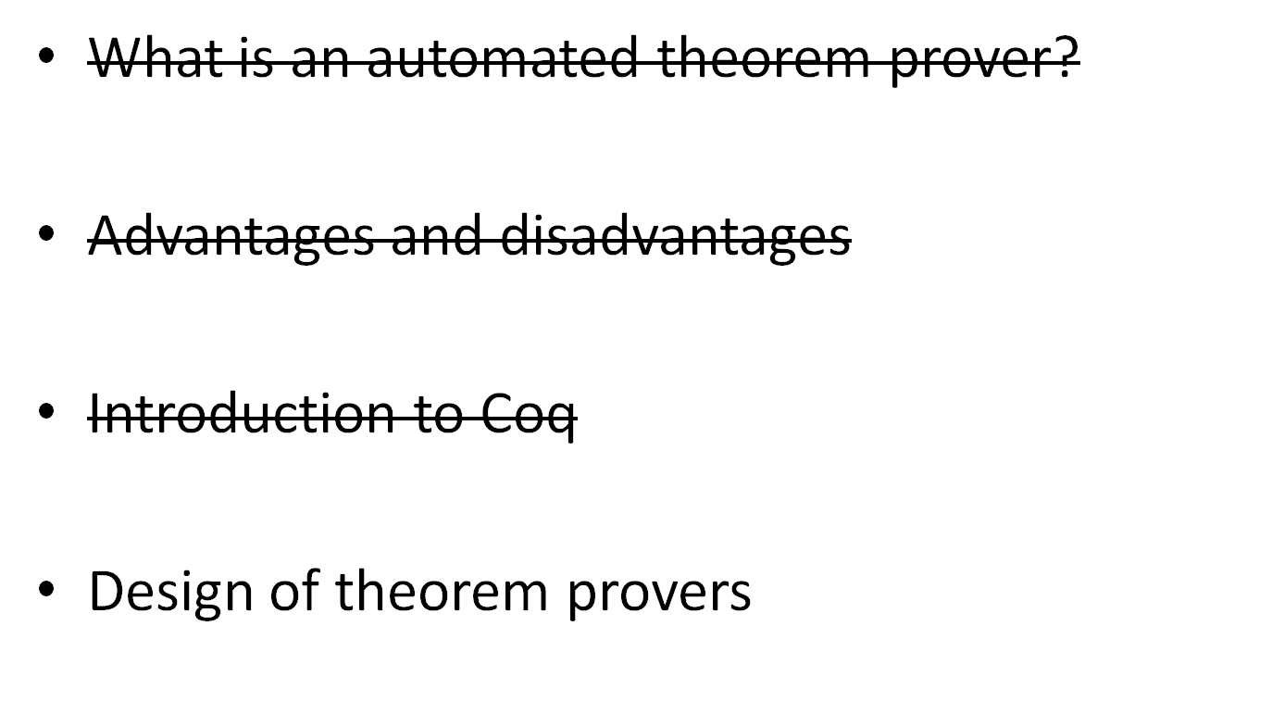
Outline

Slide 22
Differences Between Provers
The logic the prover uses
  Isabelle/HOL : Higher Order Logic (HOL)
  TWELF : Logical Framework (LF)
  Coq : Calculus of (Co-)Inductive Constructions (CiC)
  etc.
Some logics are more powerful (can express more theorems) than others
  CiC is more powerful than HOL
  More powerful logics can be harder to use

Slide 23
Differences Between Provers
The task a prover handles
  All provers can check theorems in their logic
  Automated proof generation is much harder
Different provers have different trade-offs between degree of automation and the power of the logic they handle
  The more powerful the logic, the less automatic generation of proofs
  Many automated theorem provers are really more automated theorem checkers

Slide 24
Proof Checking vs. Proof Generation
Recall that a formal proof is a list of formulas each of which is justified by an axiom or an inference rule applied to earlier formulas
    Formulas Justification
    F1 Axiom
    F2 Rule 3 and F1
    … …
    Theorem …
Formal proofs are very easy to check mechanically
  Just make sure the justifications are applied correctly
However, proof generation is harder – have to generate a list of formulas each of which has valid justification, where the last formula is the desired theorem.

Slide 25
Why Proof Generation is Hard
In the simplest logics (e.g., propositional logic),
then there are provers (SAT solvers) that for any
proposition P in the logic can prove either P or ~P.
This is because propositional logic is complete
However, propositional logic is not very expressive

Slide 26
Incomplete Logics
We want to be able to use more powerful building blocks like ∀, ∃, etc. in the statement of our theorems – this means (at least) first-order logic
But then the logic is incomplete: there are true theorems that cannot be proven

Slide 27
Infinite Loop
If you give a computer program such a theorem to prove, it will run forever (uh oh!)
Therefore, provers in practice will stop searching for a proof after a certain amount of time/work
If using a powerful logic, even a large amount of time may not be enough to prove very much

Slide 28
Differences Between Provers
Practical differences
  Or, “Oh, yeah – it’s a piece of software!”
Some provers have:
  More support if there is trouble (mailing lists)
  Bigger user base
  More frequent new versions
  Tool support
  Better library support (e.g. built-in definitions of the real numbers, etc.)
It’s possible to have bugs! Which are more trustworthy?

Slide 29
Trust
What kinds of things make software trustworthy?
Small
Simple
Stable
Redundant
Checked by human or machine

Slide 30
Theorem Prover Overview
Statement of Theorem
Provided by user
(not to scale)
Hints
Theorem Prover
Provided by
developer
(not to scale)

Slide 31
Misleading Scales
Theorem Prover
Statement of Theorem
Hints

Slide 32
Misleading Scales
Theorem Prover
Statement of Theorem
Hints
Theorem Prover
Statement of Theorem
Hints

Slide 33
Increasing Confidence
Statement of Theorem
Hints
Theorem Prover

Slide 34
Theorem Prover Overview
Statement of Theorem
Provided by user
(not to scale)
Hints
Theorem
Library
Theorem Prover
Provided by
developer
(not to scale)

Slide 35
Library
Commonly used definitions and theorems
Natural numbers
  Definition (zero + successor)
  Facts about naturals (a + b = b + a) and their proofs
Integers
  Definition (naturals + negative naturals + zero)
  Facts about integers (e.g., a + (-a) = 0) and their proofs
etc.
Does not have to be trusted, since the theorem prover will
check proofs

Slide 36
Increasing Confidence
Theorem
Library
Statement of Theorem
Hints
Untrusted
Theorem Prover
Proof
Trusted Checker

Slide 37
Misleading Scales
Untrusted
Theorem Prover
Trusted Checker

Slide 38
Misleading Scales
Untrusted
Theorem Prover
Untrusted
Theorem Prover
Trusted Checker
Trusted Checker

Slide 39
Theorem Prover
Generates proof from hints
Frequently updated with new features
Can be large (as larger or larger than a compiler, 200k+ lines)
Does not have to be trusted

Slide 40
Checker
Checker is very:
  Simple
  Stable
  Small
  Verified by humans very carefully
Smallest known checker for HOL around 800 lines of C with no library support
  Included parser and simple Prolog interpreter

Slide 41
Misleading Scales
Statement of Theorem
Hints

Slide 42
Misleading Scales
Statement of Theorem
Hints
Statement of Theorem
Hints

Slide 43
Misleading Scales
Statement of Theorem
Proof
Statement of Theorem
Hints

Slide 44
Misleading Scales
Statement of Theorem
Proof
Untrusted
Theorem Prover
Trusted Checker

Slide 45
Misleading Scales
Statement of Theorem
Proof
Untrusted
Theorem Prover
Trusted Checker

Slide 46
Misleading Scales
Statement of Theorem
Proof
Untrusted
Theorem Prover
Trusted Computing Base
Trusted Checker

Slide 47
Trusted Computing Base
The only things that have to be trusted:
  Checker
  Statement of theorem
Everything else (hints, library, theorem prover, proof) does not
Possible to get 3+ orders of magnitude difference in size (1000x) between trusted and untrusted

Slide 48
Review
Theorem
Library
Statement of Theorem
Hints
Untrusted
Theorem Prover
Proof
Trusted Checker

Slide 49
Homework
To be given out in the next few days, due in 2 weeks
Hints:
Start early. I am very unlikely to help with installation problems the night before the homework is due. Also, the learning curve for Coq can be steep.
I am available for help most afternoons. Feel free to knock on my door or write me email if you have questions.
At the end of these slides is a list resources for learning about Coq. You are encouraged to go over both the list and the script we did in class before starting the homework.

Slide 50
(Advertisement)
Graduate Students Wanted
If, while you are doing the homework, you
decide that you are having fun and might like to
do more work with theorem provers as part of
your research at NUS, then contact me privately
and we can discuss research possibilities.

Slide 51
List of resources
Coq Tutorial (recommended):
http://coq.inria.fr/V8.2/doc/html/tutorial.html
Coq in a hurry (also helpful):
http://cel.archives-ouvertes.fr/docs/00/33/44/28/PDF/coq-hurry.pdf
Coq Library (large, but with an index):
http://coq.inria.fr/library-eng.html

