Slide 1
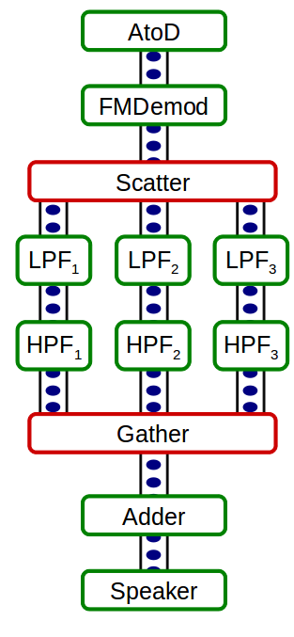
Fault Tolerance for Cloud-Based Streaming Programs
Nicholas Hollingum
School of Information Technologies
Faculty of Engineering and Information Technologies
1. Synchronous Dataflow
Streaming system
Can be thought of as a computational graph
Nodes (Actors) work like filters, modifying data passing through them
Edges (Channels) pass data between the Actors, in a FIFO manner
A stream-based radio is shown right
2. Fault Tolerance
How do we make sure the program does not crash?
Devise some Fault Tolerant mechanism and overlay it on a regular computational graph
Recomputation:
  While running, we save the program's state to disk
  When a processor dies, we revert to the last successful state
Replication
  Before running, we duplicate every node k times, we place each replica on a different processor
  When a processor dies, we hope some replicas still remain
3. Cloud Machines
We deal with theoretical cloud machines
“N-Process” machines
This is a general abstraction of a heterogeneous networked cluster
Allows us to formalise concepts based on arbitrary cloud computers
4. How do we decide which processors to put which actors on?
Called the Robust Actor Assignment Problem
We proved the problem to be NP-Hard
We develop an AMPL model of the problem to solve this for small instances
We present a Heuristic (greedy) to solve larger instances
5. What guarantees can we make in practice?
We simulate an SDF program running on a cloud machine
We see that recomputation can take excessively long, but cannot fail totally
Replication can fail on rare occasions but is much faster
6. How much does Fault Tolerance Cost us?
We see that both mechanisms increase the cost (running time, computational load) of the program.
We see that the heuristic solutions cost on average 10% more than the optimal ones
7. The SDFSimulator
Simulates the execution of SDF programs on a cloud machine
The SDF programs can be functional, but the cloud machine is represented by Java threads
Simulates processors crashing both probabilistically and deterministically
A Schematic of the simulator is shown to the right.
8. The Experiments
We run multiple experiments on the simulator
We examine multiple aspects of execution
  Execution costs
  Time spent in recovery
  We run multiple experiments on the simulator
  Probability of successful completion
Our results are used to answer questions 5 and 6 (above)
9. Contributions
A formal understanding of Fault Tolerance as applicable to Synchronous Dataflow
An AMPL model used to solver the actor assignment problem optimally
Proof of the NP-Hardness of the Robust Actor Assignment problem, and a Heuristic to solve it
Development of the SDFSimulator
Experimental analysis of the heuristic's performance on the simulator
THIS RESEARCH IS SP

