Slide 1
COMP3069 Computer Graphics 2020
Final Project Presentation
A highway knifes through the jungle
Qichen An
20032255
scyqa1@nottingham.edu.cn

Slide 2

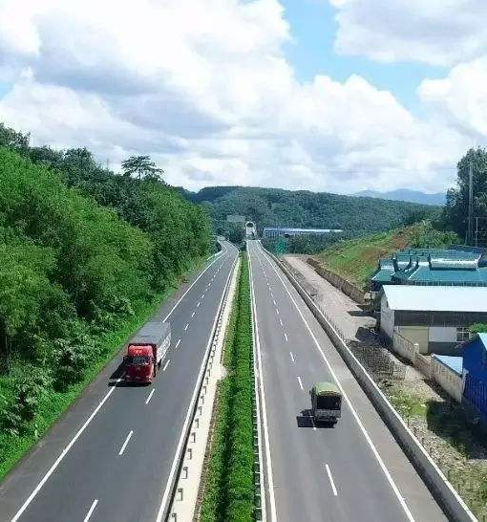
3D Objects
Highway
Wheel flag on the road
Jungle
Car
Snowmen
Trees
House
Moon and Sun
Design Sketch

Slide 3
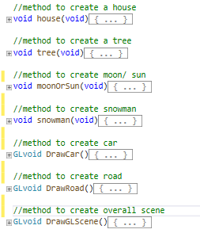
Code of creation

Slide 4
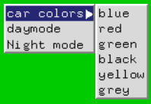
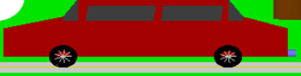

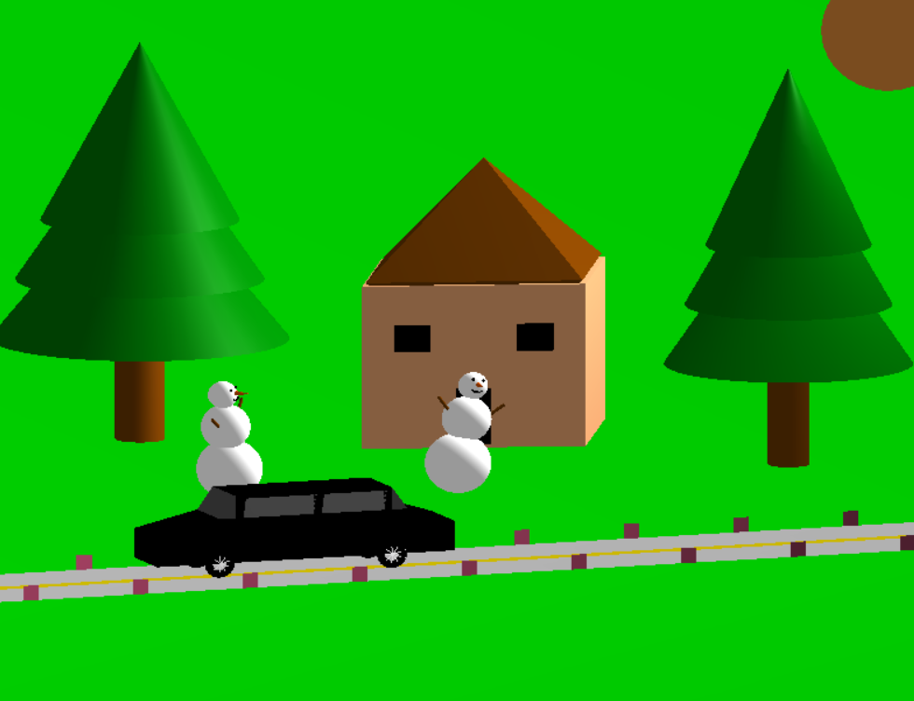
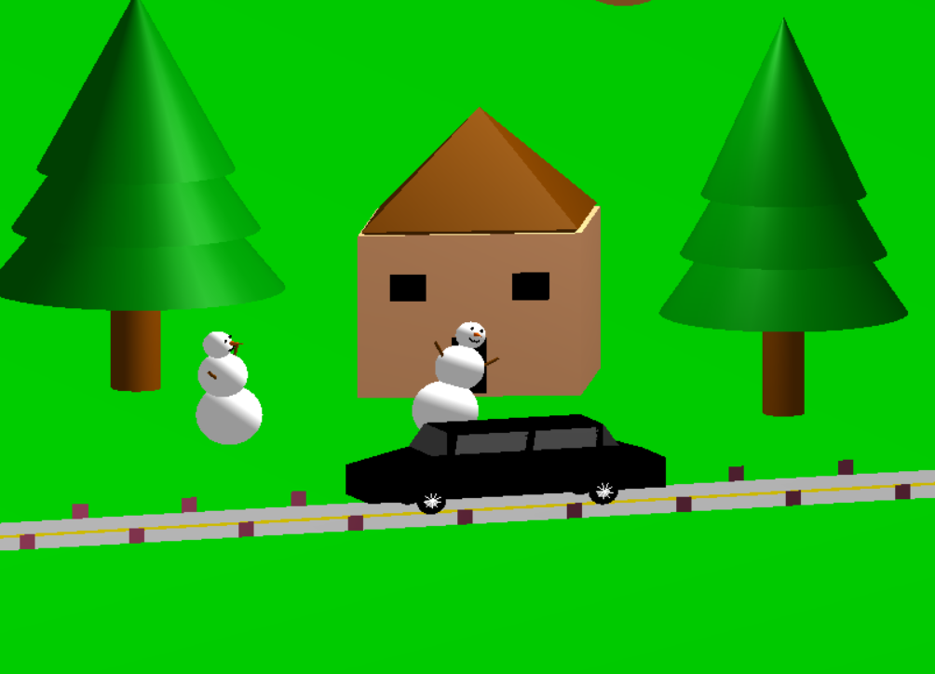
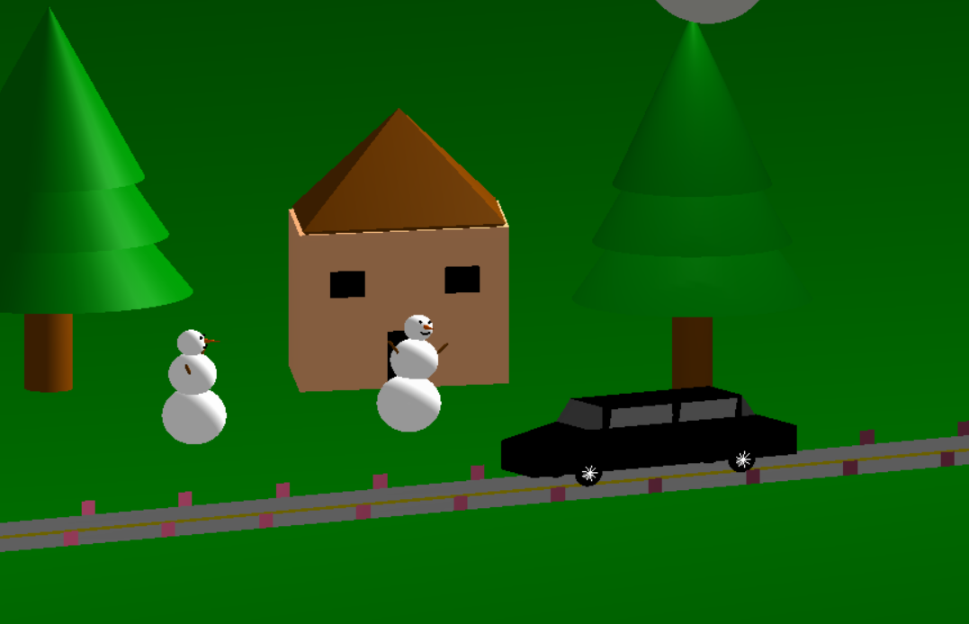
Functions
Change the color of the car
Move the car
Change the mode of day and night

Slide 5
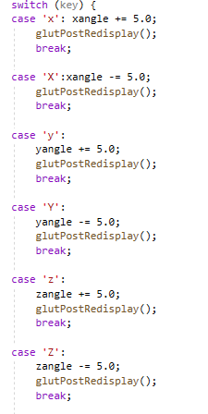
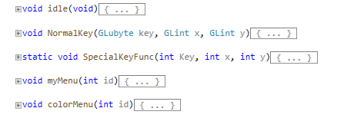
Keyboard Control
X (x): Rotate perspective around x-axis
Y (y): Rotate perspective around y-axis
Z (z): Rotate perspective around z-axis
U (u): Translate perspective up
<- : Move the car to the left
-> : Move the car to the right

Slide 6
Thank You!

