Slide 1
Ethereum Smart IOT Results
For:
https://acmblocksys.github.io/blocksys2021/
IEEE Journal COINS

Slide 2
Objective
To develop on Smart IOT Accident Usecase with Ethereum in the context of Mobility usecase
Construct a permissioning system for the Accident Use case Ecosystem
Store the Hash of the contextual data of the accident incident from a vehicle as a transaction
Measure the performance and throughput of the constructed architecture.
Construct a solidity smart contract to satisfy the above conditions and perform the Test on TAS infrastructure
Test the Performance, Scalability of the Architecture
Experiment with different conensus algorithms: Clique, IBFT 2.0, QBFT
Experiment with different Ethereum binaries: Geth, Hyperledger Besu

Slide 3
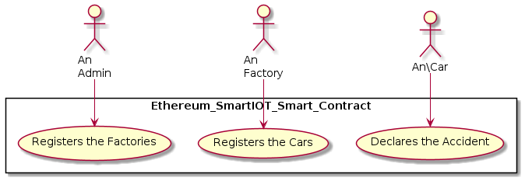
Design
3 Actors:
Admin: Deploy the smart contract and control its lifecycle
Factories: Add the requisite Public Key of the Factories to add its cars
Cars: Add the requisite Public Key of the cars for accident reporting

Slide 4
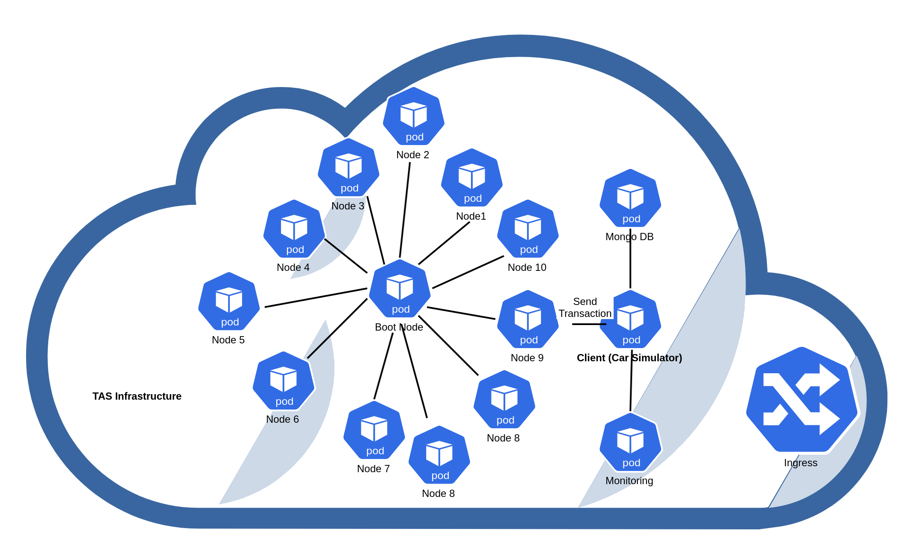
Network Topology

Slide 5
Ethereum Customised Config
Geth Latest 1.10.7
Besu Latest 21.7
Declare Accident Gas Estimate:
Geth Gas Limit fixed at 357500000 (55000 * 6500)
Besu Gas Limit fixed at 715000000 (55000 * 6500 *2)
BlockGas Limit
Tx Pool 10000000
Gas Price: 0

Slide 6
Deliverables
Full Automated Kubernetes Script to run for:
1) Clique 2) IBFT 2.0 3) QBFT
Smart Contract Files
Smart Contract Deployment Files
Client Transaction Emitter for: (Modified completely for newer version)
1) Geth 2) Besu

Slide 7
Test Suite
Input TPS: 200, 500, 1000, 1500
No of Nodes: 5, 10, 20, 25
Clique | IBFT 2.0 | QBFT

Slide 8
Consensus Variations
 | Clique | IBFT 2.0 | QBFT
Immediate Finality | Not Immediate | Yes | Yes
Fork | High | No | No
Chain Reorganisation | High | No | No
Min Validators | 4(tocheck) | 4 | 4
Liveness | Upto N/2 Failure Nodes (More) | Upto N/3 Failure Nodes | Upto N/3 Failure Nodes
Speed | High | Less than Clique | Less than Clique

Slide 9
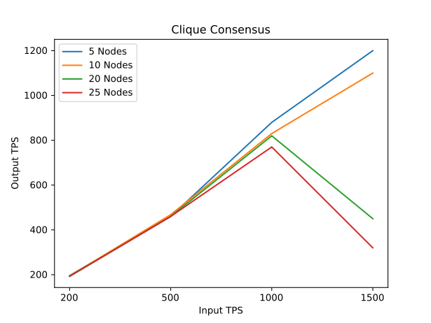
Test Results: Clique

Slide 10
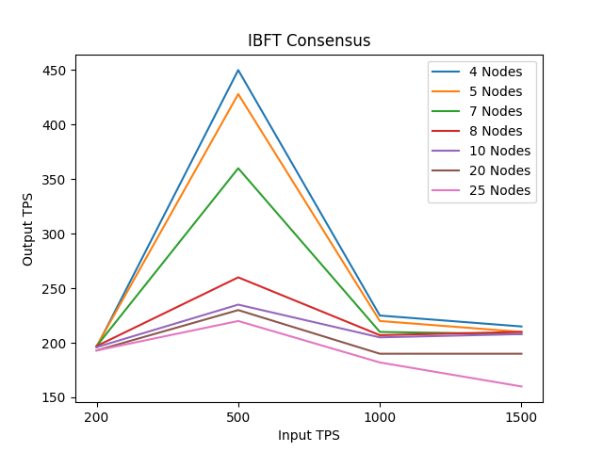
Test Results: IBFT 2.0

Slide 11
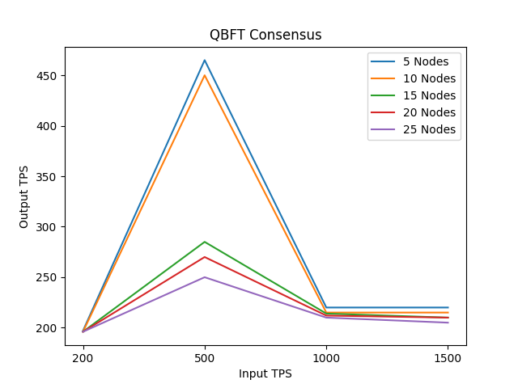
Test Results: QBFT

Slide 12
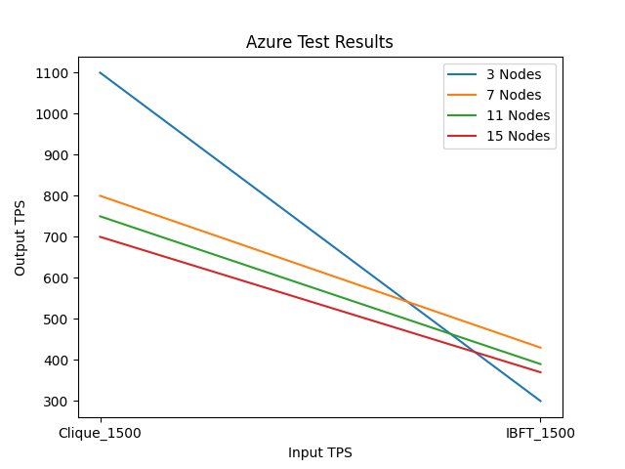
Comparison with Earlier Work
Choice of Ethereum Client for Private Blockchain:
Assessment from Proof of Authority Perspective ICBC 2021

Slide 13
Test Results

Slide 14
Interim Conclusion
Performance Comparison:
Clique > QBFT > IBFT 2.0
IBFT and QBFT show a drop with scalability
Results comparable with ICBC: TAS identical to Azure
(Minor difference | No Infra Bottleneck )
TODO: IBFT vs QBFT ( Difference)

Slide 15
Bit Bucket Links
https://bitbucket.org/edge-team-leat/sim-tas-group-tests/src/main/
https://bitbucket.org/cyrilnavessamuel/geth/src/master/
https://bitbucket.org/cyrilnavessamuel/besu/src/master/
https://bitbucket.org/cyrilnavessamuel/result_analysis/src/master/

Slide 16
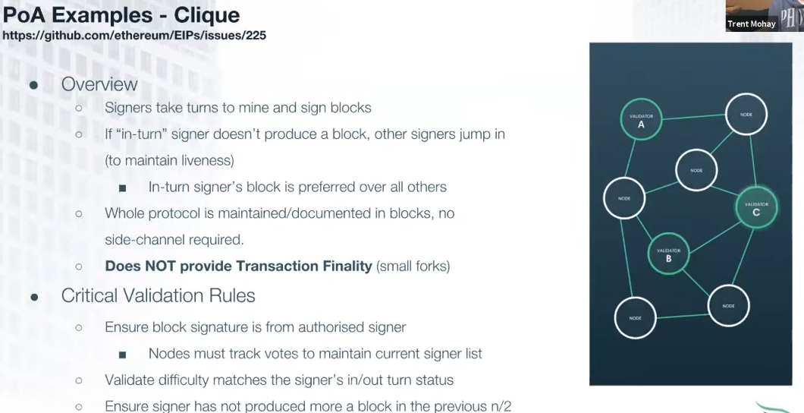
APPENDIX

Slide 17
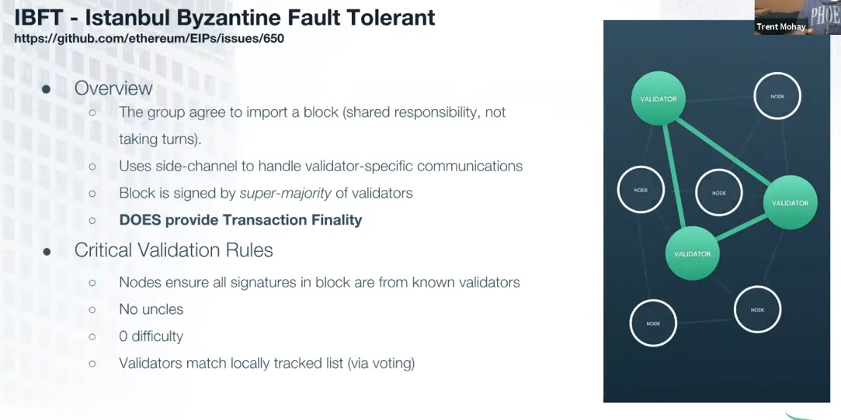
APPENDIX

Slide 18
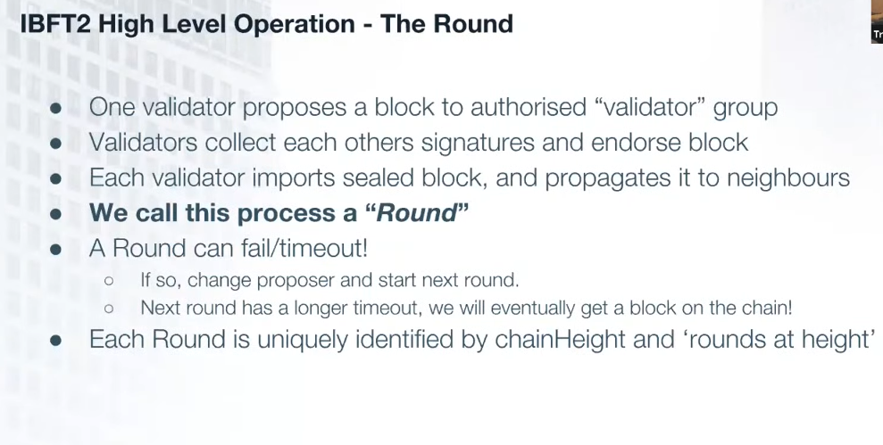
APPENDIX

Slide 19
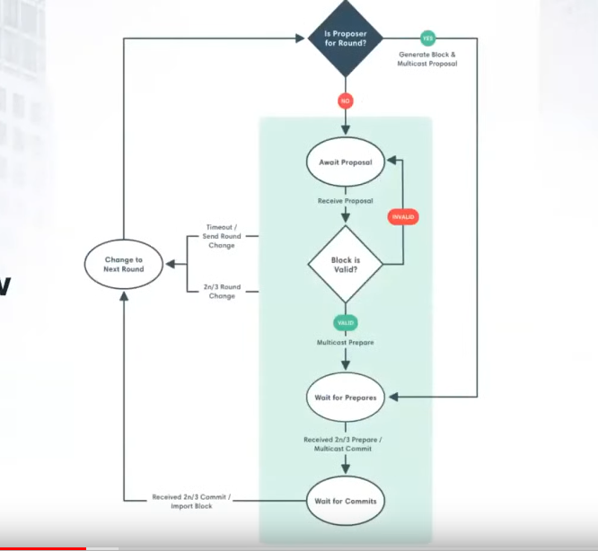
APPENDIX

Slide 20
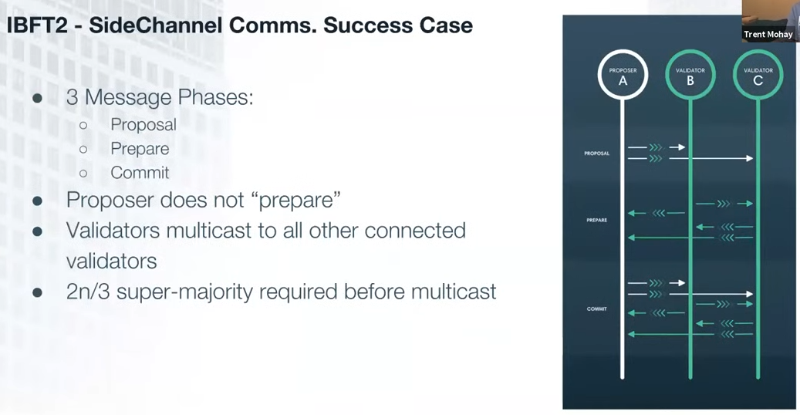
APPENDIX

Slide 21
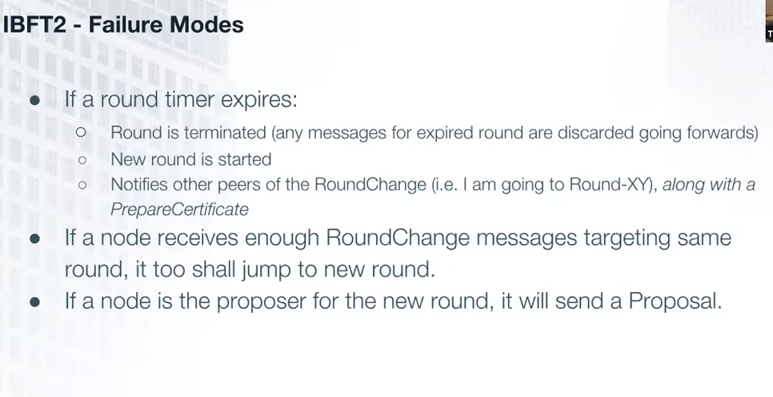
APPENDIX

