Slide 1
Simulator V1 Test
Cyril Naves

Slide 2
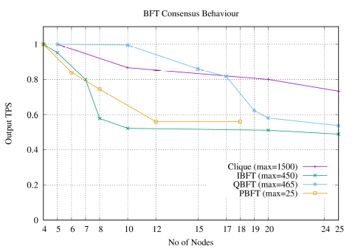
BFT Behavior Normalised Result
No of Txs: 30000 over 3 iterations
Consensus:
Clique: Geth
PBFT: Hyperledger Sawtooth
IBFT: Besu
QBFT: Besu
Test Motive : Scalability

Slide 3
Test Motivation
To test the performance of Simulator
To replicate the test with the Simulator and test if it deviates
Already identified bottlenecks in the Heterogeneous layers ( Geth, Besu, Hyperledger)
So in order to homogenise results and avoid the bottlenecks identified earlier.

Slide 4
Test Format
Environment : TAS Cloud
Block Size: 6000 (Similar to ACM)
No control on input TPS as it is complete P2P diffusion of messages.
Latency / Network Control / Behaviour / Network Type: Kept Constant Mesh / Honest (Similar to ACM)
Change in No of Nodes: 5, 10, 15, 20, 25 (Similar to ACM)
Collator Frequency: 3 secs
No of Txs: 30000 over 3 iterations
No of Txs: 200000 over 3 iterations
Block Gas Limit: 6000

Slide 5
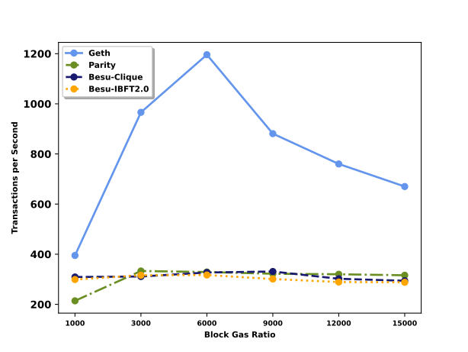
Simulator General Idea
Transaction:
Heterogenous:
Smart Contract Transaction
Logic Execution
Virtual Machine State Read / Write
Aggregation and Stored in DB
Homogenous:
Message Transaction
No Logic Execution
Aggregation and Stored in Virtual Memory
Commonalty:
Transaction execution workflow
Transaction Consensus Verification
Transaction Finalisation
Overall:
Heterogenous:
Different Software Design
(Abstract, Factory, Model Driven)
Different Programming Plattform (Python, Golang, Java)
DB: LevelDB, RocksDB used for persistence
Homogenous:
Controller Design Pattern
Concurrency implemented.
Enterprise Java 8
All in virtual memory
Commonalty:
Consensus Execution Logic
Heterogenous Result (Block Limit)

Slide 6
Simulator General Idea
Consensus | No of Nodes | Block Size | Finalized TPS
PBFT | 5 | 500 | 250
PBFT | 5 | 5000 | 300
PBFT | 5 | 50000 | 420
PBFT | 10 | 500 | 25
PBFT | 10 | 5000 | 100
PBFT | 10 | 50000 | 300
Block Size = 1 / Message Communication Complexity

Slide 7
Simulator General Idea
But the Idea is not to test the simulator but to homogenise the results at the same parameter of Block Size, No of Nodes inspite of certain differences.
Also the diffusion of message of transactions is peer to peer so we dont have control on the input tps rate. But in earlier the transaction were sent from an external client to the actual node.

Slide 8
PBFT
Block Size: 100
No of Nodes | Finalized TPS
4 | 200
5 | 160
6 | 90
8 | 48
10 | 18
12 | 18
15 | 18
18 | 18
20 | 14
24 | 8
https://bitbucket.org/edge-team-leat/sawtooth_pbft_v1.2-benchmark/src/master/

Slide 9
Clique
Block Size: 6000
Block Period: 3 secs
No of Nodes | Finalized TPS
5 | 700
10 | 500
15 | 400
20 | 350
25 | 350

Slide 10
IBFT
Block Size: 6000
No of Nodes | Finalized TPS
4 | 600
5 | 600
7 | 550
8 | 500
10 | 350
20 | 200
25 | 200

Slide 11
QBFT
Block Size: 6000
No of Nodes | Finalized TPS
5 | 550
10 | 400
15 | 350
17 | 300
19 | 270
20 | 250
25 | 250

