Slide 1
Simulator V3 Test
Cyril Naves

Slide 2
Retours
PBFT?
500 TPS
https://www.sciencedirect.com/science/article/pii/S2090447921000630
https://www.google.com/url?sa=t&rct=j&q=&esrc=s&source=web&cd=&cad=rja&uact=8&ved=2ahUKEwiw1Mbunpb5AhUuxYUKHSn9CtA4ChAWegQIHRAB&url=https%3A%2F%2Farxiv.org%2Fpdf%2F2103.04234&usg=AOvVaw2MPyWaFNrdz6o8XYMDFhpd

Slide 3
https://www.google.com/url?sa=t&rct=j&q=&esrc=s&source=web&cd=&cad=rja&uact=8&ved=2ahUKEwiw1Mbunpb5AhUuxYUKHSn9CtA4ChAWegQIAhAB&url=https%3A%2F%2Fzenodo.org%2Frecord%2F3466686%2Ffiles%2F2019.conference.ispdc.camera.pdf%3Fdownload%3D1&usg=AOvVaw0MAM3y9hxLLeVAxnURMTvO
https://www.google.com/url?sa=t&rct=j&q=&esrc=s&source=web&cd=&cad=rja&uact=8&ved=2ahUKEwiw1Mbunpb5AhUuxYUKHSn9CtA4ChAWegQIBBAB&url=http%3A%2F%2Fsecurity.riit.tsinghua.edu.cn%2Fshare%2FICBC2019_ShuoWang-2.pdf&usg=AOvVaw24gsKKjto8a3hIfwhFRb-b
https://repository.tudelft.nl/islandora/object/uuid:01083a4a-900b-4cf9-9746-cb9258c11d9e/datastream/OBJ/download
Q. Nasir, I. A. Qasse, M. Abu Talib, and A. B. Nassif,
“Performance analysis of hyperledger fabric
platforms,” Security and Communication Networks,
vol. 2018, 2018

Slide 4
To Add Explanation for Difference
PBFT Why high?
Compartmentalisation:----

Slide 5
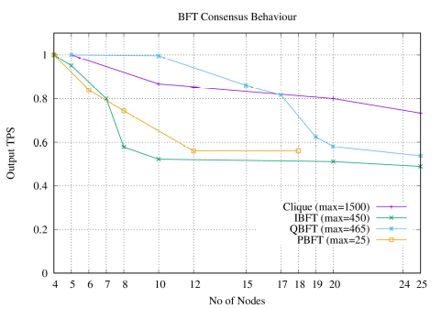
BFT Behavior Normalised Result
No of Txs: 30000 over 3 iterations
Consensus:
Clique: Geth
PBFT: Hyperledger Sawtooth
IBFT: Besu
QBFT: Besu
Test Motive : Scalability

Slide 6
Test Motivation
To test the performance of Simulator
To replicate the test with the Simulator and test if it deviates
Already identified bottlenecks in the Heterogeneous layers ( Geth, Besu, Hyperledger)
So in order to homogenise results and avoid the bottlenecks identified earlier.

Slide 7
Test Format
Environment : TAS Cloud
Block Size: 6000 (Similar to ACM)
Latency / Network Control / Behaviour / Network Type: Kept Constant Mesh / Honest (Similar to ACM)
Change in No of Nodes: 5, 10, 15, 20, 25 (Similar to ACM)
Collator Frequency: 3 secs
No of Txs: 30000 over 3 iterations
No of Txs: 200000 over 3 iterations
Block Gas Limit: 6000

Slide 8
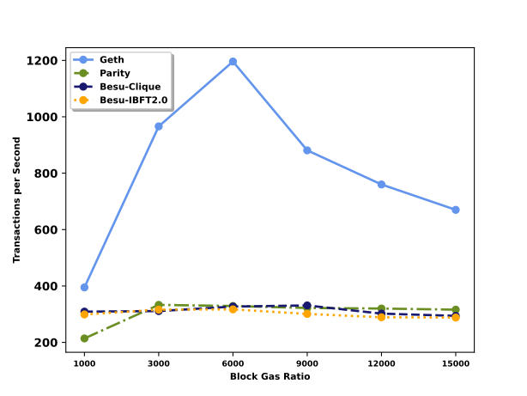
Simulator General Idea
Transaction:
Heterogenous:
Smart Contract Transaction
Logic Execution
Virtual Machine State Read / Write
Aggregation and Stored in DB
Homogenous:
Message Transaction
No Logic Execution
Aggregation and Stored in Virtual Memory
Commonalty:
Transaction execution workflow
Transaction Consensus Verification
Transaction Finalisation
Overall:
Heterogenous:
Different Software Design
(Abstract, Factory, Model Driven)
Different Programming Plattform (Python, Golang, Java)
DB: LevelDB, RocksDB used for persistence
Homogenous:
Controller Design Pattern
Concurrency implemented.
Enterprise Java 8
All in virtual memory
Commonalty:
Consensus Execution Logic
Heterogenous Result (Block Limit)

Slide 9
Simulator General Idea
To homogenise the results at the same parameter of Block Size, No of Nodes inspite of certain differences.
Also the diffusion of message of transactions is peer to peer so we dont have control on the input tps rate. But in earlier the transaction were sent from an external client to the actual node.

Slide 10
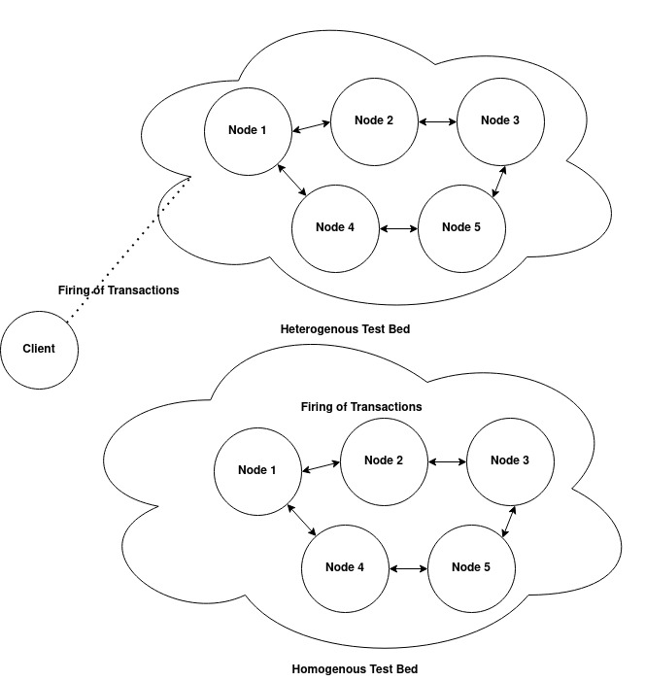
Architecture

Slide 11
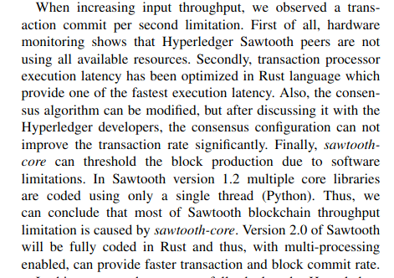
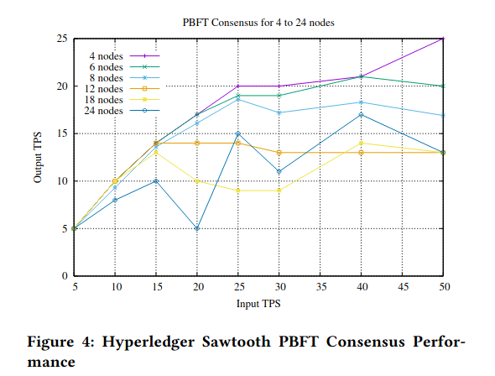
PBFT View
Gerrits: Coins 2020

Slide 12
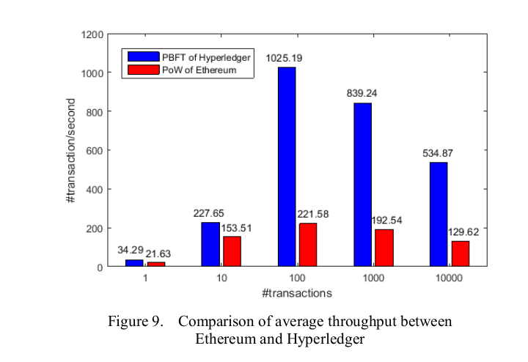
PBFT View
Hyperledger Fabric : PBFT 4 Nodes
Smart Contract
Performance Analysis of Consensus Algorithm in Private Blockchain: Yue Hao , Yi Li 2018

Slide 13
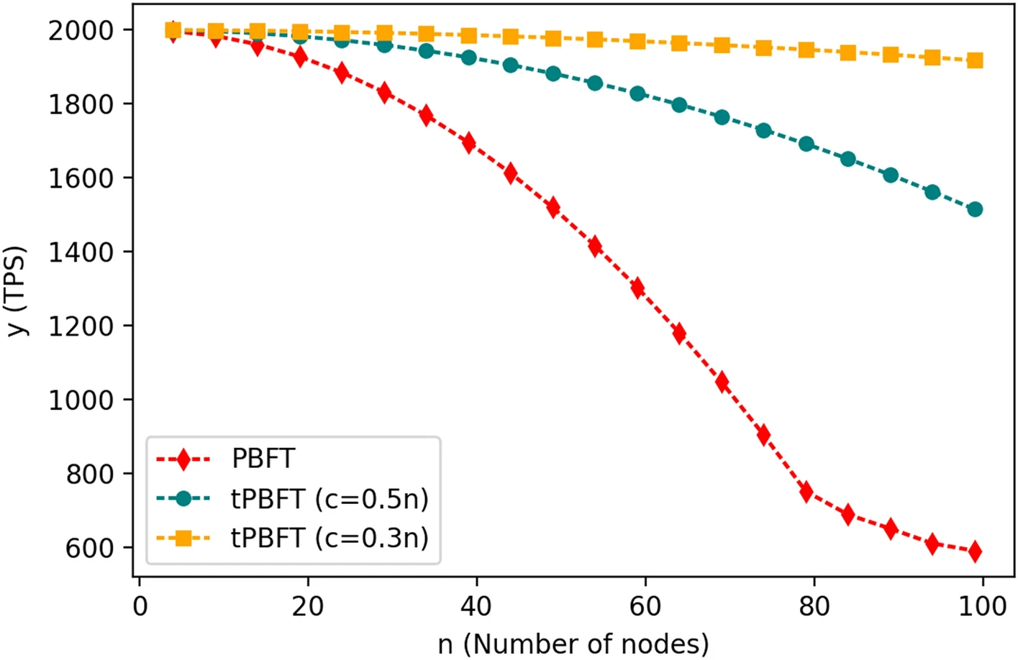
PBFT Another
https://www.nature.com/articles/s41598-022-08587-1
Improved PBFT algorithm for high-frequency trading scenarios of alliance blockchain

Slide 14
PBFT
No of Nodes | Finalized TPS | ACM Measured Saw tooth
4 | 200 | 25
5 | 160 | 20
6 | 90 | 16
8 | 48 | -
10 | 18 | -
12 | 18 | 13
15 | 18 | -
18 | 18 | 13
20 | 14 | -
24 | 14 | 13
Block Size: 100
Input TPS: 500
We limit the block size as to have the same test method.
Saw tooth has a bottleneck and increases the reject rate when batches per sec is increased than 100 as mentioned by Gerrits et al
https://bitbucket.org/edge-team-leat/sawtooth_pbft_v1.2-benchmark/src/master/

Slide 15
PBFT New
Txs=50000
Block Size: 6000
Socket | 1 | 2 | 3 | 4 | 5 | 6 | 7 | 10 | 12
Input TPS | 500 | 500 | 500 | 500 |  |  |  | 500 | 600
No of Nodes
5 | 100|266 | 366 | 350 | 166 | 366 | 233| 350 |  | 200 |  | 200 | 500|400
10
15
20
25

Slide 16
PBFT New
Txs=50000
Block Size: 6000
Socket | 2 | 4 | 12
Input TPS | 500 | 500 | 600
No of Nodes
5 | 366 | 350 | 233 | 350 | 500 | 400
10 |  |  | 66
15
20
25

Slide 17
Clique
No of Nodes | Finalized TPS | ACM Measured Geth
5 | 360 | 480
10 | 340 | 480
15 | 340 | -
20 | 330 | 480
25 | 320 | 480
Block Size: 6000
Block Period: 3 secs
Input TPS: 500

Slide 18
Clique New
Block Size: 6000
Block Period: 3 secs
No of Nodes | 400 | 500 | 800 | 900 | 1000 | 1100 | 1200 | 1300
5 | 380 | 400 | 780 | 830 | 933 | 900 | 880 | 800
10
15
20
25

Slide 19
IBFT
No of Nodes | Finalized TPS | ACM Measured Besu
4 | 480 | 450
5 | 450 | 430
7 | 450 | 370
8 | 400 | 260
10 | 350 | 230
20 | 200 | 220
25 | 200 | 210
Block Size: 6000
Input TPS: 500

Slide 20
QBFT
No of Nodes | Finalized TPS | ACM Measured Besu
5 | 480 | 470
10 | 400 | 470
15 | 350 | 400
17 | 300 | 380
19 | 270 | 290
20 | 250 | 270
25 | 250 | 250
Block Size: 6000
Input TPS: 500

Slide 21
Intermediate Conclusion
Current Testing of 500 TPS two low to benchmark
Solution to increase and test.
Found the bottleneck in the Socket Communication and Transaction Processing
Increased the Socket Communication handling, Transaction Processing by creating seperate channels.
Each Channel will handle transaction independently with no interaction and aggregate all the processed transaction in the transaction pool.
Ref: https://bitbucket.org/cyrilnavessamuel/cliquedltsimulatorfinal/commits/0935c969b84f02b19aa13fad3ed64c713020baf4
Now we can increase input upto 1100 – 1000 TPS.
To redo the test with the new version V1.1 from V1 of simulator in all Clique / IBFT / PBFT / QBFT
To do the same in our V2 simlator of proposed consensus to v2.1

Slide 22
PBFT New
Txs: 1500000
Block Size: 2000
8G
3CPU
Tx Channel: 4 (2 instances)
No of Nodes | 5 | 10 | 15 | 20 | 25
TPS 1 | 2100 | 1866 | 800 | 350 | 230
TPS 2 | 2050 | 1633 | 800 | 350 | 240
TPS 3

Slide 23
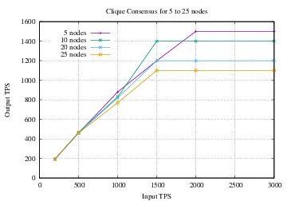
Clique New
Txs=300000
Block Size: 1000
6G
2CPU
Tx Channel: 4 (2 instances)
Block Period: 2sec

Slide 24
Clique New
Txs: 1500000
Block Size: 2000
8G
3CPU
Tx Channel: 4 (2 instances)
Block Period: 1sec
No of Nodes | 5 | 10 | 15 | 20 | 25 | 30
TPS 1
TPS 2
TPS 3

Slide 25
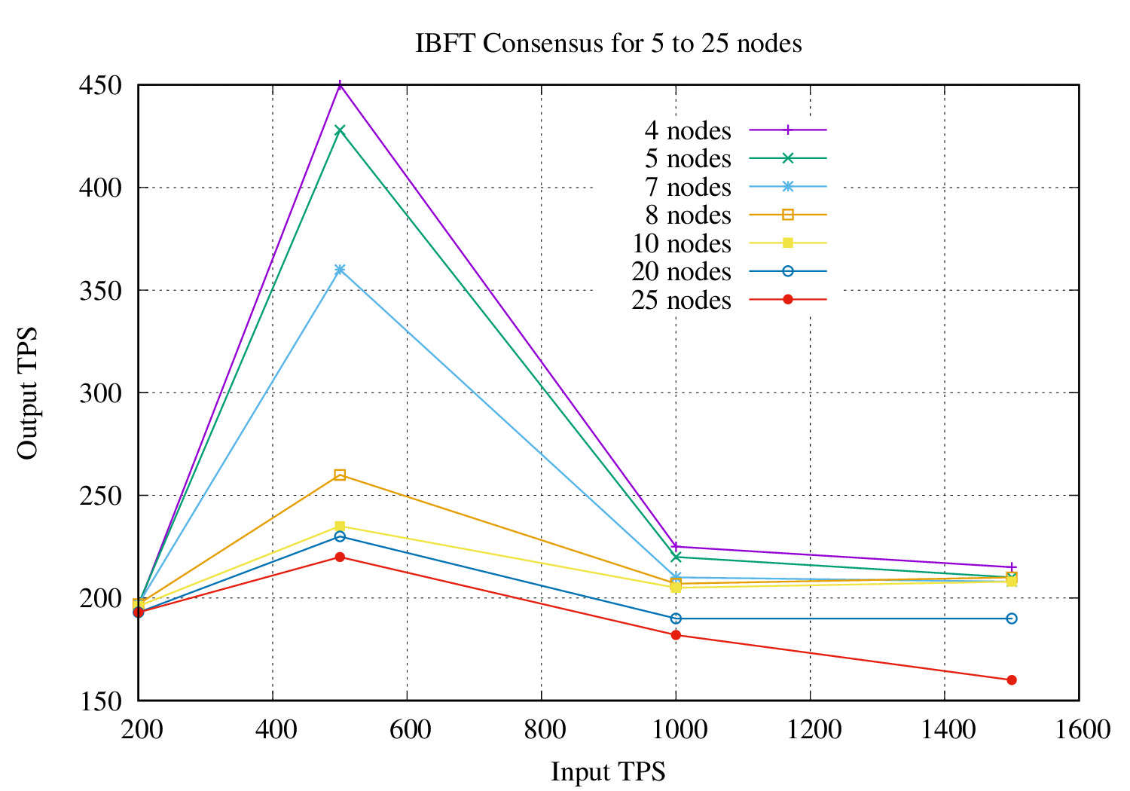
IBFT New

Slide 26
IBFT New
Txs: 1500000
Block Size: 2000
8G
3CPU
Tx Channel: 4 (2 instances)
No of Nodes | 5 | 10 | 15 | 20 | 25 | 30
TPS 1
TPS 2
TPS 3

Slide 27
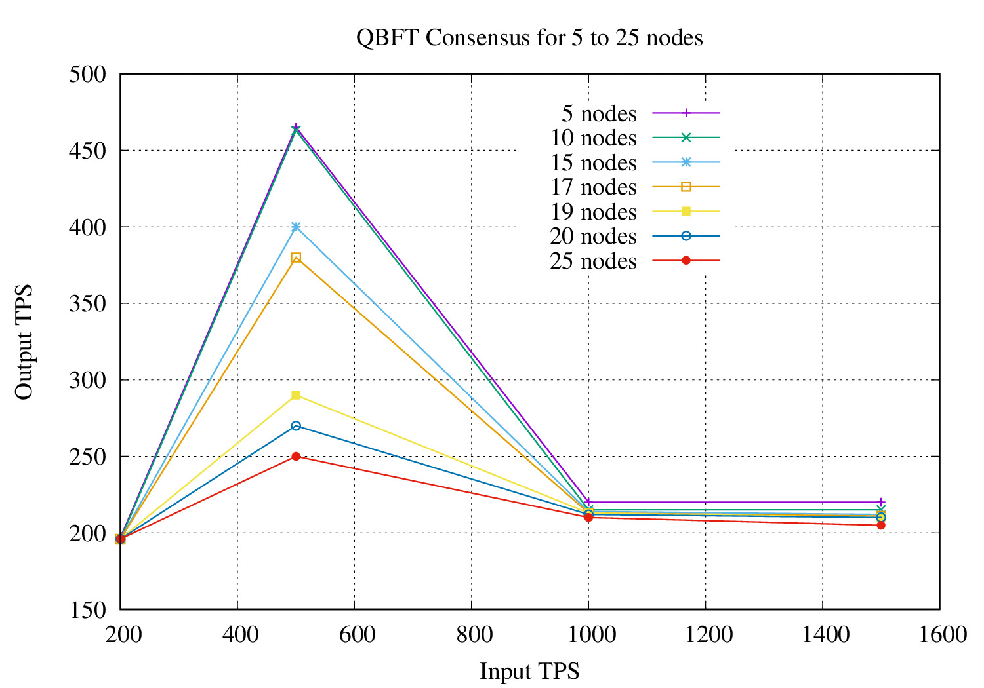
QBFT New

Slide 28
QBFT New
Txs: 1500000
Block Size: 2000
8G
3CPU
Tx Channel: 4 (2 instances)
No of Nodes | 5 | 10 | 15 | 20 | 25 | 30
TPS 1
TPS 2
TPS 3

Slide 29
Graphs

Slide 30
Altruism may be seen as similar to utilitarianism, however an essential difference is that the latter prescribes acts that maximize good consequences for all of society, while altruism prescribes maximizing good consequences for everyone except the actor.
So change to Utilitarian- Better

Slide 31
Inference

