Slide 1
DataMarket / Hybrid Consensus

Slide 2
Schema
Test Objective
DataMarket UML
Consensus
Development
Deployment
Results

Slide 3
Objective
To test again a mobility usecase with a new blockchain platform having a different approach to consensus: Hybrid
Block Proposer: Aura / Babe
Block Finaliser: Grandpa

Slide 4
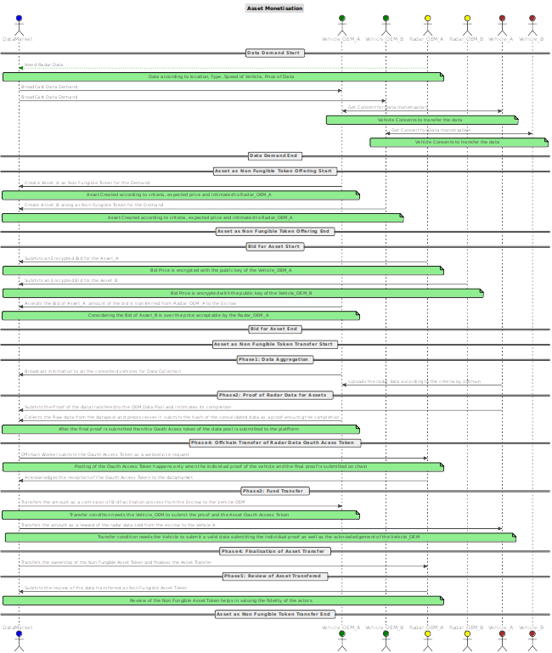
Asset Monetisation
Asset

Slide 5
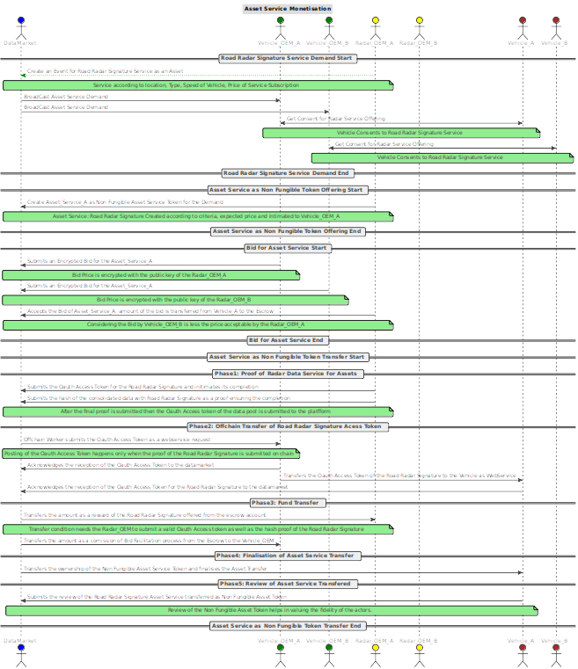
Asset Service Monetisation
Asset_Service

Slide 6
Status
Development:
Rework: V2 [initial] → V3[major change] → V4 [minor change]
Major Changes in pallette[Dual and Multi, Bidding etc] [Onchain]
Modified Web Service Components[Radar & Vehicle API] [Offchain]
ReTest
Added Babe pallette as consensus [not by default]
Client : Modified and Completed
Cloud Deployment: Modified test in progress
Study on Hybrid Consensus: To start
Test: To start
Analyse: To start

Slide 7
Planning
Test/ Analyse: 13 Oct (If everything goes good)

Slide 8
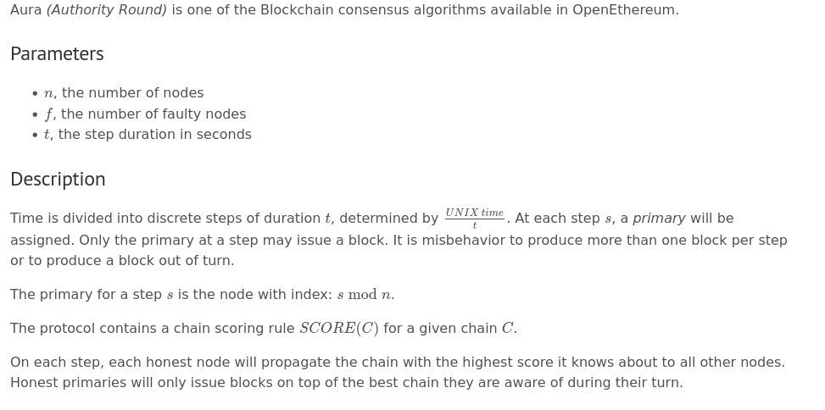
AURA:

Slide 9
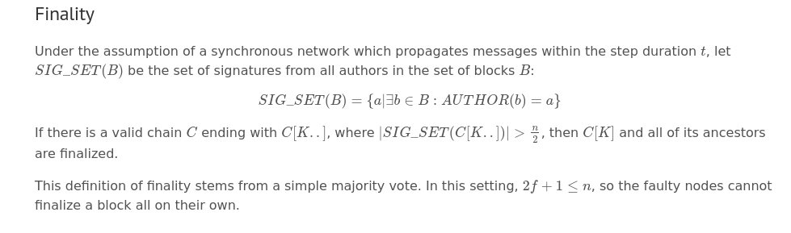
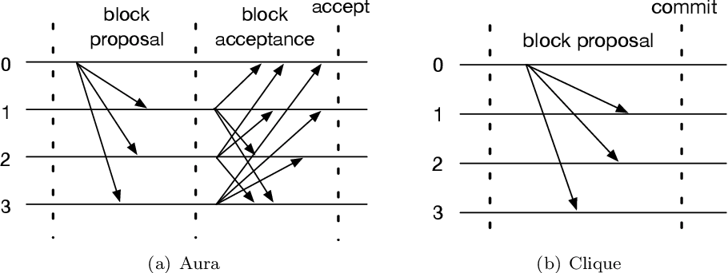
Angelis, Stefano De, Leonardo Aniello, Roberto Baldoni, Federico Lombardi, Andrea Margheri and Vladimiro Sassone. “PBFT vs Proof-of-Authority: Applying the CAP Theorem to Permissioned Blockchain.” ITASEC (2018).

Slide 10
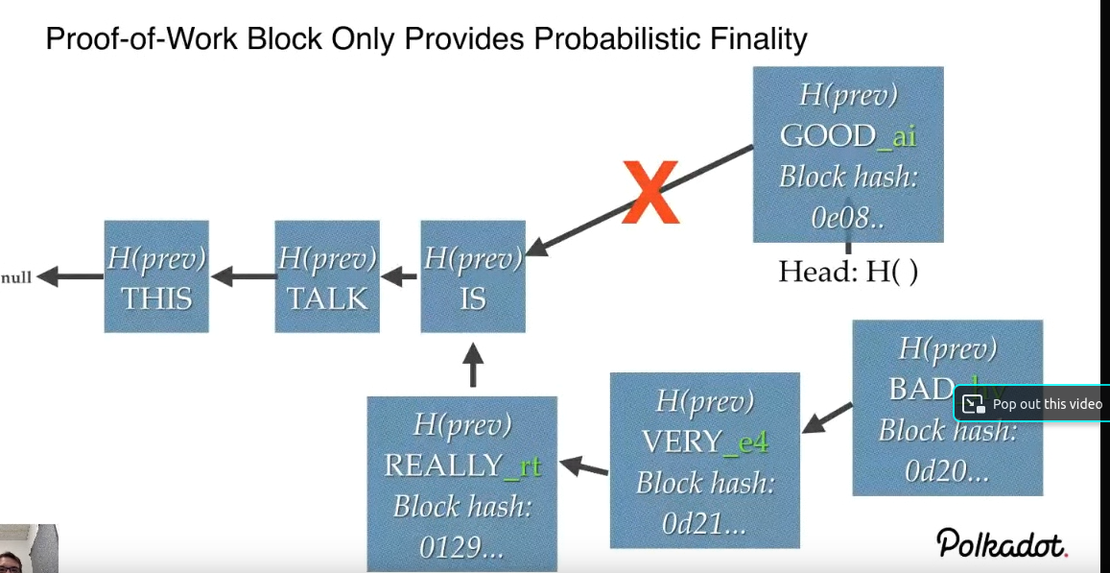
Problem
How is the longest Chain the canonical chain? Not Correct

Slide 11
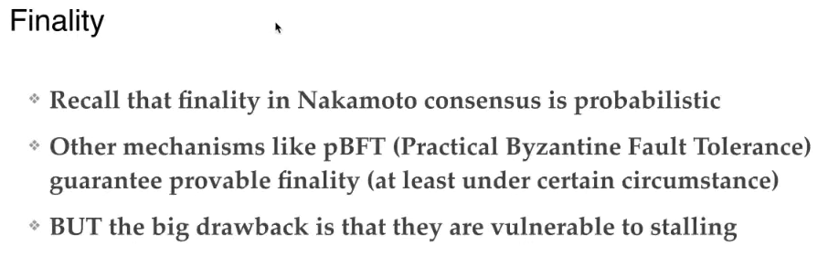
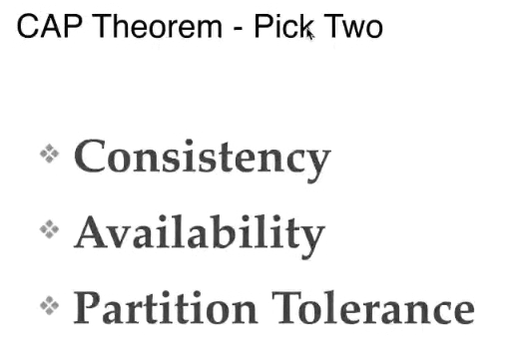

Slide 12
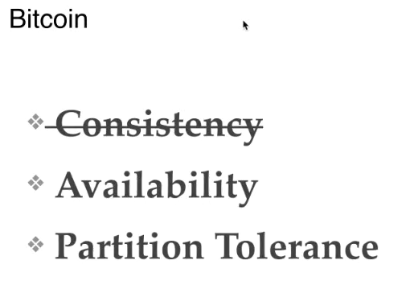
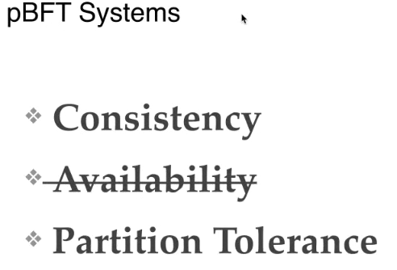
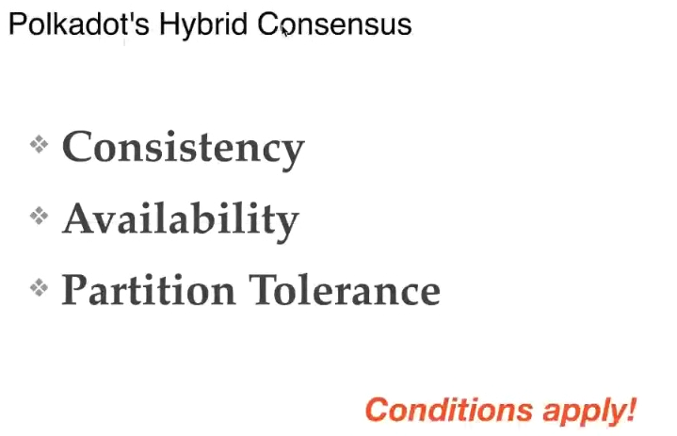

Slide 13
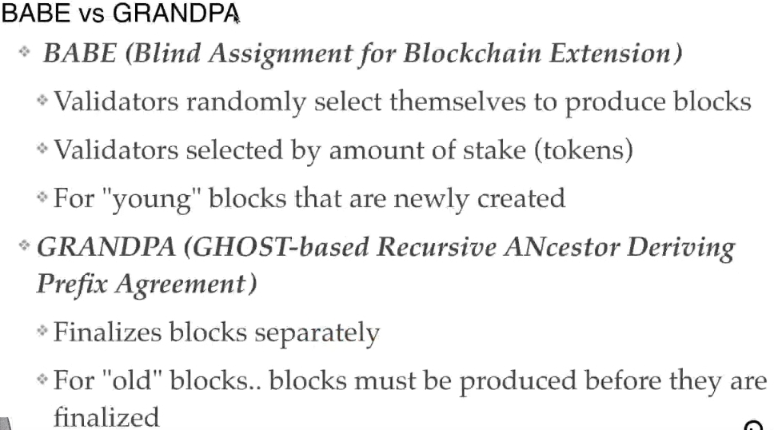

Slide 14
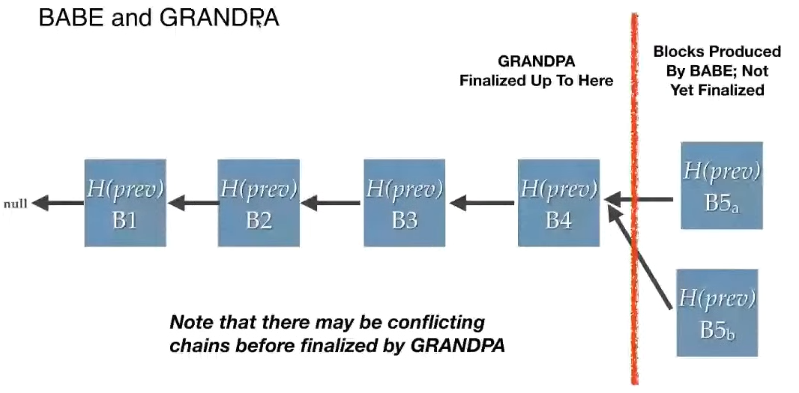

Slide 15
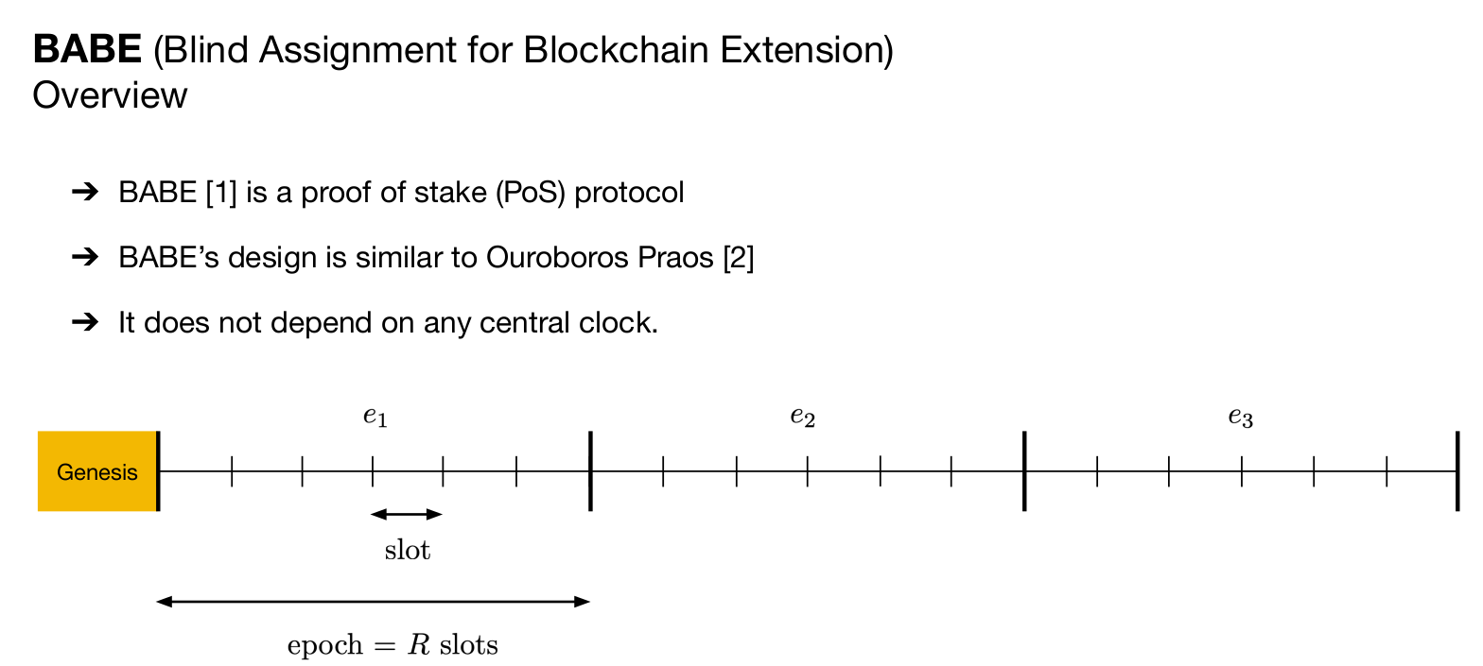

Slide 16
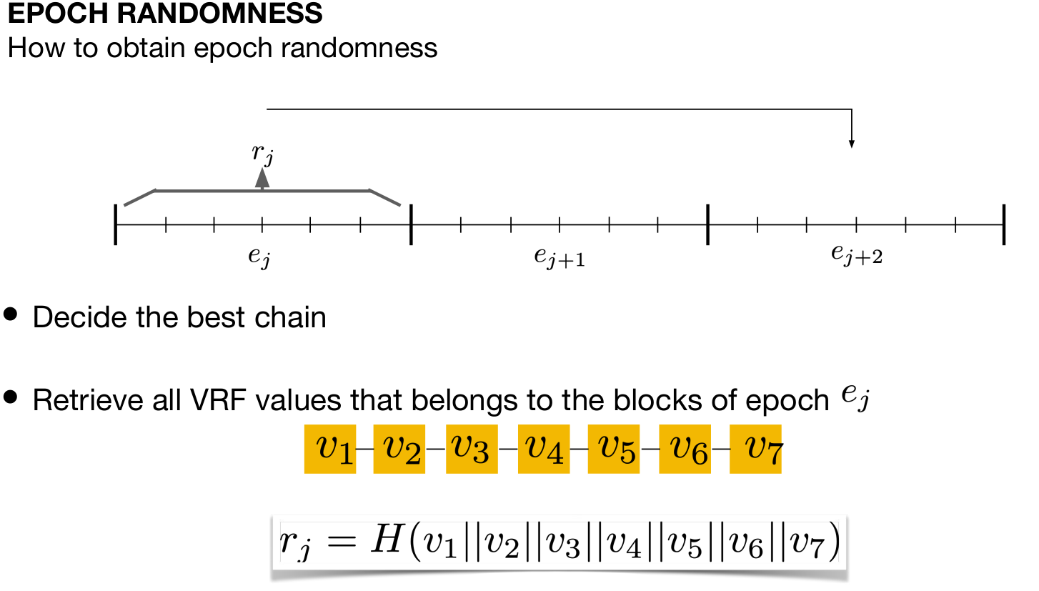

Slide 17
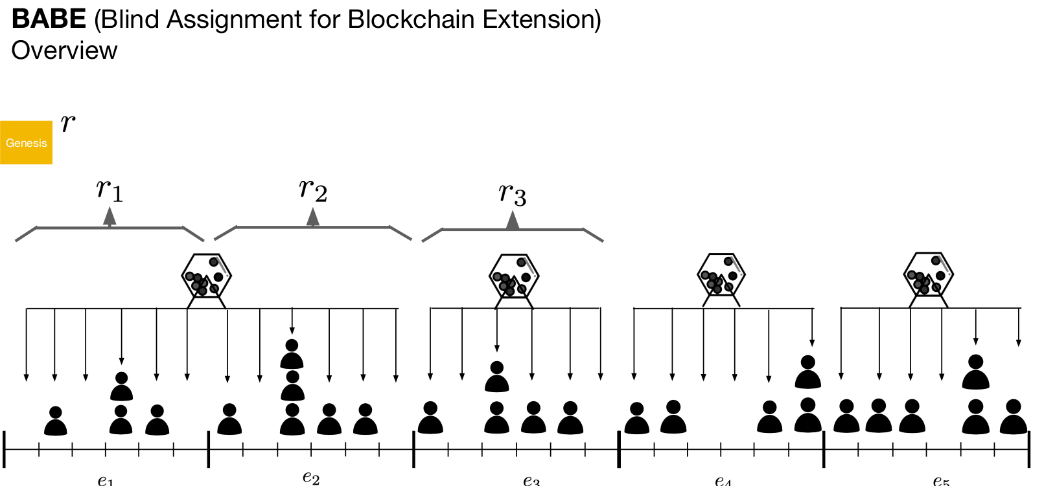
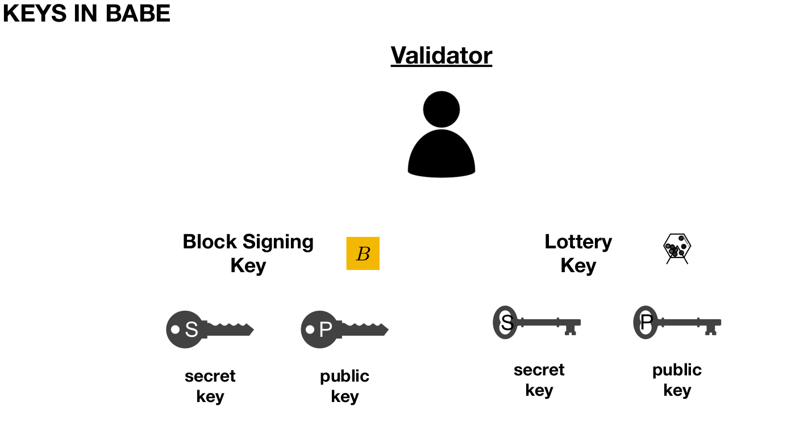

Slide 18
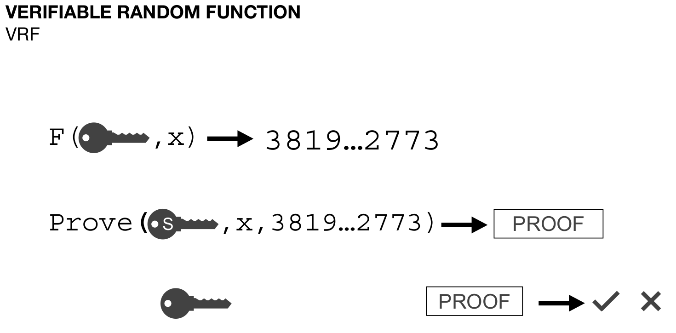
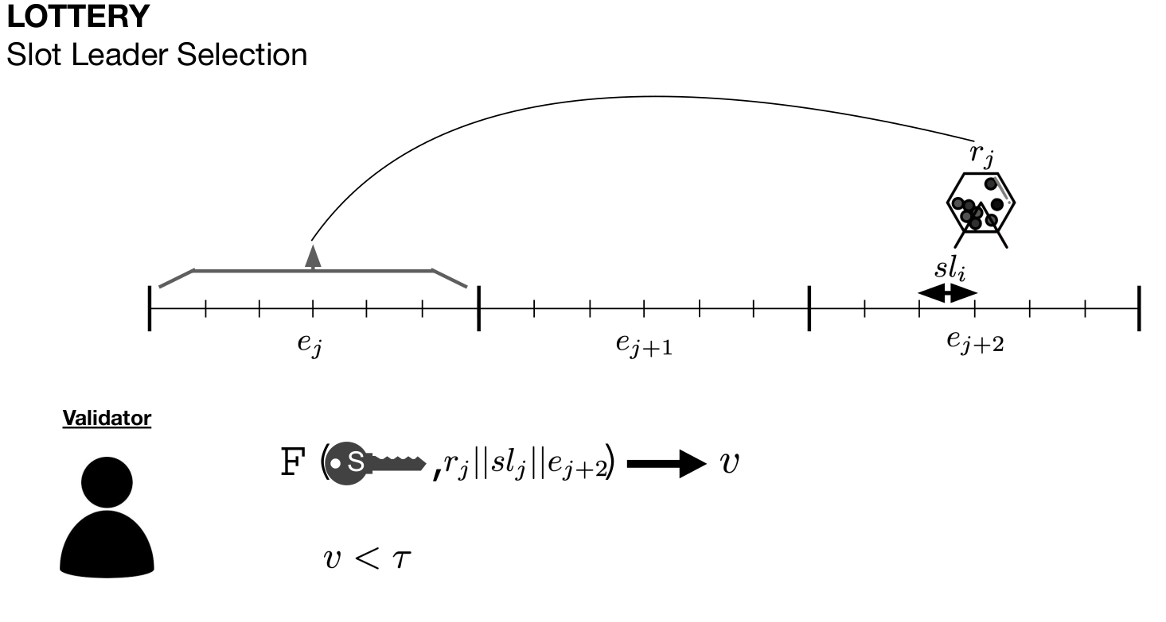

Slide 19
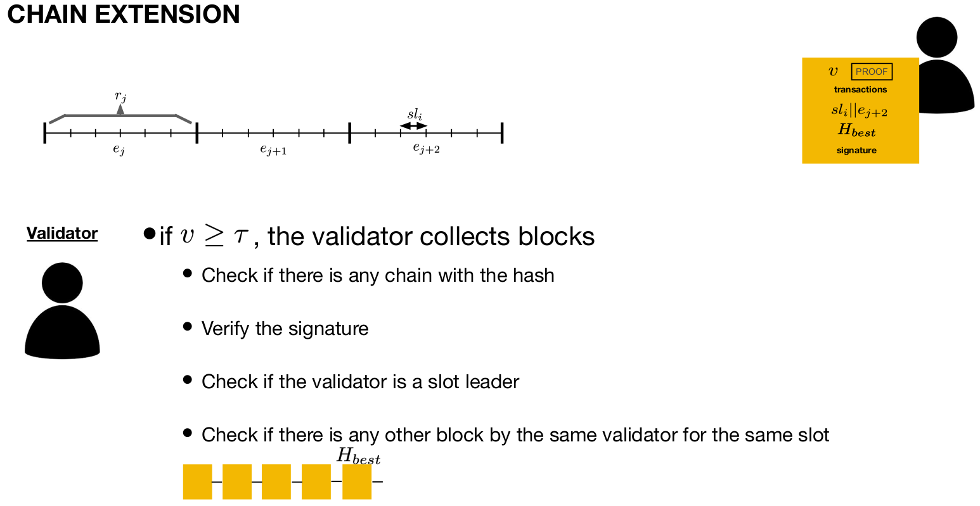
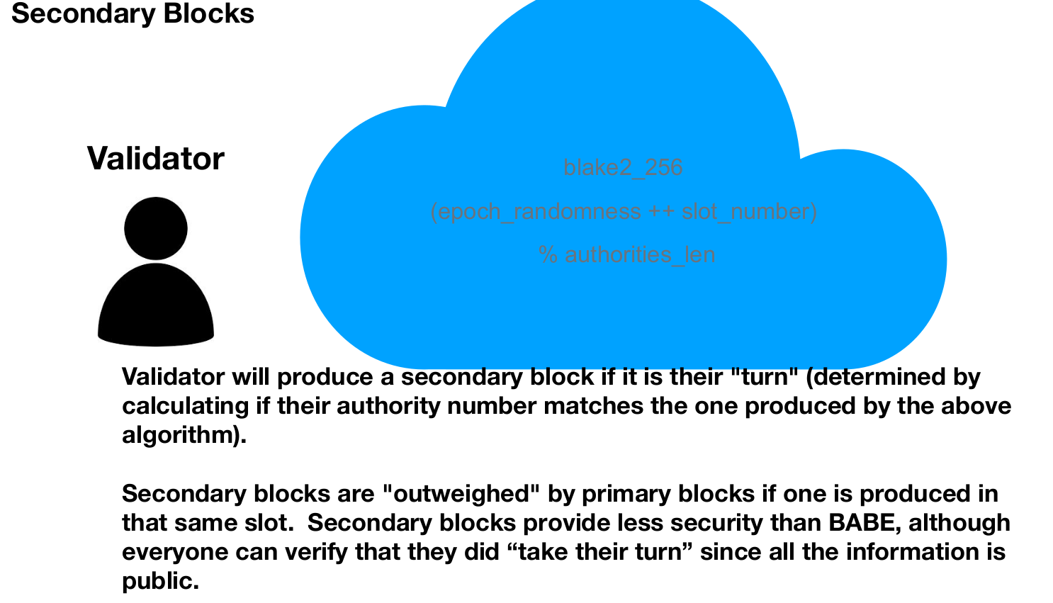

Slide 20
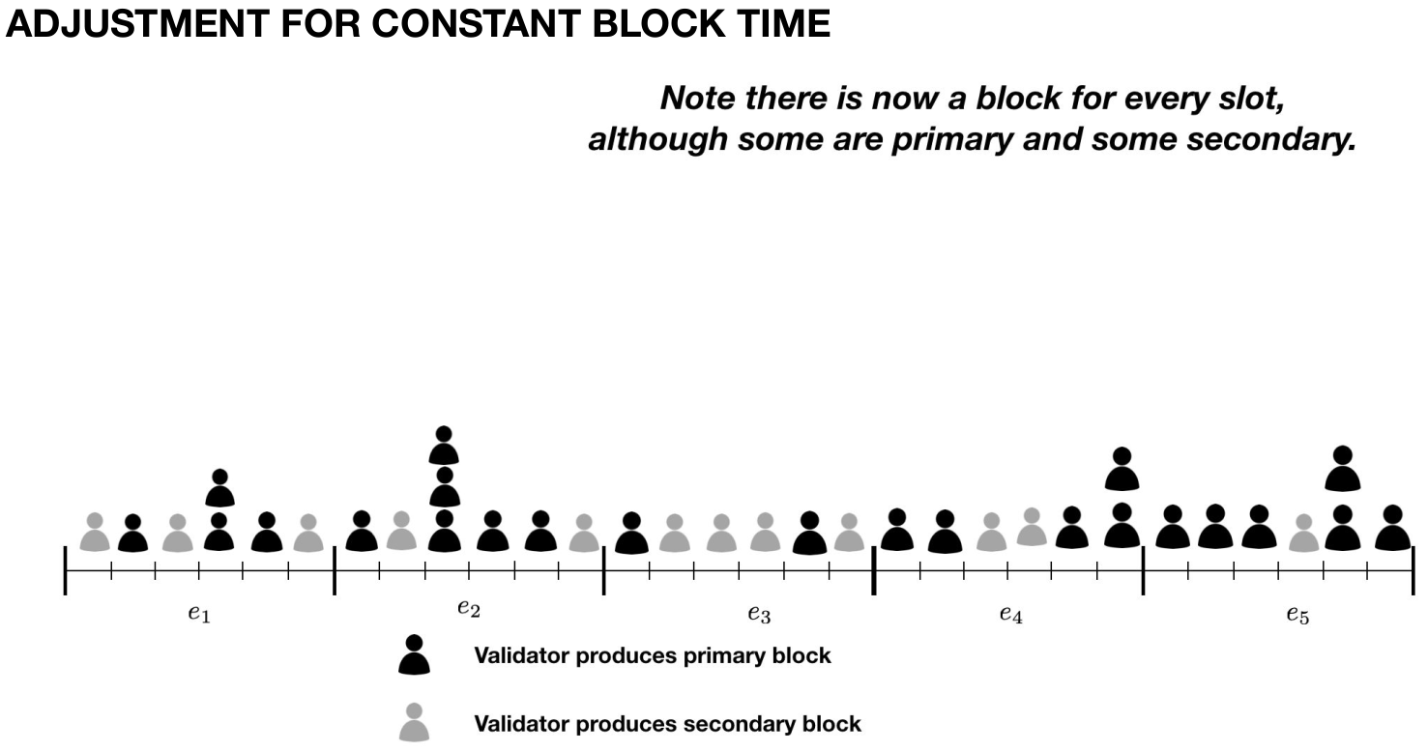
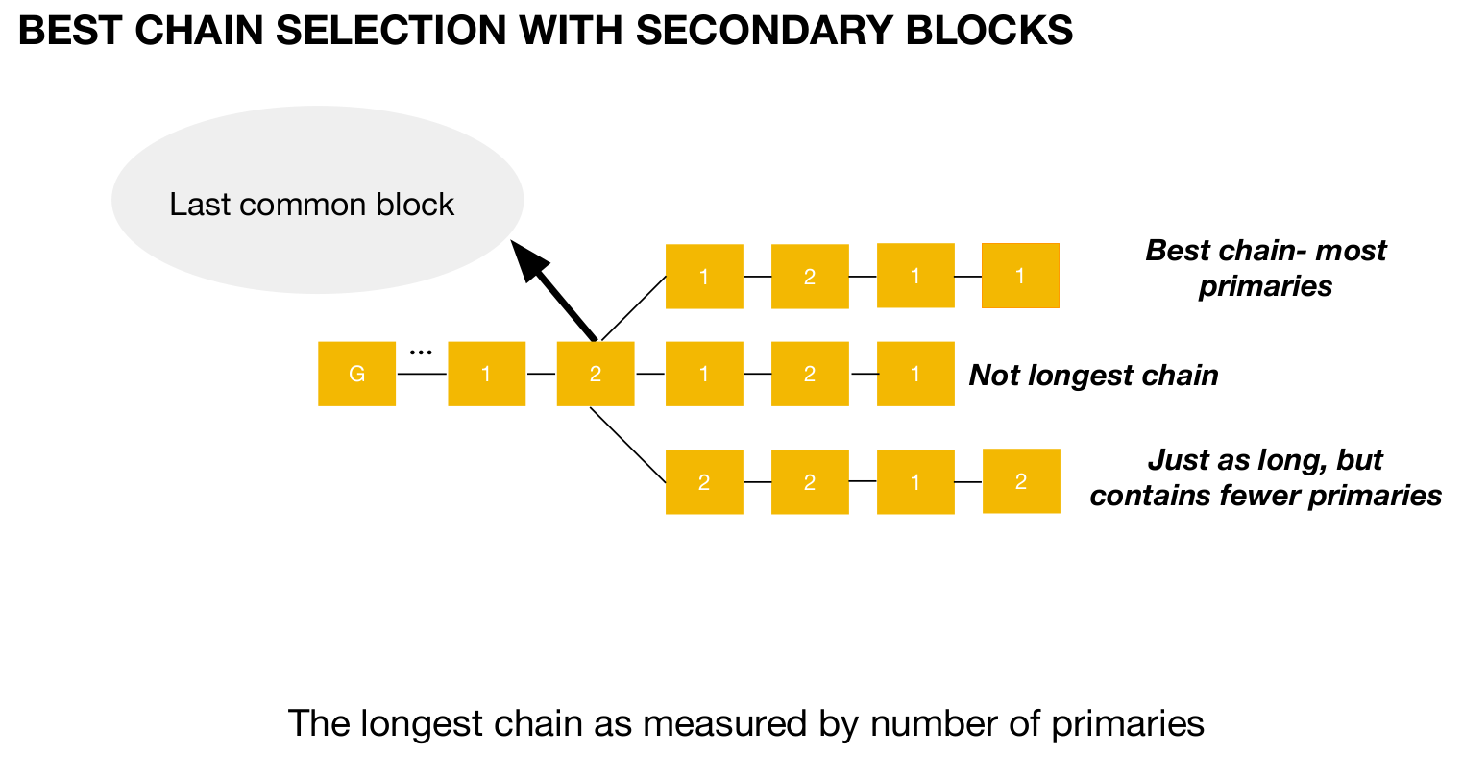

Slide 21
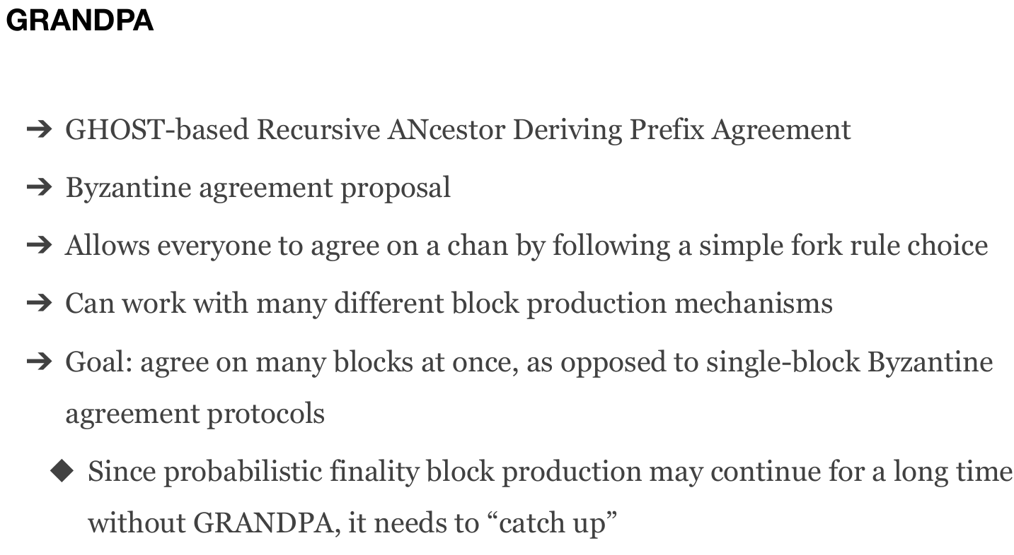
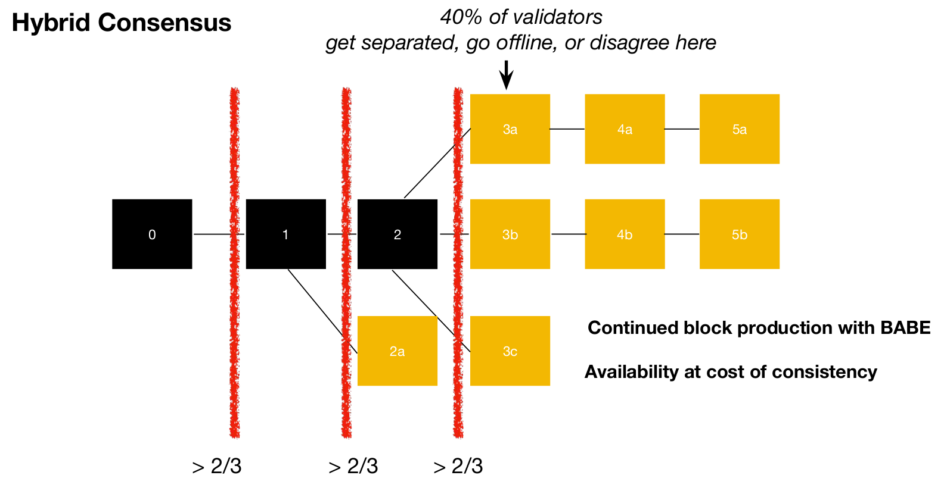

Slide 22
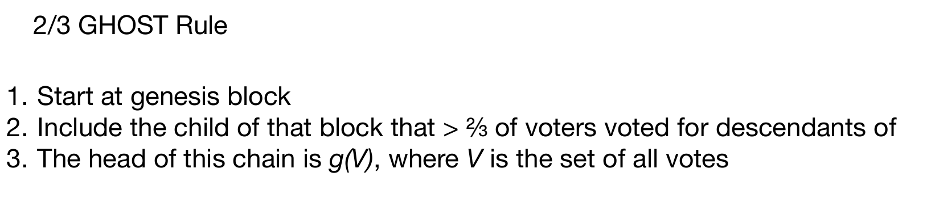
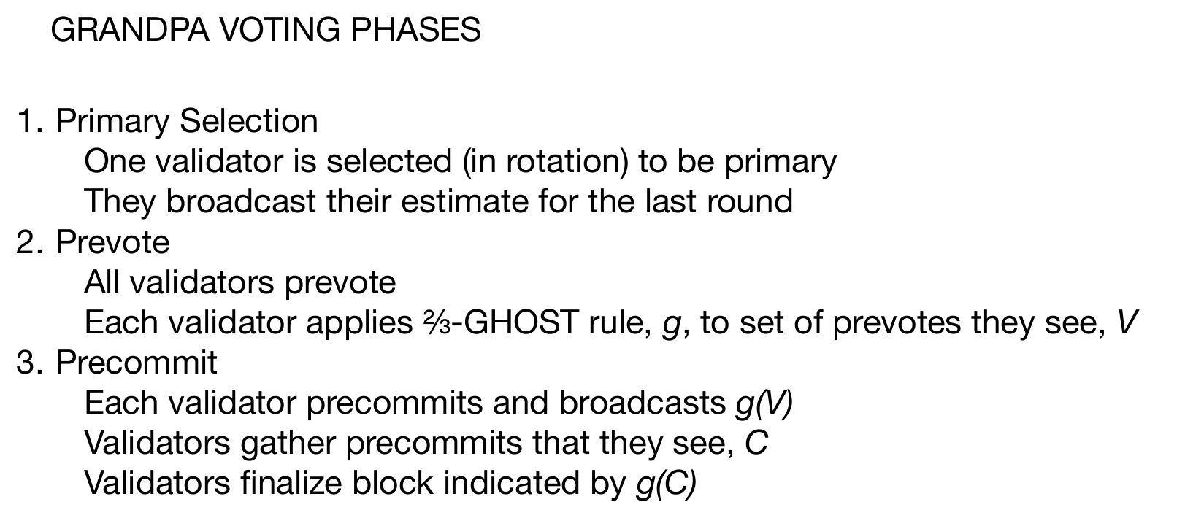

Slide 23
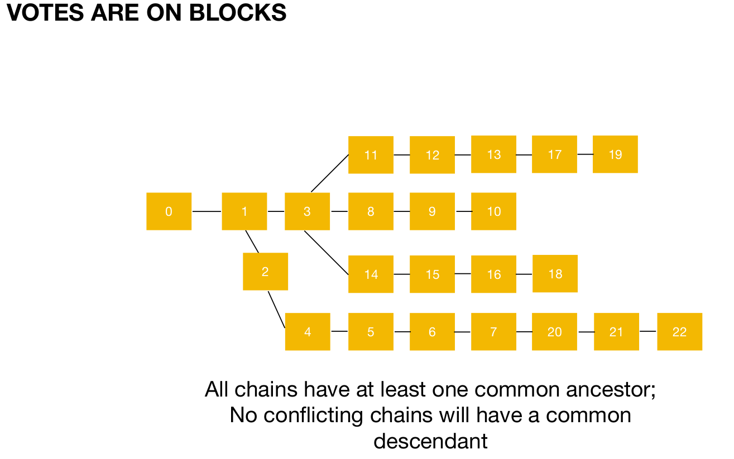
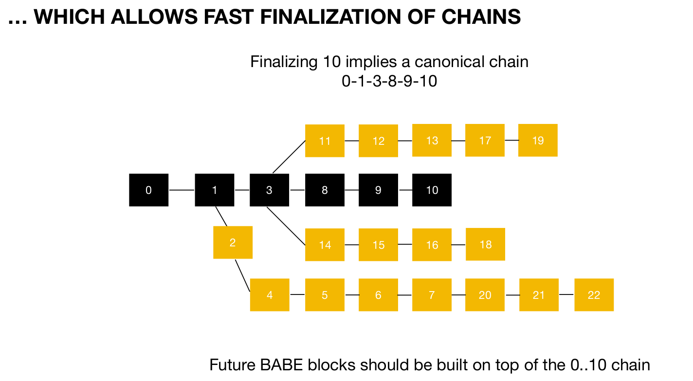

Slide 24
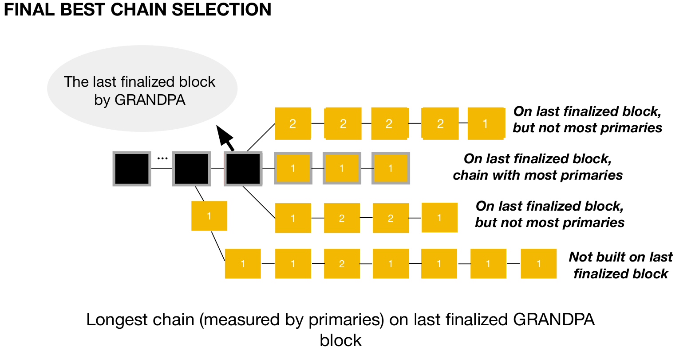
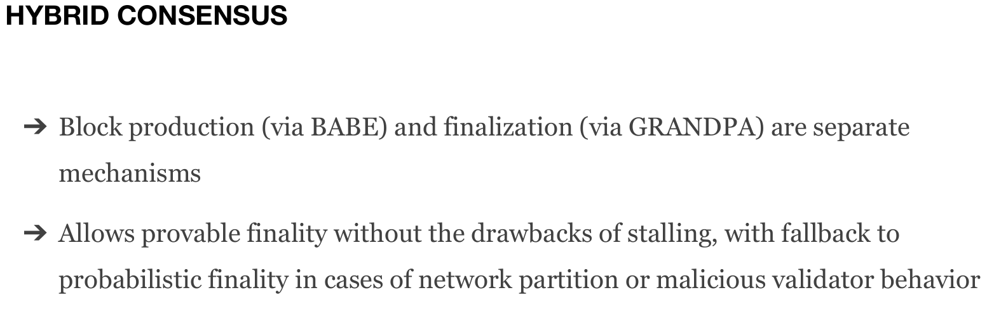
Similar to CASPER Friendly Finality Gadget: Hybrid Consensus

Slide 25
DEMO:

Slide 26
FEEDBACK:
What are drawbacks on Aura/ Babe Grandpa with respect to CAP theorem?

Slide 27
APPENDIX

Slide 28
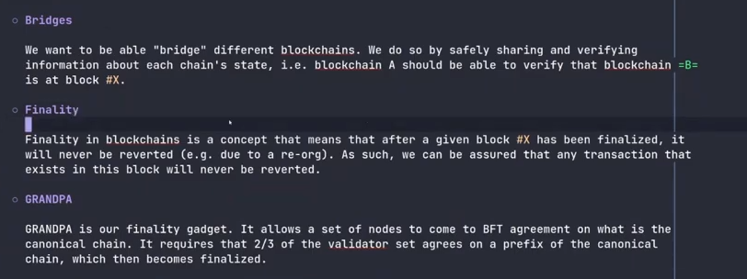
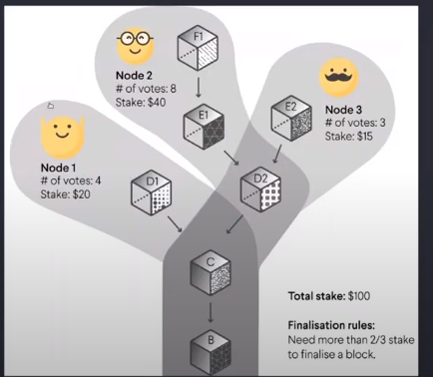

Slide 29
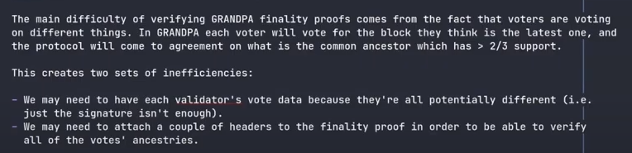
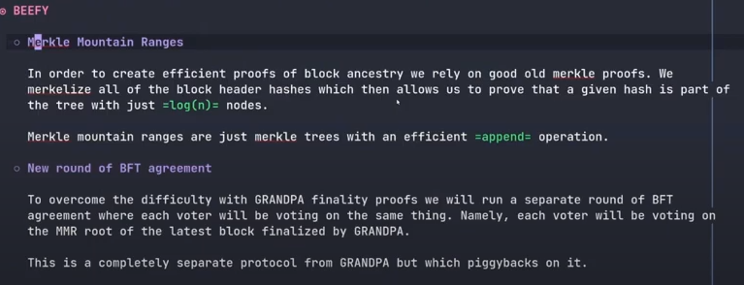
Voting on Chains and not blocks
Drawbacks: https://www.youtube.com/watch?v=ZmIa_4hPRZ8
BEEFY

Slide 30
Feedback
Data Demand
Legal Offloading
Gateau pour chacun

