Slide 1
Hybrid Consensus

Slide 2
Objective
Measure, Understand and Analyse the Hybrid Consensus

Slide 3
Schema
Performance Measuring Normalisation
Performance Measurement Details
Aura + Grandpa Block Period Influence
Aura + Grandpa Scalability Influence
Aura + Grandpa Forks
Babe + Grandpa Block Period Influence
Babe + Grandpa Scalability Influence
Babe + Grandpa Forks

Slide 4
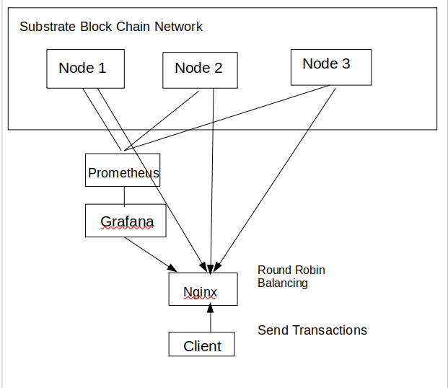
Performance Measuring Normalisation

Slide 5
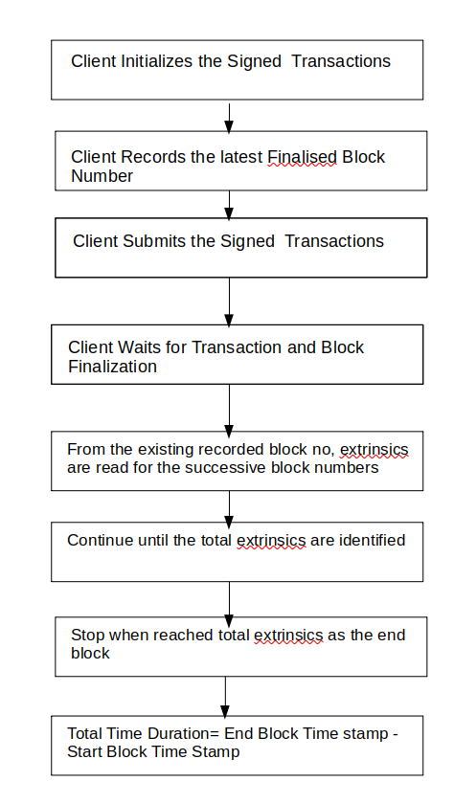
Performance Measuring Normalization

Slide 6
Performance Measurement Details
No of Nodes: 5, 10, 15, 20, 25
No of Accounts: 2000
Client Threads: 1000
Transaction Type: Create Asset Transaction
Complexity of Method:
Hash Calculation (1)
Read from storage (5)
Write to Storage (10)

Slide 7
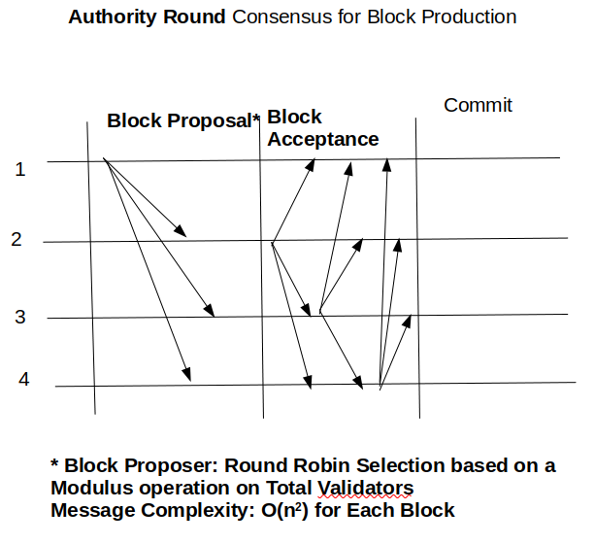
Aura
Ref: https://docs.rs/sc-consensus-aura/latest/sc_consensus_aura/

Slide 8
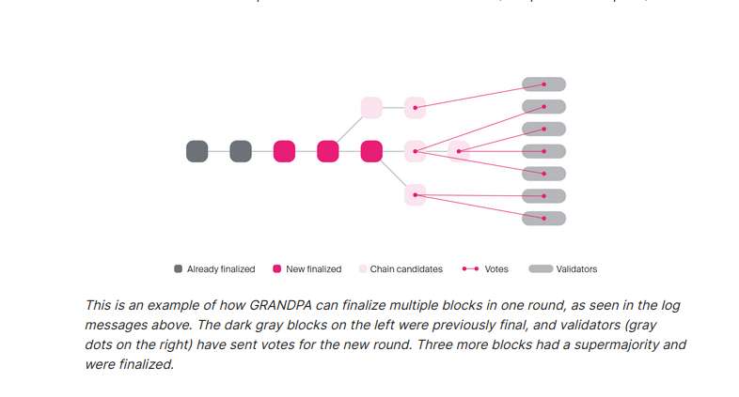
Grandpa
Ref:
https://docs.rs/pallet-grandpa/3.0.0/pallet_grandpa/
https://docs.rs/sc-finality-grandpa/0.9.0/sc_finality_grandpa/

Slide 9
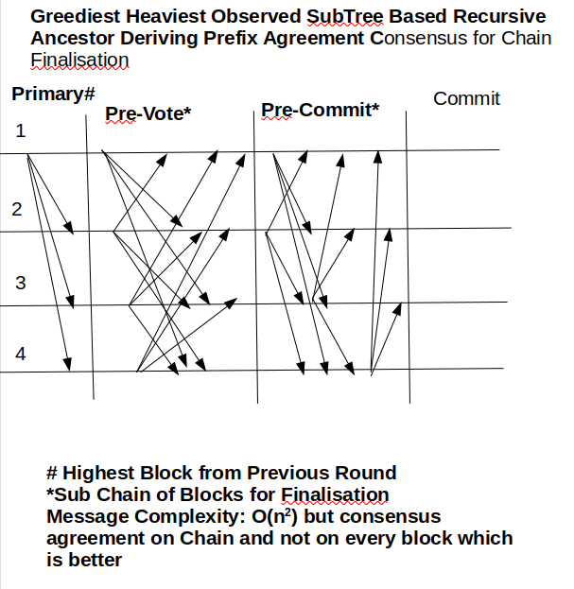
GRANDPA
Ref:
https://docs.rs/pallet-grandpa/3.0.0/pallet_grandpa/
https://docs.rs/sc-finality-grandpa/0.9.0/sc_finality_grandpa/

Slide 10
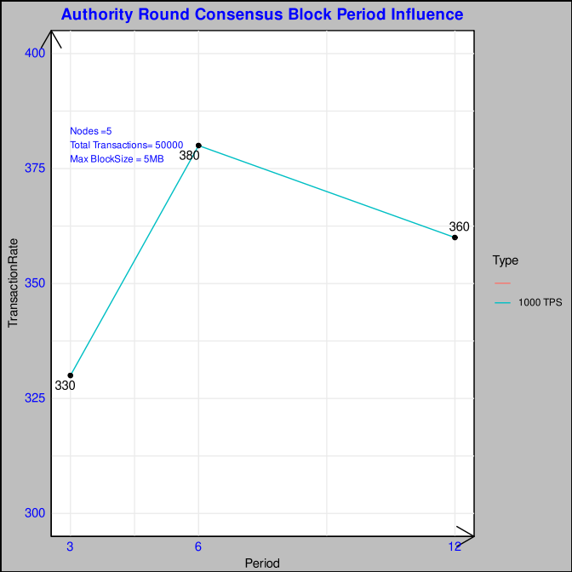
AURA + GRANDPA Block Period Influence
Higher Block Period Increases the time for Block Production
Lower Block Period decreases the turn around time for block creation but the time interval is short for transaction verification, block creation and consensus operation
Ideal around = 6 secs

Slide 11
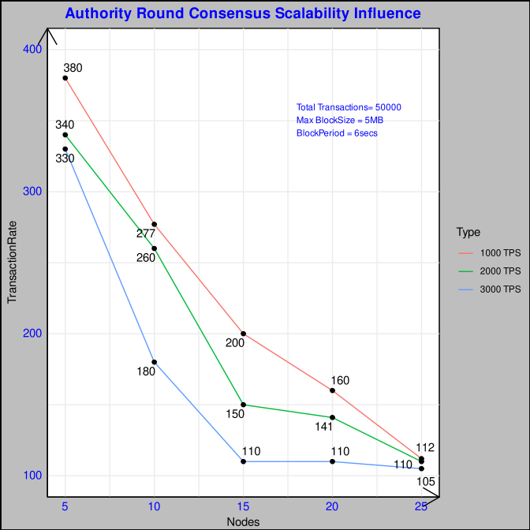
AURA + GRANDPA Scalability Influence
Since the message communication is O(n²) it decreases the throughput significantly with the increase of nodes. In addition GRANDPA O(n²) augments the drop but the consensus decision is on the chain rather than the block level.
Also at higher TPS, the bottleneck of higher transaction processing increases the fork in the system thereby bringing down the throughput

Slide 12
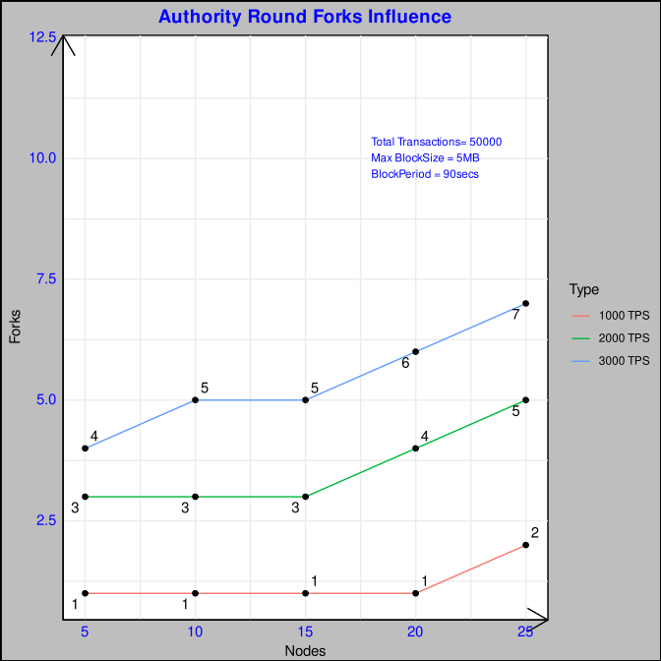
AURA + GRANDPA Forks Occurence
Increase of Forks in the system with increasing Nodes and increasing input TPS rate.

Slide 13
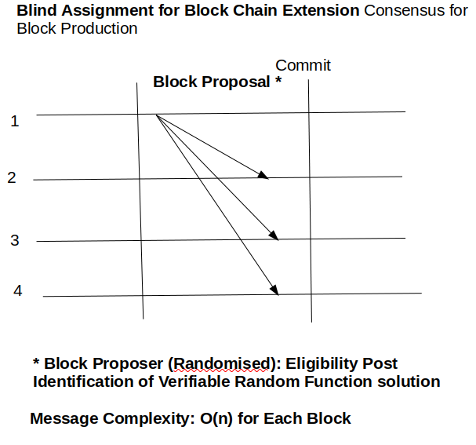
Babe
Ref:
https://docs.rs/sc-consensus-babe/0.9.0/sc_consensus_babe/
https://docs.rs/sc-consensus-babe/0.9.0/sc_consensus_babe/struct.BabeParams.html
Good Intro:
https://dev.to/cocoyoon/polkadot-consensus-part-1-babe-code-base-3ch4

Slide 14
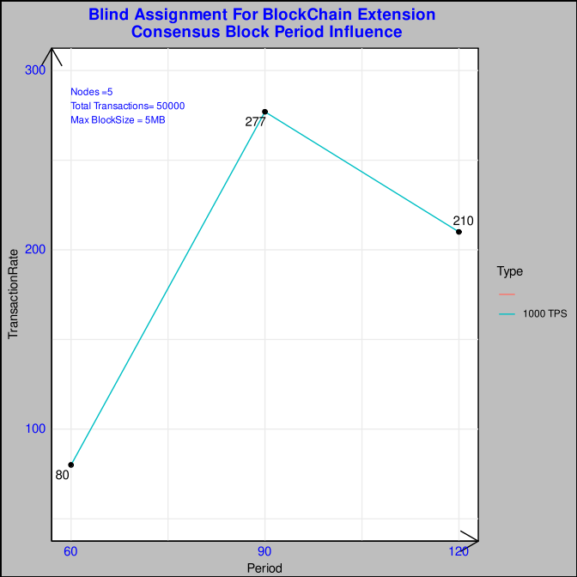
BABE + GRANDPA Block Period Influence
BABE is prone to lot of forks and GRANDPA is unable to resolve the fork at a very lower block period time lesser than 60 secs. GRANDPA consensus is stalled.
90 Block period presents an idea time duration with a minimum fork of 1.

Slide 15
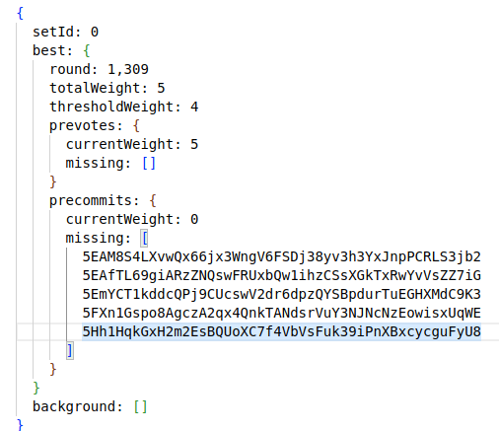
BABE + GRANDPA Block Period Influence
GRANDPA NODE STALLED
RPC Response for stalled GRANDPA state.
Votes for Pre-Commit is missing from the 5 validators which stalls the system for lesser block period times.
It means there is no synchronicity between the decision of final block for the 5 validators

Slide 16
BABE + GRANDPA Block Period Influence
https://substrate.stackexchange.com/questions/214/recovering-from-stalled-finality-babe-grandpa

Slide 17
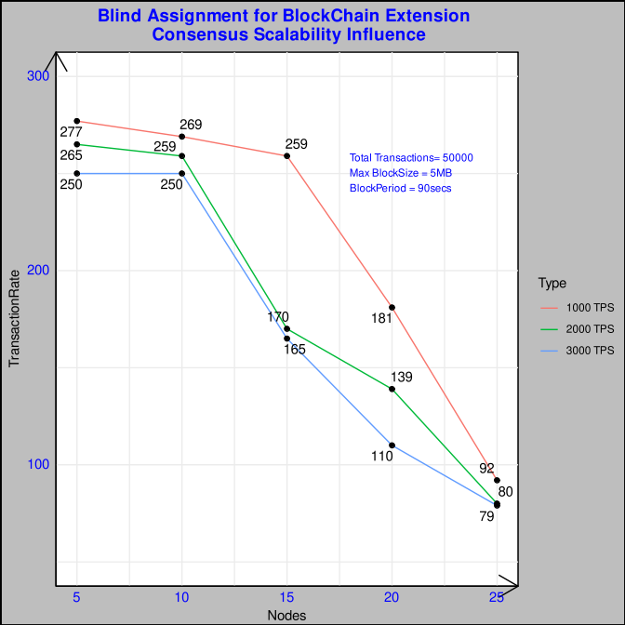
BABE + GRANDPA Scalability Influence
Message Complexity is O(n) similar to Clique but suffers from a larger amount of forks given the susceptibility of multiple eligible validators for the same block height.
It is also accompanied by a computation effort of VRF proof which slows down the system

Slide 18
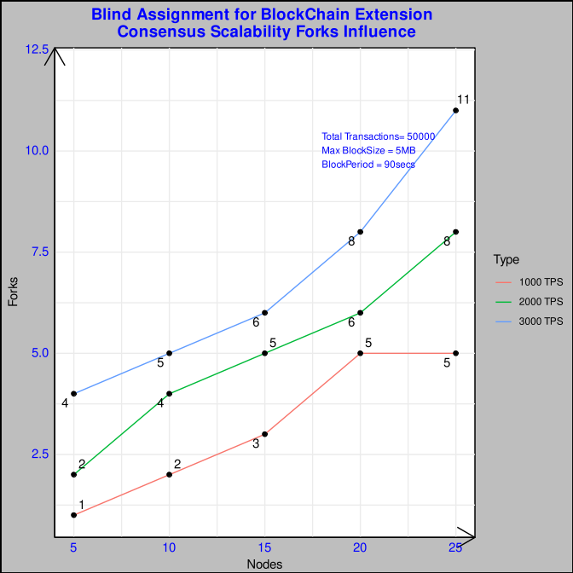
BABE + GRANDPA Forks Occurence
Forks Occurence is higher give the possibility of multiple validators per round,dependence on block time stamp interval for epoch calculation brings in more forks than AURA.

Slide 19
Reference:
https://polkadot.network/blog/polkadot-consensus-part-1-introduction/
https://polkadot.network/blog/polkadot-consensus-part-2-grandpa/
https://polkadot.network/blog/polkadot-consensus-part-3-babe/
https://polkadot.network/blog/polkadot-consensus-part-4-security/
https://medium.com/polkadot-network/grandpa-block-finality-in-polkadot-an-introduction-part-1-d08a24a021b5
https://research.web3.foundation/en/latest/polkadot/block-production/Babe.html
https://research.web3.foundation/en/latest/polkadot/finality.html
https://arxiv.org/pdf/2007.01560.pdf
Bill Laboon PDF
https://stackoverflow.com/questions/43465552/how-does-paritys-aura-consensus-protocol-work
https://openethereum.github.io/Aura

Slide 20
Feedback

