Slide 1
Hybrid Consensus Results (Resumé)

Slide 2
Objective
Measure, Understand and Analyse the Hybrid Consensus
Performance Measuring Normalisation
Performance Measurement Details
Aura + Grandpa Block Period Influence
Aura + Grandpa Scalability Influence
Aura + Grandpa Forks
Babe + Grandpa Block Period Influence
Babe + Grandpa Scalability Influence
Babe + Grandpa Forks

Slide 3
Performance Measurement Details
No of Nodes: 5, 10, 15, 20, 25
No of Accounts: 2000
Client Threads: 1000
Transaction Type: Create Asset Transaction
Complexity of Method:
Hash Calculation (1)
Read from storage (5)
Write to Storage (10)

Slide 4
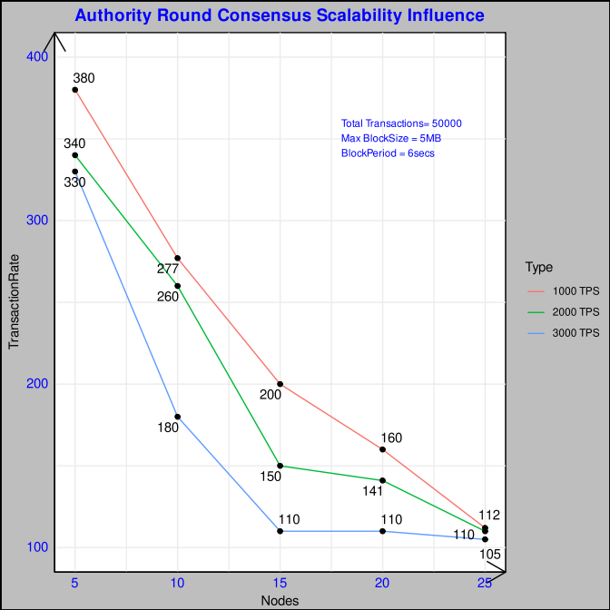
AURA + GRANDPA Scalability Influence
Since the message communication is O(n²) it decreases the throughput significantly with the increase of nodes. In addition GRANDPA O(n²) augments the drop but the consensus decision is on the chain rather than the block level.
Also at higher TPS, the bottleneck of higher transaction processing increases the fork in the system thereby bringing down the throughput

Slide 5
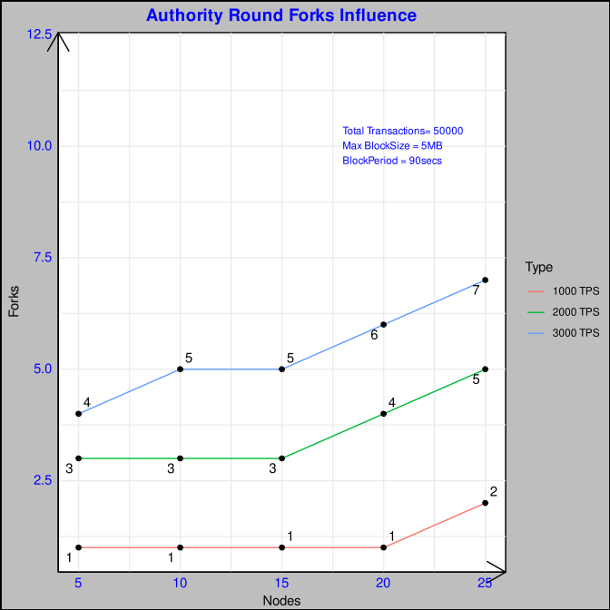
AURA + GRANDPA Forks Occurence
Increase of Forks in the system with increasing Nodes and increasing input TPS rate.

Slide 6
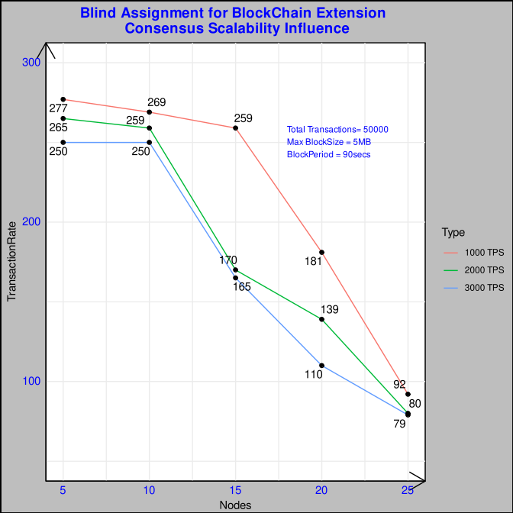
BABE + GRANDPA Scalability Influence
Message Complexity is O(n) similar to Clique but suffers from a larger amount of forks given the susceptibility of multiple eligible validators for the same block height.
It is also accompanied by a computation effort of VRF proof which slows down the system

Slide 7
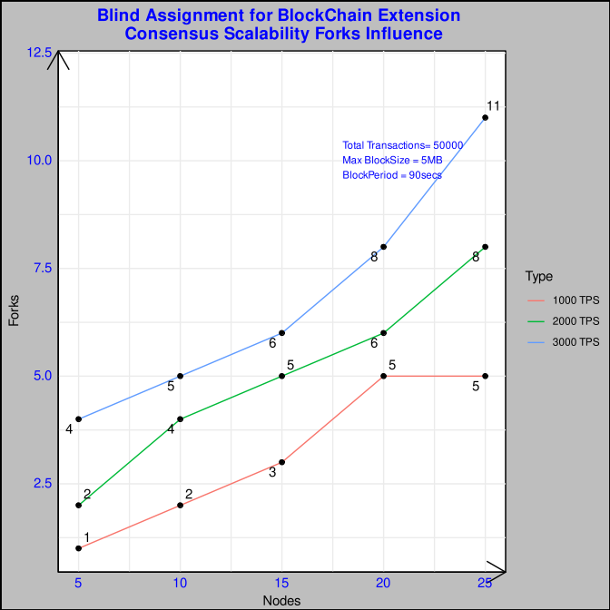
BABE + GRANDPA Forks Occurence
Forks Occurence is higher give the possibility of multiple validators per round,dependence on block time stamp interval for epoch calculation brings in more forks than AURA.

Slide 8
Cloture de Programming et Conception :)
All code in BitBucket Université
Merci à M.Verdier, Severine et Patricia pour les contributions de Nouveau Consensus Modelling, Multiple Mobility Use-Cases Definition, Multiple Consensus Performance Testing and Study.
Next Step …??

Slide 9
Next Step Planning
These:
1) Redaction de Rapport (4mois)
2) Redaction de Papier pour conference – co travail de Rapport (concise)
Two Works:
DataMarket on Hybrid Consensus (Performance and Focus On CAP Theorem for Aura, Babe + Grandpa)
Deadline: 4 Dec 2022
ICBC 2023
Self Optimising Utilitarian Leader (SOUL) Consensus Algorithm
Deadline: 30 Dec 2022
MetaCom 2023
----------------------------------------------------------------
PODC 2023
Abstract submission: January 6
Full paper submission: January 10
Administratif:
1) FSD LEAT ( Deja Fait, Merci à M. Verdier et Francoise)
2) Prolongation Contrat CNRS 4 mois (en cours)
3) Demande de Titre De Sejour (en attente pour contrat)
4) Renault Prolongation Acces et Materiel (à demarrer)
5) Grammarly

Slide 10
Reference:
https://polkadot.network/blog/polkadot-consensus-part-1-introduction/
https://polkadot.network/blog/polkadot-consensus-part-2-grandpa/
https://polkadot.network/blog/polkadot-consensus-part-3-babe/
https://polkadot.network/blog/polkadot-consensus-part-4-security/
https://medium.com/polkadot-network/grandpa-block-finality-in-polkadot-an-introduction-part-1-d08a24a021b5
https://research.web3.foundation/en/latest/polkadot/block-production/Babe.html
https://research.web3.foundation/en/latest/polkadot/finality.html
https://arxiv.org/pdf/2007.01560.pdf
Bill Laboon PDF
https://stackoverflow.com/questions/43465552/how-does-paritys-aura-consensus-protocol-work
https://openethereum.github.io/Aura

Slide 11
Feedback

