Slide 1
The post that wasn’t: Understanding Facebook Groups
Amber, Jason, Manya, Rebecca, Sauvik
Notes:
Jason

Slide 2
High Level Objectives
Understand groupings of friends for privacy decisions
Friends that prevent sharing
Friends that promote sharing
By type of content
First step to create default groups, suggestions for groups
Notes:
Jason

Slide 3
Sharing content
People have content they decide not to share
Self-censorship may be motivated by certain people/groups of people
Common attributes?
Content dependent?
Notes:
Jason

Slide 4
Study design
7-day long diary study in which participants text in posts they decide not to post
Nightly online surveys
Final in-lab interview with qualifying participants
Screening survey
Notes:
Jason

Slide 5
Screening survey
Target 7-10 participants
Recruit through CBDR, flyers, Craigslist
Direct to online survey
Screen for participants who:
Are frequent Facebook users
Can send SMS text messages
Are English speakers
Have history of content they decided not to post and are willing to share
Notes:
Manya

Slide 6
Diary study
Participants describe content that they think about sharing with friends but decide not to post on Facebook
Receive instructions at beginning of study
Send as text messages real-time
Week long
Notes:
Manya

Slide 7
Diary study
Nightly online surveys to gather detailed information on texts
Probe on privacy decisions
Why did they decide not to share it?
Who did they want to share it with?
Who did they not want to share it with?
Prevent “gaming” by asking questions on Facebook posts if participants don’t send in any content
Pay $2/survey
Notes:
Manya

Slide 8
Final Interview
Lab-based semi-structured interview
Delve into results of online surveys
Probe on social network usage
Pay $20 for interview
Notes:
Manya
Attributes of friends wanted to share with/not share with
Attributes of content
Privacy preferences
Current grouping and sharing

Slide 9
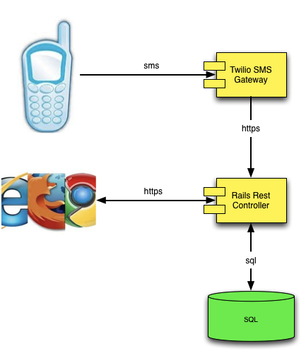
Technology
Notes:
Jason

Slide 10
Progress and next steps
New IRB submitted
Technology infrastructure prototyped
Plan to pilot on our friends while waiting for IRB
Volunteers? Super fun and earn a cookie (the good kind)!
Notes:
Jason

Slide 11
Questions?

