Slide 1
Application Building Process
                Sireesha S

Slide 2
Contents
Preprocessor Stage
  Header inclusion
  Comment removal
  Macro Substitution
  Conditional Compilation
Compilation Stage
  Analysis phase
  Synthesis phase
Assembler
Linker

Slide 3
Introduction
Application building process covers the stages that a source file (.c file) undergoes to generate the executable object file.

Slide 4
Flow Diagram of the process
1.c
Preprocessor
1.i
Compiler
1.s
Assembler
1.o
Linker
a.out

Slide 5
Preprocessor
Comment removal -
  Comments can be provided by // …......................
  Multi-line comments are provided by /* …............. */
Macro substitution -
macro is used for textual replacement of data,at the preprocessor stage the text defined in the macro is substituted by data.
Header files inclusion -
All the header files will be included at this stage.

Slide 6
Conditional compilation -
- conditional compilation is the process in which one can instruct preprocessor whether to include certain chuck of code or not.
- The following conditional directives are used.
  - #ifdef
  - #if
  -#define
  -#else
  -#elseif
  -#elif

Slide 7
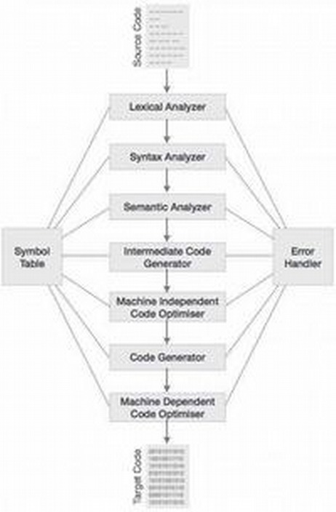
Compilation stage
Compilation is the second phase it takes output from preprocessor(hello.i) and generate assembler source code(hello.s).
The compilation process is a sequence of various phases.
- lexical analyzer
- syntax analysis
- semantic analysis
- intermediate code generation
- code optimization
- code generation

Slide 8
Flow diagram of compilation process
Lexical
syntax
Analysis
Phase
semantic
Symbol table
Intermediate code
Synthesis
phase
Code optimizer
Code generator

Slide 9
Lexical analyzer This phase scans the sequence of code as a stream of characters and converts in a meaningful lexemes.
- Lexemes are represented by lexical analyzer in the form of tokens as <token – name,attribute value>
- There are six classes of tokens.
  - identifiers
  - keywords
  - constants
  - string literals
  - operators
  - seperators

Slide 10
Syntax analysis -
- Syntax analysis is also known as parsing.
- Syntax analysis generates the syntax tree.
- In this phase parser checks if the expression made by the tokens is syntactically correct
Semantic analysis -
- semantic analysis checks whether the parse tree constructed follows the rules of language.
  Type checking is performed in semantic analysis.

Slide 11
Intermediate code generation -
- After the semantic analysis the compiler generates an intermediate code of the source code for the target machine.
Code optimization -
- Optimization of code can be done to speed up the program execution.
Code generation -
- Code generator translates intermediate code in to relocatable machine code.

Slide 12
Assembler -
  In the assembly phase assembler translates (hello.s) in to machine language instruction and packages them in the form known as relocatable object programs and stores the result of (hello.o).
Linker -
  linking refers to creation of a single executable file from multiple object files.

Slide 13
Conclusion
Gcc is a compiler and is an application for end user and is a piece of code which is used throughout the building process to create an target file.

