Slide 1
Data Types, Qualifiers and Storage Class Specifiers with memory layout
                By
                Madhu Latha

Slide 2
Contents
Data Types
Qualifiers
Storage classes
Storage Class Specifiers
Memory Layout

Slide 3
Data Types
What is data type?
Data type: “It defines what type of data the variable is ”
“It say to compiler that how much space should be allocate to variable and perform operations on it”
Why we need data type?
→storage space
→Variable
→Operations

Slide 4
Types Of Data types...
DATA TYPES
→ Primitive
  → Char, Int, float, double and void
→ Non-Primitive
  → Linear : array, structure, union, linked list, stack and queue.
  → Non-linear : Trees and graphs.

Slide 5
Table shows size and range of data types
Data type | Size | Range
char(signed char) | 1 byte | -128 to 127
Unsigned char | 1 byte | 0 to 255
Short int | 2 bytes | -32,768 to 32,767
Int (signed int) | 4 bytes | -2,147,483,648 to 2,147,483,647
Unsigned int | 4 bytes | 0 to 4,294,967,295
Long | 4 bytes | -2,147,483,648 to 2,147,483,647
Double | 8 bytes | 1.175494E-38 to 3.402823E+38

Slide 6
Qualifiers
Qualifier : The keywords which are used to modify the properties of a variable are called type qualifiers.
It is of two types
→ constant – const
→ volatile - volatile

Slide 7
Constant Qualifier
“The qualifier const can be applied to the declaration of any variable to specify to compiler that its value will not be change”
Declaration :
qualifier_keyword data_type variable;
const int number;
→ But the declaration is always give with initialization of some value.
Const int number = 10;

Slide 8
Volatile Qualifier
“Qualifier volatile intended to prevent the compiler from applying any optimizations on variable that can change in explicitly that can not be determined by compiler”
Declaration :
→ volatile_keyword Data_type Variable_name;(or)
→ Datatype Volatile_keyword variable_name;

Slide 9
Storage Classes
Storage class defines “ tell to compiler that where the variable has to be stored”
It is having two classes
→ auto
→ static

Slide 10
Storage Class Specifiers
It tells the compiler that where the variable has to be placed
“Storage Classes are used to describe about the features of a variable/function. These features basically include the scope, visibility and life-time which help us to trace the existence of a particular variable during the runtime of a program”
Scope
Visibility
Life-time

Slide 11
Types of storage class specifiers
Storage class specifier | Storage space | scope | Life time | Visibility
Auto | Cpu memory | Within the block/function | Alive with in the block/function | Up to the block/program
Register | Register memory | Within the block/function | Alive within the block/function | Up to the block/program
Static | Cpu memory | Within the program | Alive within the program | Up to the program
Extern | Cpu memory | Outside the program | Alive till program exist | Outside of the program

Slide 12
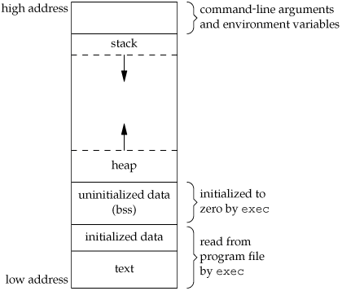
Memory Layout

Slide 13
Memory layout
Text segment
Uninitialized data segment
Initialized data segment
Stack
Heap

Slide 14
Any Queries?

Slide 15
Feedback

